Slide 1
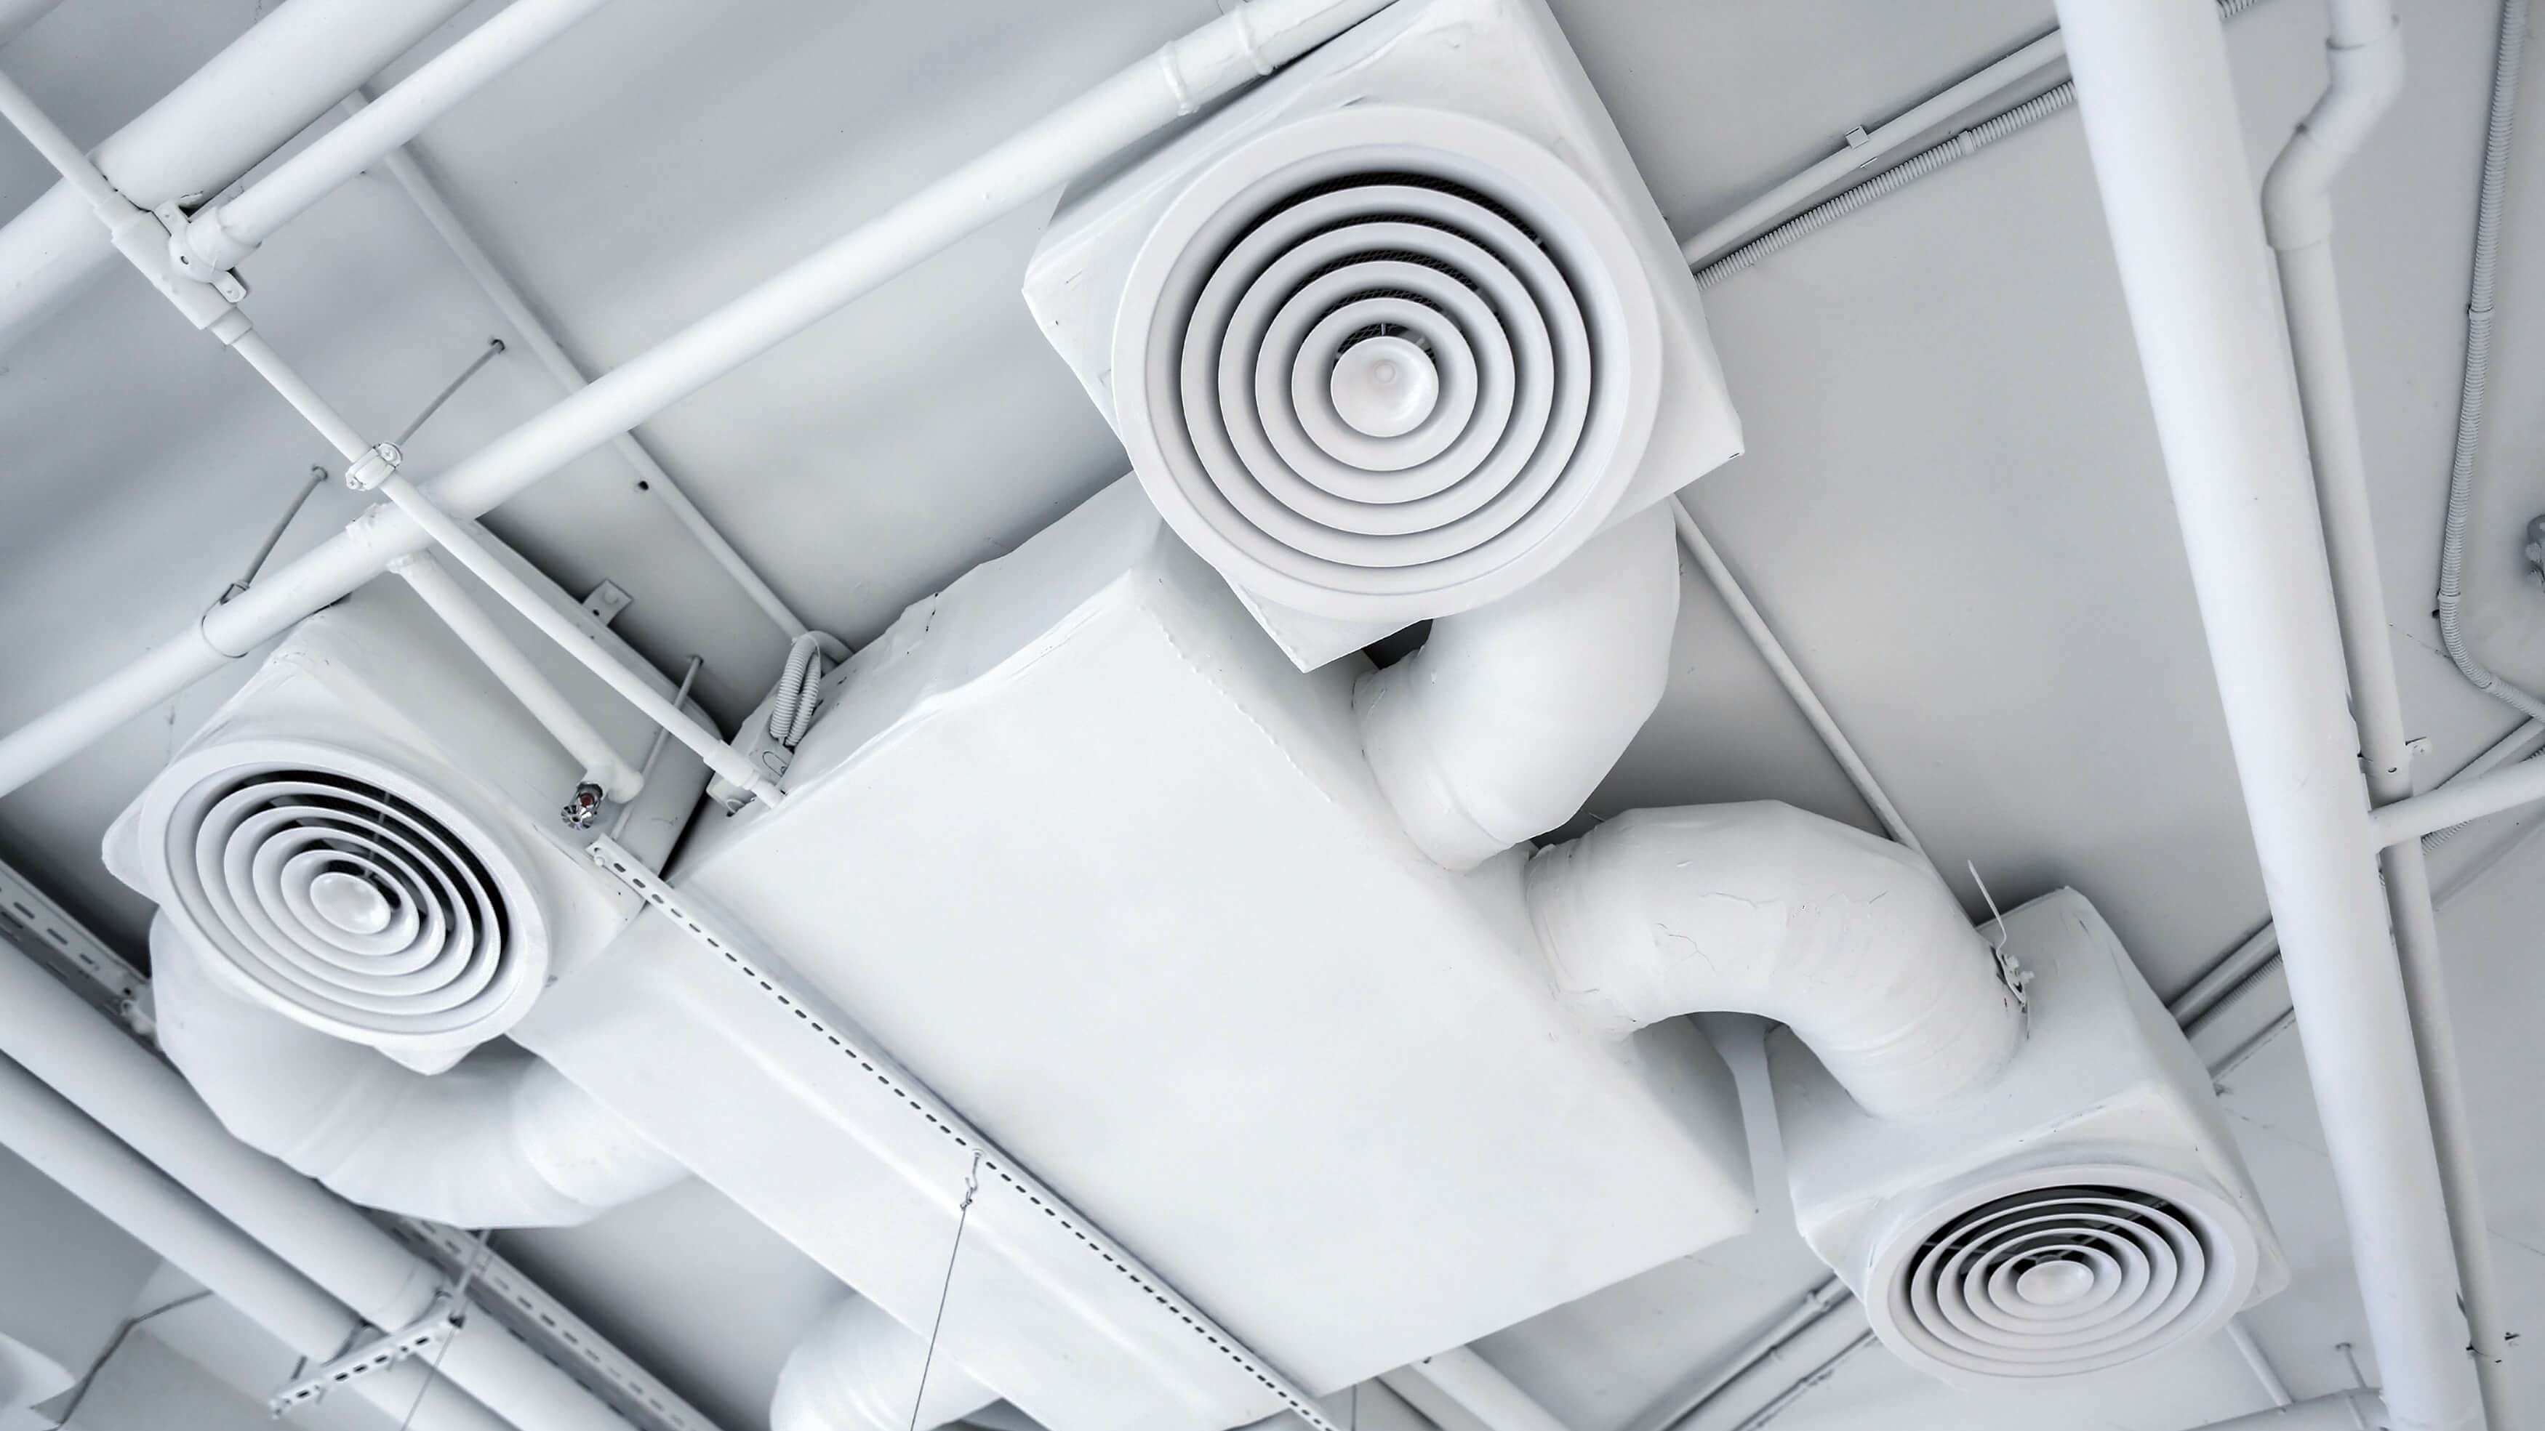

Free Cooling Effectiveness of Integrating an Air-side Economizer with a Water-based Thermal Energy Storage System in a Canadian Home
Ken Chen
Building Science Graduate Program, BCIT
Supervised by: Dr. Bo Li
2025/11/14, Presented at the 2025 BCBEC Conference & AGM
Notes:
Good morning everyone! My name is Ken Chen. I’m a master’s student in Building Science graduate program at BCIT, supervised by Dr. Bo Li.
It’s great to be here today. I actually attended this conference over the past two years, sitting somewhere near the back, and I never thought I’d be up here presenting this time. So it’s really exciting, and a little surreal, to be sharing my research with you.
Today I’ll be talking about my research on integrating an air-side economizer and a water-based thermal energy storage system to provide free cooling for a Canadian home.
To begin, let’s take a quick look at the background of this study.

Slide 2
Residential Energy Context in Canada
Residential Energy Consumption by Type of Dwelling, Canada
Global Energy Consumption
Energy Consumption by Sectors, Canada
Residential Energy End-Use, Canada
Notes:
As we know, the building sector is a major contributor to climate change, accounting for roughly one-third of global energy consumption.
In Canada, the residential sector alone represents about 16% of national energy use, and single-detached houses are by far the largest energy consumers among all residential building types, responsible for over 60% of total residential energy consumption.
This means that even modest improvements in the energy performance of single-detached dwellings can have a significant national impact.
Historically, most residential energy use has gone toward heating, while cooling accounted for only about 2%, mainly because of Canada’s mild summers and the limited use of air-conditioning.

Slide 3
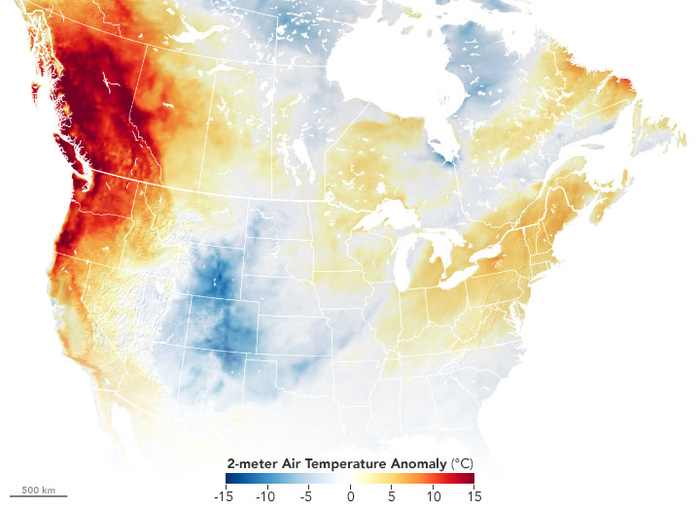
Warming Climate & Heat-Related Health Risks
From 1948 to 2016, the annual average temperature has risen by
1.7 ℃
in Canada, twice the global average.
The 2021 Western North America heat wave resulted in
619 fatalities
in British Columbia.
Air temperature anomalies across North America on June 27, 2021, compared to 2014-2020 baseline
Canadian households with at least one AC unit increased from 64% to 77% between 2021 and 2023.
Cooling demand in Canada is expected to continue increasing in the coming decades.
Notes:
However, this situation is changing due to the warming climate.
Over the past few decades, Canada’s average annual temperature had risen by 1.7 degrees, that’s roughly twice the global average rate.
We’ve already started to see the impacts of this change: extreme heat events are becoming more frequent and more intense.
For example, the 2021 heat wave caused devastating impacts here in British Columbia.
As a result, more and more Canadian households have been installing air conditioners in recent years.
According to climate projections, this warming trend is expected to continue, meaning that the demand for space cooling in Canadian homes will keep increasing in the near future.

Slide 4
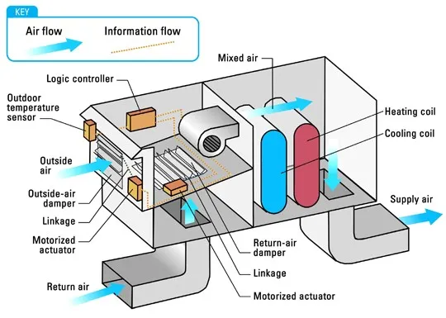
Air-Side Economizer: Taking Advantage of Vancouver’s Cool Air
July 2023
Opportunity for air-side free cooling
Cool outdoor air
Diagram of an air-side economizer (ASE)
Notes:
Vancouver’s mild climate provides a significant opportunity to mitigate heat-related risks without compromising building’s energy efficiency.
Because even in July, Vancouver’s night temperatures often drop below 15 °C, which allow us to use outdoor air directly to cool indoor spaces, what we call air-side free cooling.
This can be achieved through air-side economizers (ASEs), which enable mechanical ventilation systems to introduce additional outdoor air when external conditions are favorable, thereby reduce a building’s cooling needs.

Slide 5
Limitation of ASE & Need for Thermal Energy Storage
Peak cooling load cannot be met by ASE operating at full capacity
Annual Utilization Rate
< 5%
Cooling load met by ASE operating at partial capacity
Supply-demand mismatch
Need for thermal energy storage
Notes:
However, after conducting a preliminary study to evaluate the free cooling effectiveness of an ASE in Vancouver, we found that the performance of the ASE alone was quite limited as it could only utilize less than 5% of the available free cooling annually, as shown in the left chart.
And from the right chart, between 2 pm to 7 pm, we can see that the building still relied heavily on mechanical cooling, even when the ASE operated at its maximum airflow.
This happens because free cooling availability doesn’t always align with the building’s cooling demand.
Often, when outdoor air is cool, the building needs little or no cooling. Conversely, when the building’s cooling load peaks, the outdoor air is usually warmer, making the available free cooling insufficient.
To bridge this gap, we need a way to store the coolness for later use, and that’s where thermal energy storage comes in.

Slide 6
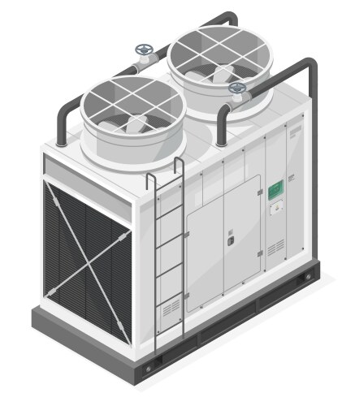
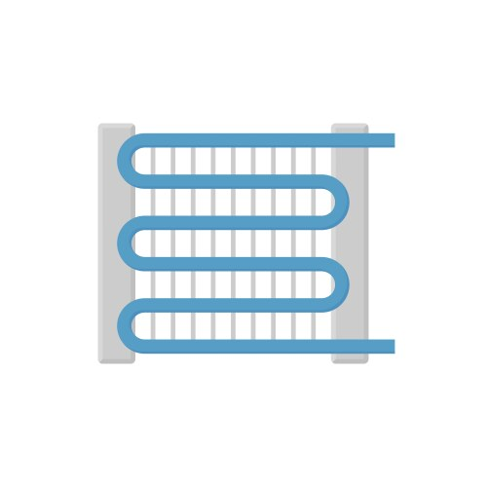
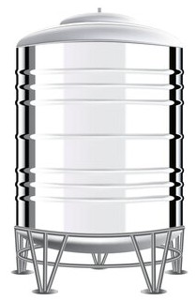

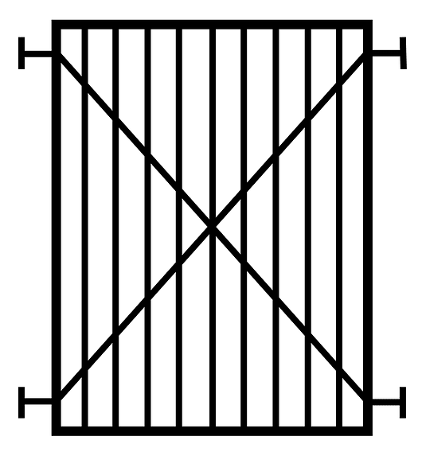
Proposed System: ASE + Water-Based TES
ASE
Relief Air Damper
Outdoor Air Damper
Hydronic Cooling Coil
Return Air Damper
Source Side
ASE Controller
Source Side Outlet
Cooling Tower
Pump 2
Pump 3
Use Side Inlet
Stratified Water Storage Tank
Use Side
Pump 1
Fluid-to-fluid Heat Exchanger
Source Side Inlet
Use Side Outlet
Notes:
In this study, we combined the air-side economizer with a water-based thermal energy storage system.
The system consists of a stratified water storage tank, connected to a cooling tower and a heat exchanger on the source side, and a hydronic cooling coil on the use side.
When free cooling is available, the system uses cool outdoor air to chill the tank water through evaporative cooling.
During peak cooling hours, the stored chilled water is circulated through the hydronic cooling coil in the air duct to pre-cool the incoming air.

Slide 7
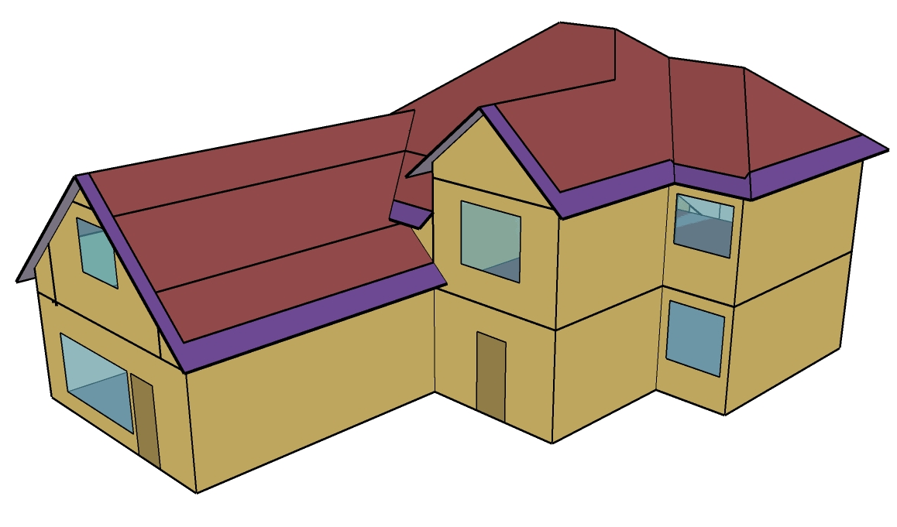


Simulation Setup: Building Model, Scenarios, and Weather Data
TMY
AMY 2023
A single-detached house in Vancouver
2 weather data
16 Simulations
System Type | 1 | 2 | 3 | 4
A: Furnace | A1: Furnace Only | A2: Furnace + ASE | A3: Furnace + WTES | A4: Furnace + ASE + WTES
B: Air-Source Heat Pump (ASHP) | B1: ASHP Only | B2: ASHP + ASE | B3: ASHP + WTES | B4: ASHP + ASE + WTES
8 system configurations
Notes:
The effectiveness of the proposed system was assessed through energy simulations using EnergyPlus.
We modeled a 2-story single-detached house in Vancouver and tested eight system configurations to evaluate both the combined and individual impacts of the ASE and the TES system under two baseline HVAC systems.
The first baseline was a heating-only furnace, reflecting the actual HVAC system of the house. And the second was an Air-Source Heat Pump, representing the growing adoption of heat pumps in Canada.
In today’s presentation, I’ll focus on comparing Scenario A1 and A4, to show how combining an ASE with a TES system improves indoor thermal comfort when there is no mechanical cooling, and comparing Scenario B1 and B4, to demonstrate how much the combined free cooling system can reduce mechanical cooling energy use.
Simulations were conducted using both the TMY (Typical Meteorological Year) and actual 2023 weather data for Vancouver, but today I’ll only present the 2023 results, since they reflect real, recent weather conditions.

Slide 8
Indoor Thermal Conditions: Air Temperature
Control Zone Air Temperature during the Hottest Week of 2023
31.9°C
25.2°C
The combined free cooling system effectively controlled the zone temperature below the cooling setpoint.
Annual peak temperature of the control zone reduced from 31.9°C to 25.2°C.
Notes:
Let’s start by looking at the impact of this combined free cooling system on indoor thermal conditions when there is no mechanical cooling.
This chart shows the air temperature in the control zone of the house during the hottest week of 2023, before and after the combined free cooling system was implemented.
From the light blue curve above, we can see that in the furnace-only scenario, the zone temperature remained above 25 degrees for most of the time, with a peak of nearly 32 degrees.
From the dark blue curve below, we can see that, after applying the ASE and the TES system, the air temperature was well-controlled below the cooling setpoint, with only a few brief high-temperature periods, and a peak of just over 25 degrees.
To better illustrate this improvement, let’s look at the unmet cooling hours across all thermal zones in this house.

Slide 9
Indoor Thermal Conditions: Unmet Cooling Hours
Annual Unmet Cooling Hours, 2023
Thermal Zone | Main Floor | Bedroom 1 | Laundry & Mech | 2F Common | Bedroom 2 | Bedroom 3 | Bedroom Master
Variation | -98.63% | -99.23% | -97.66% | -98.81% | -99.43% | -84.22% | -87.79%
Notes:
This chart shows the unmet cooling hours of each thermal zone over the year 2023, before and after applying the combined system.
After implementation, the unmet cooing hours in all thermal zones were significantly reduced. In some thermal zones, such as bedroom 1 and bedroom 2, the unmet cooling hours were almost eliminated.
These findings demonstrate that, the combined free cooling system is highly effective in improving the indoor thermal conditions for a single-detached house without mechanical cooling in Vancouver.

Slide 10
Building Energy Performance: Cooling Energy Use
Cooling-related Energy Uses
Operation Intensity of ASHP Cooling
 | ASHP | ASHP with ASE + WTES
Peak Total Cooling Rate (W) | 3919.79 | 1611.29
Annual Total Operation Time (h) | 1240.67 | 21.50
Annual Total On-off Cycles | 295 | 15
Annual Total Short On-off Cycles | 142 | 2
Cooling energy use of the ASHP was reduced by 98.9%.
ASHP cooling operation intensity was significantly reduced.
Additional energy use by the WTES system was minimal compared to the overall savings.
The building’s overall energy efficiency improved.
Notes:
Next, let’s look at how this combined free cooling system affected the energy use of a house with mechanical cooling.
The chart on the left shows that after implementing the combined system, the energy used by the ASHP for cooling dropped dramatically from over 450 kWh per year to just 5 kWh.
The table on the right further shows the building’s reduced reliance on mechanical cooling. The system not only lowered the ASHP’s peak cooling rate, but also reduced its cooling operation time, number of on-off cycles, and the occurrence of short cycling events.
Although the TES system consumed some additional energy for pumping and heat rejection, these were much smaller than the cooling energy savings.
So overall, the building’s total energy use was reduced, and its energy efficiency was improved.

Slide 11


Conclusions & Implications
High-Performance Envelopes?
ASE & WTES
Part 9 House in Vancouver
No mechanical cooling
With mechanical cooling
BC Building Code 2024:
‘Dwelling units intended for use in the summer months on a continuing basis shall be equipped with cooling facilities.’
‘Required cooling facilities shall be capable of maintaining an indoor air temperature of not more than 26°C in at least one living space in each dwelling unit.’
Improved indoor thermal comfort
Reduced cooling energy use
Improved Building Resilience
Notes:
Finally, let’s summarize the key findings and implications of this study.
For a Part 9 single-detached house in Vancouver, integrating an ASE with a WTES system proved effective in improving indoor thermal comfort when there is no mechanical cooling, and reducing cooling energy use when mechanical cooling is available.
In this way, the system can enhance the resilience of single-detached houses during extreme heat events.
As we know, the BC Building Code 2024 introduced a maximum design temperature limit for a single living space in each dwelling unit to minimize the risk to health and safety from overheating. It also suggested that maintaining a safe temperature can involve a combination of both passive and active strategies.
I believe that if the system proposed in this research is combined with high-performance envelopes, the building’s resilience during extreme heat could be further enhanced.
The envelope would reduce daytime external heat gain and help the delivered cooling last longer, while the free cooling system would actively remove internal heat—making them complementary to each other.
So overall, this approach could be a promising low-energy cooling solution for Canadian homes, especially in mild climates like Vancouver.

Slide 12
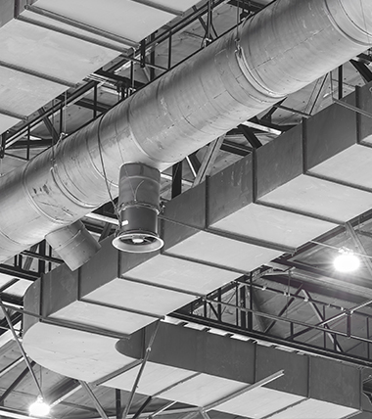

Thank you.
Any questions?
Ken Chen
MASc Candidate
Building Science, BCIT
kchen212@my.bcit.ca
Connect with me on LinkedIn!
Notes:
That’s all for my presentation today.
Thank you very much for your time and attention.
I’ll be happy to take any questions you may have.
And if you’d like to connect or discuss this further, you can scan the QR code here to find me on LinkedIn.

