Slide 1
Beyond Energy Targets: Rethinking Value in Deep Energy Retrofits
BCBEC Annual General Meeting
November 14, 2025
Notes:
Good evening everyone, thank you so much for coming.

Slide 2
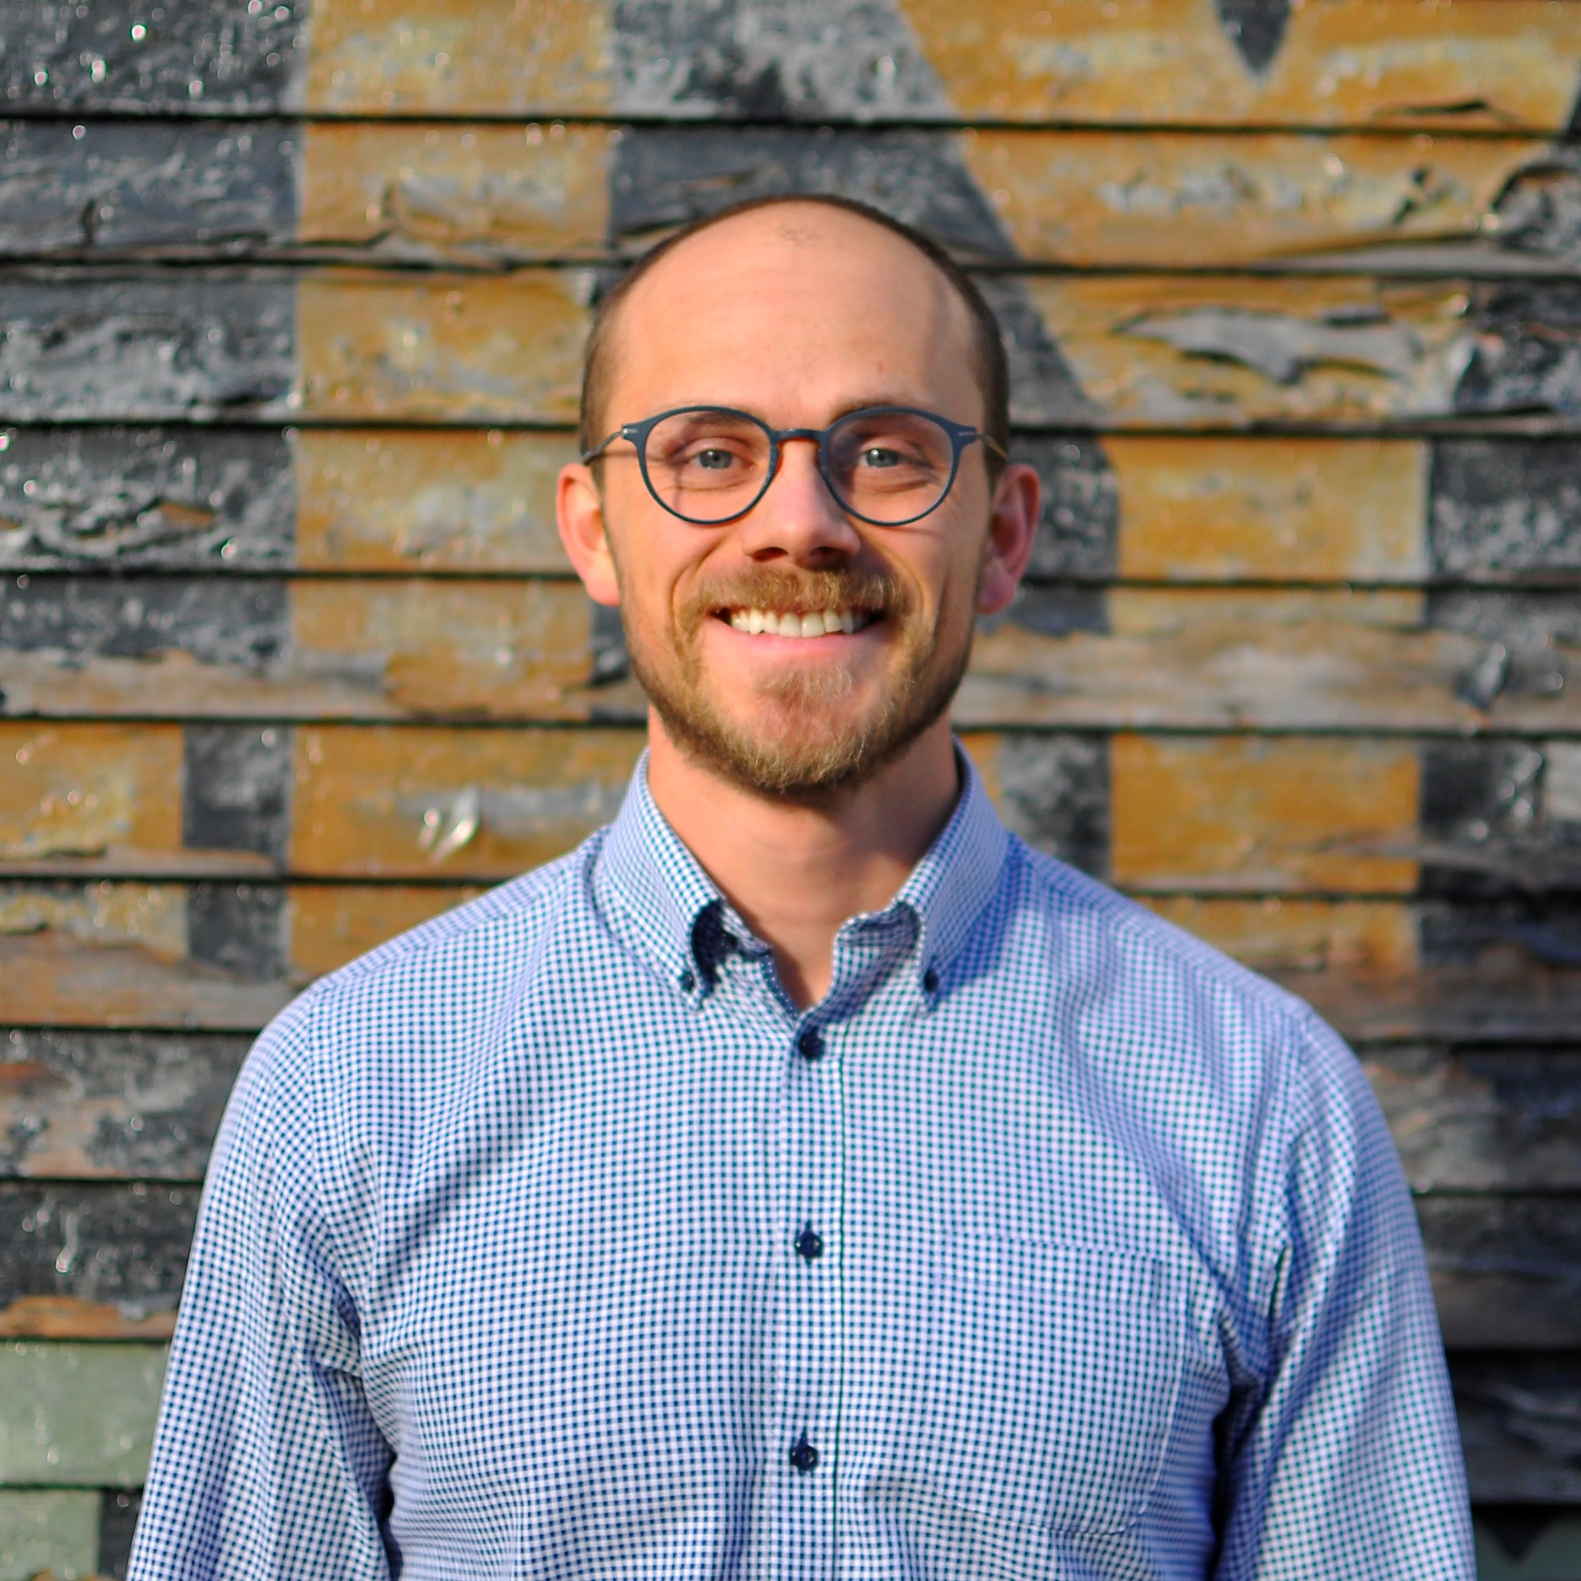
About Us
Evoke is a building science and energy consulting firm that takes a collaborative approach to our work and industry involvement.
Sophie Mercier
Spécialiste en science du bâtiment
Sophie Mercier
Spécialiste en science du bâtiment
Alex Janusz, P.Eng., M.A.Sc. Building Energy Consultant
Notes:
My name is Alex, I work at Evoke Buildings Engineering. We’re a building science and energy consulting firm, presently about 25 people in Vancouver and Victoria.
I studied mechanical engineering, I have a masters of building science, and during the past 6 years I’ve worked at RDH and then Evoke as an energy consultant. Aside from energy modelling, I’ve dabbled a bit in embodied carbon analysis, thermal analysis, depreciation reports, and policy research.
Today, I’m talking about something I’m very passionate about, deep energy retrofits.
How many people know the definition of a deep energy retrofit?

Slide 3
Deep Energy Retrofits
50+% energy savings
Critical to Canada 2050 Net-Zero Strategy
Faster and cheaper than new construction
Keep tenants in place & keep in affordable housing stock
Low embodied carbon
Resilience + Safety (Cooling)
Notes:
A deep retrofit achieves over 50% energy savings. Typically, they involve electrifying gas systems as well, which reduces the carbon emissions.
Deep retrofits seem like a lot of money, for some old buildings, but theres a lot of benefits and alignment with policy goals.
Deep energy retrofits are a major piece we need to figure out to reach net-zero by 2050. We won’t rebuild everything in the next 25 years.
Deep retrofits are significantly faster and cheaper.
One that’s really important, particularly for affordable housing, is you get to keep the tenants and place, and you spend less on the building, so you can keep the rents really low.
Retrofits have much lower embodied carbon, which is crucial.
And you’re adding cooling which makes them more resilient.

Slide 4
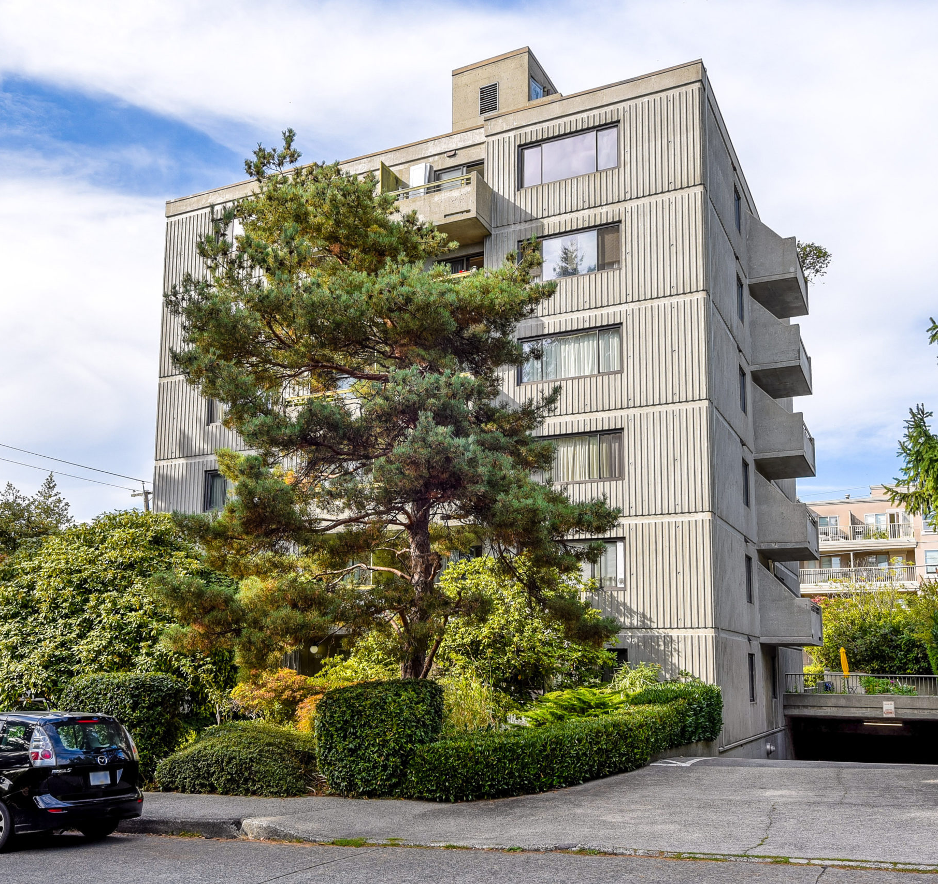
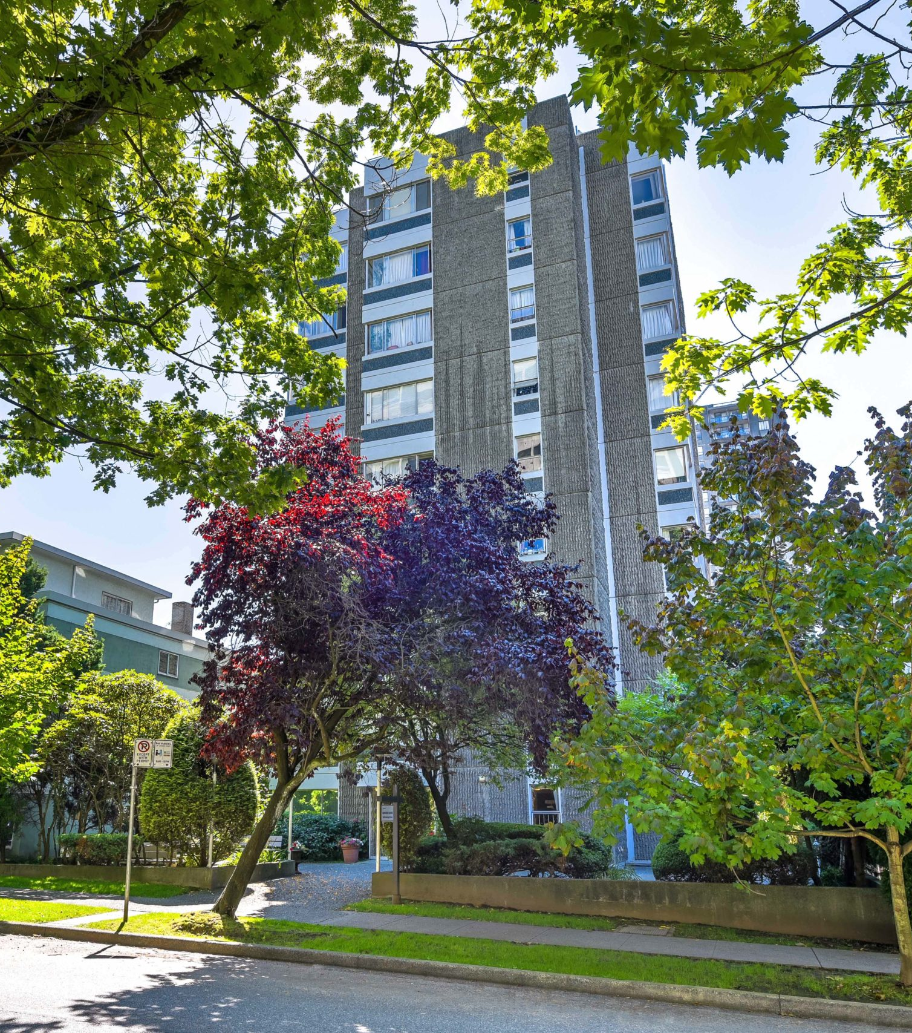
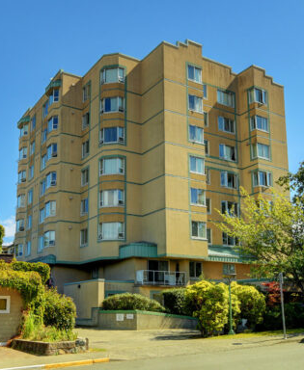
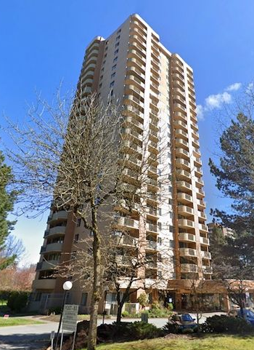
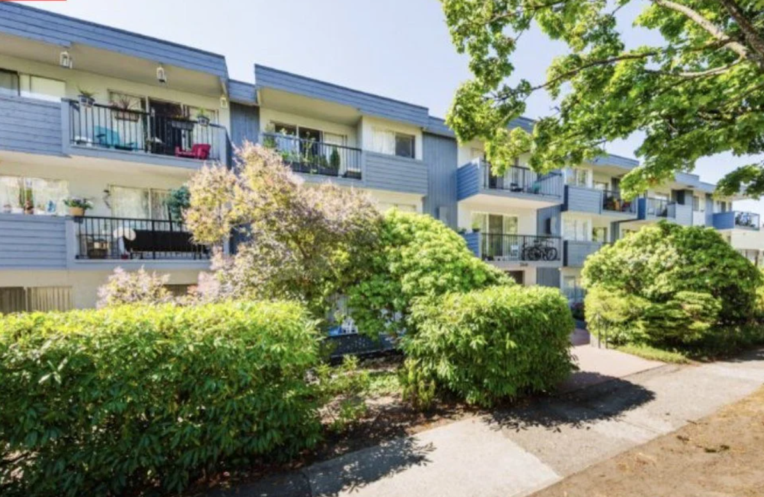
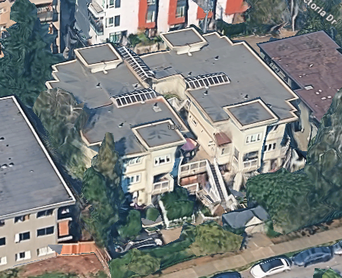
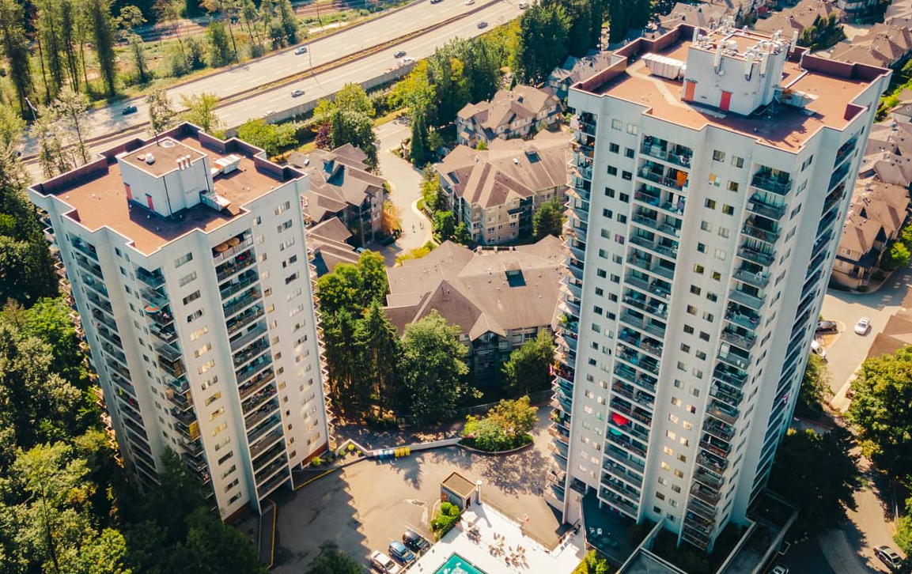
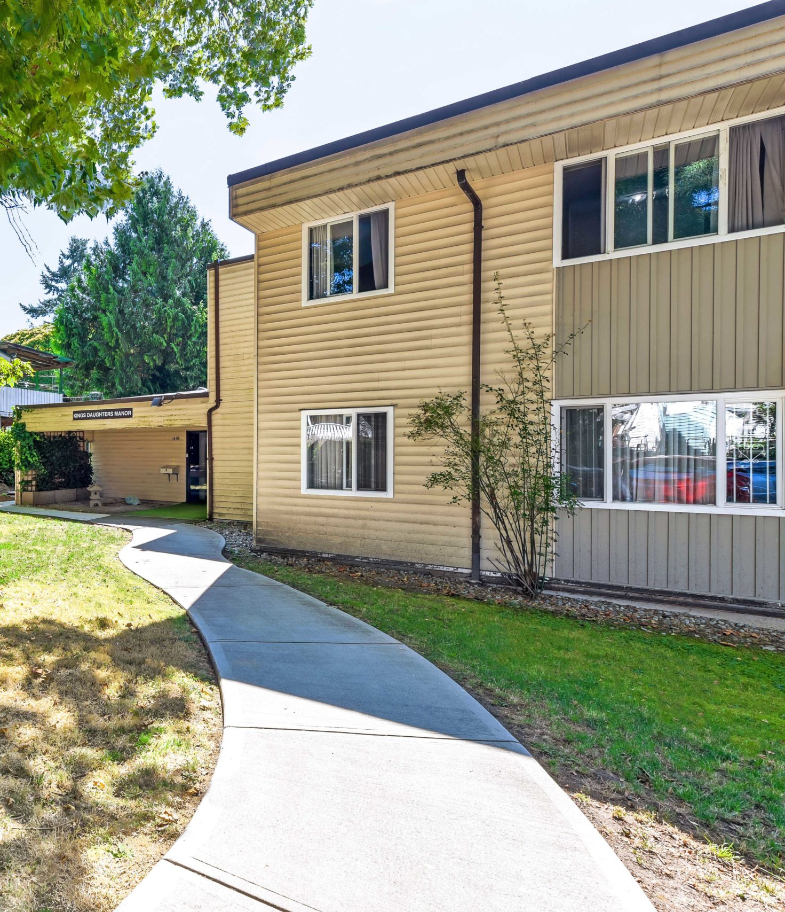
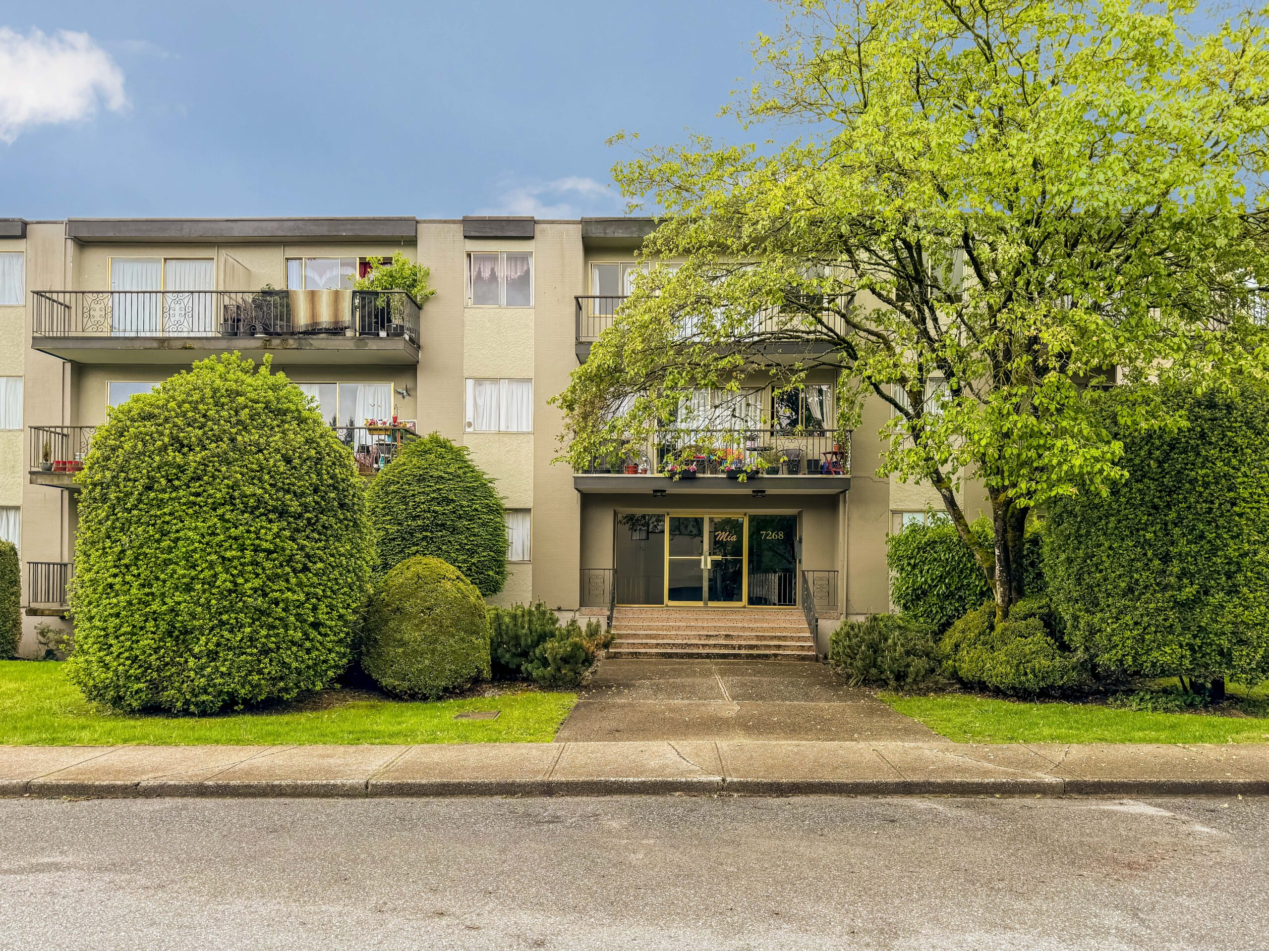
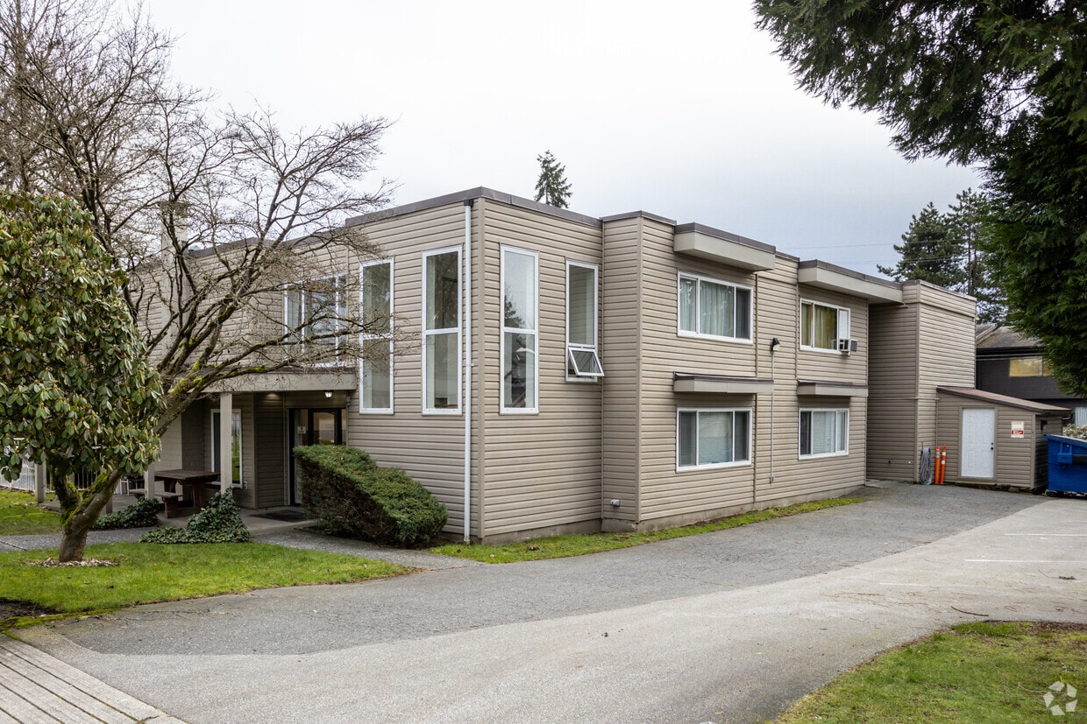
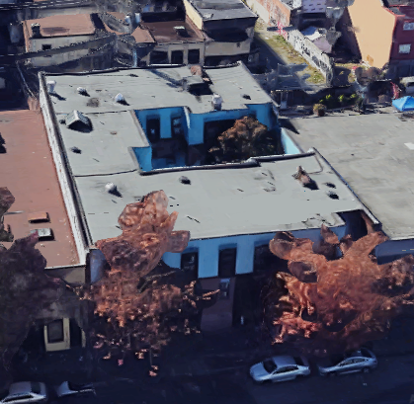
Notes:
At Evoke this year we did a tonne of affordable housing retrofit projects. These projects were largely pursuing the CMHC CGAH program, which provides up to $170,000 funding, per unit, if they can meet very stringent energy and emission targets. Remember a deep retrofit is 50% energy and GHG savings? Well, these project have to hit 70% energy savings, and 80% GHG savings.
I worked on several of these buildings, and I wanted to use tonight as an opportunity to reflect on what we’re achieving.
Now, I want to apologize, for the cryptic title. I’ll admit, chatgpt may have been involved.
Rethinking value in deep energy retrofits, refers to the fact that it often becomes value engineering exercise, where we try to achieve the energy target as cheaply as possible.
But I think that overlook the real value that these projects CAN and SHOULD provide.
What we should be asking,

Slide 5
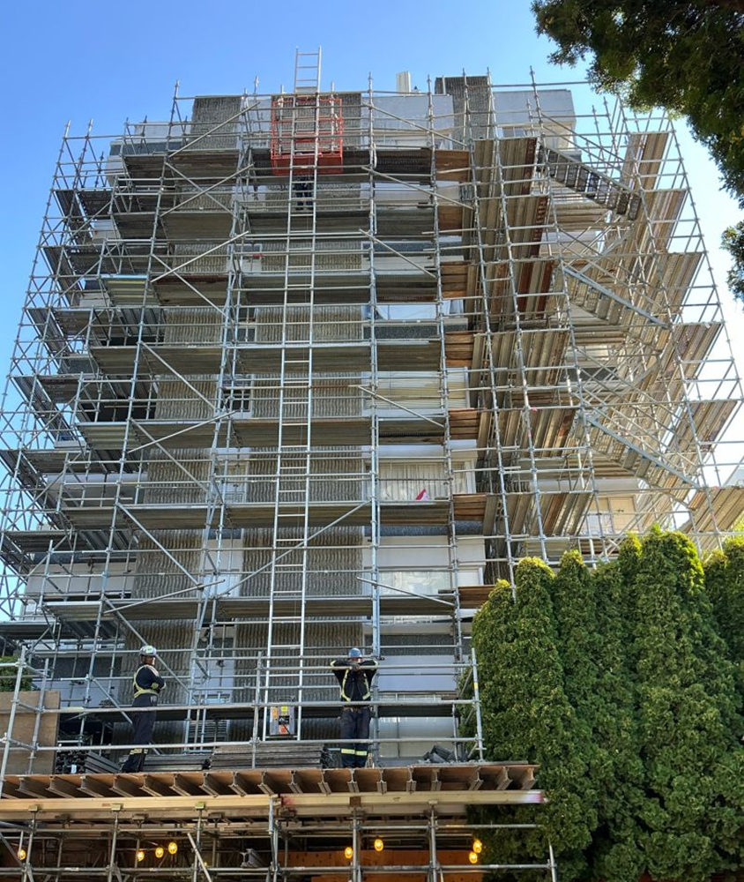
How do we make the most of deep energy retrofits?
Notes:
How do we make the most of these retrofits?
We have this incredible chance to overhaul these buildings, and likely only one chance before 2050. How do we maximise the benefit for the owner, the occupants, and the planet? Because ultimately that is our responsibility as engineers.
I’m not talking about abstract ethical theory here, because we’re seeing some retrofits that are fundamentally worrying.
We see retrofits that overlook huge durability issues,
We see retrofits that the owners up for massive upkeep costs down the road.
We saw one, where they retrofitted in new high efficiency windows, but you could see daylight through cracks in the wall.
What kind of VALUE, is that providing?

Slide 6
Targets vs Objectives
CO₂ Emissions = Operating CO₂ + Embodied CO₂
Operating Costs = Energy + Upkeep + Other
Durability + Safety Improvements
Notes:
5:15
These programs focus a lot on operating energy and operating costs, but I think that these don’t really address the goals, of making these building affordable and low emission.
But I think that’s missing a few really important things.
One is embodied emissions, which is now an equally important to operating emissions.
Another is upkeep costs, because just addressing low hanging fruit, can actually lead to some really expensive upkeep costs down the road, when there might not be any grants to fix them.
Another objective, is these projects should really be aiming to provide health and safety improvements, but that there’s no prescriptive requirements for health and safety improvements in these programs, and not a lot in the code – for example addressing seismic, humidity issues, ventilation, or overheating- these are things we have to be mindful of as designers.

Slide 7
Today
CO₂ Emissions = Operating CO₂ + Embodied CO₂
Importance of Embodied Carbon
Low-Carbon Envelope Design Strategies
Operating Costs = Energy + Upkeep Cost
Durability + Safety Improvements
Envelope First Retrofits
Notes:
I’m going to first talk about embodied carbon more broadly, and why I think it’s important.
I’m then going to talk low-carbon envelope design, because we did some research and found, and found a lot of misguided information out there.
In terms of the upkeep costs, durability, and safety improvements, I’m going to be talking about where this money is going, some upkeep cost implications, and how an envelope first approach can really make these safe, durable, and affordable retrofits.

Slide 8
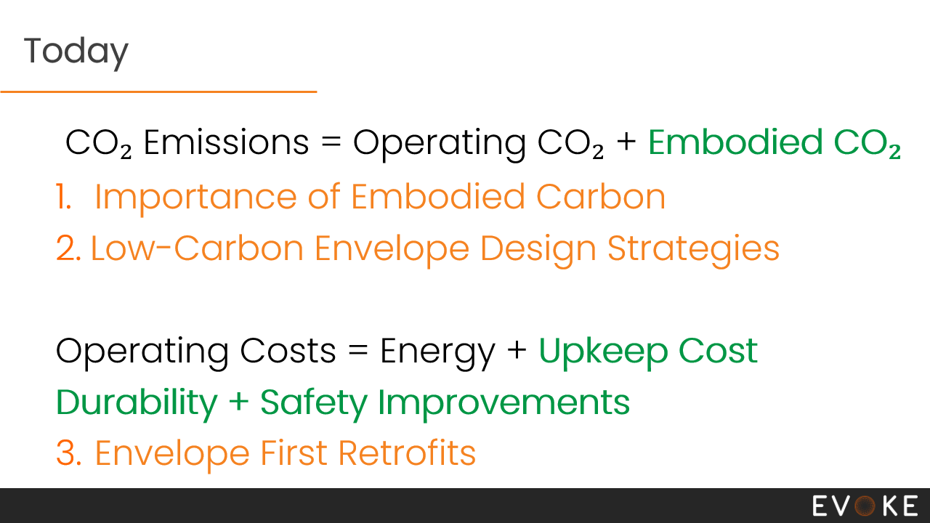
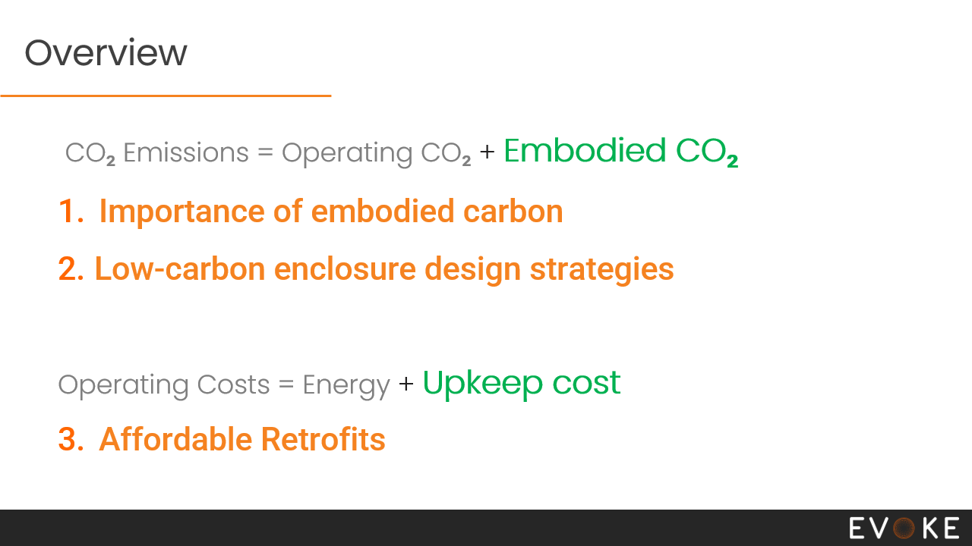
Overview
CO₂ Emissions = Operating CO₂ + Embodied C2O₂
Importance of embodied carbon
Low-carbon envelope design strategies
Operating Costs = Energy + Upkeep cost
Retrofit Costs
Benefits of an envelope-first approach
Notes:
7 min

Slide 9
Net-Zero Emissions
Source: Breakdown of Canada’s GHG Emissions by Economic Sector 2023 (Environment Canada, 2025)
Notes:
6.00 I want to start off by talking about the big picture, this won’t be a deep dive, but it’s worth discussing because I find there a lot of confusion around what net-zero is, what we’re aiming for.
Now, what is net zero? Well, in terms of absolute targets, the carbon emissions that earths ecosystem can sustain, is 2-3 tonnes per person each year.
Canadas average carbon footprint is 17 Tons CO2 per year. Now, half of that is from personal consumption - things you would deal with in your day to day life, like how you get to work, the food you eat, and how your heat your house. This other half, is Alberta.
So, how do we get from here, to there? Well, as you can tell - it’s not going to be a little tweak here or there. It will require transformative changes in every sector.
It looks hard right? Some of you are probably thinking, Aghh, is it really worth surviving, if we have to eat lentils and ride bikes around the rest of our lives?
But remember, 90% of the problem is solved if we stop burning stuff. Think about that. Now, it will take awhile unfortunately, but every expert I’ve talked to about their field, thinks this doable. Of course, that comes with a price tag.

Slide 10
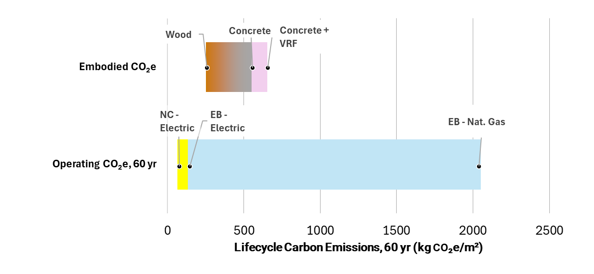
Embodied Carbon for BC Buildings
Low-Rise
Highrise
Source: BC Housing 2025 “Low Carbon Solutions for Multi-Unit Residential Buildings”
CoV 2021 Greenhouse Gas Emissions of Refrigerants in Residential Heat Pump Based Mechanical Systems “”
Notes:
8:40
So, how important is embodied carbon in buildings?
Embodied carbon here, refers to all the carbon emissions associated with extracting, manufacturing, transporting materials, and building the building.
This figure shows embodied emissions for a wood frame building, a concrete building, and a concrete building with VRF heat pump heating system.
The bottom, has operating emissions for a new electrified building, an old electrified building, and an old gas heated building.
When you add those two together, you get the lifecycle emissions of the building.
When buildings have gas heating and hot water, operating emissions are way more than embodied emissions.
But once you electrify, suddenly embodied emissions are the majority. It might be tempting to say we’ve done enough, but as you saw in the last slide – we really need transformative change everywhere, not just in one sector.
In electric buildings, something interesting happens, because now, not every energy retrofit will actually decrease total lifecycle emissions. We have to think carefully.
For example - Mechanical refrigerants are one area we really need to watch for – switching from electric heat, to a VRF system, will probably increase lifecycle emissions.
Likewise in envelope systems, not all retrofits are beneficial. We have to be careful, how we do things.

Slide 11
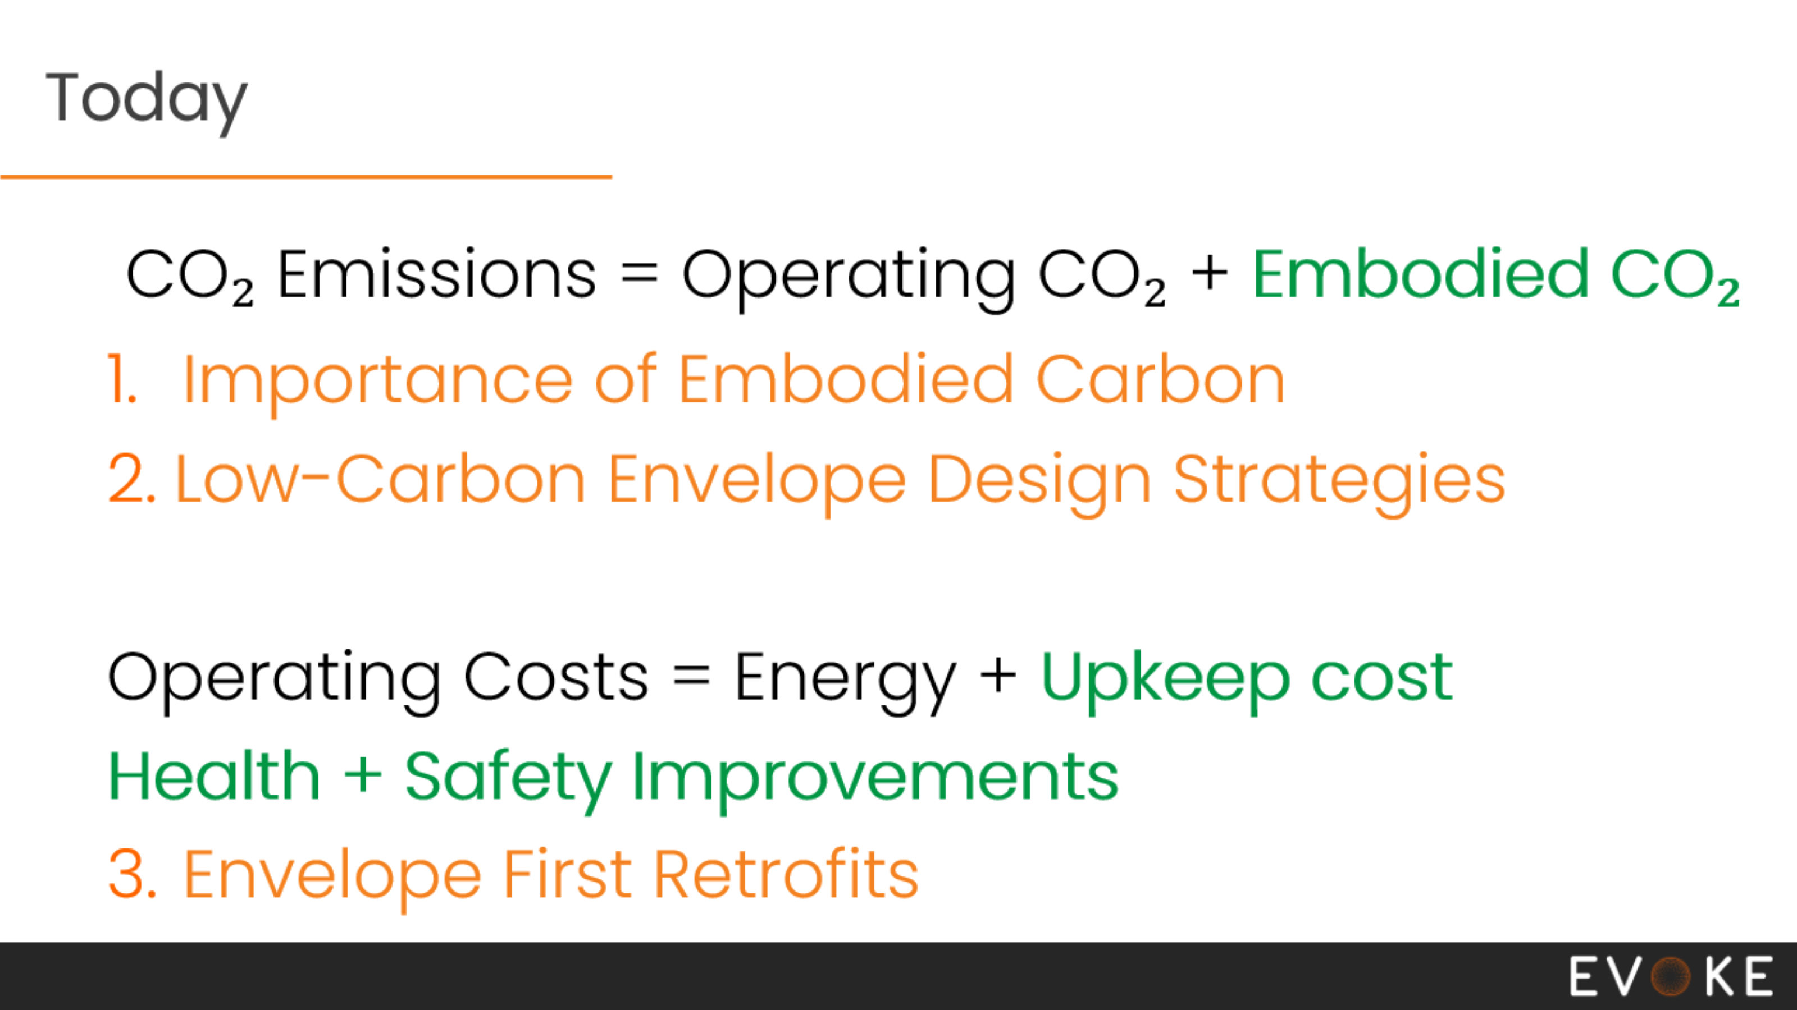
Overview
Notes:
10:40

Slide 12
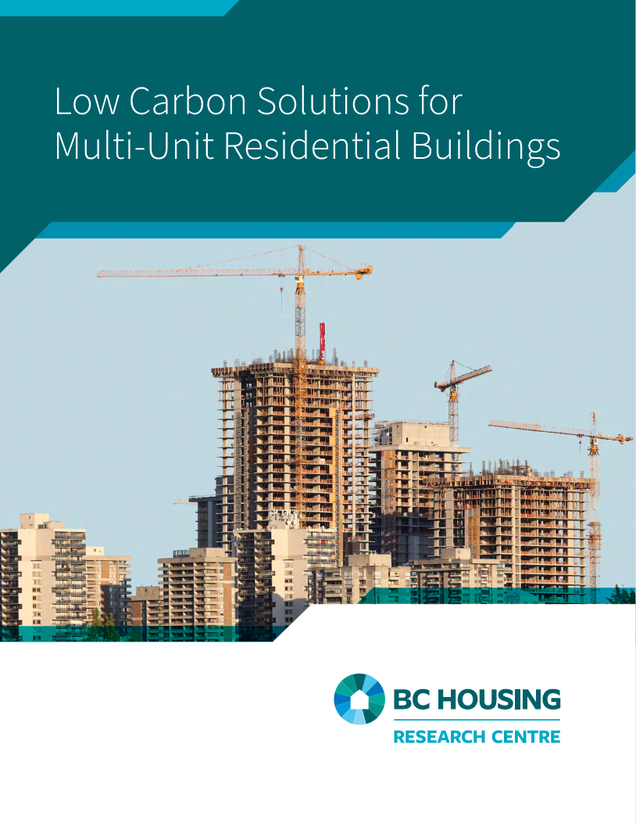
Goals
Low-Rise MURB
High-Rise MURB
Existing High-Rise MURB
Notes:
This comes from a study Evoke did last year with BC Housing, low carbon solutions for multi-unit residential buildings,
or as we like to call them, MURB.

Slide 13
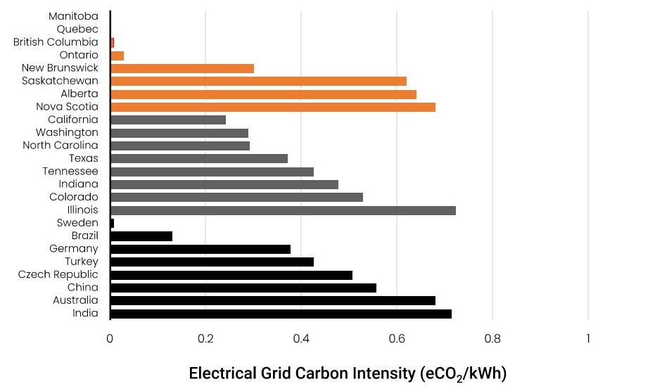
Emission Factors
(Kg CO₂ / kWh)
Notes:
I want to highlight that BC has an exceptionally clean grid.
A lot of the studies we see are based in the US, and the lessons there are not transferrable, and that is why you see so much conflicting information on the relative importance of embodied carbon.

Slide 14
Goals
Assess calculation methods
Low-Rise MURB
High-Rise MURB
Existing High-Rise MURB
Notes:
One of the main goals of this study, was to assess the envelope embodied carbon calculation method.
It looked at what sort of calculations are needed to assess the envelope accurately. Right now, most assessments are just looking at the clear wall, they don’t think of all the intersections and connections, and the people doing them aren’t envelope engineers, sort of like where envelope R-values were 15 years ago.

Slide 15
Assess Calculation Methods
Notes:
In contrast, this study was completed by building envelope experts.
It worked through realistic envelope designs, it looked at clip orientation and spacing, it accounted for insulation thickness and cladding weight etc. It looked at the impact of interface details – the flashing, extra framing around windows.
This study did a super deep dive the impact of all these details, and then determine what’s required to get a reasonably accurate calculation.

Slide 16
Goals
Assess calculation methods
Assess envelope emissions
Provide design guidance
Low-Rise MURB
High-Rise MURB
Existing High-Rise MURB
Notes:
Aside from assessing calculation methods, the study also
more accurately assesses the relative impact of envelope compared to structure, since prior studies haven’t assessed the envelope very well
focuses on building envelope design guidance, which is going to be the focus of my presentation today.
I’m going to structure it as a Q&A. I’m going through common questions, and to answer I’ll provide the general guidance from the study.

Slide 17
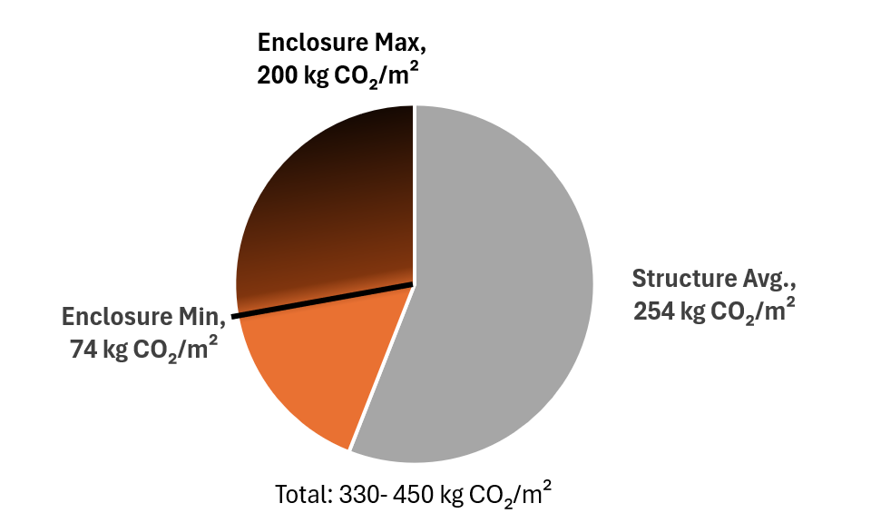
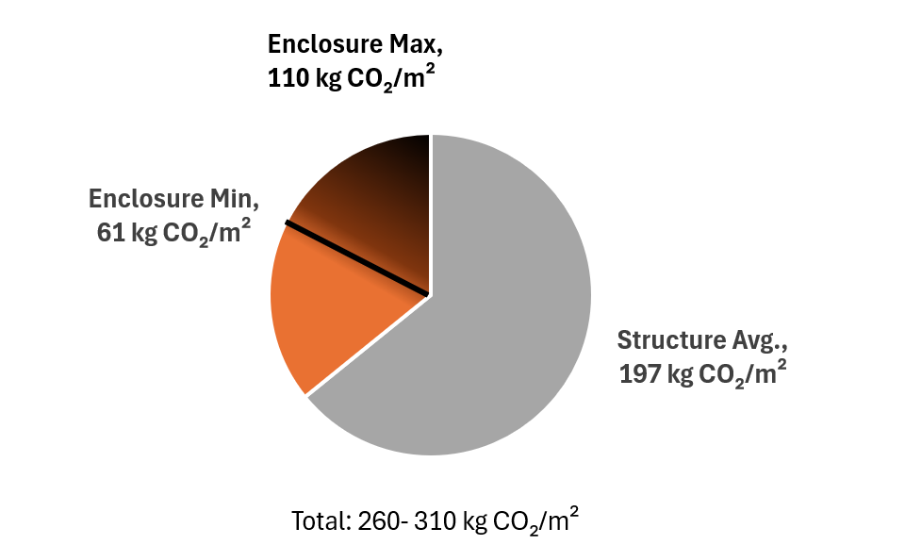
How Significant is Envelope?
High Rise
Low Rise
Notes:
14min
we often get the impression that envelope doesn’t really matter, we hear about insulation and the structure so much.
Here we have the embodied emissions for high rise and low rise buildings, including the structure and the envelope. High rise is more emission intensive, because you have more concrete and metal.
In both cases, we the envelope is around 20-40% of the total building fabric emissions.
This is a pretty significant chunk, we found that most studies have underestimated envelope emissions.

Slide 18
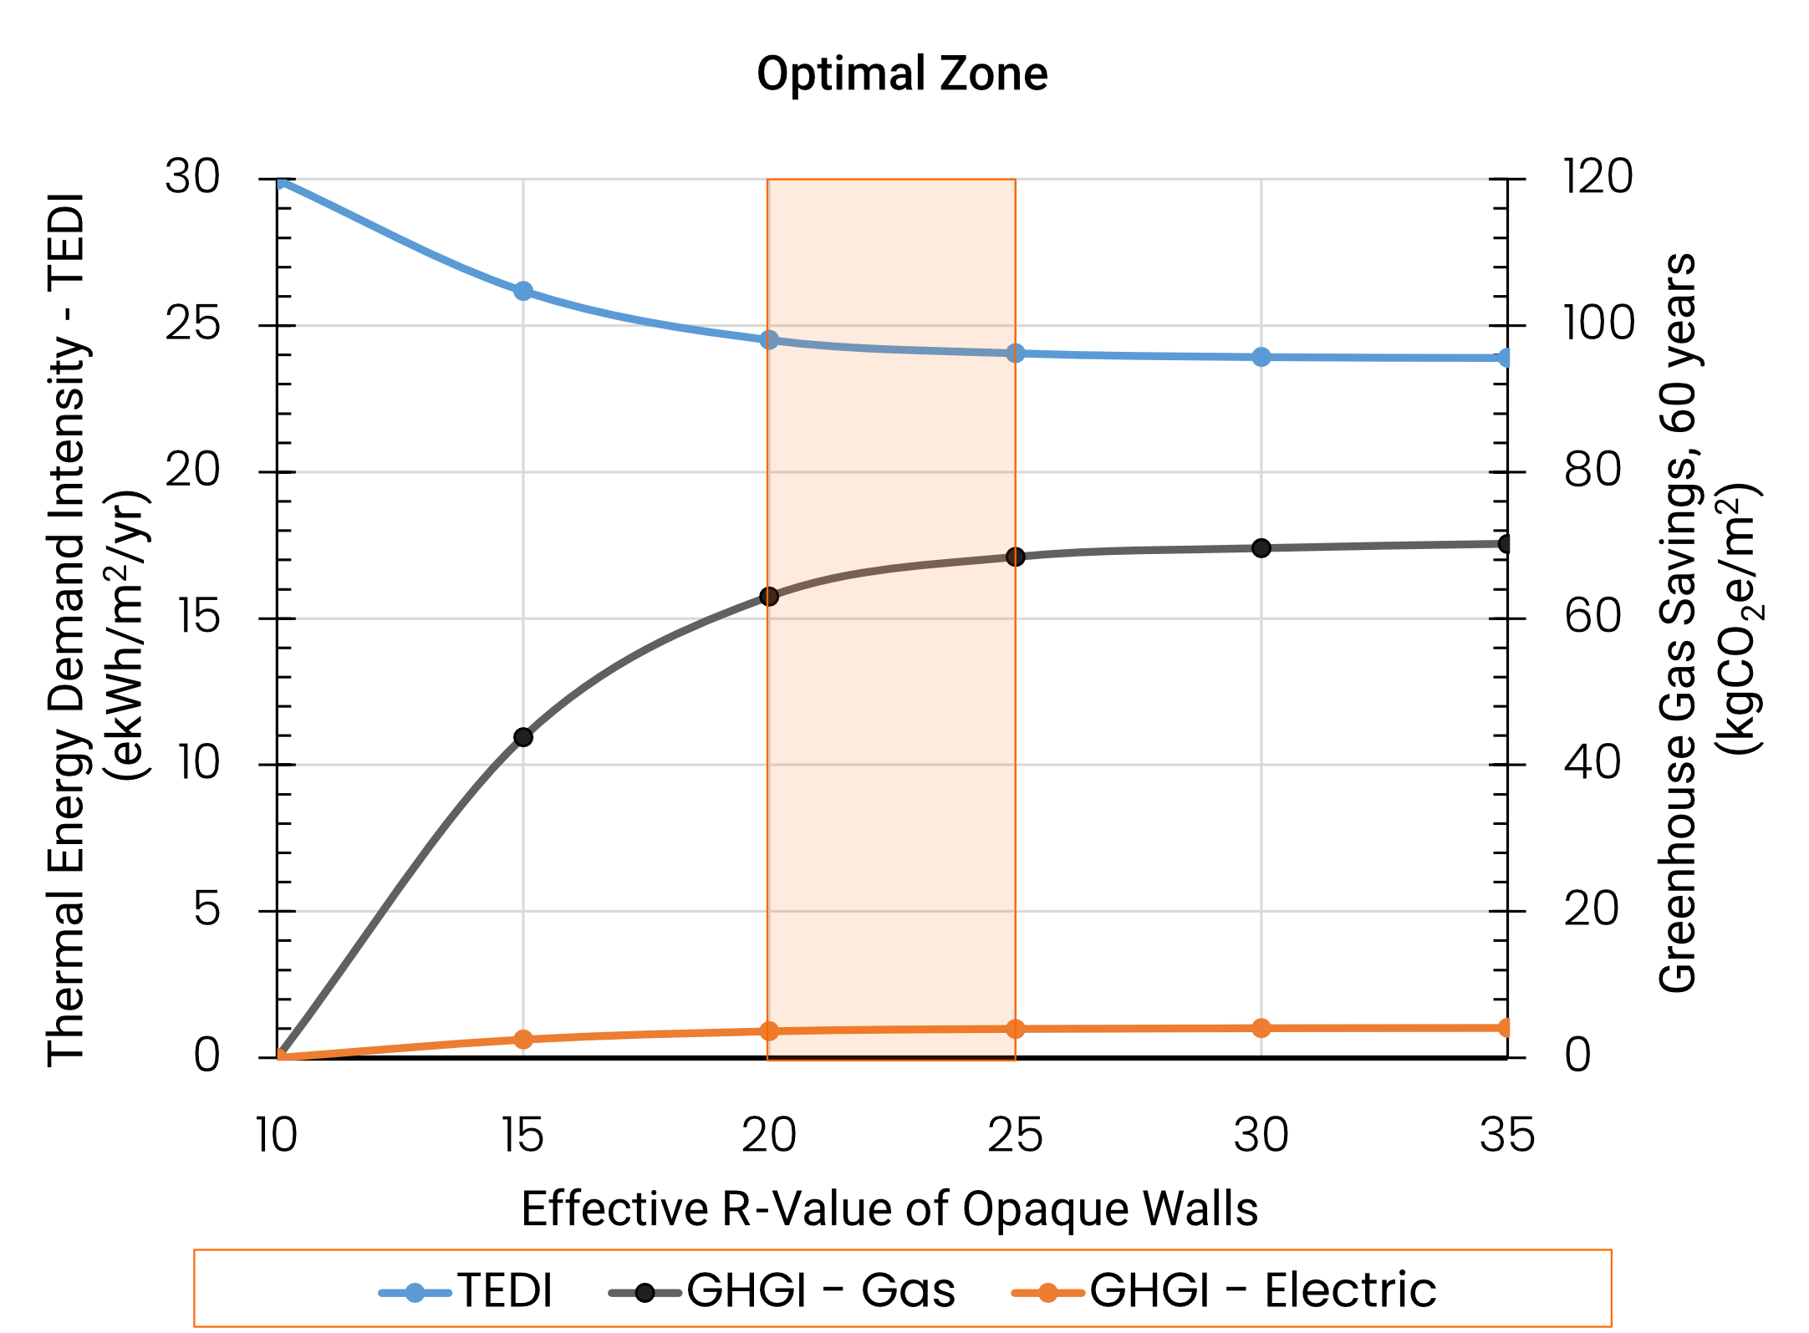
Optimal Insulation for Walls and Roof
Does insulation pay off?
Yes, if thermal bridging is mitigated and there’s energy savings.
Notes:
does insulation pay off, even in BCs super clean grid?
And Yes, it does – if thermal bridging is mitigated and you’re seeing energy savings.
It doesn’t take any kind of special requirement to assess – we found if you just look at the energy model results, and is that savings making a TEDI impact. If it’s helping, then the you are achieving a net GHG savings.
If you don’t mitigate thermal bridging though, then it’s not worth it for electrically heated buildings.
This applies more generally to roofs as well, if you're seeing significant savings, than it’s most likely achieving a net benefit.

Slide 19
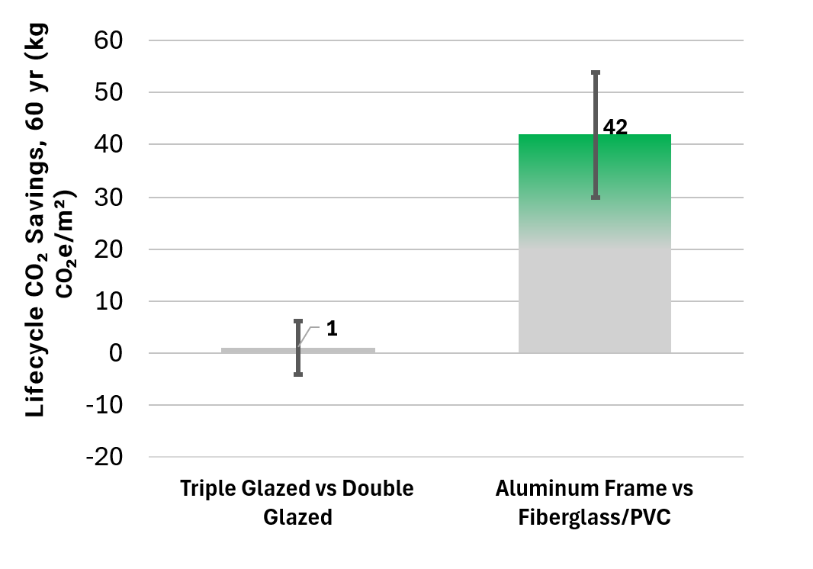
Do Triple-Glazed Windows Reduce Emissions?
Notes:
When it comes to triple glazed, sure, its great if you have gas heating. But for electric buildings, it’s sort of a wash. Ind
Might have a mob after me for this one, but personally, I think there is a strong case to be made for double-glazed windows. Double glazed is pretty good, and there’s significant cost savings.
Much more influential, was the frame material. Switching from aluminum to fiberglass, could reduce building lifecycle emissions by around 15%.

Slide 20
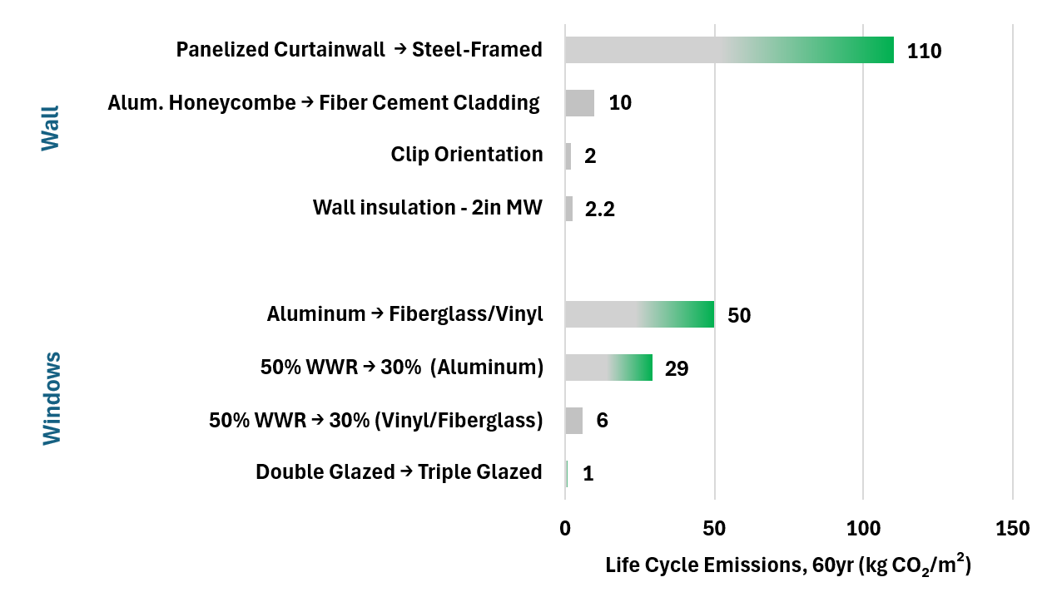
Best places to reduce envelope emissions
Notes:
Where are the big savings?
Well, they’re in the bigger picture decisions.
One big difference is switching out the backup wall – I was really torn, whether to includes this or not, because this was not the intent of this study, but looking through it – I was blown away to see that the backup wall is the single most significant envelope decision. Going steel frame, window wall, or panelized curtainwall can make a huge difference.
Next factor for walls, is the cladding. Fiber cement cladding. Cladding is something you can change, that doesn’t impact thermal performance as much, so this is a really key place to chase savings.
In Windows – the frame material is really significant. Switching to non-metal is huge.
Perhaps the least impactful option, is the insulation. Which is funny, because we hear about it so much, but its problematic, because the performance is not equivalent, and it’s not the most intensive component by a long shot.
To us, this really highlights that to achieve a low emission design, its about so much more than the insulation. It’s about finding savings all over.
Another rthing I need to point out, is that Aluminum emissions are very sensitive to how its made. These numbers are based on dirty, coal power aluminum, because those were the only numbers available. If we built with BC aluminum, the savings would be HUGE. We have a huge opportunity in BC to reduce emissions and support the economy by buying local.

Slide 21
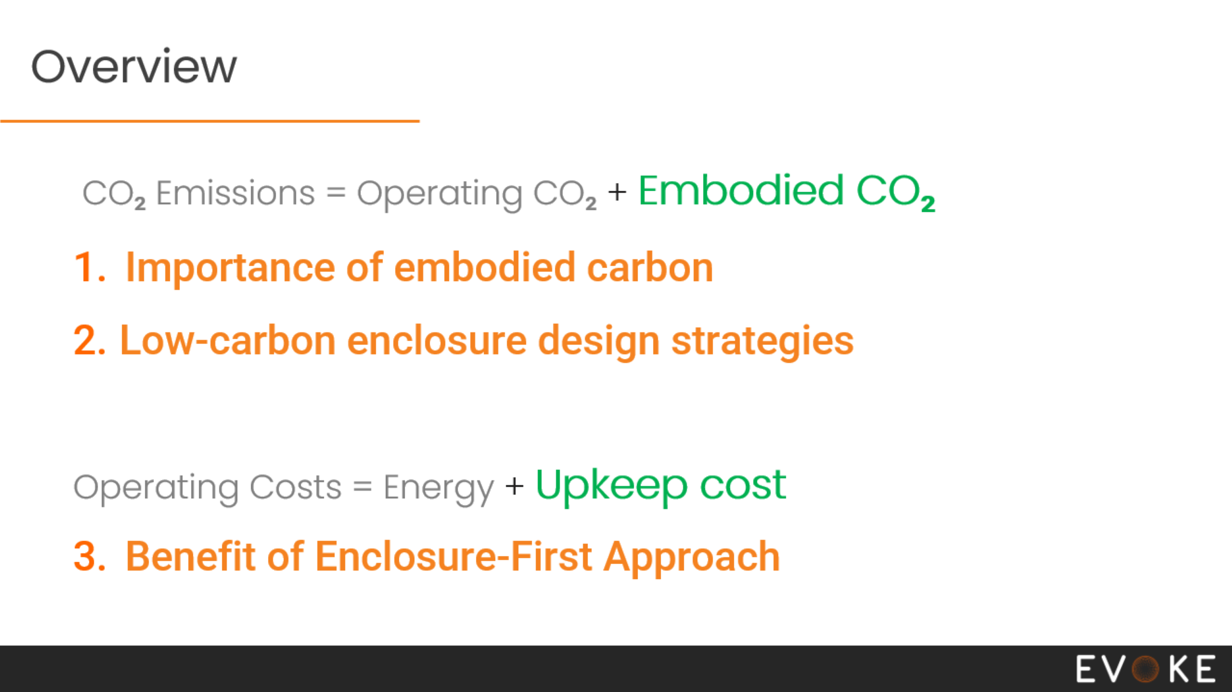
Overview
CO₂ Emissions = Operating CO₂ + Embodied C2O₂
Importance of embodied carbon
Low-carbon envelope design strategies
Operating Costs = Energy + Upkeep cost
Retrofit Costs
Benefits of an envelope-first approach
Notes:
20min
This next part, I’m going to be talking about how an envelope first approach can have some significant benefits for the affordability, as well as enabling durability and safety upgrades.

Slide 22
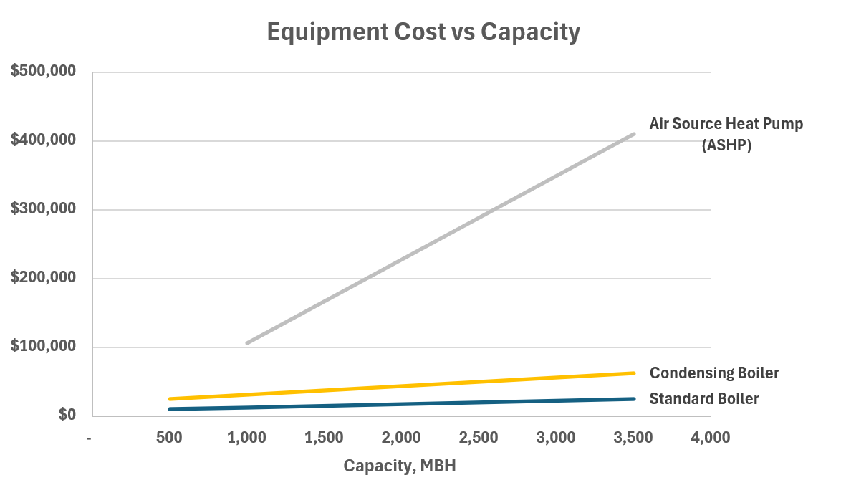
The good old days
Adapted from B2E & SES, 2024 “B2E Commercial Building Electrification Guide”
Notes:
Back in the gold old days, ie 2020, a mechanical system upgrade was putting in a condensing boiler, oversize it, capacity cheap.
These projects highlighted for me that we are in a new paradigm,
Heat pumps, are super expensive.
It used to be that envelope upgrades and renewals were far more expensive than mechanical equipment, no comparison. But that has changed.

Slide 23
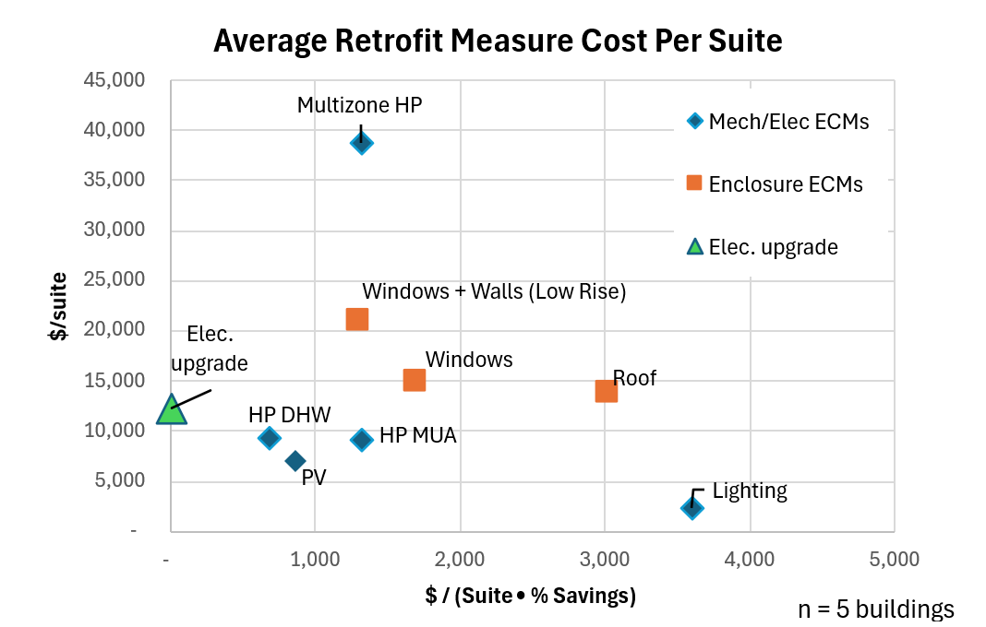
Retrofit Cost
Notes:
22m
This is the average capital cost for each measure on five of our projects. The vertrical axis is the cost of the equipment, per suite. The horizontal axis is $ per % savings, so, further left means you get more savings, with less money.
When I saw the estimates for these retrofits, knock me over with a feather – The single most expensive system was the multi-zone heat pumps, this is like a VRF system, big unit on the roof, refrigerant piping comes down and is run through the building in bulkheads, and it provides heating and cooling to multiple suites.
On a lot of projects, the team wants to pick upgrades based on $/percent savings, how do we get to the target as cheaply as possible. And based on that metric, multi-zone heat pumps are pretty good bang for your buck. The envelope upgrades are over here to the right.
But the issue here, is you’re really just talking about upfront costs. But what about over the long run? heat pumps last around 15-20 years.
Well, I think this mechanical equipment is going to be just as expensive to replace, as it is to put in.
For the multizone heat pump, it might seem like we are setting up all the pipes for the future, but there is no guarantee we can re-use them, because refrigerants are changing in the next couple years. So they may have to tear out the copper line sets and replace those, or these type of systems may not be allowed at all.
In 15 to 20 years, will the owner have an extra $60,000 per unit, to replace all these heat pumps? That’s like $240 per suite, every month.
So, how do we do it differently?

Slide 24
Envelope first approach – MURB Retrofit
Modernize performance & minimize upkeep 25+ years:
Sheathing (Seismic)
Airtightness
Water control
Insulation
Resolve durability issues
Notes:
I think, if you’ve got this huge capital - use that upfront cash to renew the envelope as much as possible.
That money can modernize the performance of the building and minimize upkeep costs for decades. You can upgrade the safety, like seismic, you can massively improve the airtightness, and water control. You can add insulation everywhere, solve any durability issues.
These upgrades will last the life of the building.

Slide 25
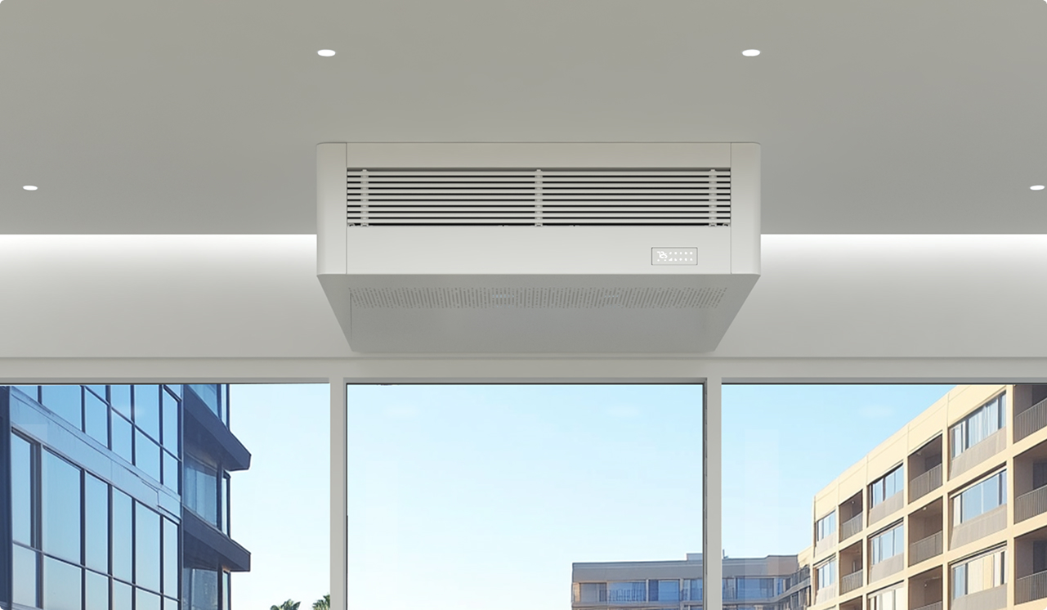
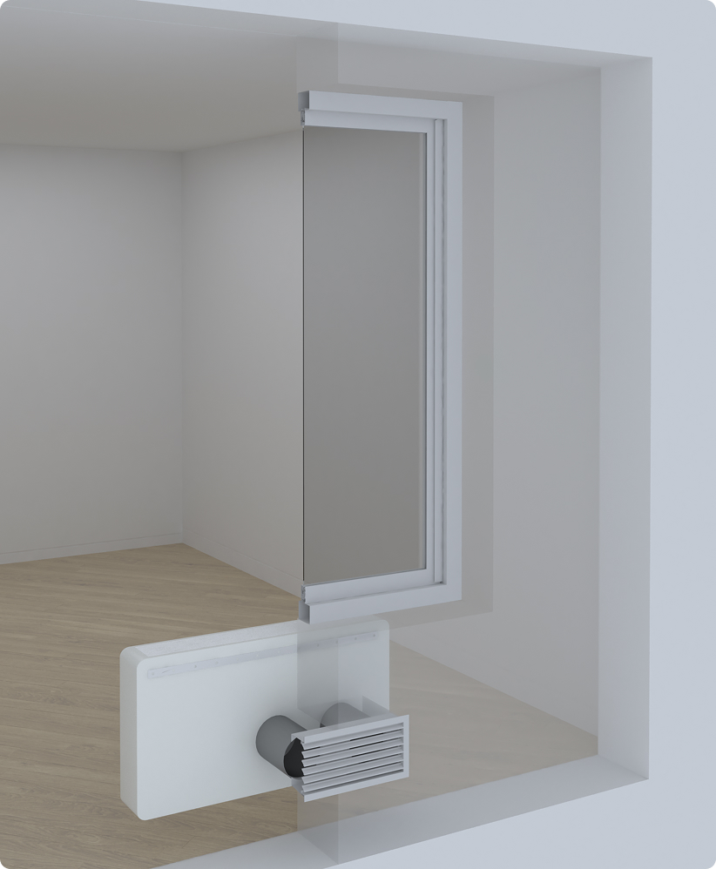
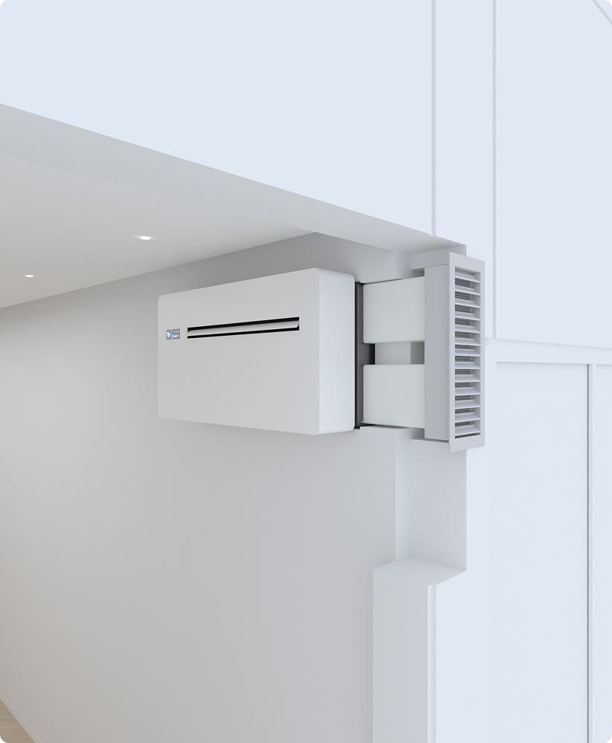
Envelope first approach – MURB Retrofit
Confirm with mech expert
Mechanical Synergies
Minimize peak loads
Add penetrations
Install small, unitized HRVs + heat pumps
Result: Enhanced ventilation, reduce embodied carbon, and lower upkeep costs.
Notes:
And this comes with some serious mechanical synergies. It used to be, spend $2M on the envelope, save $40,000 on your boiler, but in this new paradigm, we’re talking about a significantly smaller and simpler heat pump system.
An envelope retrofit minimize loads and gives you the opportunity to do envelope penetrations, which provides an ideal situation installing small, unitized HRVs and heat pumps, like the ones here.
With small unitized equipment, it still is a significant retrofit initially. You still need drainage, ducts, and wiring.
But, there’s a three key advantages.
One, is you get much better ventilation, and can downsize or eliminate the makeup air unit.
Two, the embodied carbon is much lower, since there’s much less refrigerant.
And, three, in 15 years, the costs are much lower – it’s like replacing your washer and dryer, rather than rewiring your house.
For anyone that knows the reframed pilot program – this was the most common strategy.

Slide 26
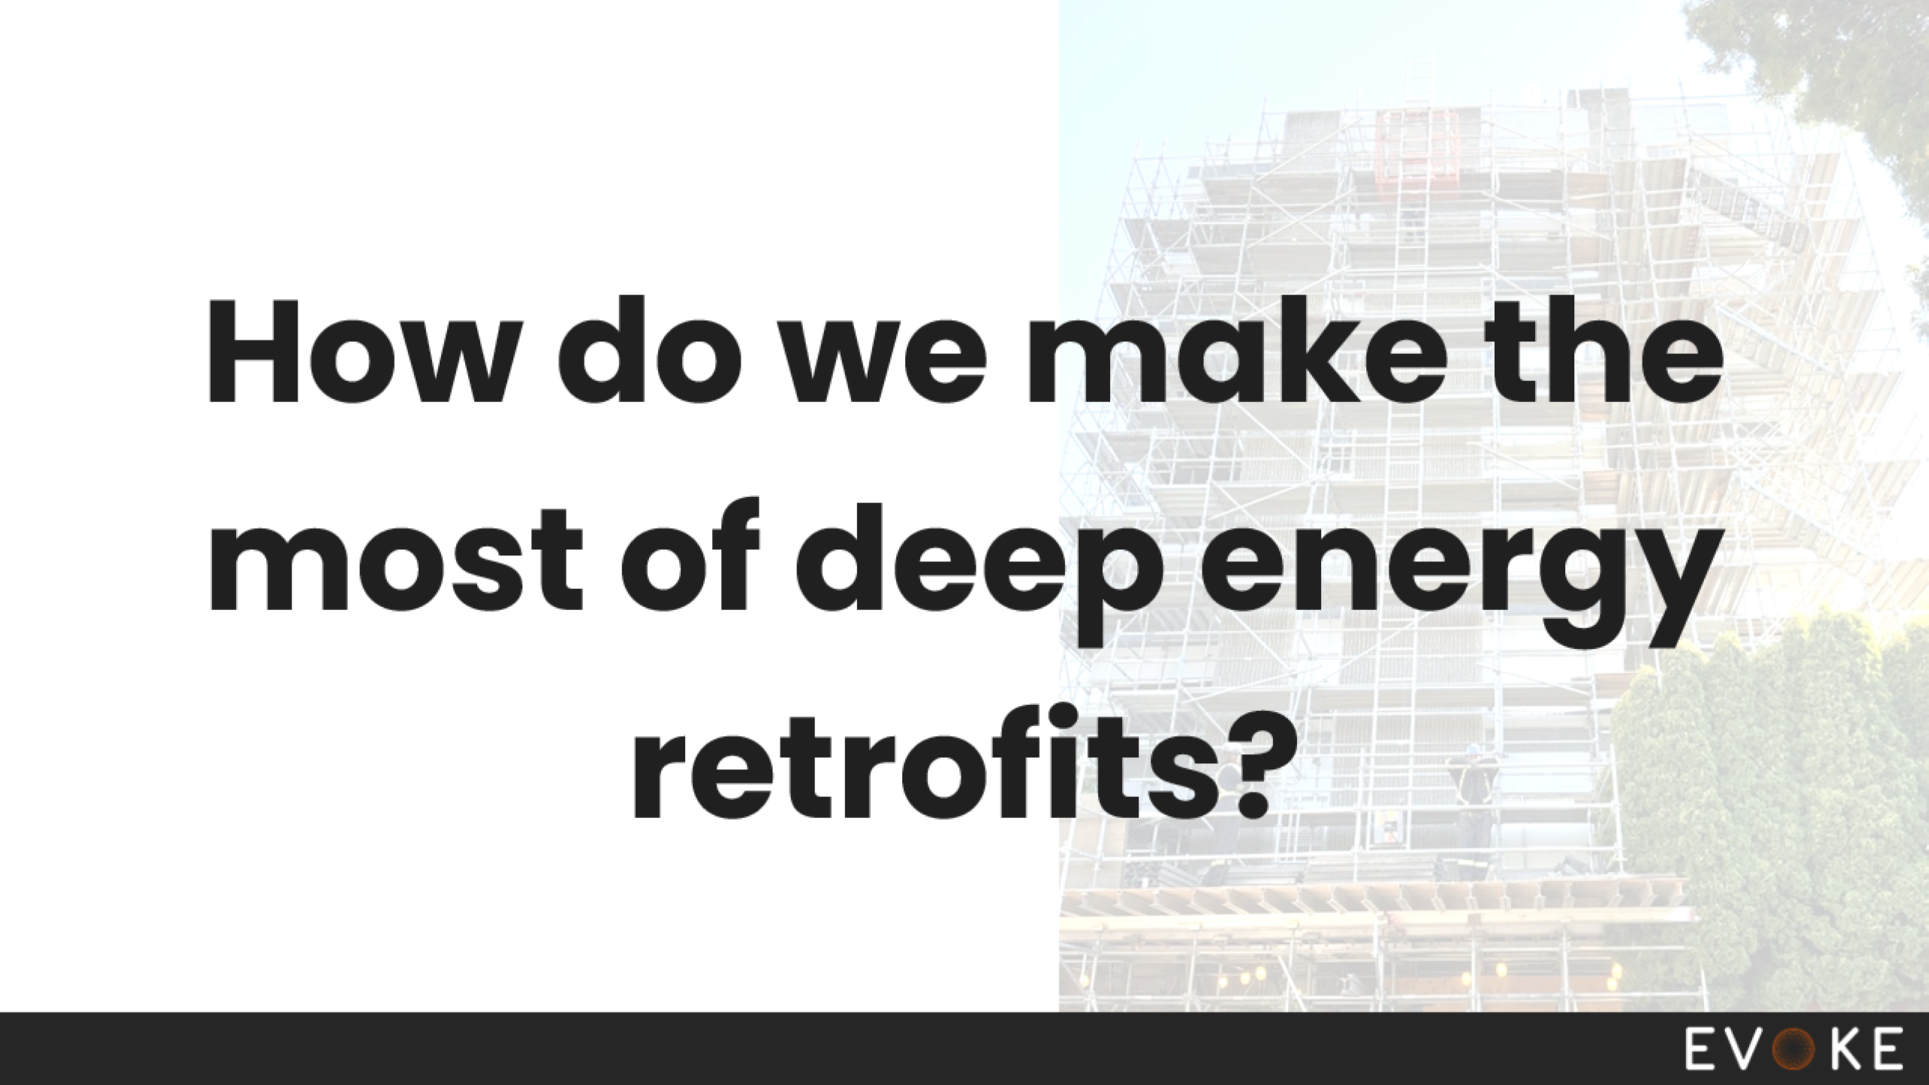
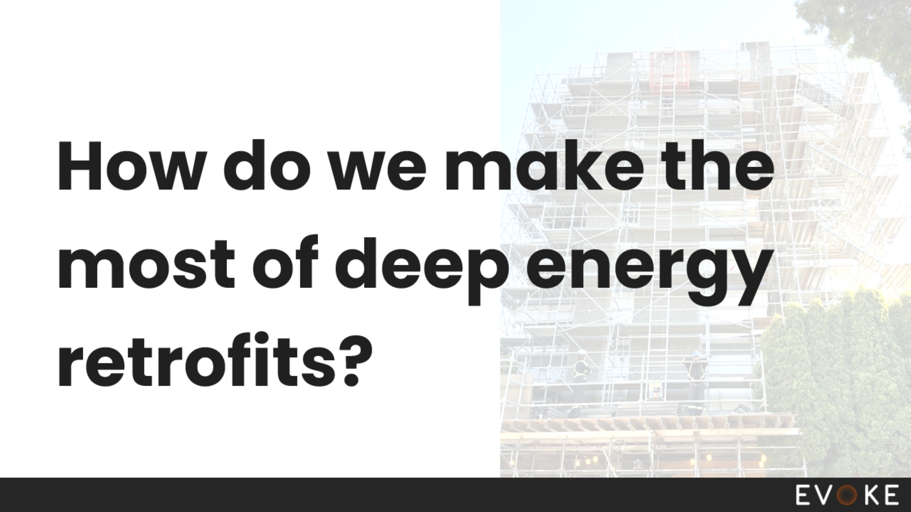
Notes:
So how do we make the most of the deep retrofits?
Heat pumps are crucial, we should electrify these buildings and provide cooling.
But, let's not lose sight of the fact that this is about more than heat pumps and energy targets.
This is about reducing lifecycle carbon emissions.
This is about creating safe, durable buildings.
This is about creating affordable buildings.
Thank you.

Slide 27
Thank you for your attention!
Notes:
29 min

