Slide 1


Slide 2
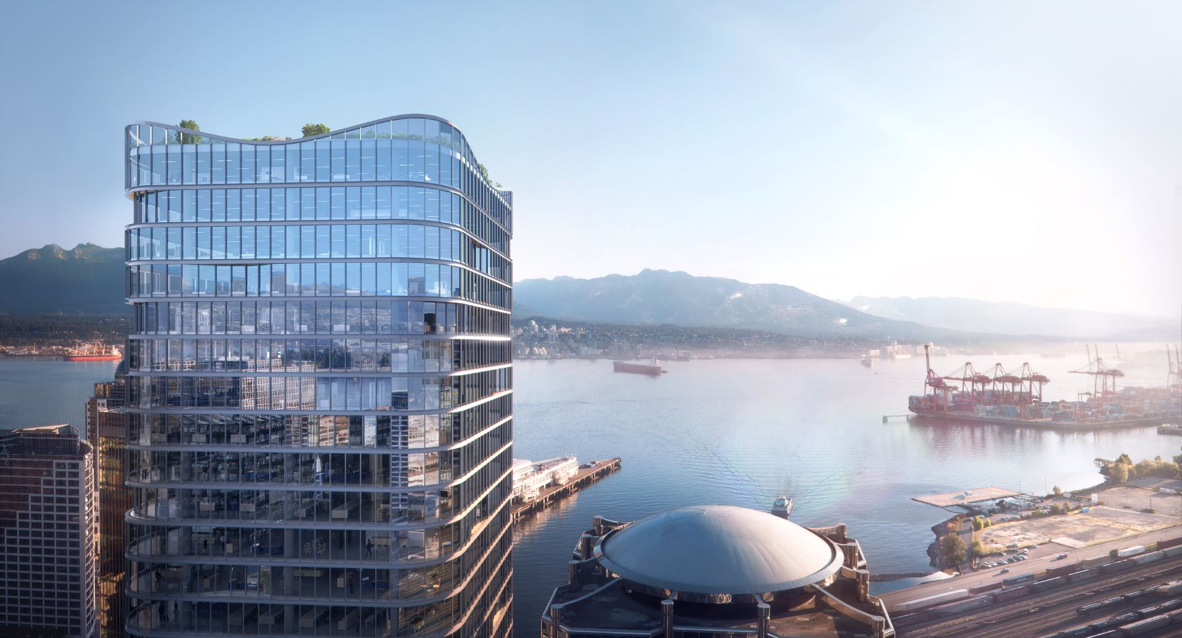

Fenestration Durability for a Resilient Future
Presented by
Anton Van Dyk

Slide 3
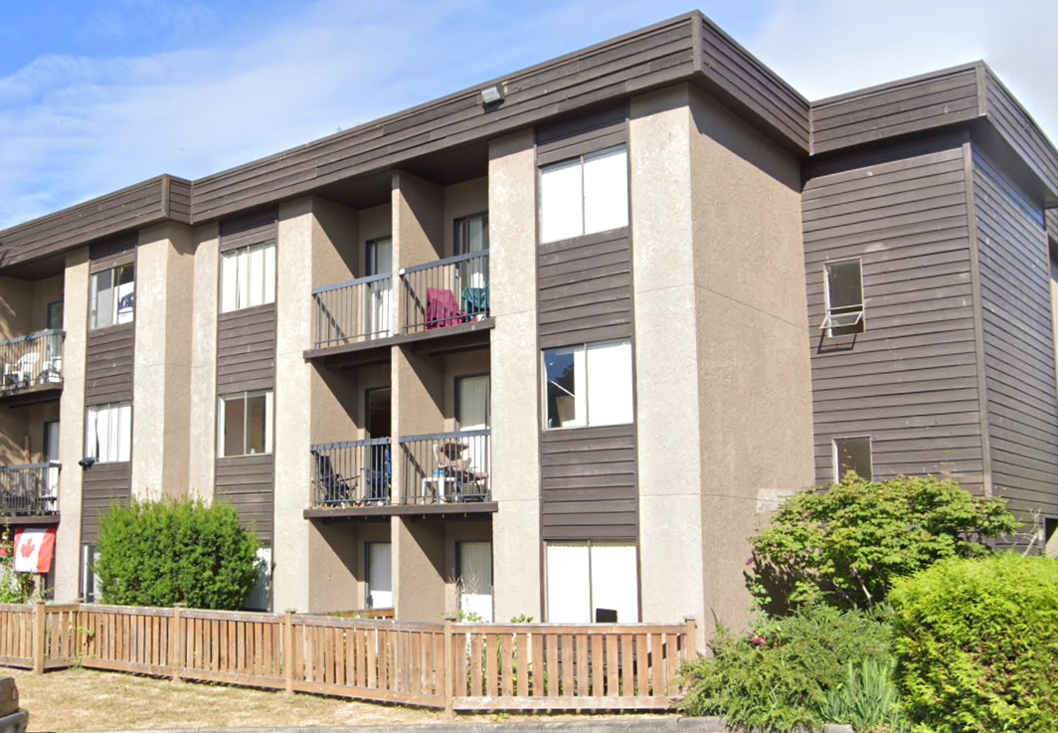
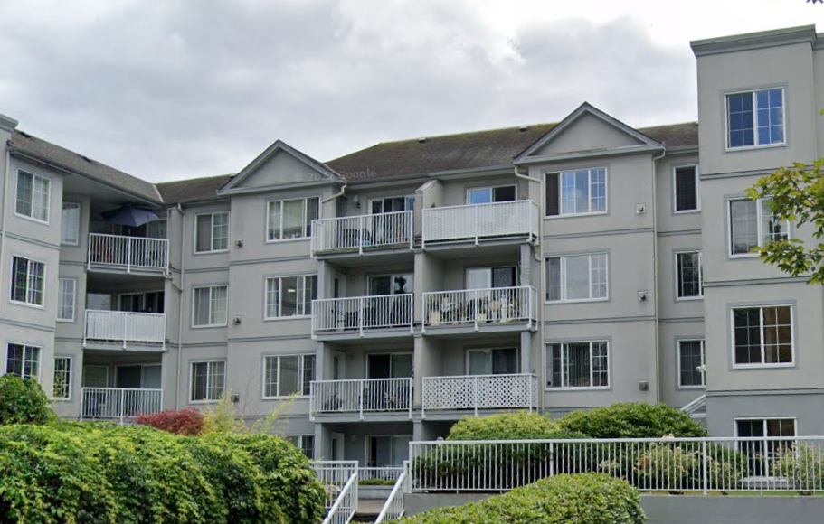
history Lesson
Drying Potential l Wetting Potential
Drying Potential l Wetting Potential
Wall Assembly
2x4 Wood Stud
R12 Paper backed Batt Insulation
No Poly
3/8” Plywood
Building Paper
Non Rainscreen Cladding
Wall Assembly
2x6 Wood Stud
R21 Batt Insulation
6 mil Poly
½” OSB
Building Paper / Tyvek
Non Rainscreen Cladding
“Measures for Energy Conservation in New Buildings 1978” - NRCan

Slide 4
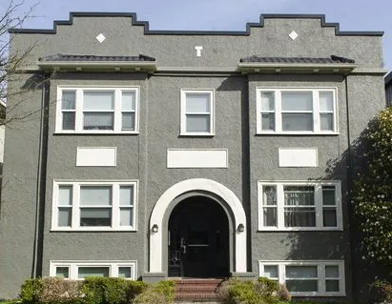
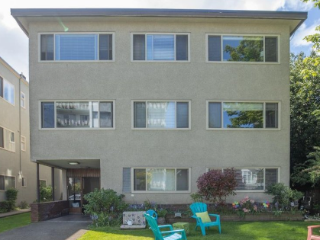
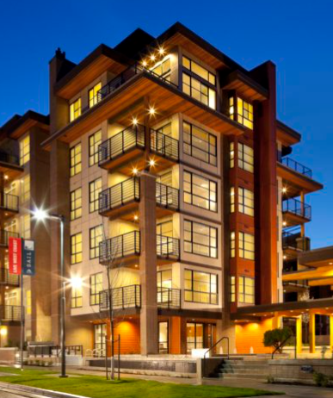
How has fenestration changed?
Wood Windows
Aluminum Windows
Vinyl/Fiberglass Windows

Slide 5
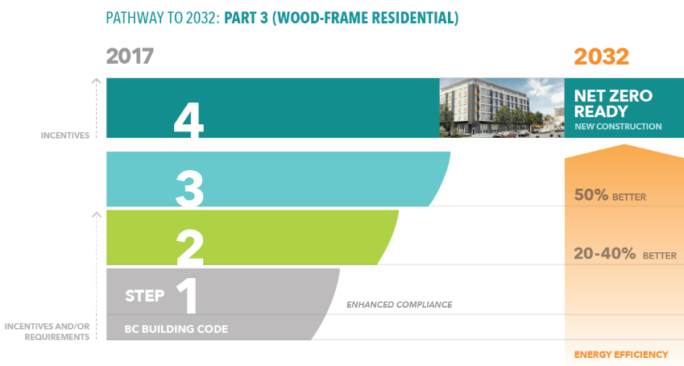
Do energy codes change our fenestration options?
U – Value? SHGC? Durability?
What type of product falls into this range?
2025

Slide 6
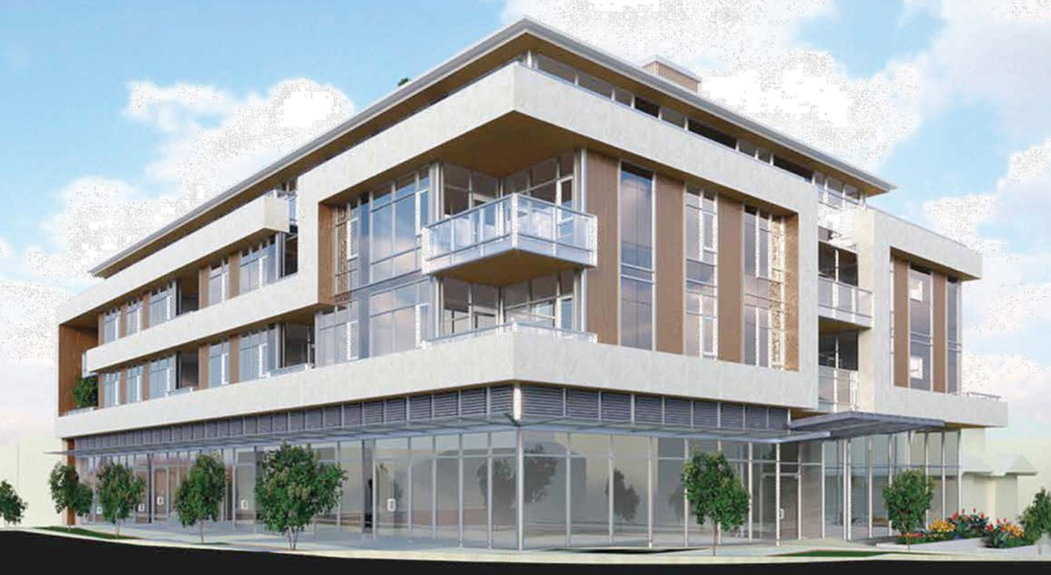
Energy Modelling: Whole Building Solutions
TEUI (Total Energy Use Intensity)
Easy to meet because of advanced energy-efficient measures:
Heat pumps,
LED lighting,
Low-flow plumbing fixtures, etc.
TEDI (Thermal Energy Demand Intensity)
Difficult to meet mostly due to thermal bridging calculations
Improve envelope details,
Higher performance windows & WWR,
Enhance airtightness/reduce air leakage rate
GHGI (Greenhouse Gas Intensity):
The trend is:
Electricity,
Renewable energy
This word lacks context
Notes:
The purpose of energy modelling is to verify compliance with requirements of TEUI, TEDI, GHGI, and airtightness.
Usually, TEUI targets are relatively easy to meet because the total energy consumption can be reduced through energy-efficient measures, such as heat pumps, LED lighting, energy star appliances, etc.
On the other hand, TEDI is more challenging because it depends on the building envelope performance, especially that the thermal bridging calculations are now mandatory for Part 3 buildings.
As a result, to improve TEDI, it usually requires us to improve envelope systems such as reducing thermal bridges, optimizing window-to-wall ratio (WWR), as well as improving airtightness.
The last metric, GHGI, sets limits on operational greenhouse gas emissions. In BC, compliance with GHGI usually involves electrification through electric heat pumps, and/or adopting renewable energy sources.

Slide 7
How does total energy use of a building impact components?
“The focus on total energy use as a target for design and construction creates a significant number of these less-than-optimal choices. Knowing how much gas a truck uses in a year does little to help understand what load it can carry up a hill or to safely descend the other side”.

Slide 8
What does our environment look like today and into the future?
January 2024
June 2021
-15.6ºC
3.1ºC
23.5ºC
39.8ºC
Victoria Average High and Low
January 2024
June 2021
-26.6ºC
-5.7ºC
29.4ºC
47.3ºC
Kamloops Average High and Low
Atmospheric River
November 2021

Slide 9
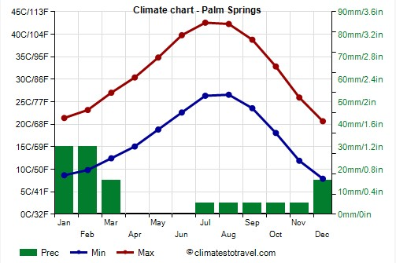
Key performance considerations linked to durability

Slide 10
Examples of performance considerations linked to durability
Excessive localized air leakage in cold climates.
High SHG Glazing damaging window frames.
Dark window frames at peak summer temperatures.
Use of Surface 4 LowE’s in cold climates in lieu of triple glazing.
Low SHG Glazing reflectivity causing fires.

Slide 11
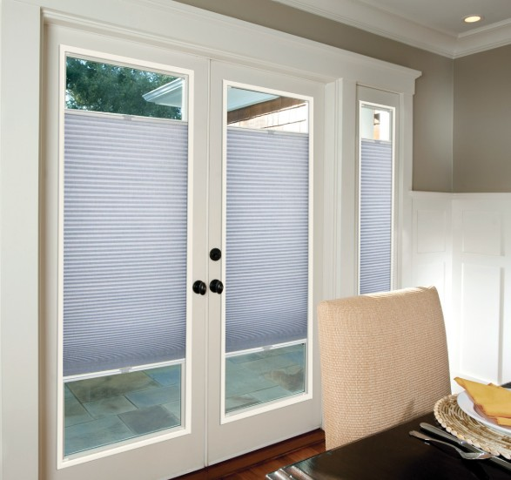
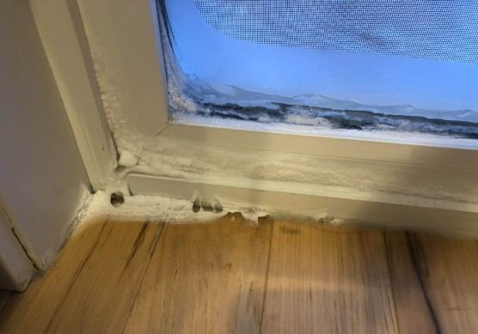
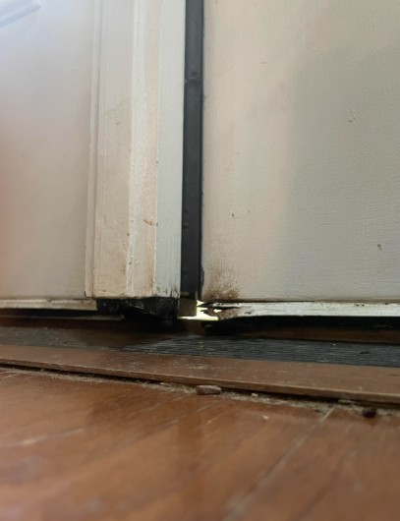
Excessive localized air leakage at peak winter lows

Slide 12
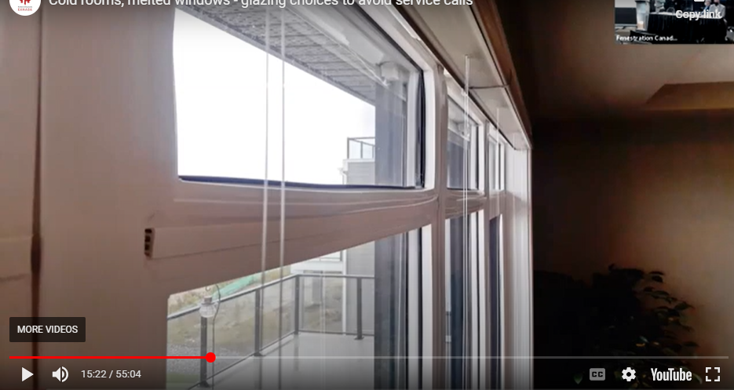

How High SHGC can impact durability
0.40 SHGC
FenCan TechTalk - Melted Windows and High SHG

Slide 13
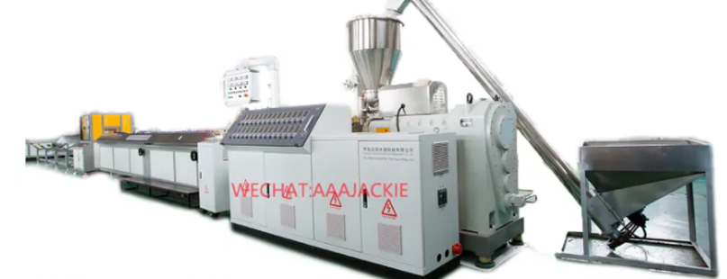
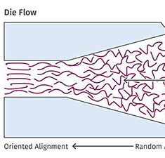
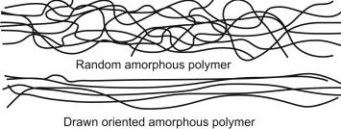
Understanding the extrusion process

Slide 14
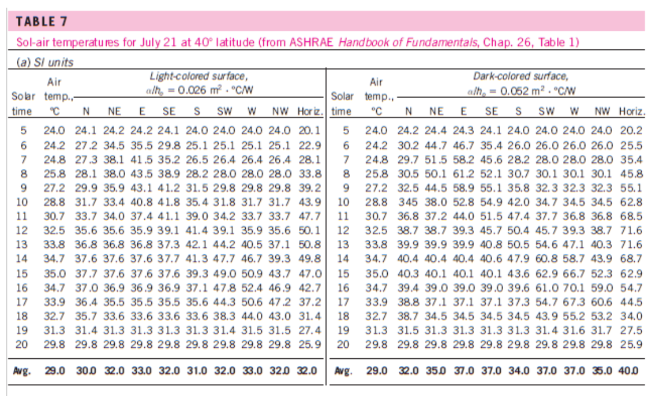
Light vs. Dark surfaces

Slide 15
What does our environment look like today and into the future?
January 2024
June 2021
-15.6ºC
3.1ºC
23.5ºC
39.8ºC
Victoria Average High and Low
January 2024
June 2021
-26.6ºC
-5.7ºC
29.4ºC
47.3ºC
Kamloops Average High and Low
Atmospheric River
November 2021

Slide 16
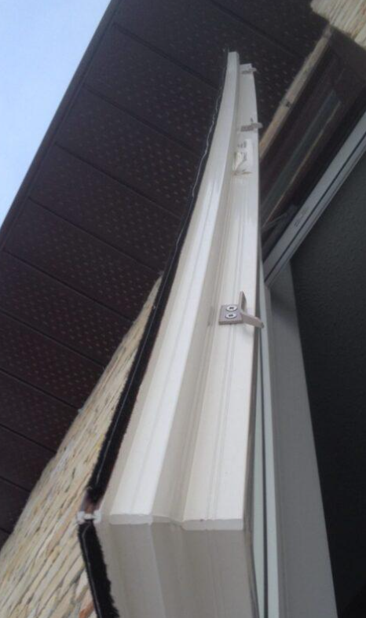
What happens to PVC WHEN IT REACHES NEAR 80ºC?

Slide 17
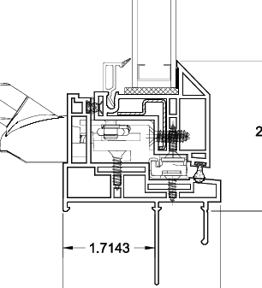

WHY DO FRAMES BOW?

Slide 18
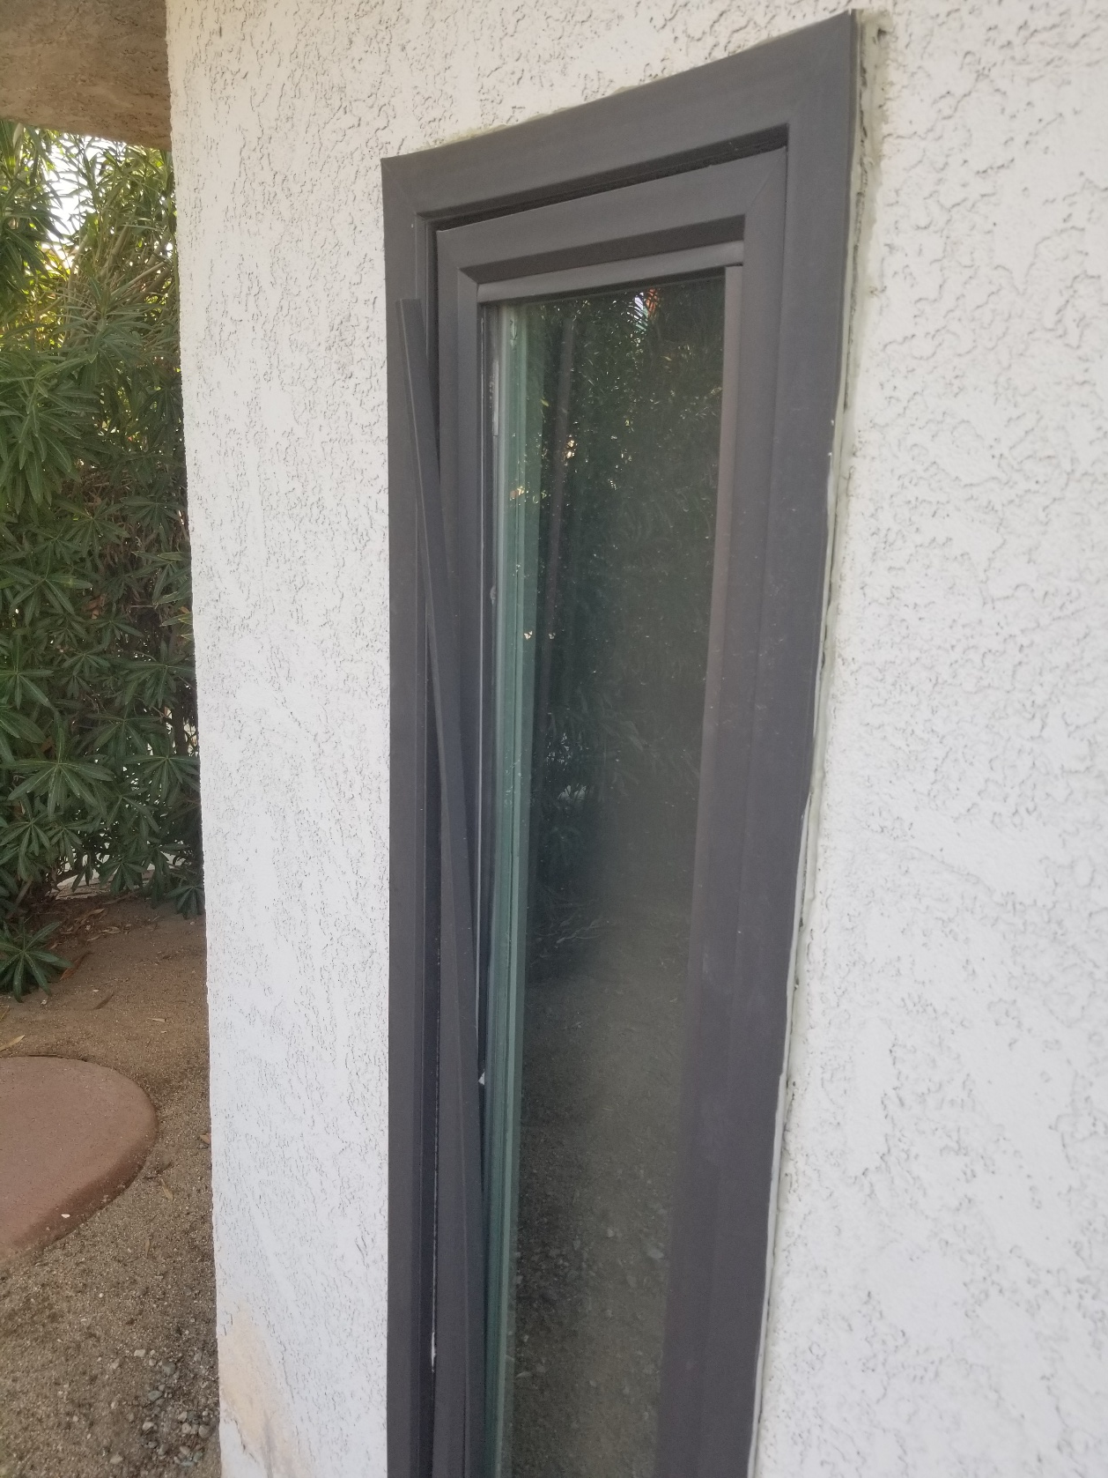
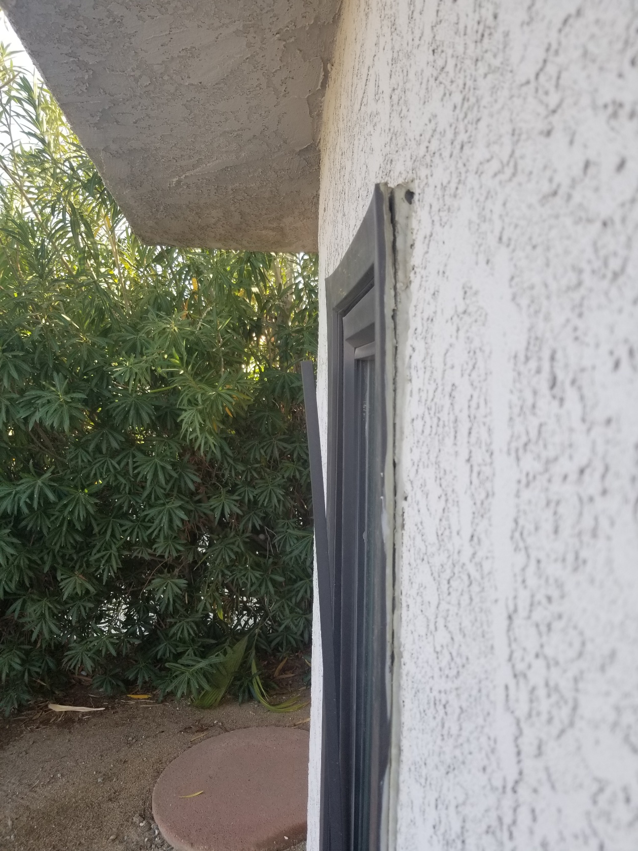
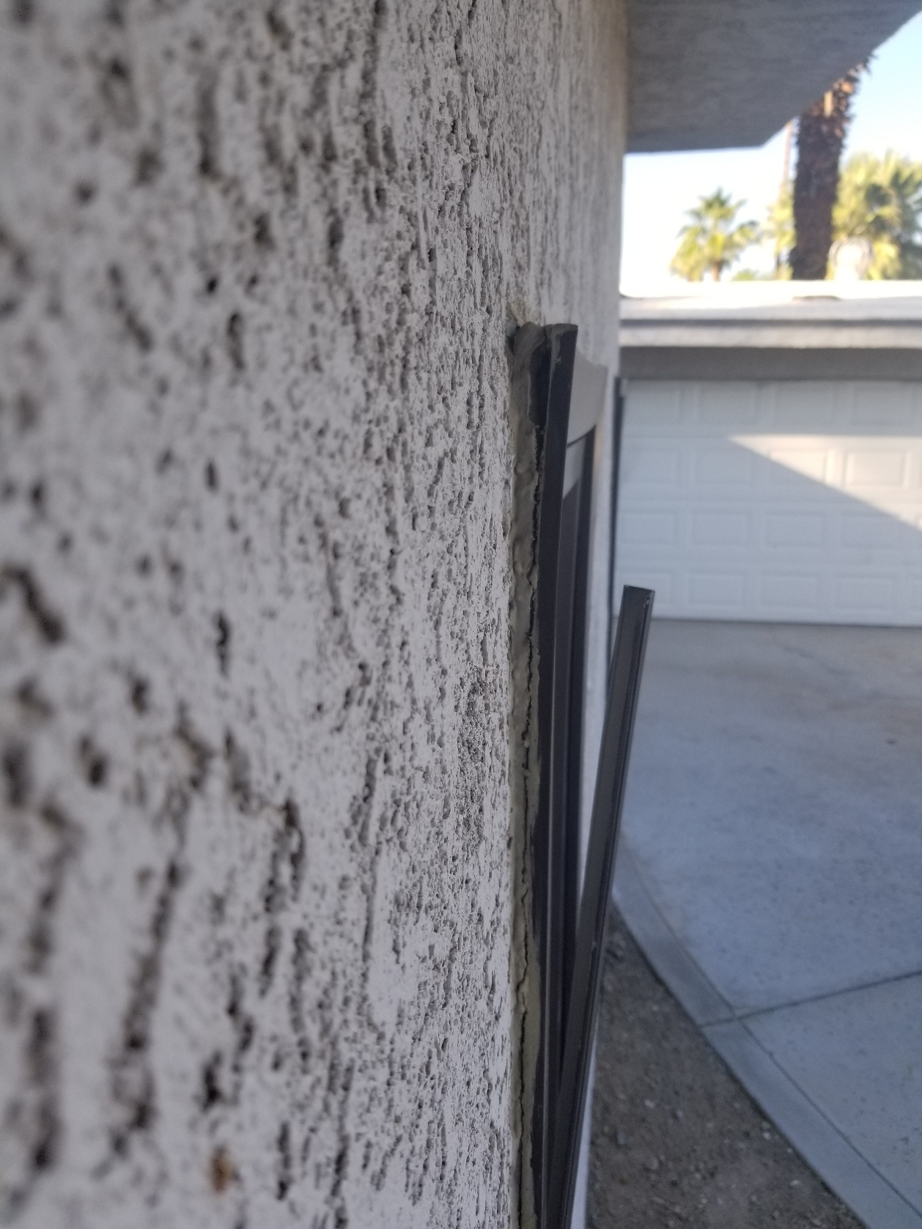
This was palm springs

Slide 19
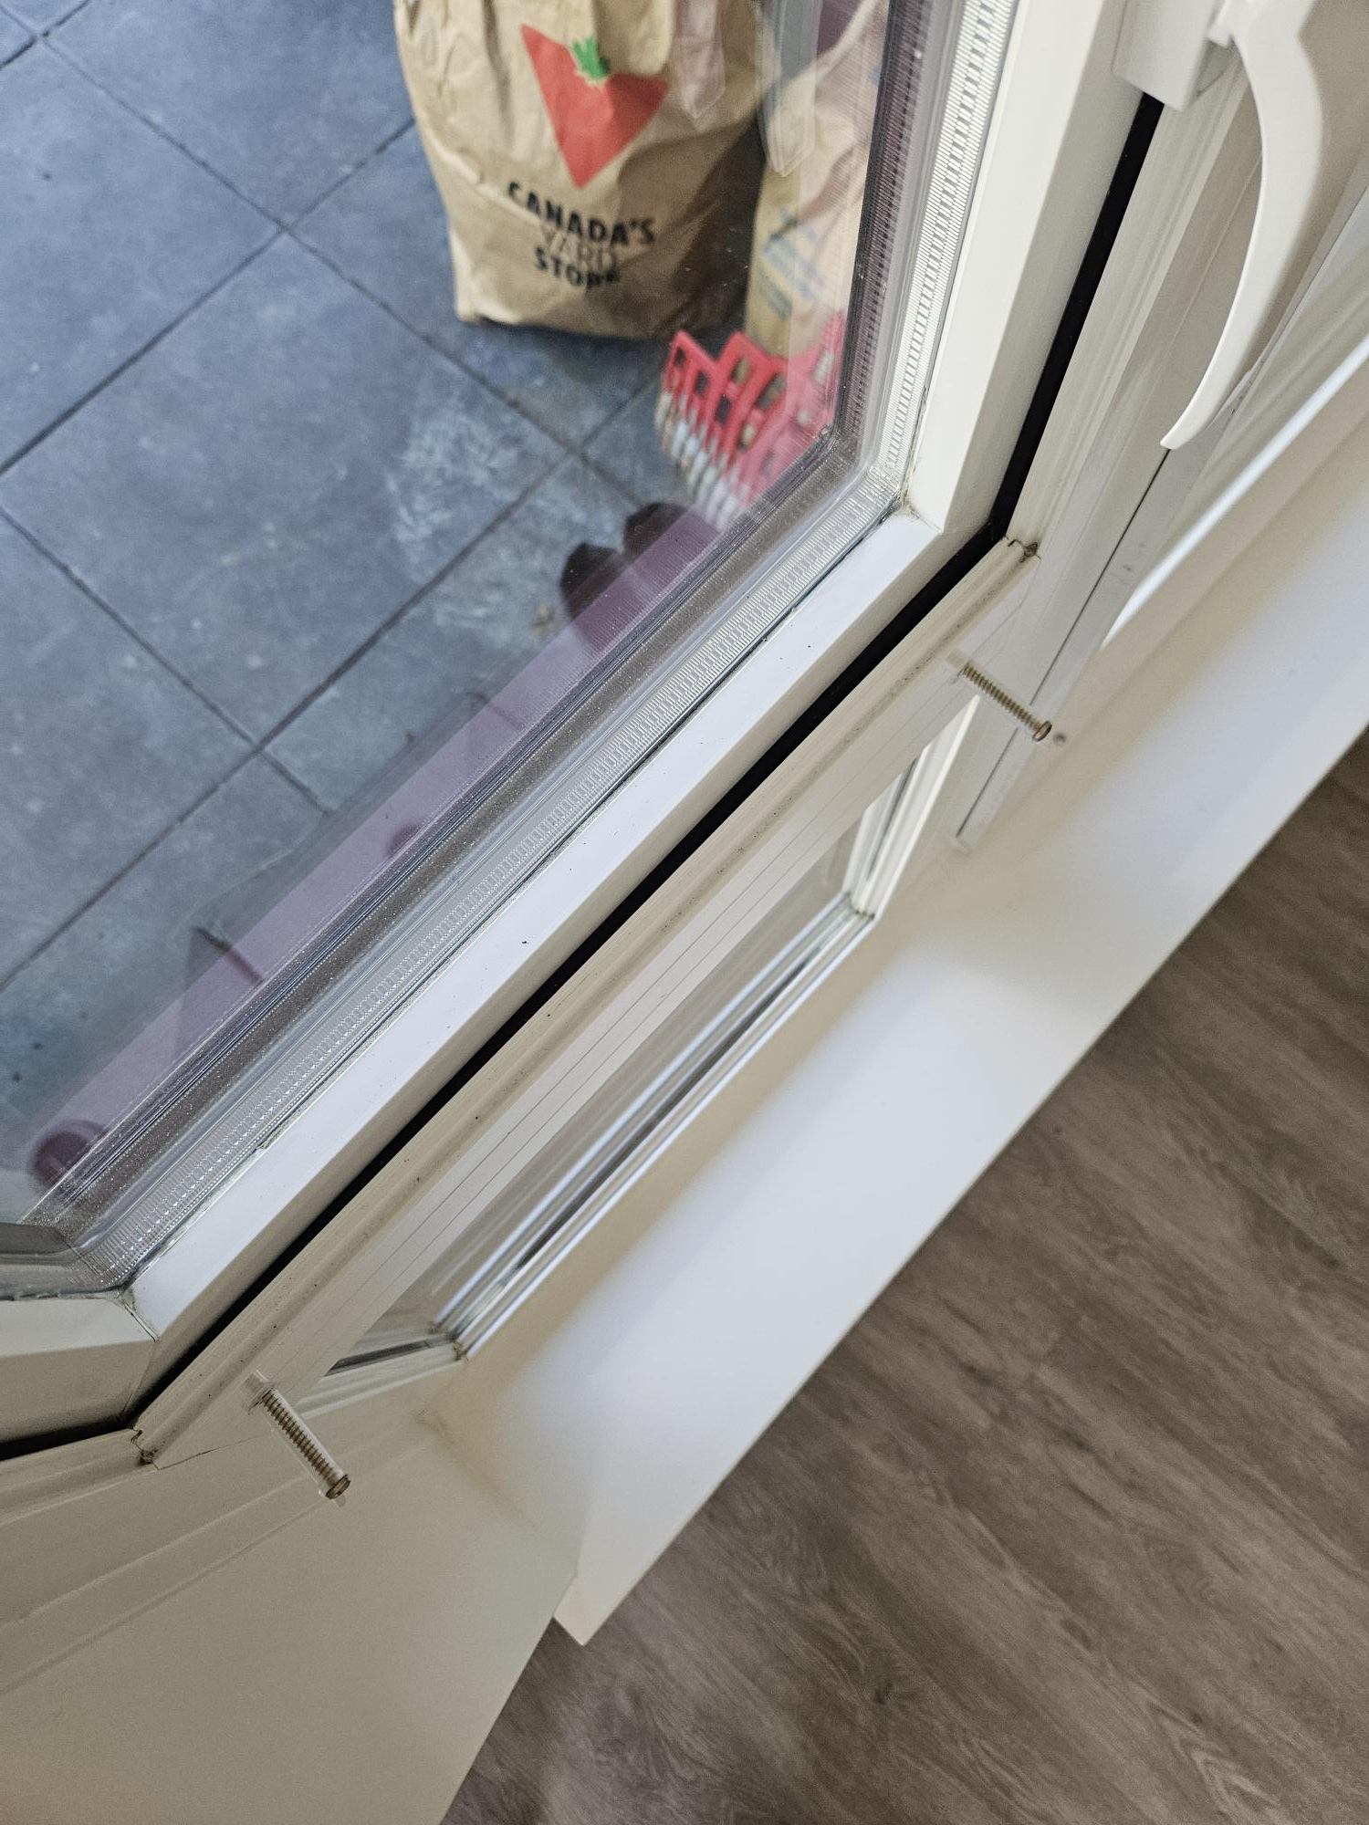
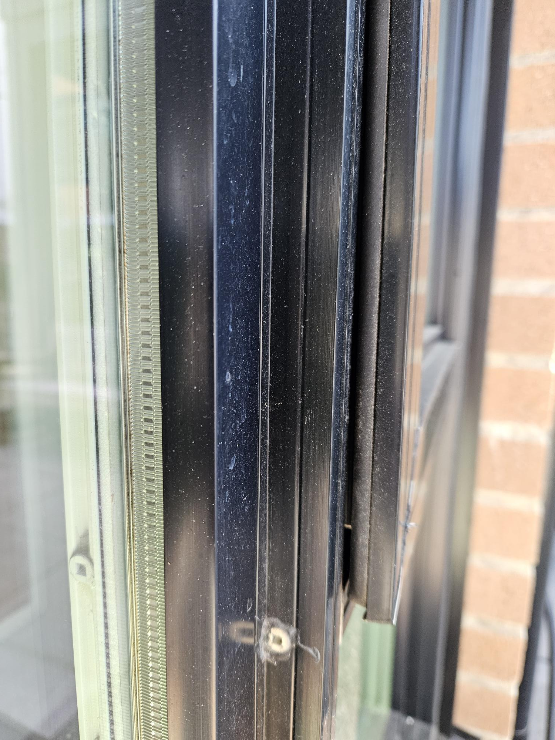
Sash gasket – Air and Water Performance

Slide 20
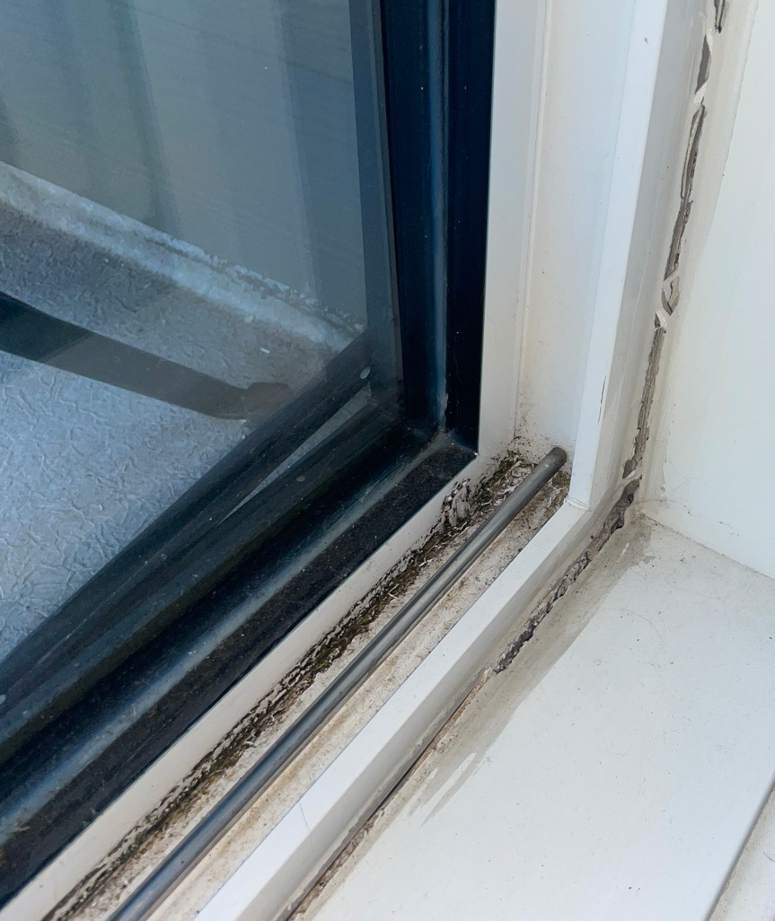
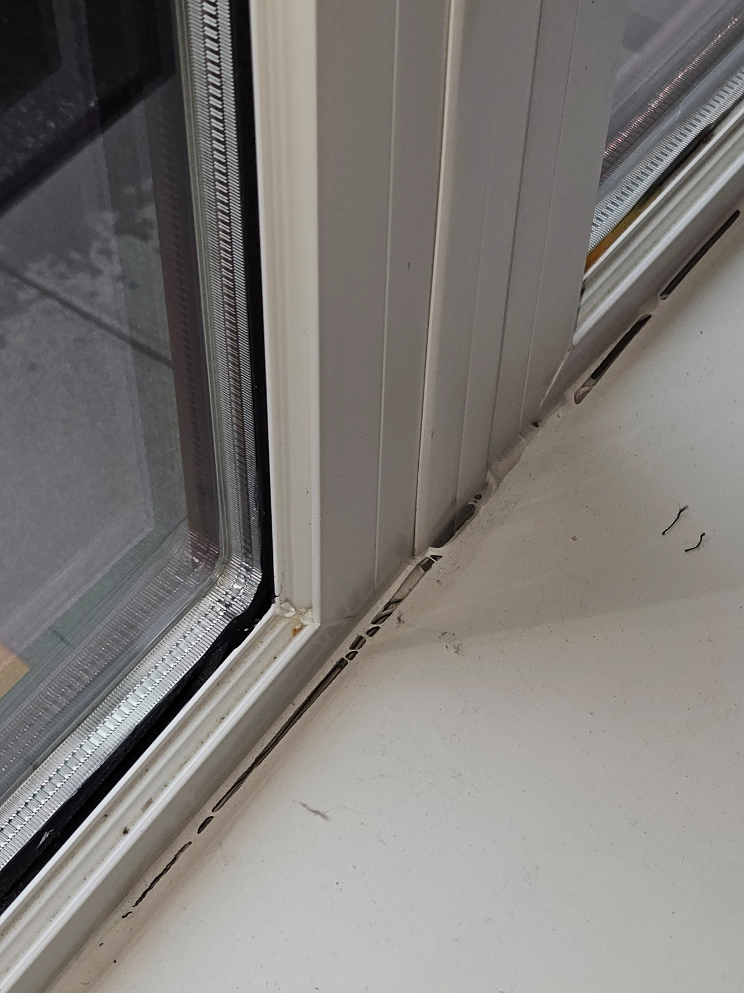
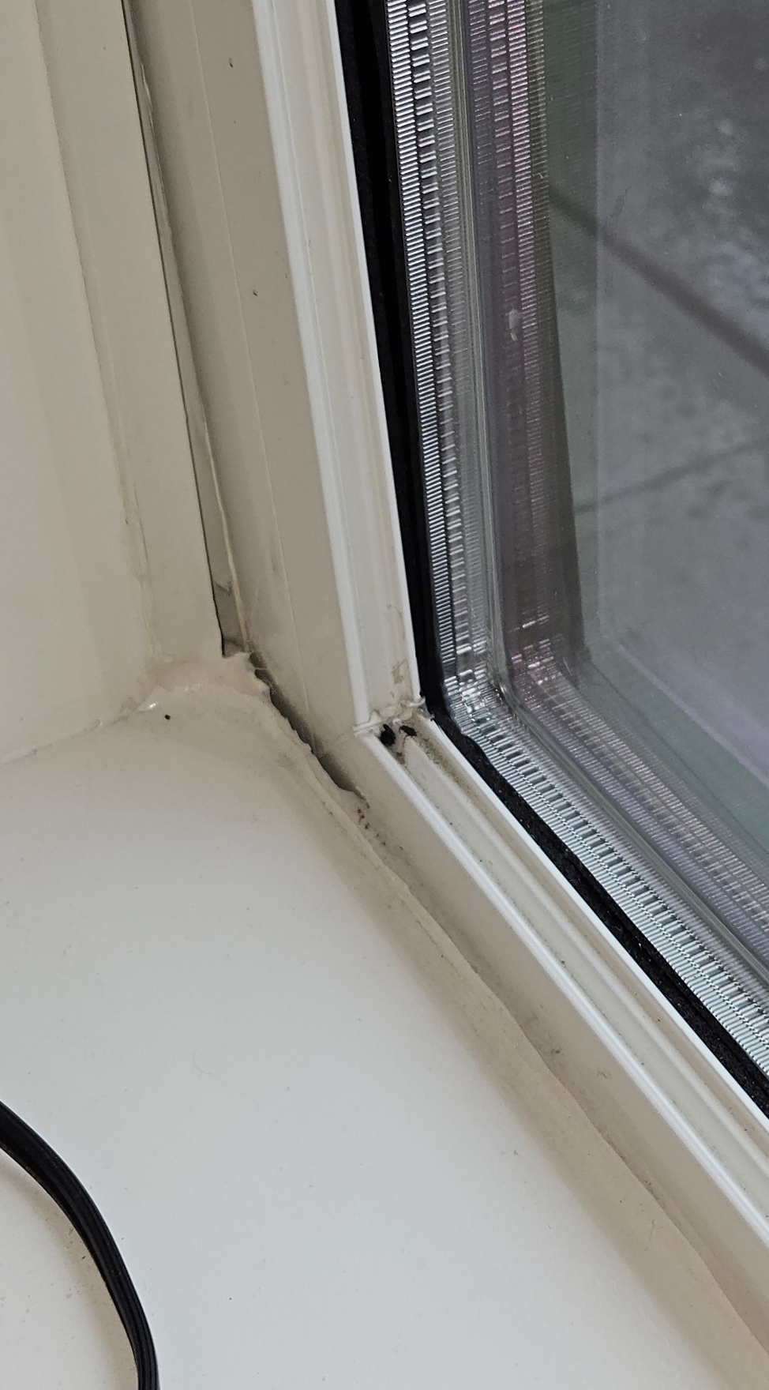
Main frame distortion– Integration Performance

Slide 21
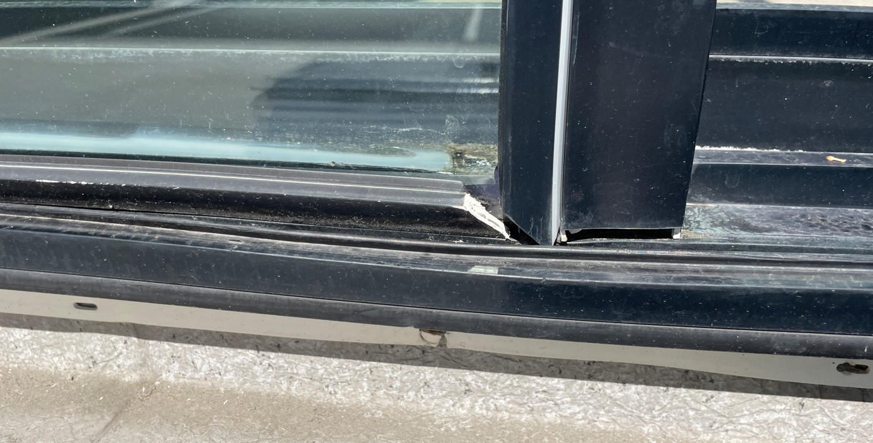
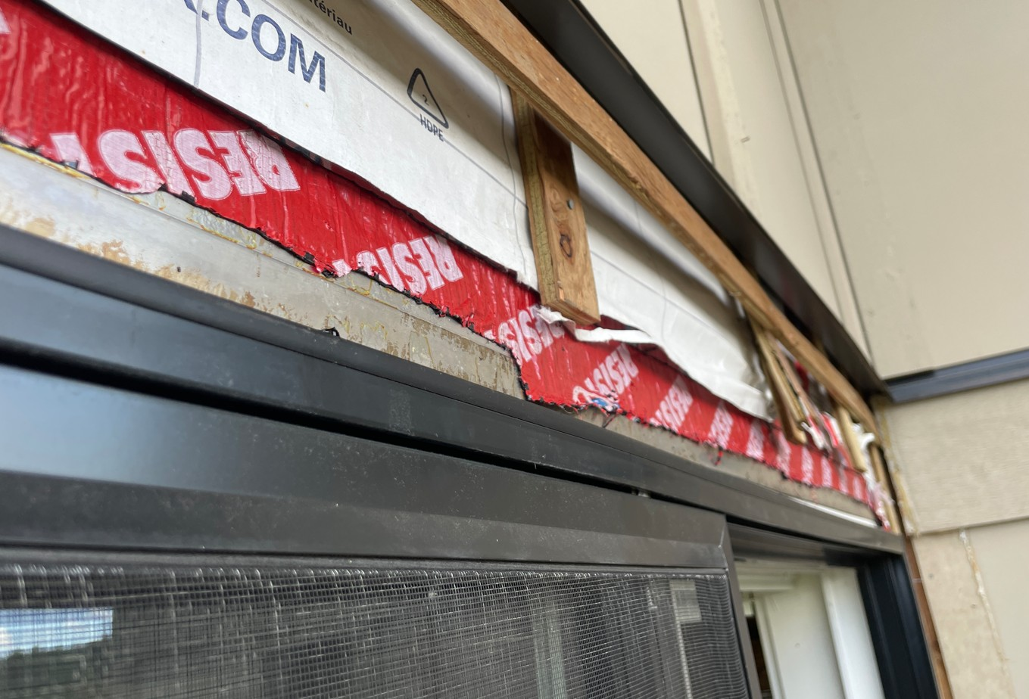
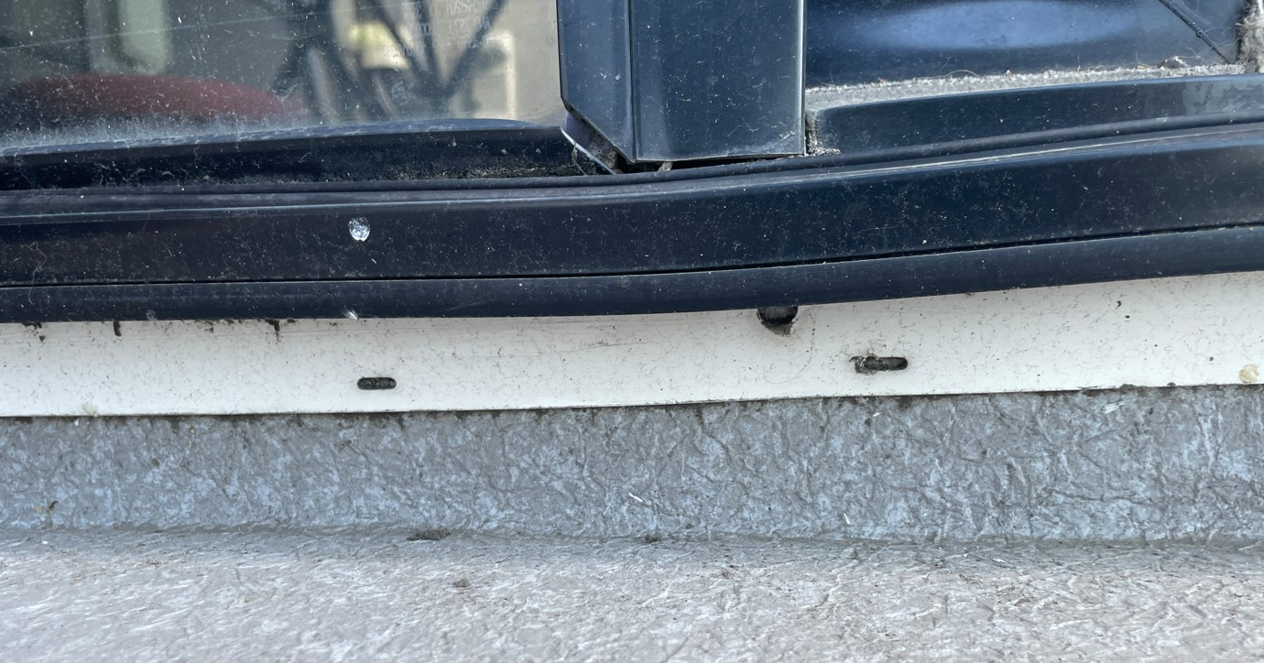
Frame support– Integration Performance

Slide 22
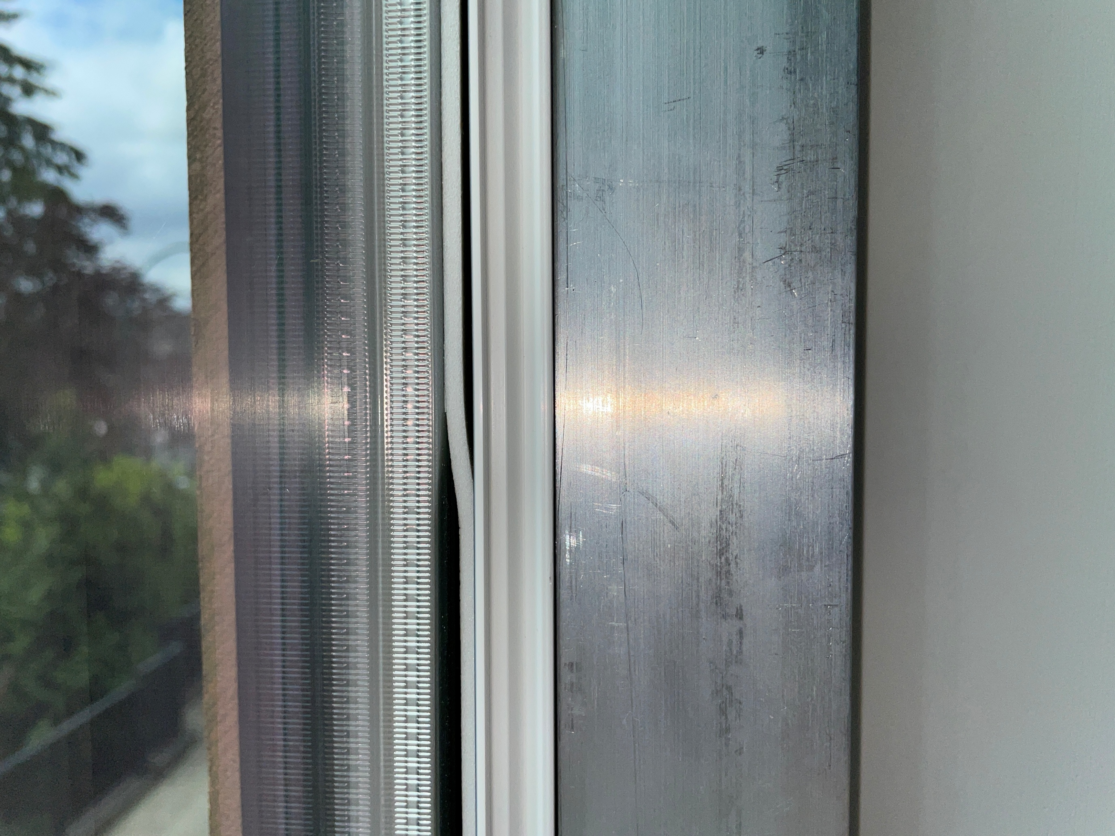
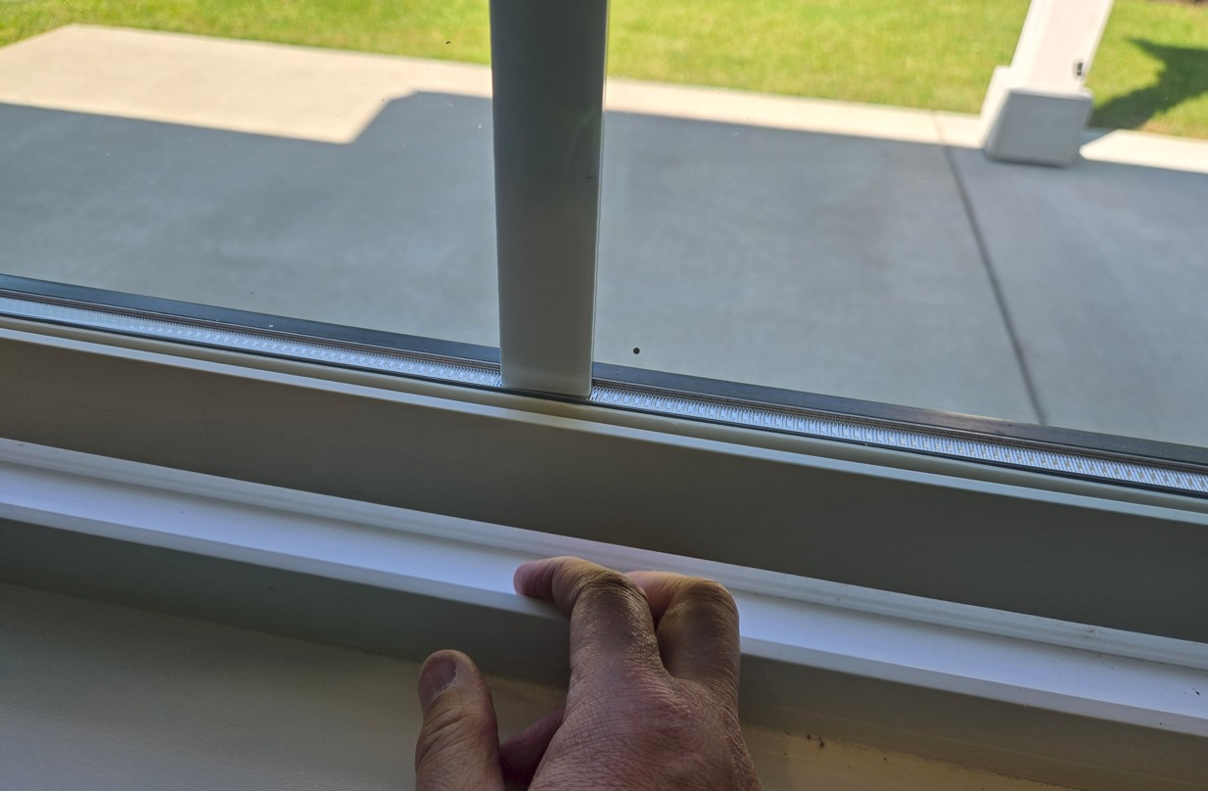
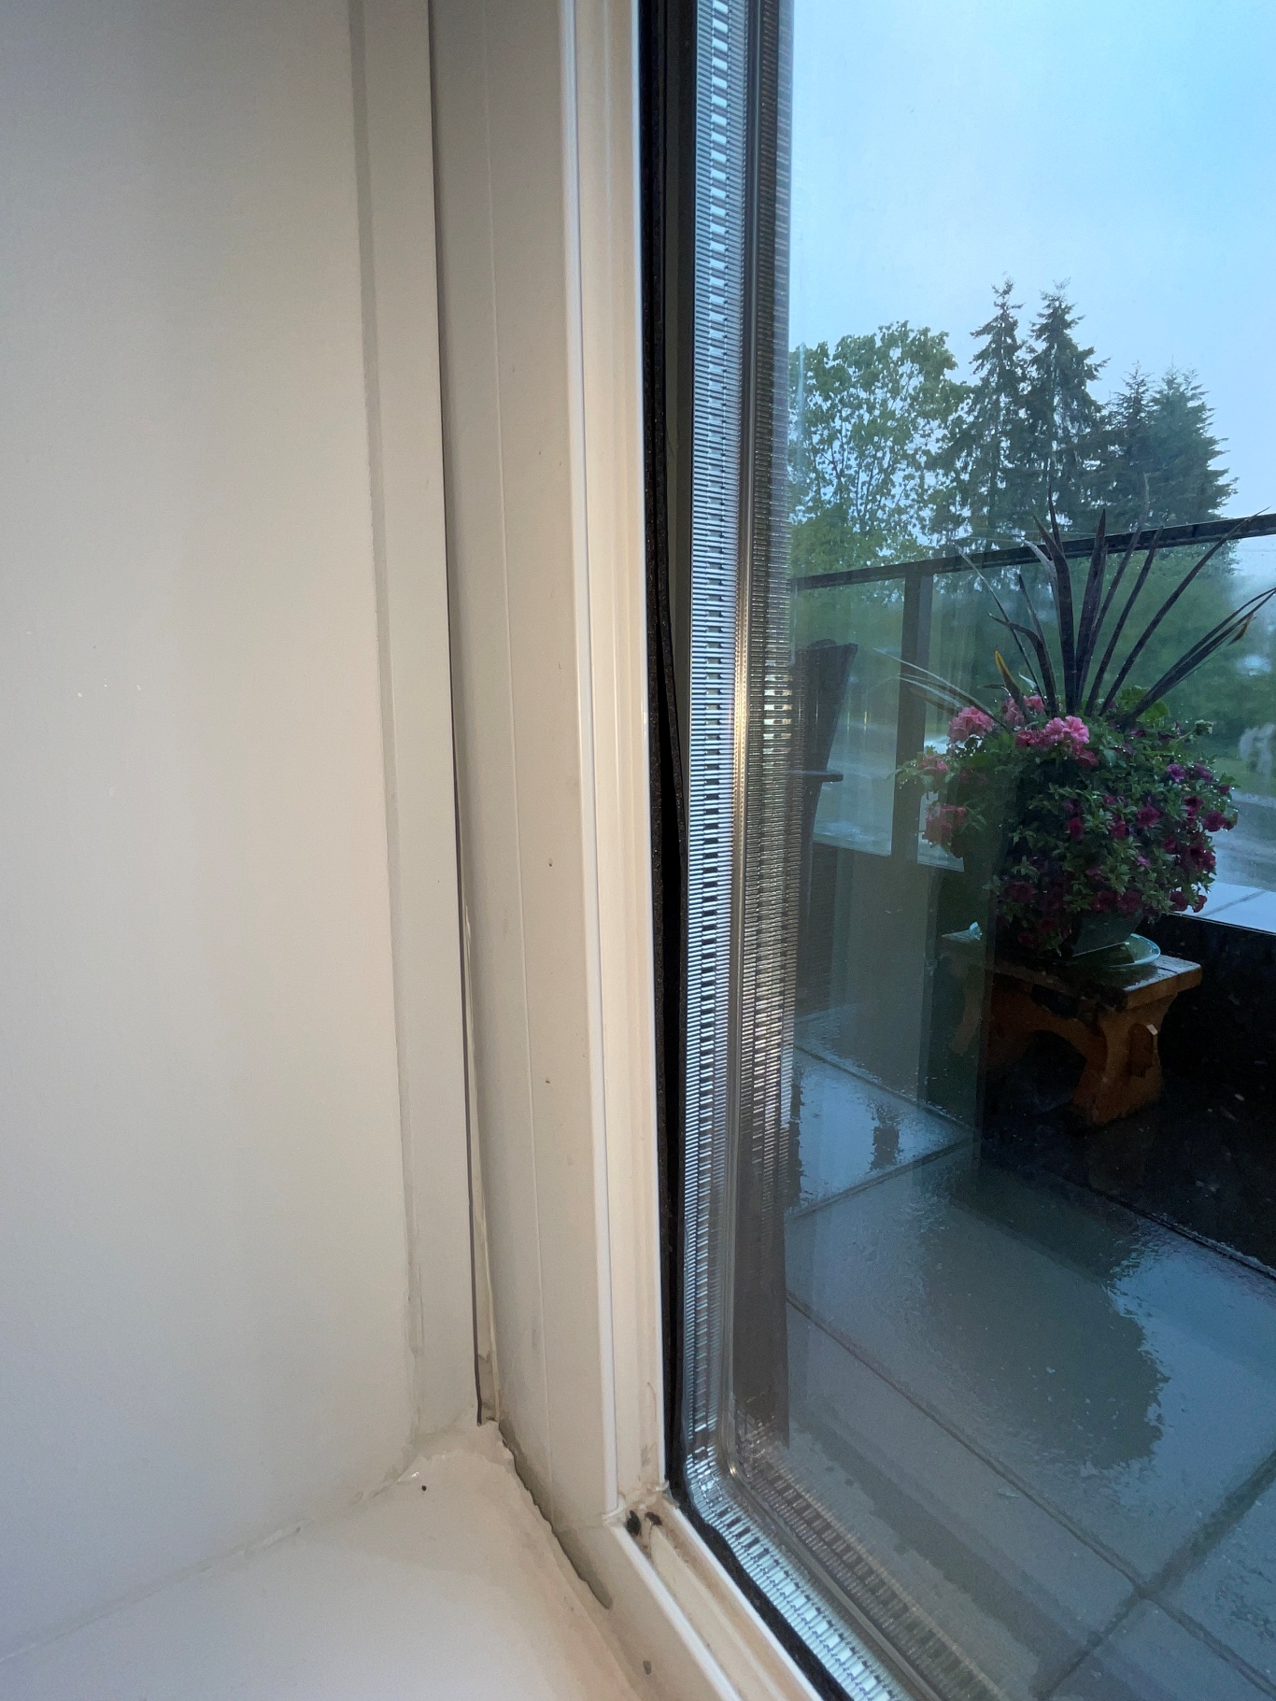
Glazing tape – Air Water & Structural Performance

Slide 23
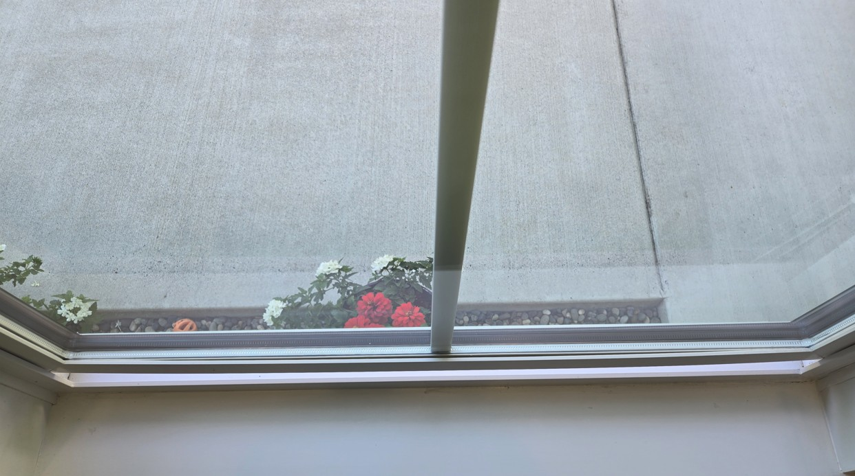
Sash Bow– Functionality Issues

Slide 24
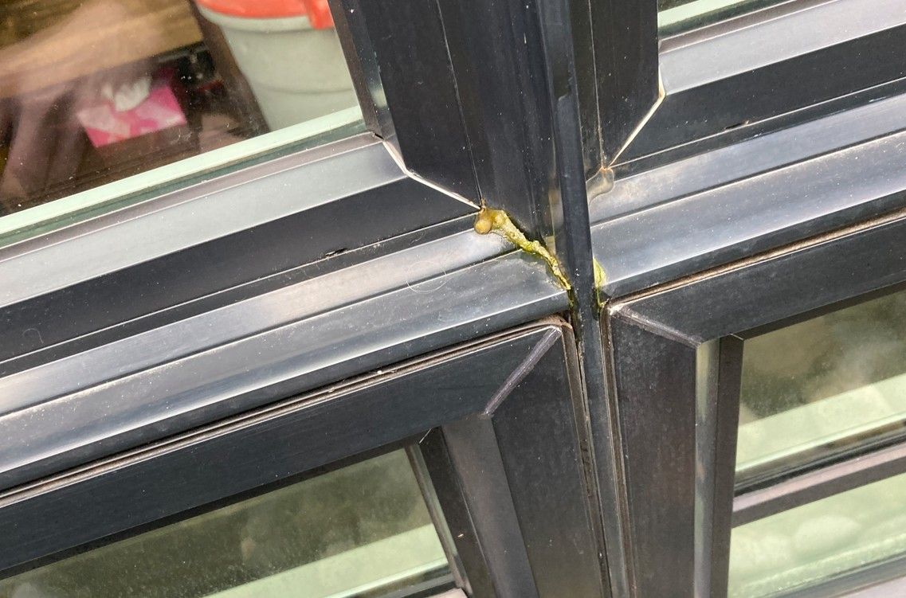
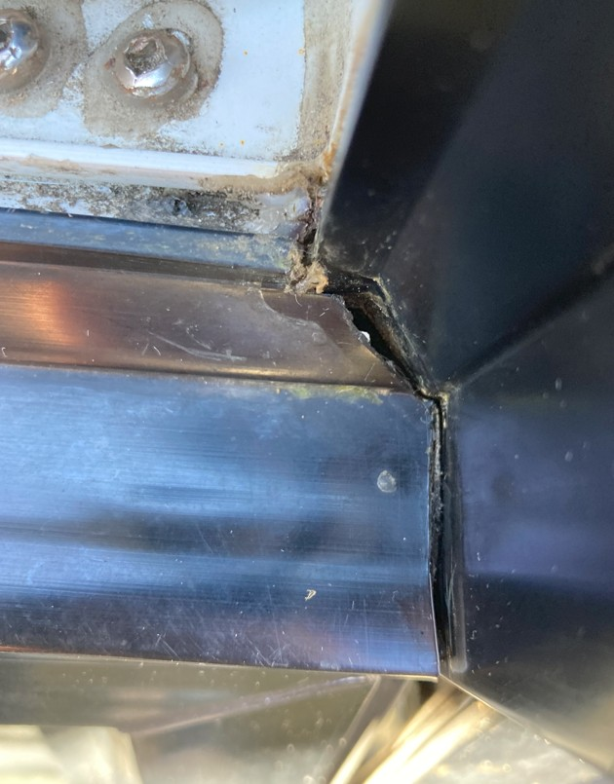
Mullion joints separate – water leakage – outside view

Slide 25
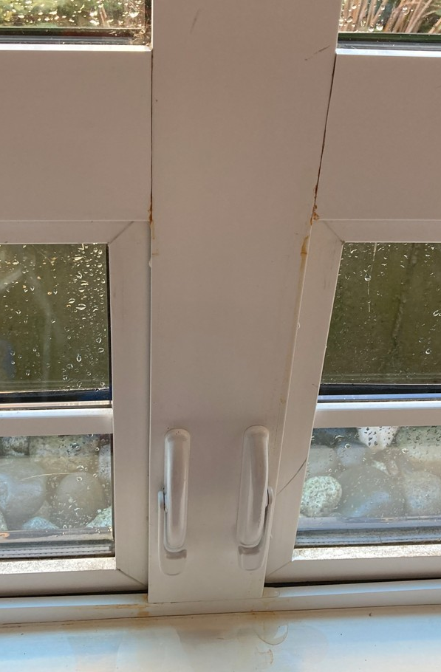
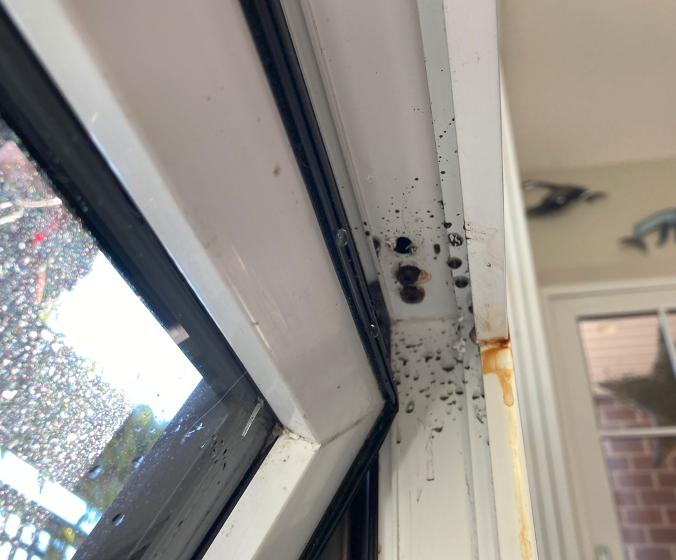
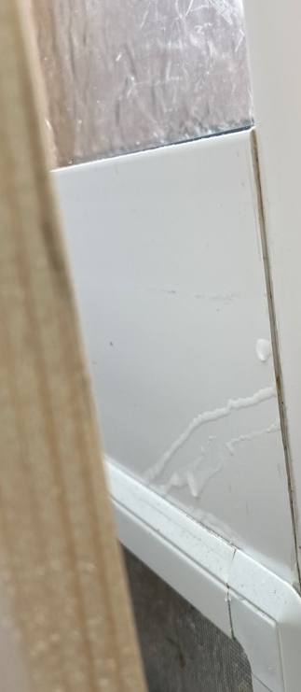
Mullion joints separate – water leakage – Inside view

Slide 26
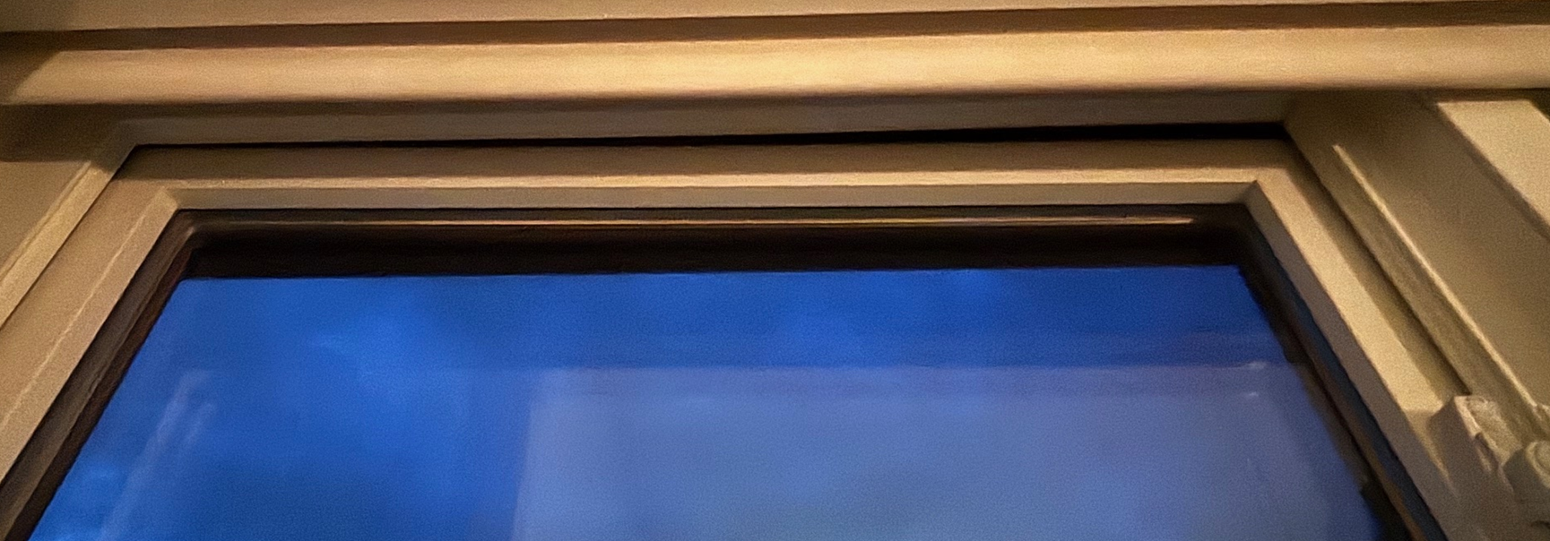
Within the last 3 years

Slide 27
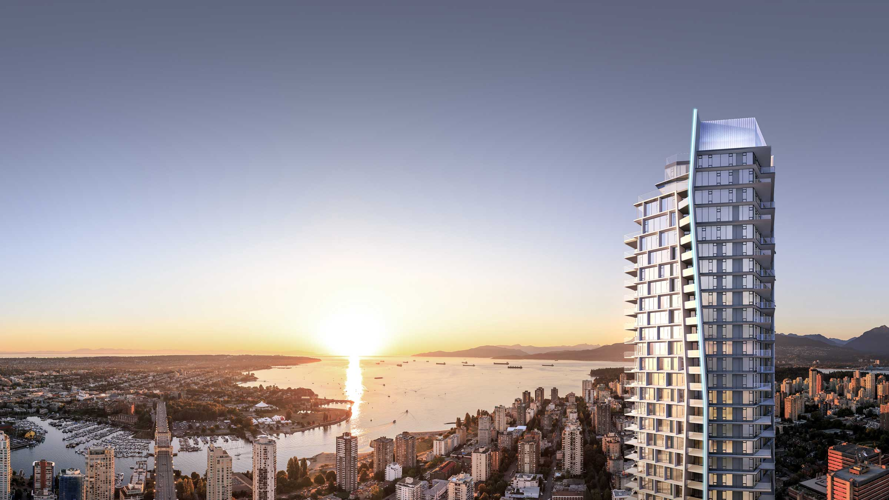
WHAT CAN CHANGE

Slide 28
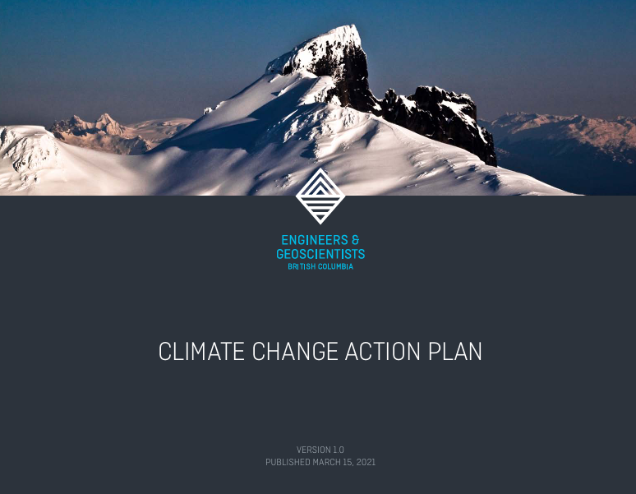
Egbc - Climate change action plan

Slide 29
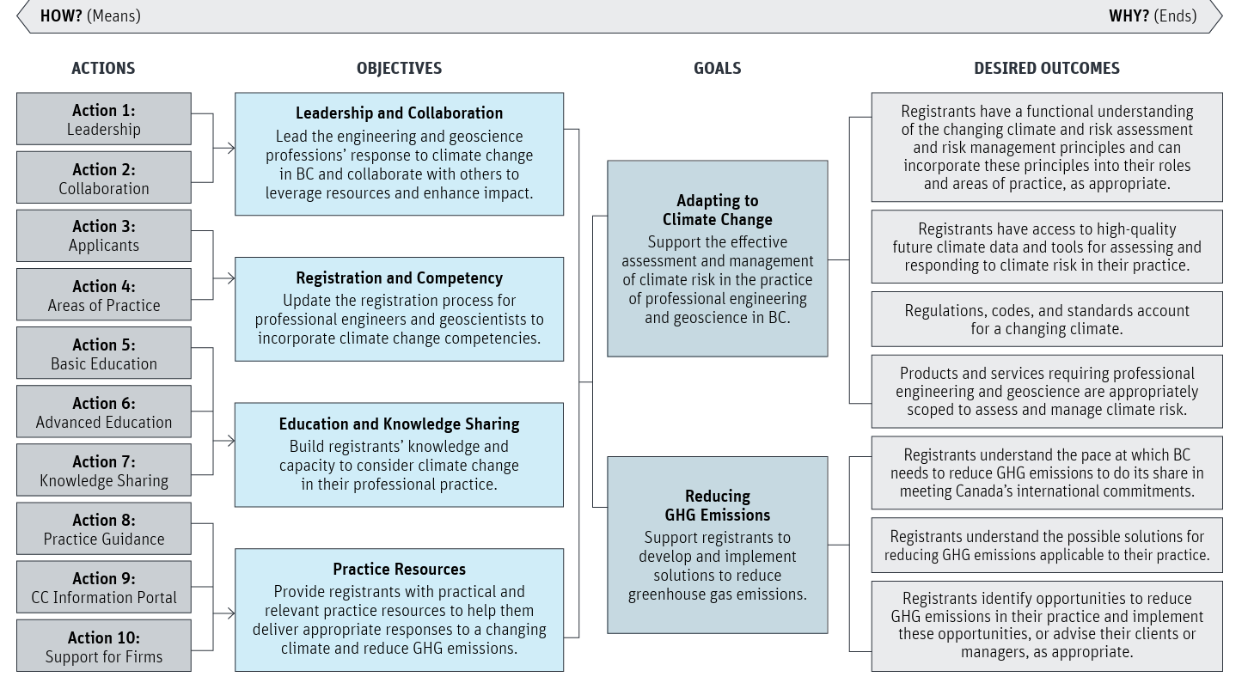
Egbc - climate change action plan

Slide 30
Are our standards good enough?
The Scope of NAFS. Does it address durability?
How do we deal with other dark materials on a building.

Slide 31
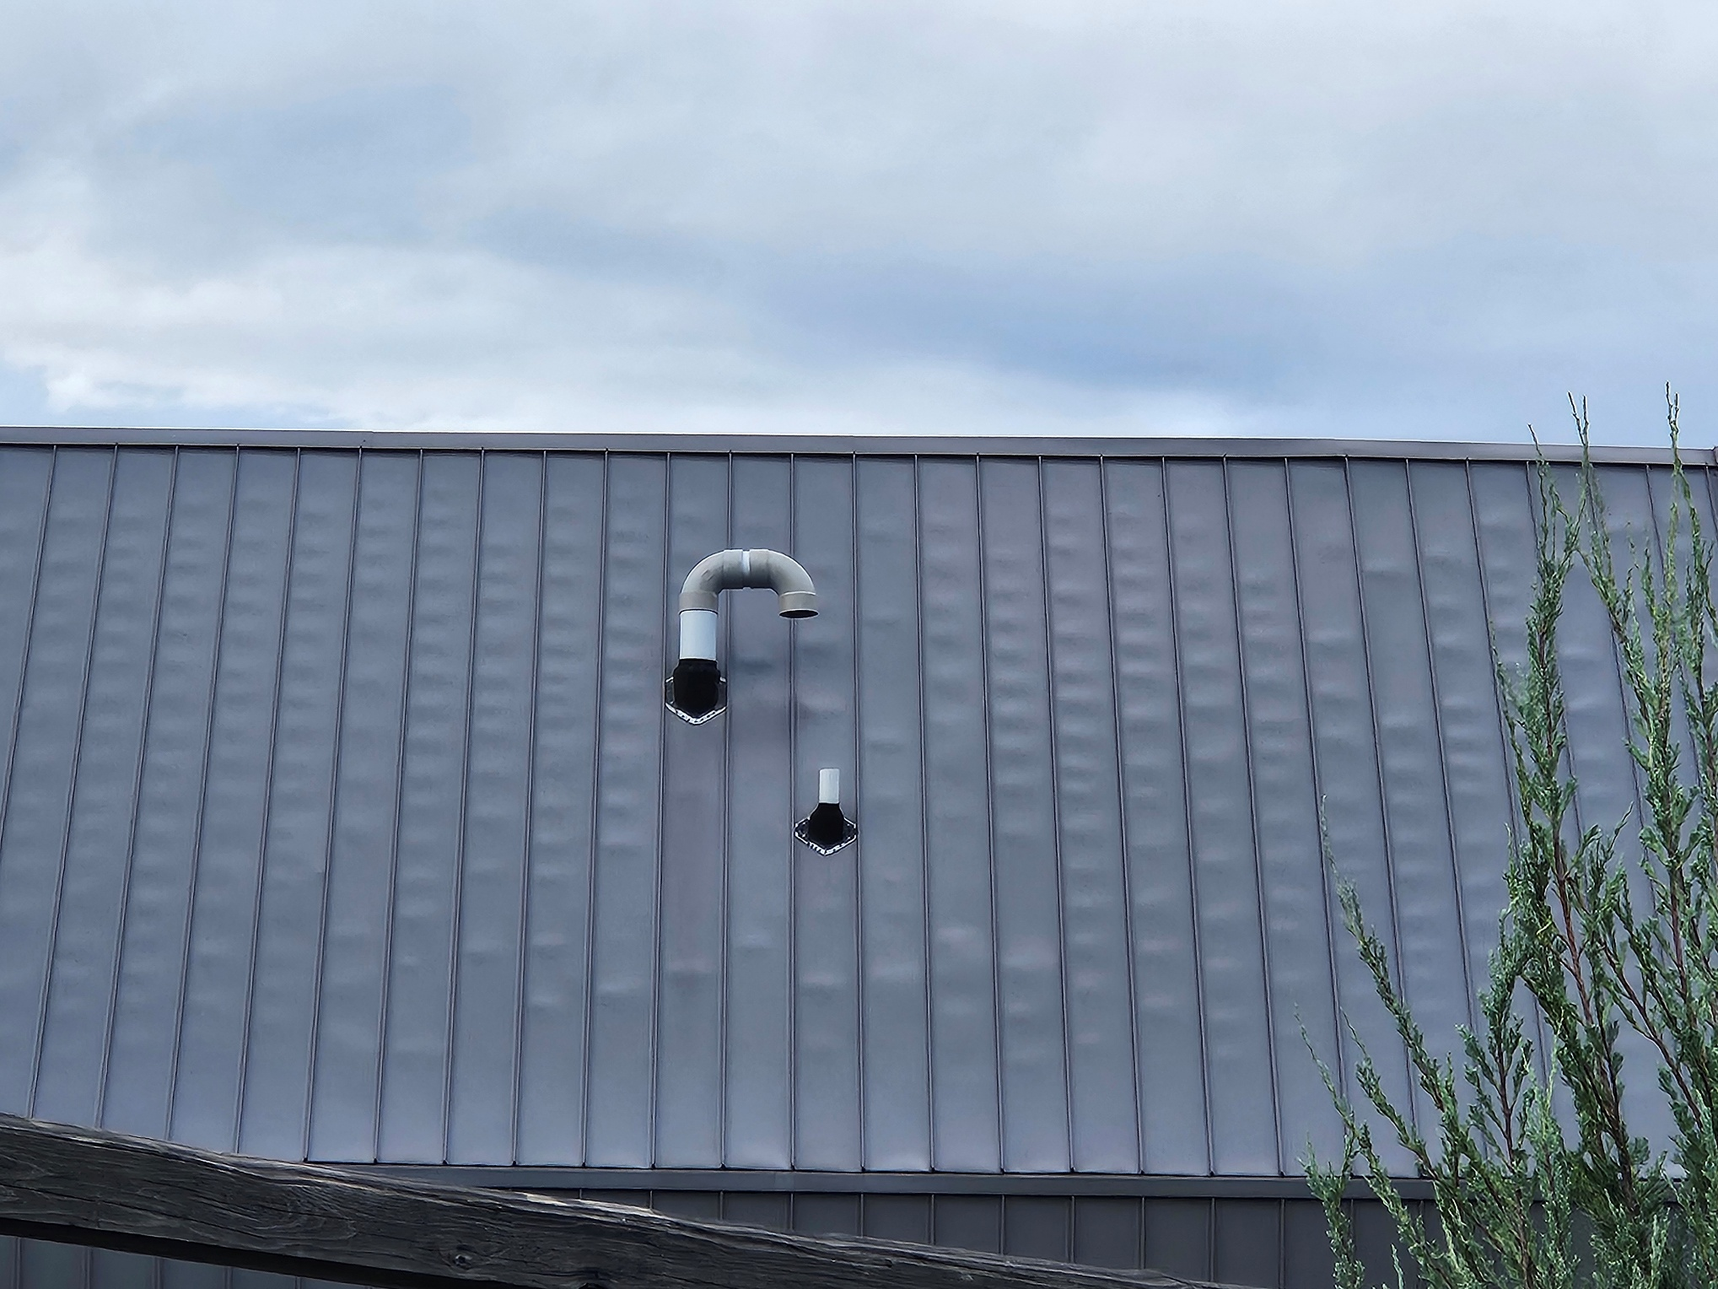
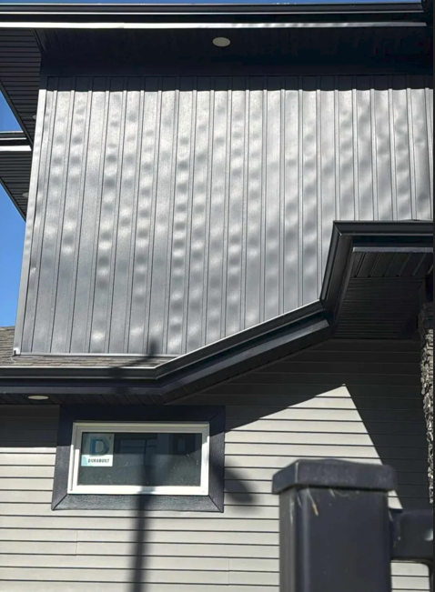
Other dark materials

Slide 32
Are our standards good enough?
The Scope of NAFS. Does it address durability?
How do we deal with other dark materials on a building.
How do we specify finishes? As a colour or as a material or system.

Slide 33
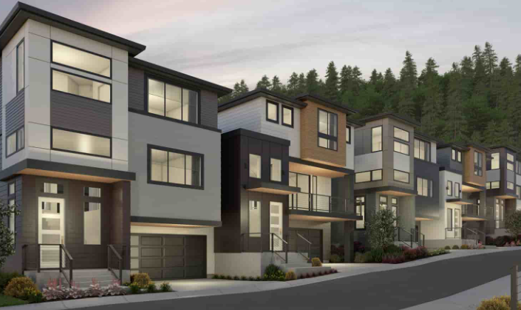
How do we specify windows?
Colour - Established at the Development Permit application. Often linked to marketing and housing trends.
Thermal Performance - Is established early in design due to step code level.
Budgeting - Window Product specification is established at feasibility stage.
When do we consider durability and performance in the selection process?

Slide 34
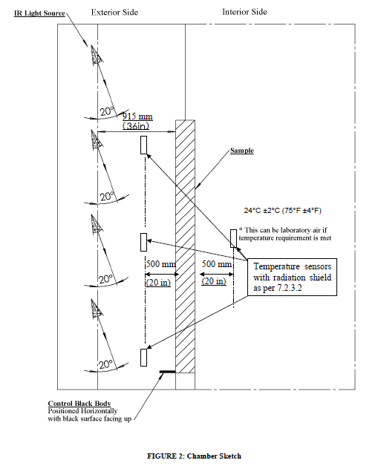
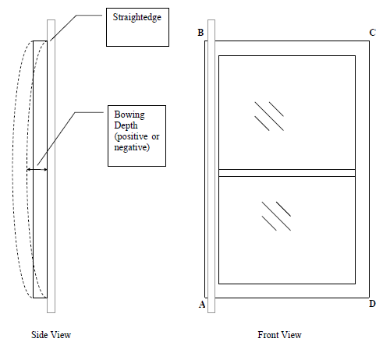
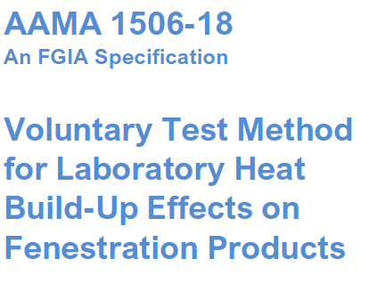
Can we Test for this?
Durability Test (AAMA 1506) Within Performance Testing (NAFS)

Slide 35
National Research Council Canada & Fenestration Canada
We are currently in discussion with NRC and Fenestration Canada to develop guidelines around fenestration durability, particularly in relation to long-term performance assessment, increased energy efficiency and carbon reduction. Fenestration Canada will be issuing a survey seeking industry interest and support.

Slide 36
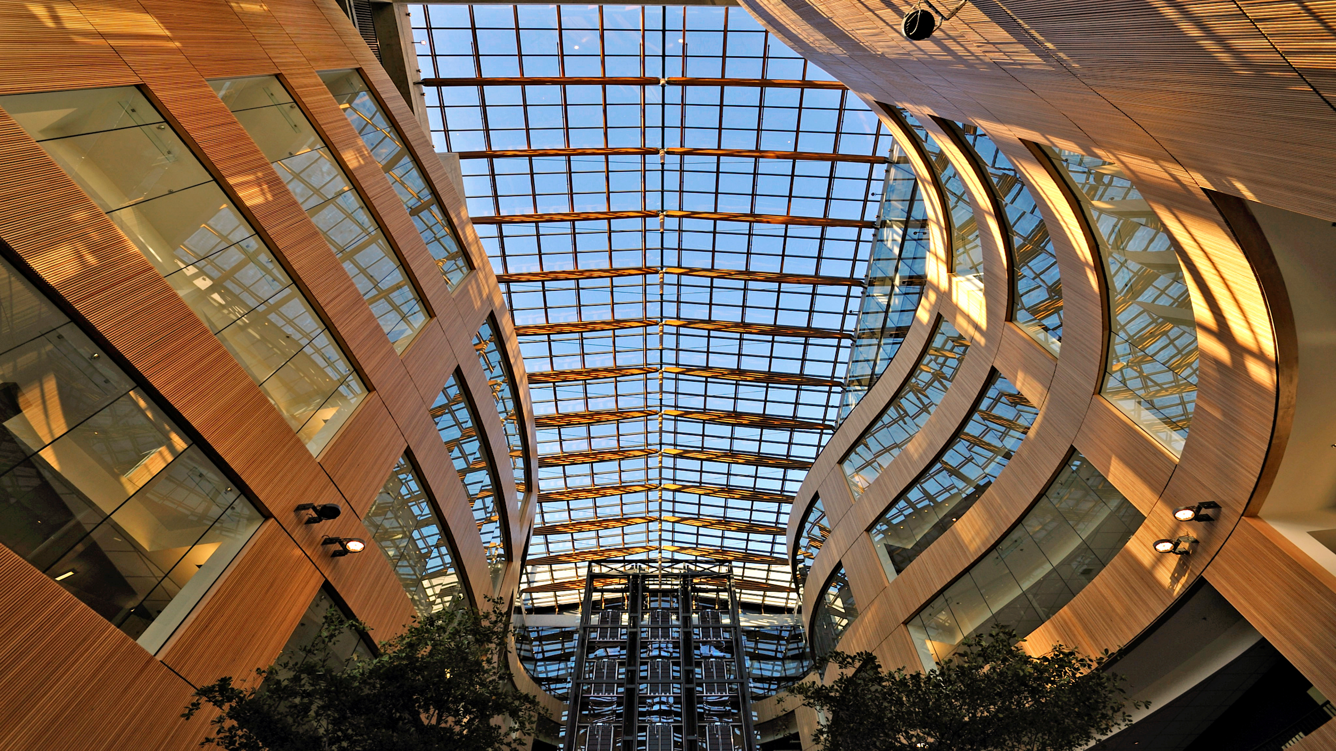

Questions & Answers

