Slide 1
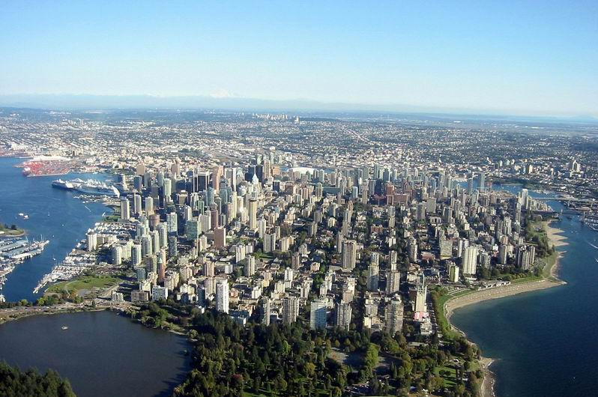
BRITISH COLUMBIA BUILDING ENVELOPE COUNCIL CONFERENCE - NOVEMBER, 2025
NEW DIRECTIONS IN CITY BUILDING
BY LARRY BEASLEY, C.M., F.C.I.P.

Slide 2
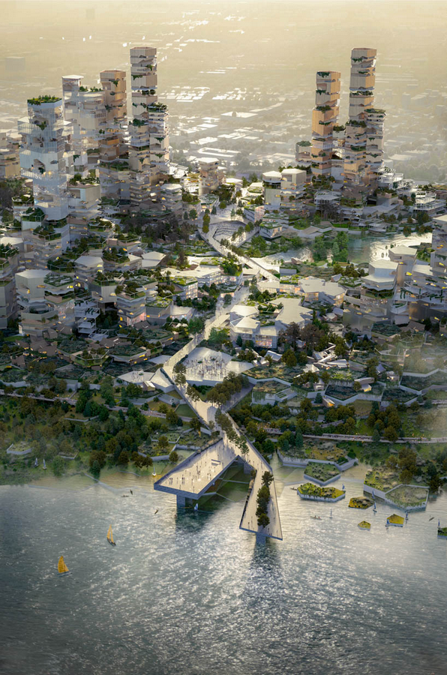
Thesis: Nature and Fabric of Buildings has to Evolve

Slide 3
The Drivers:
-Aspirational Imperatives
-Spontaneous Trends
Thesis: Nature and Fabric of Buildings has to Evolve

Slide 4
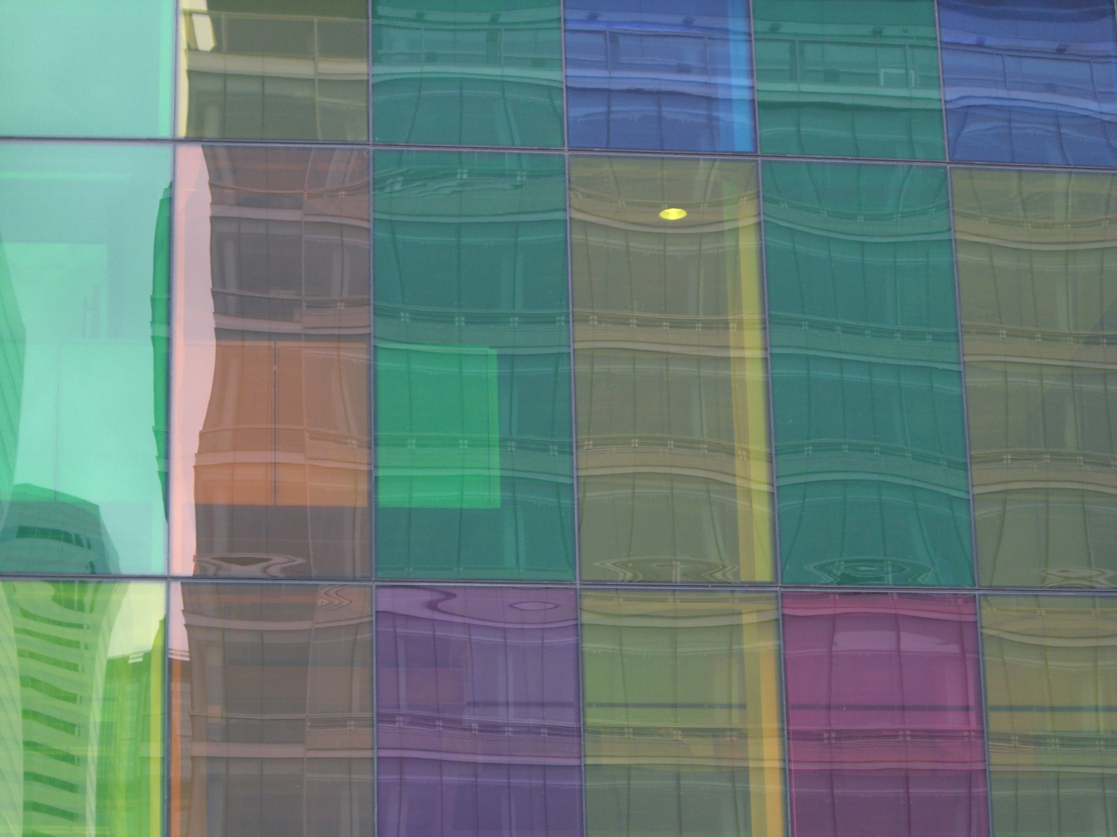

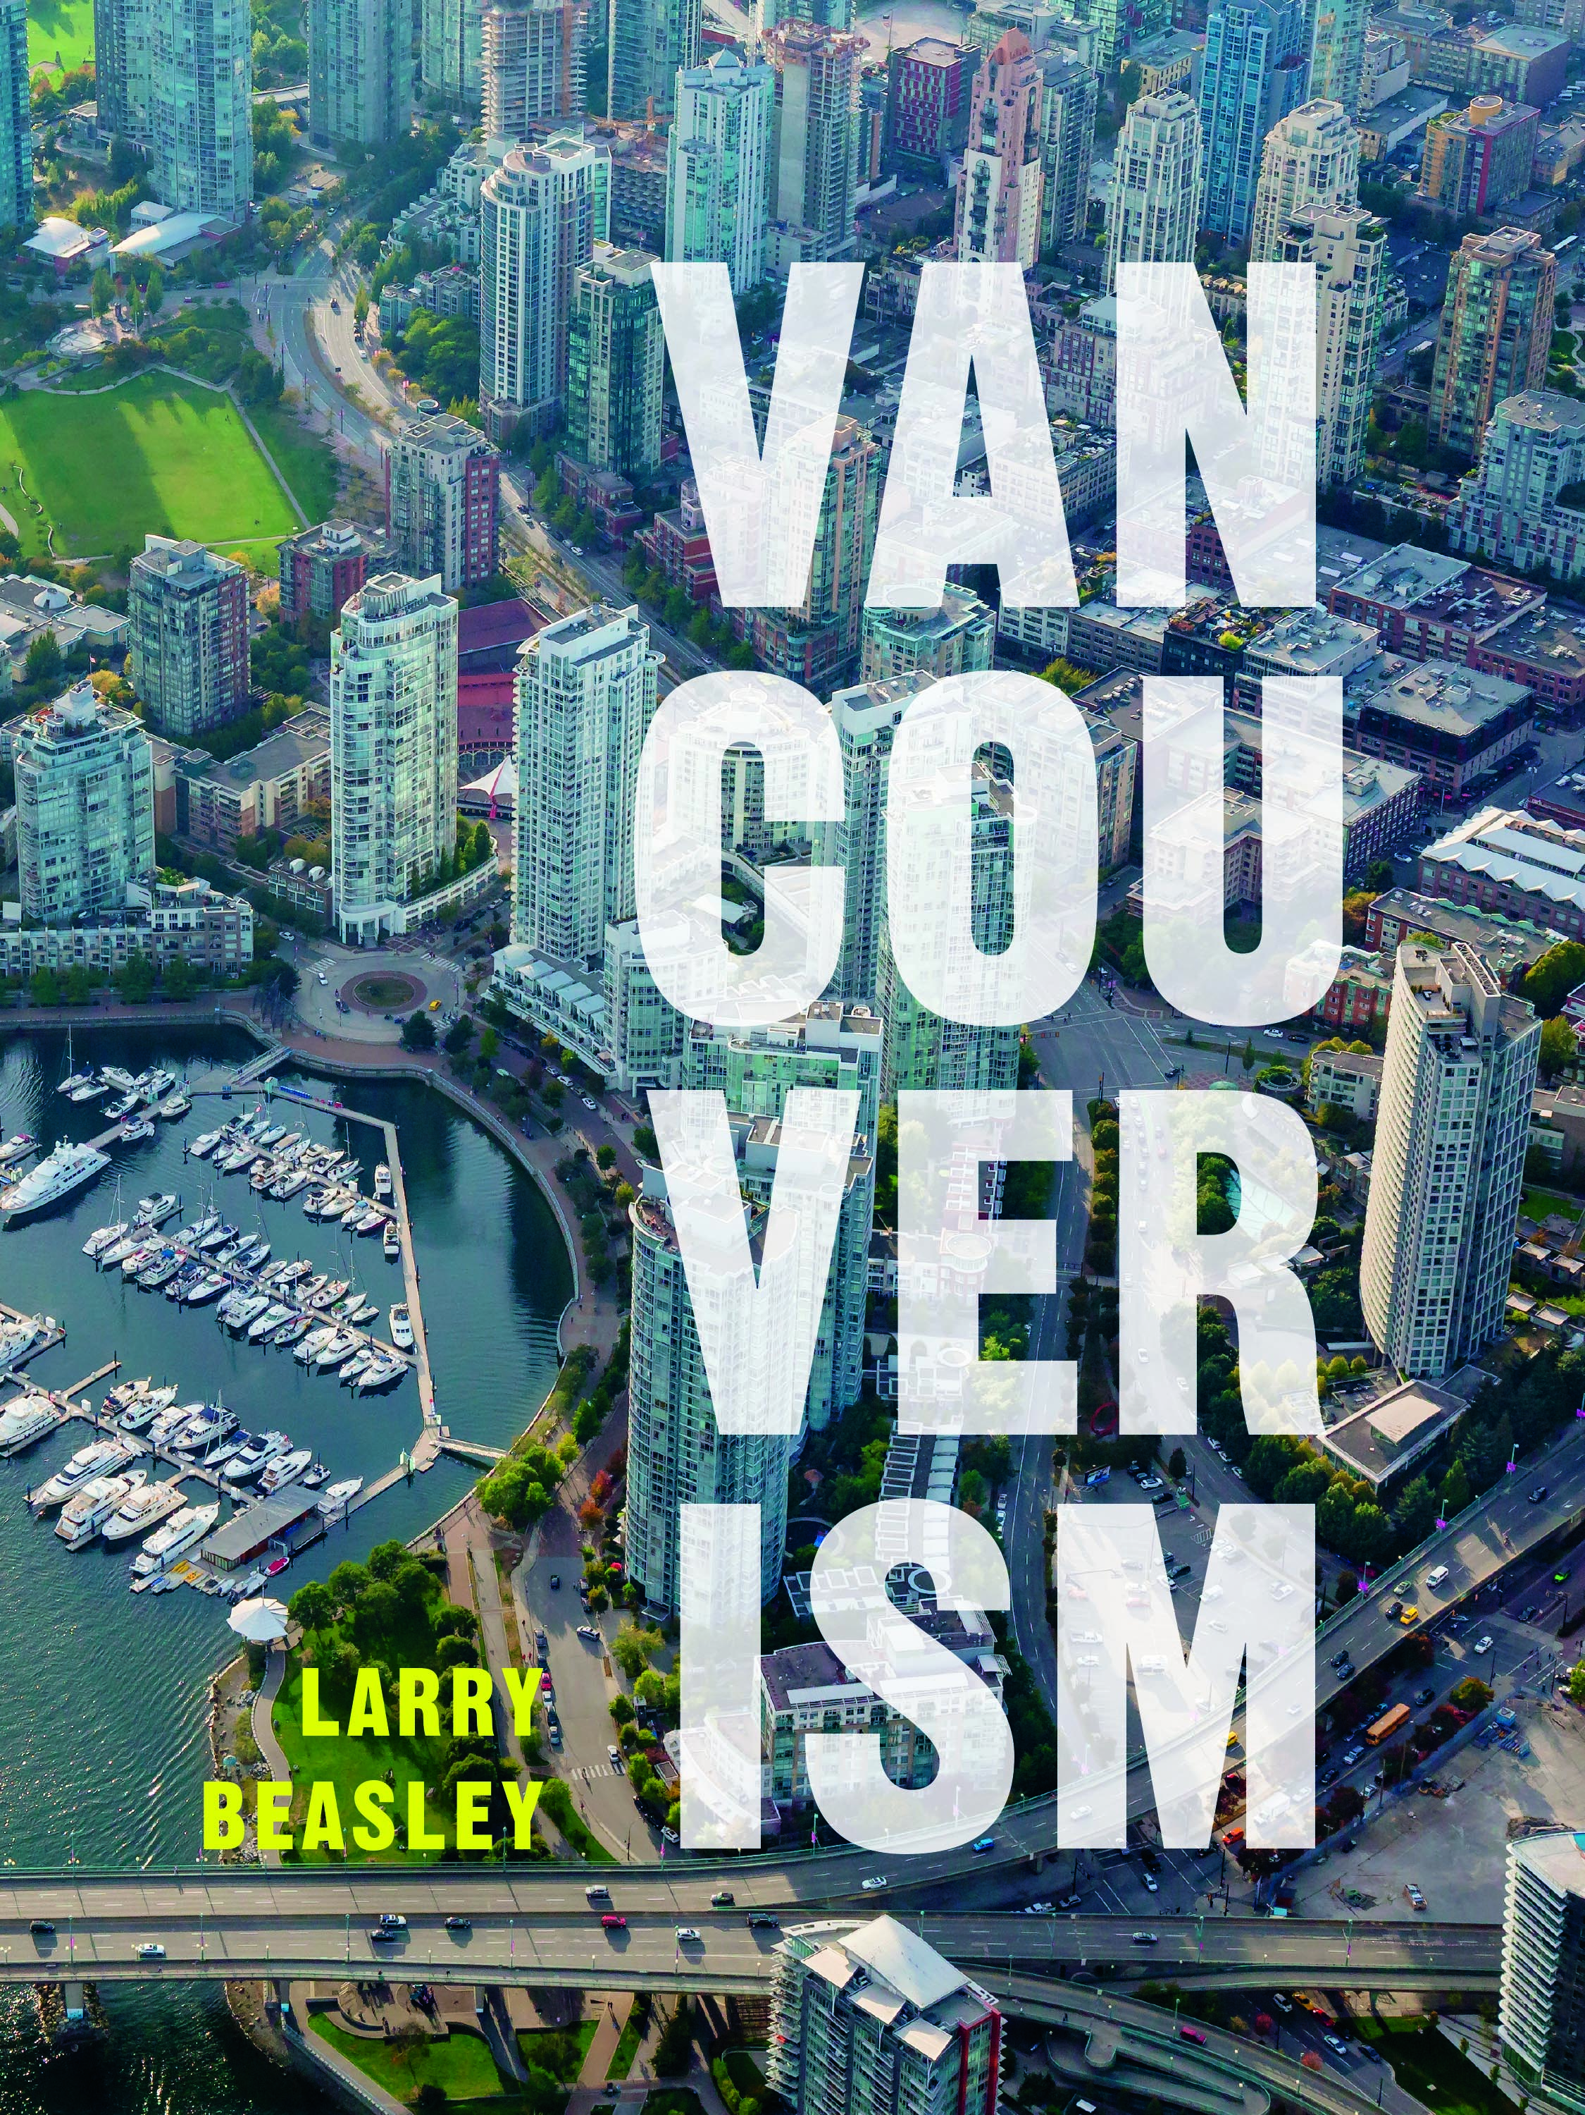
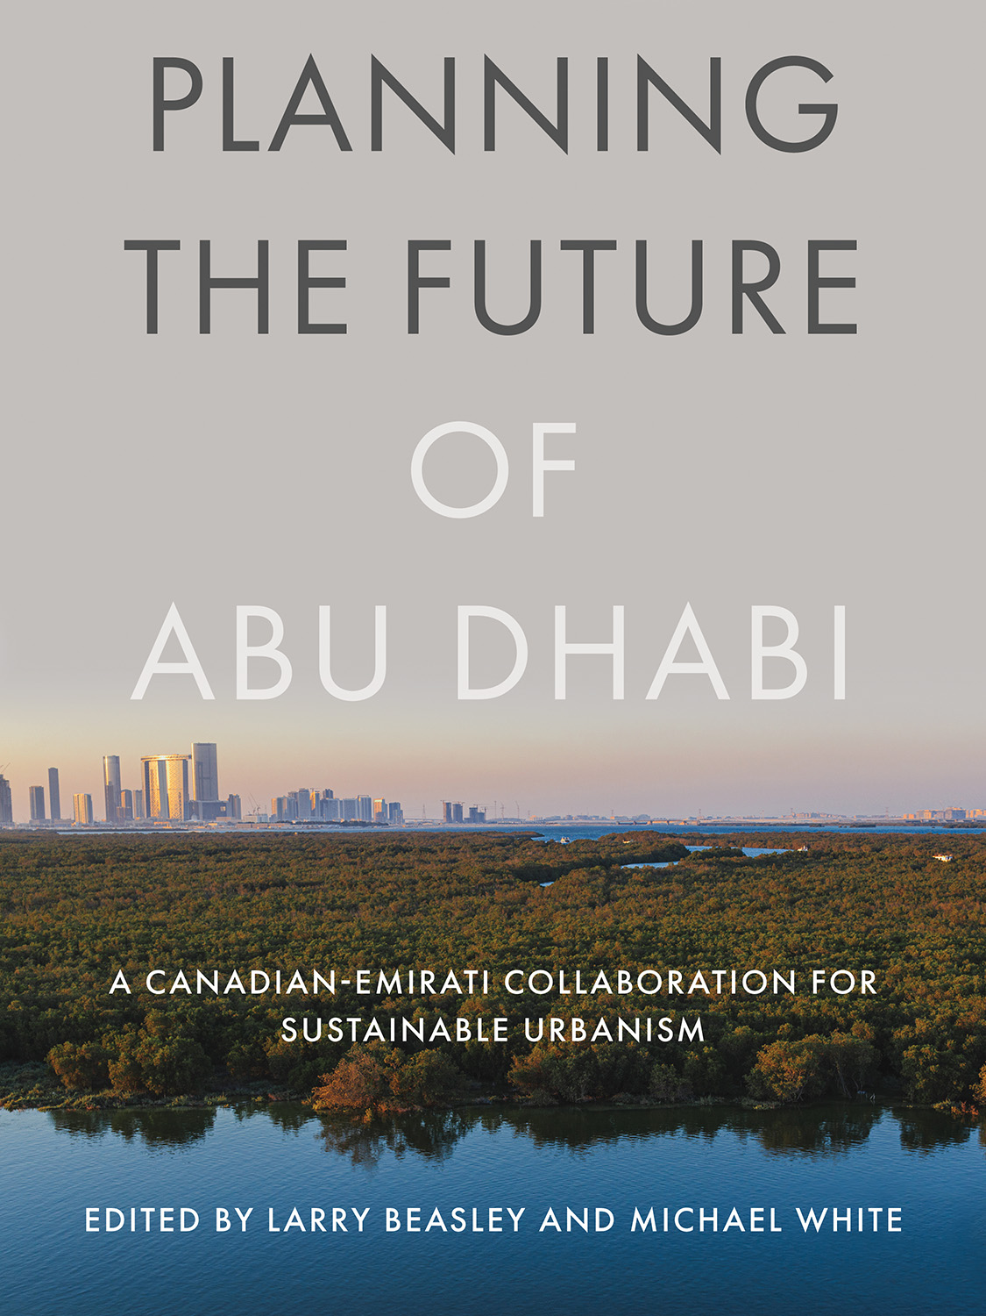
Available from
Amazon
Out in early-2026

Slide 5
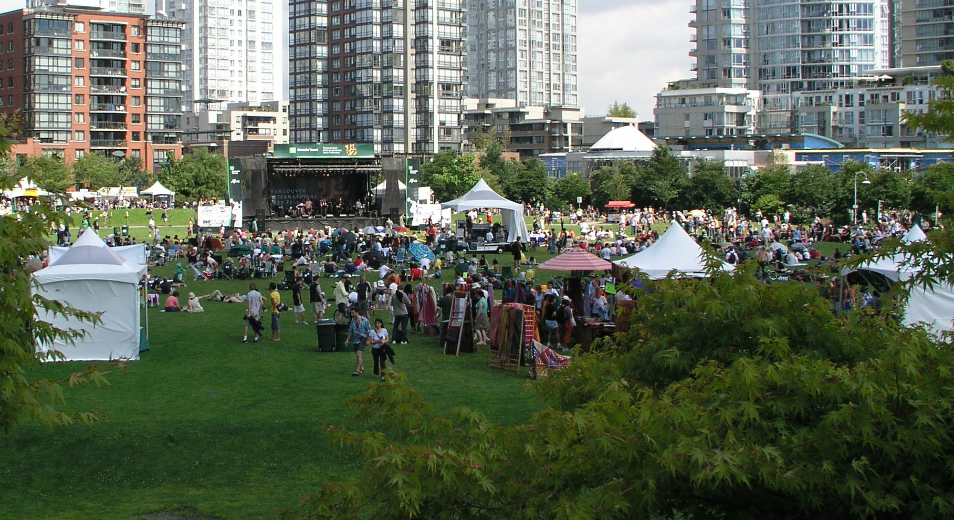
The Aspirational Imperatives
Vancouver

Slide 6
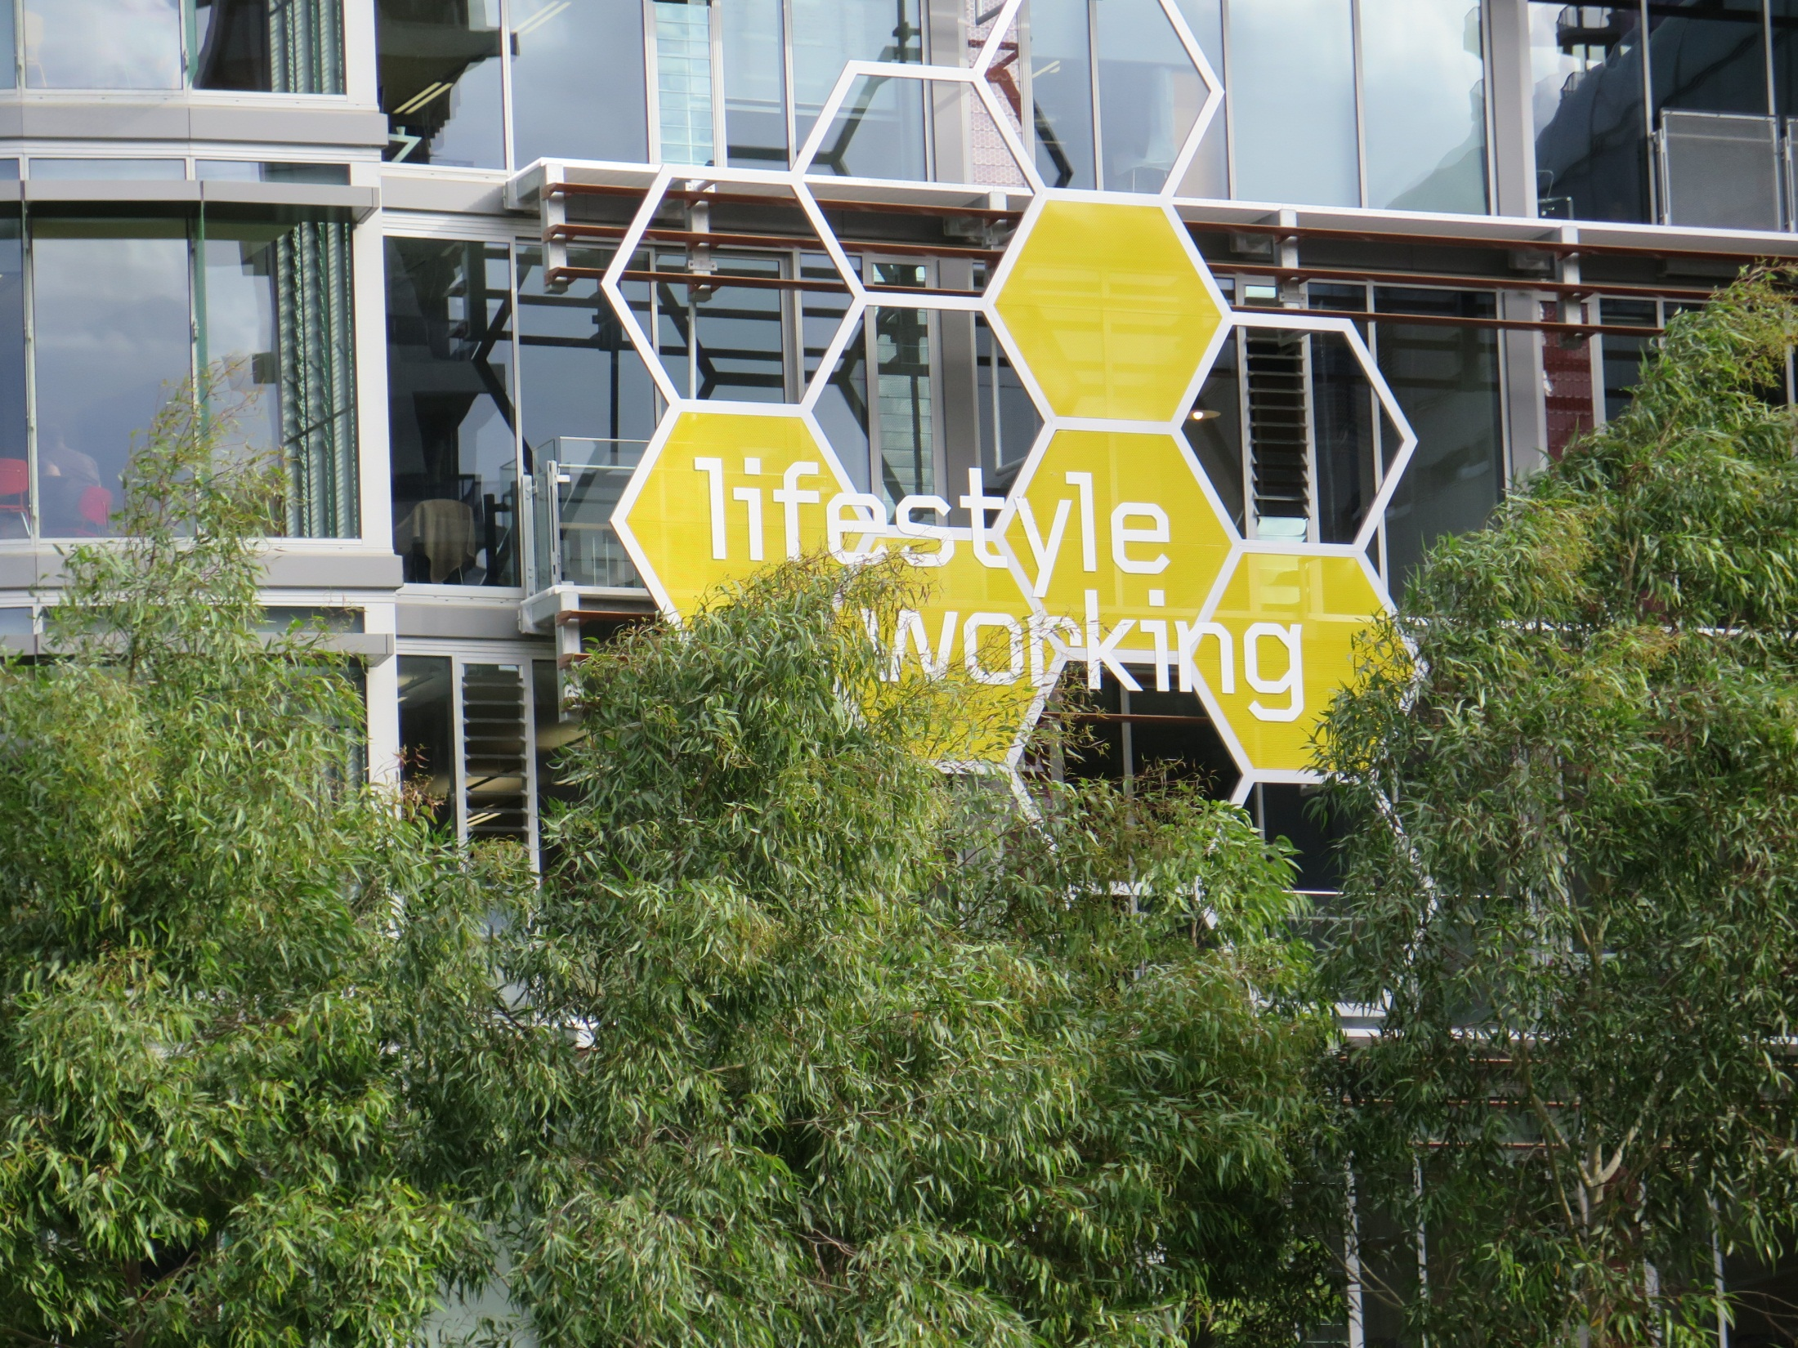
Liveability
Melbourne

Slide 7
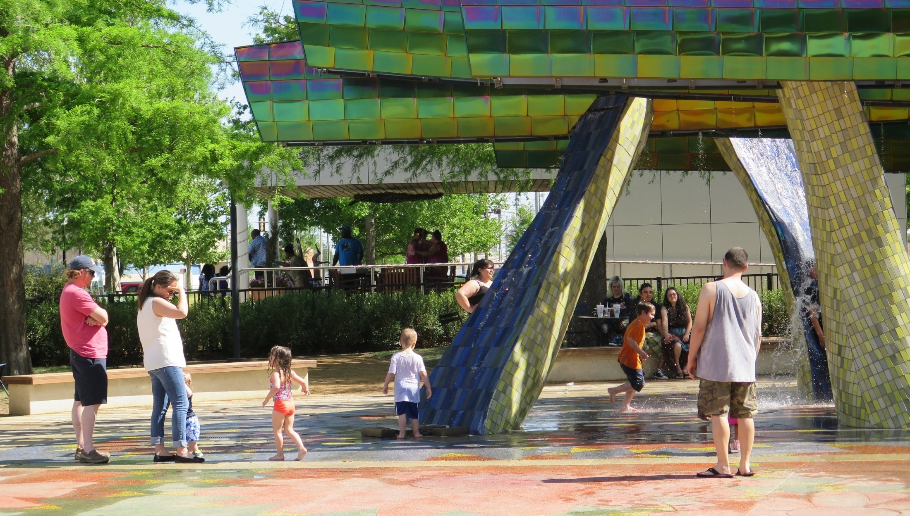
Oklahoma City

Slide 8
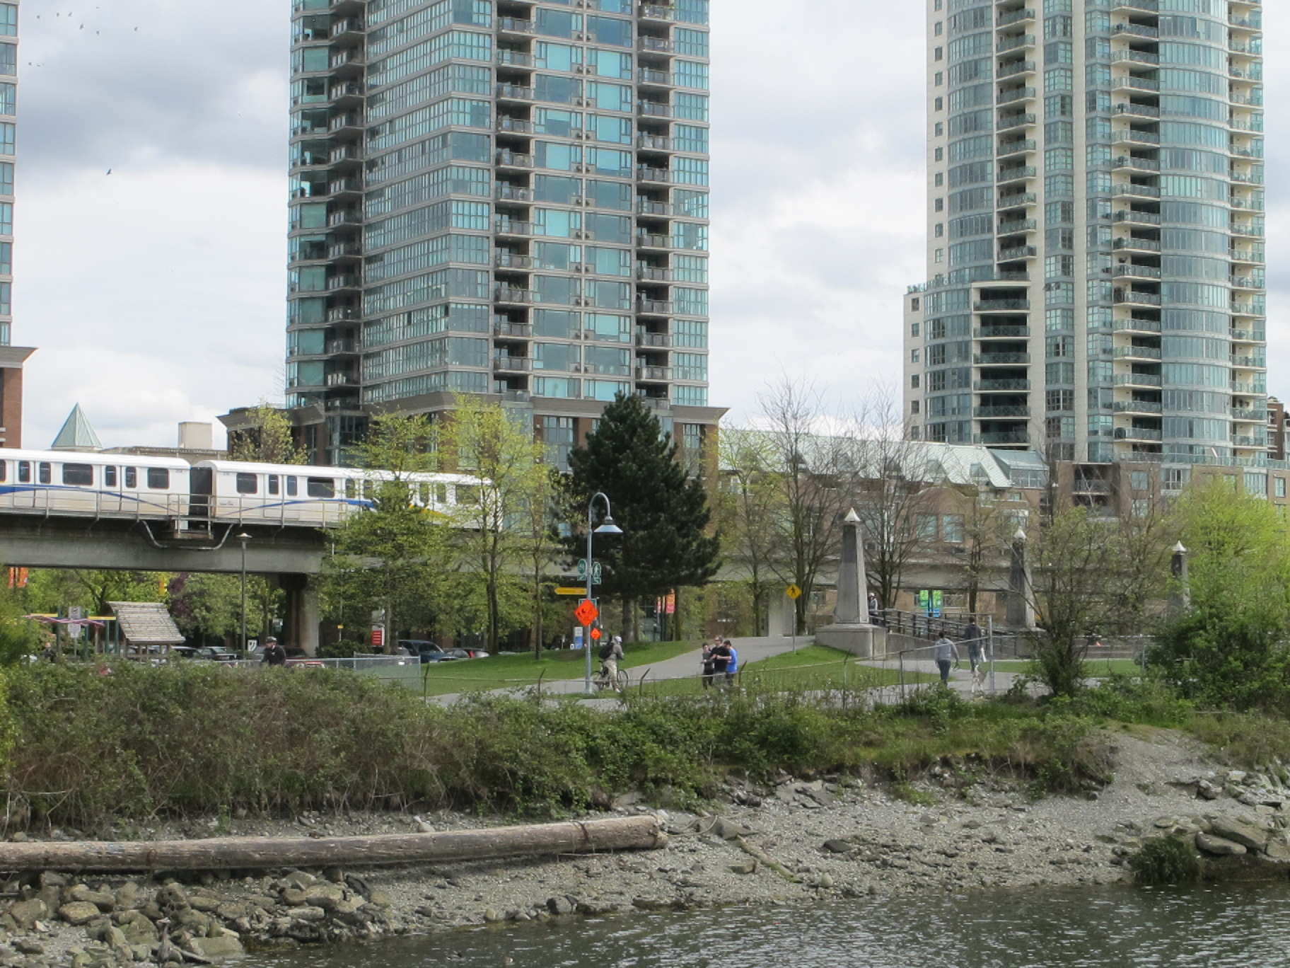
Sustainability
Vancouver

Slide 9
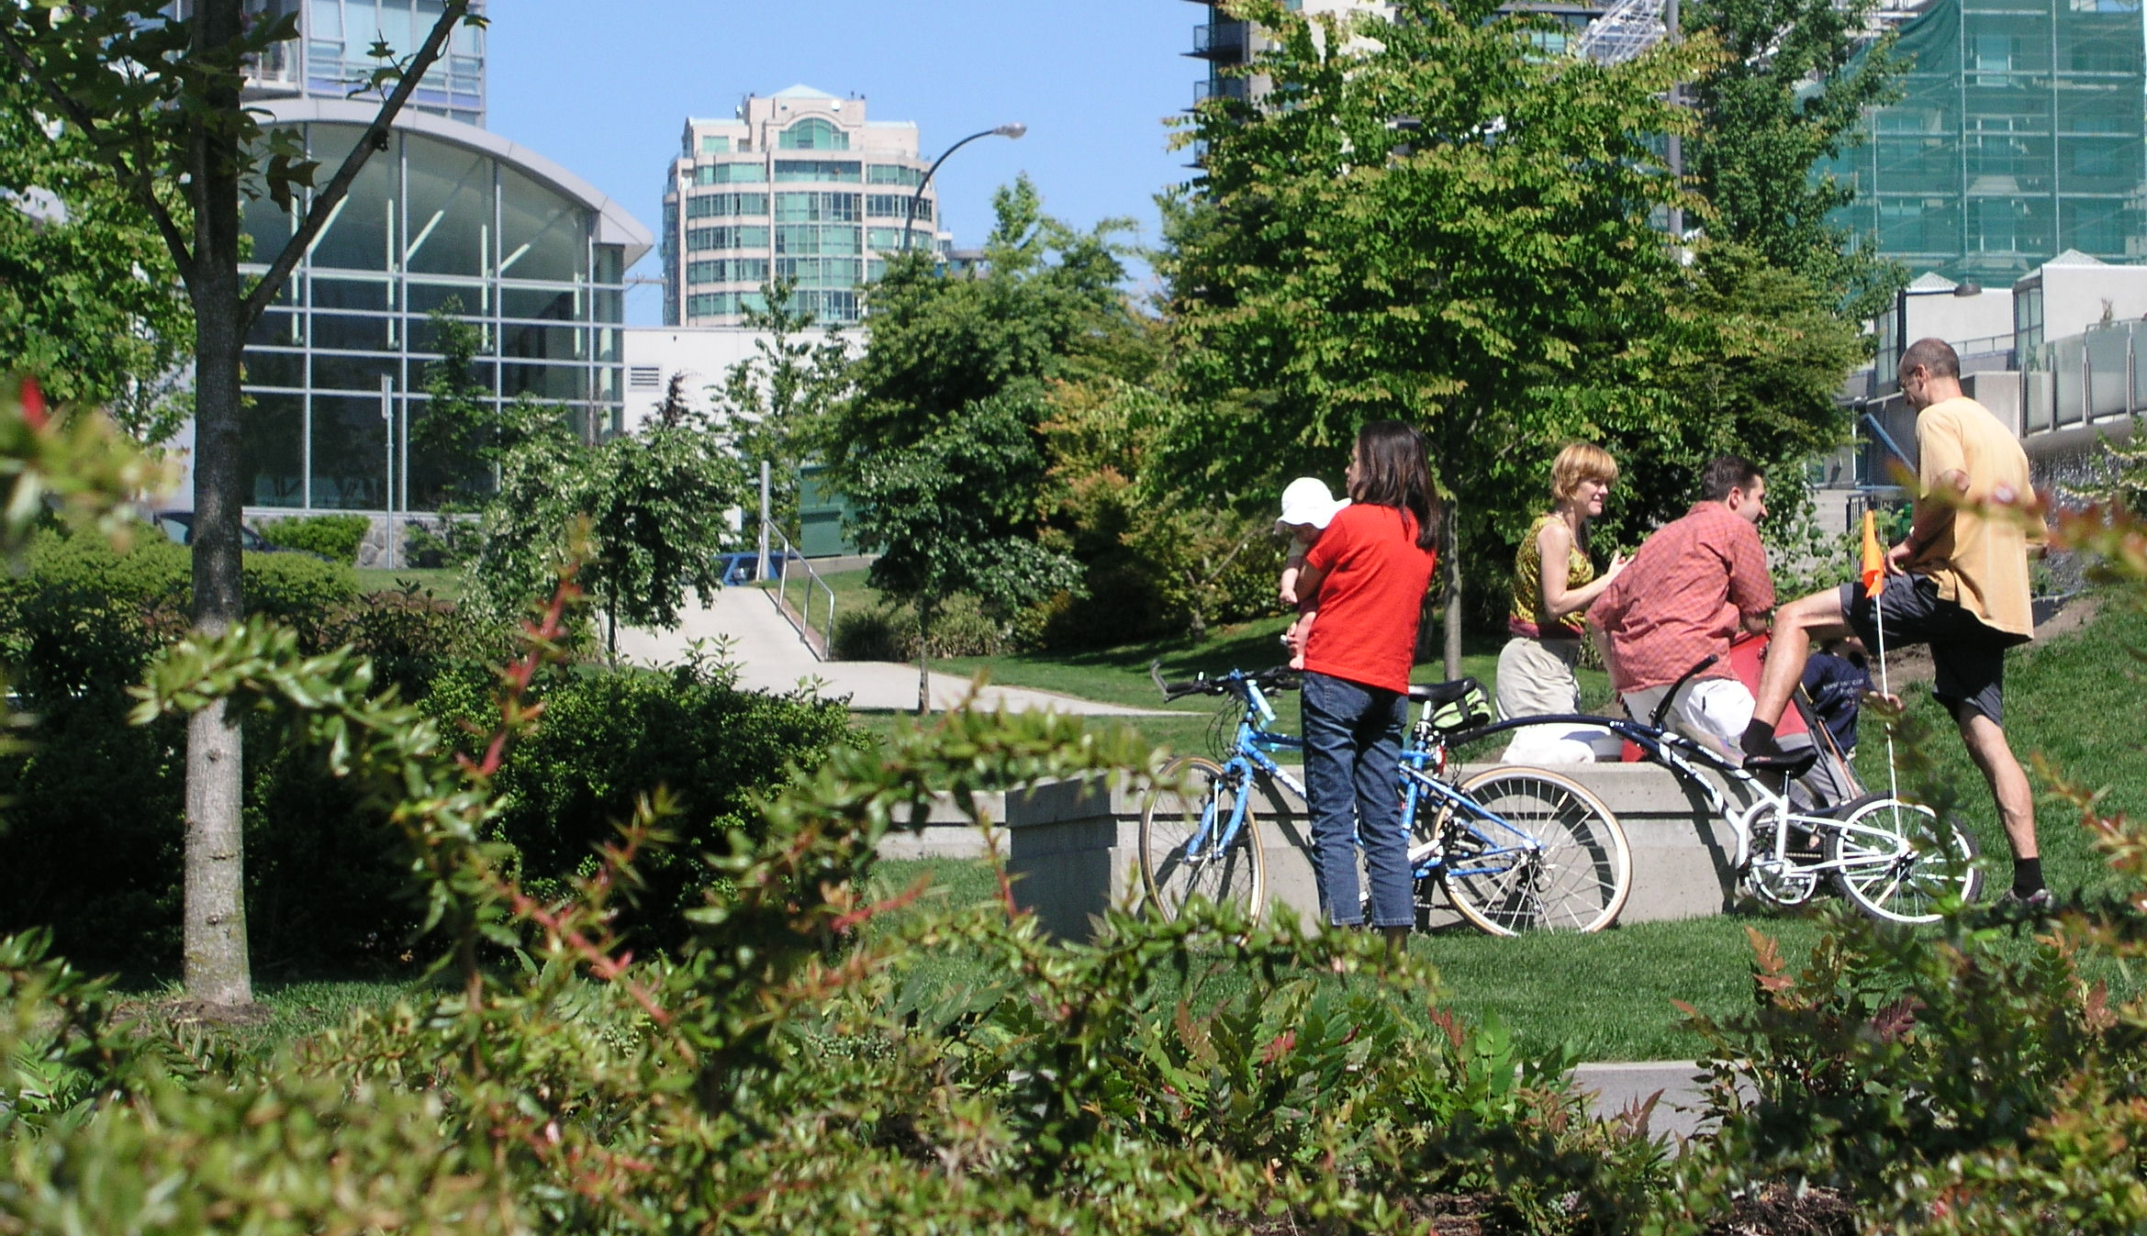
Vancouver

Slide 10
Structural side
Smart Growth
Urban Structure
Urban Infrastructure
Clustered Density
Mixed Use
Diversity
=
Alternative
Mobility
Neighbourhood
Module
Open Space Context
Community
Facilities
Placemaking
Green
Construction
Renewable
Utilities
Infrastructural side

Slide 11
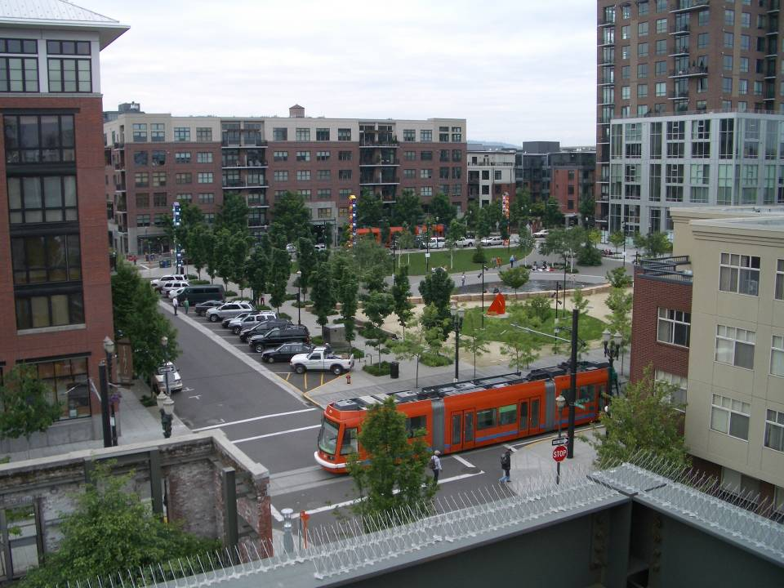
Portland

Slide 12
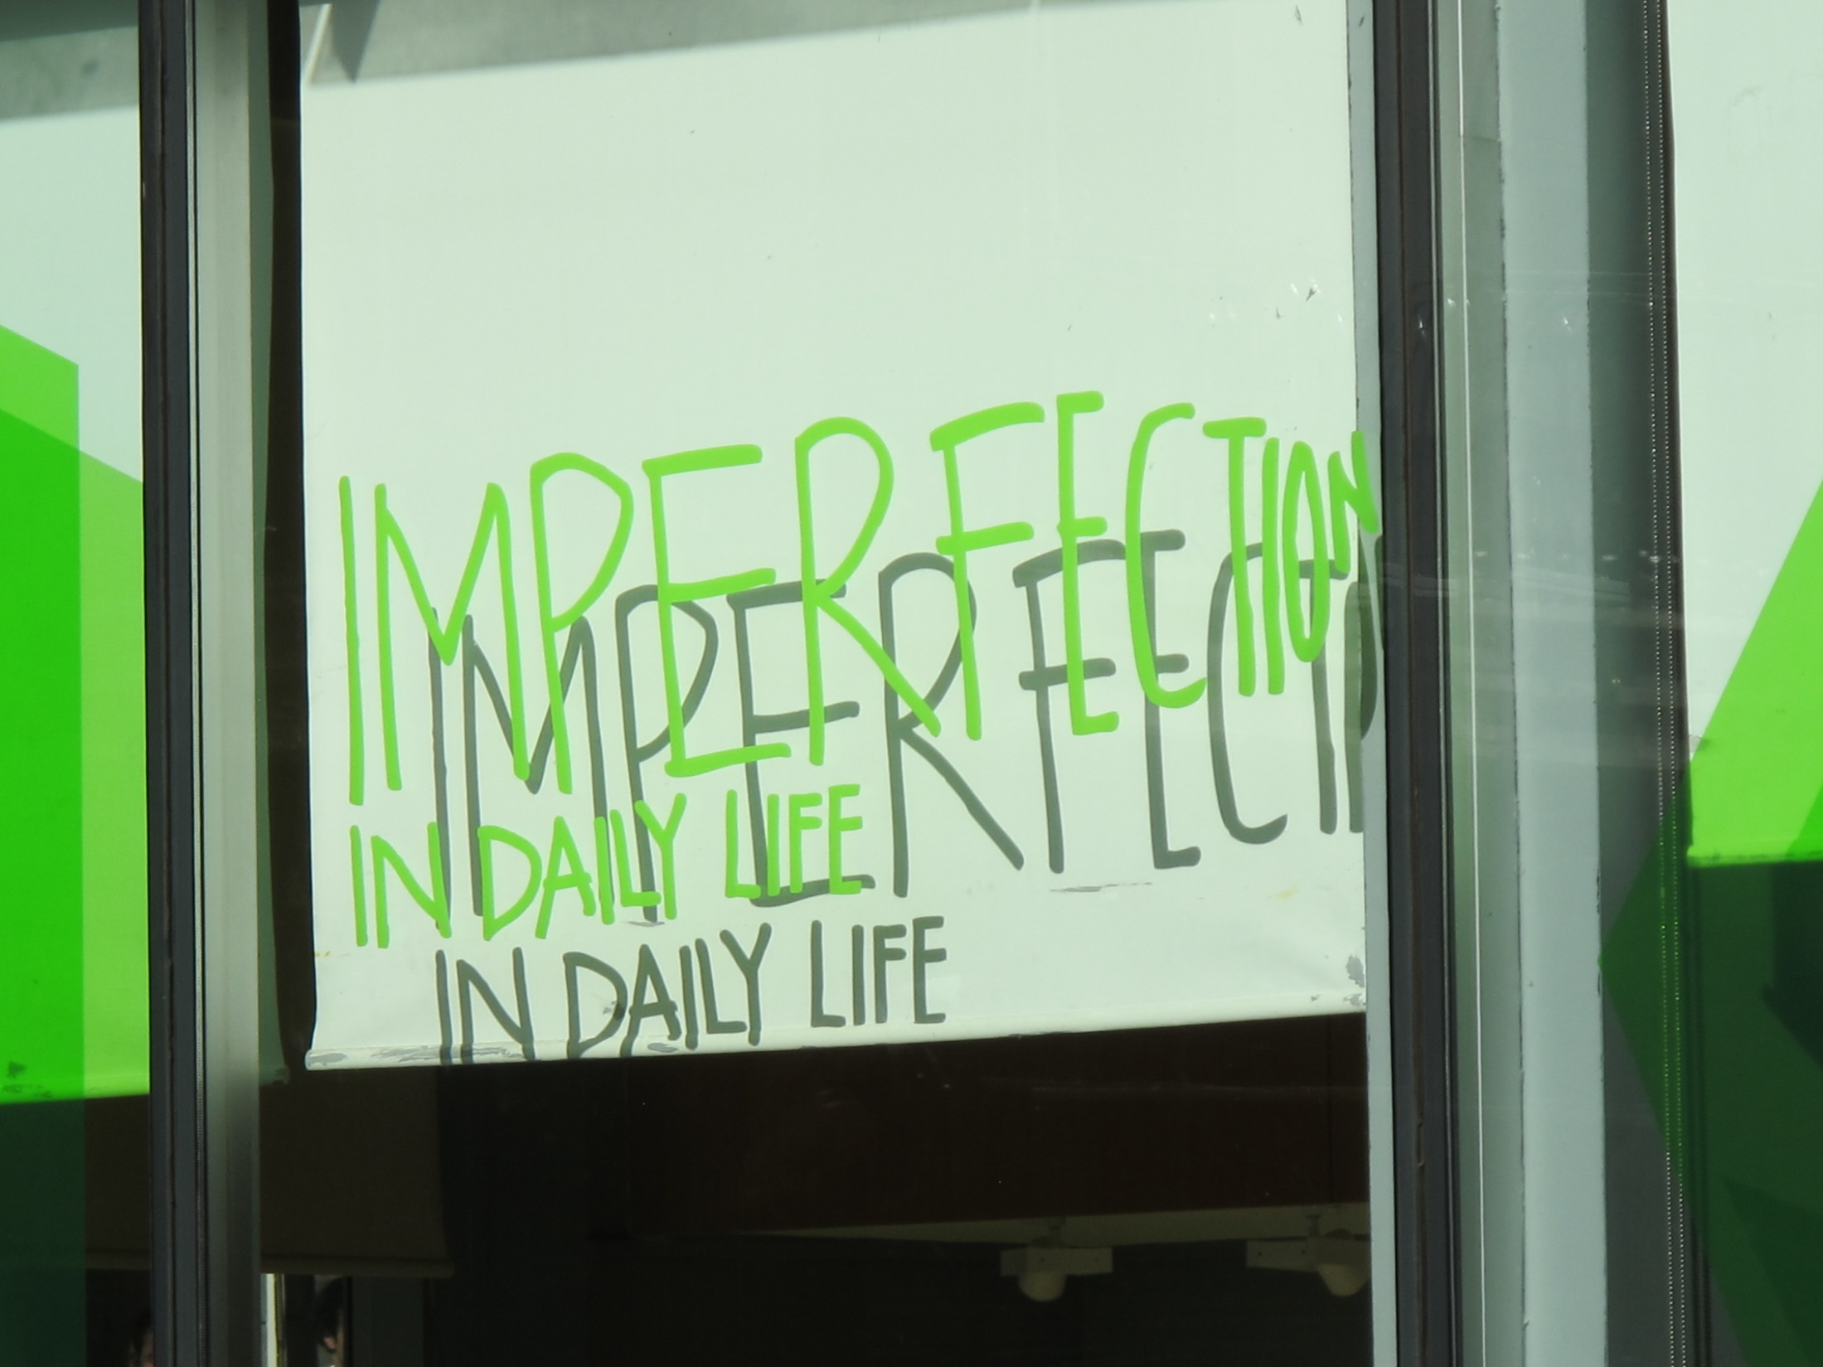

Slide 13
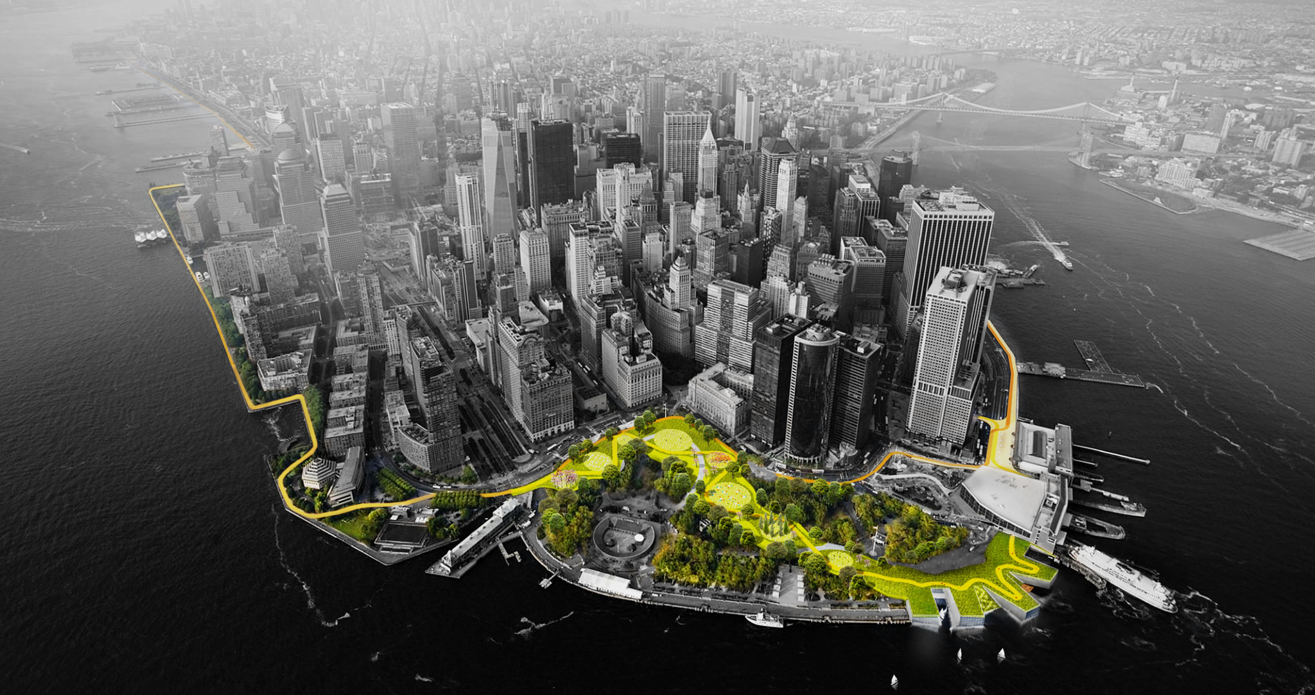
Resilience
New York – Flood Management Strategy

Slide 14
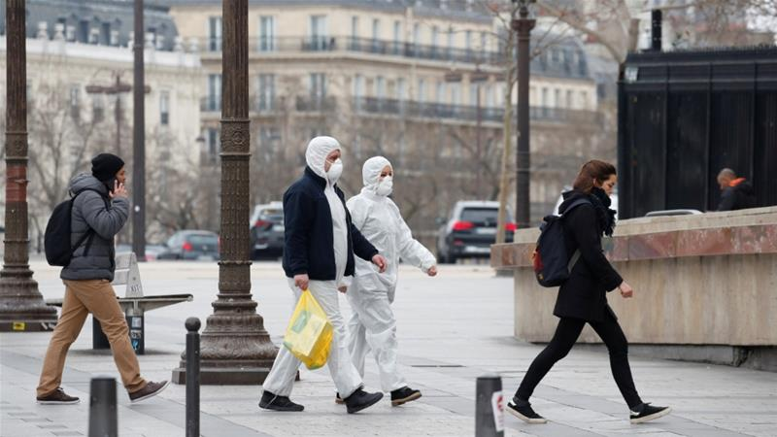
Paris

Slide 15
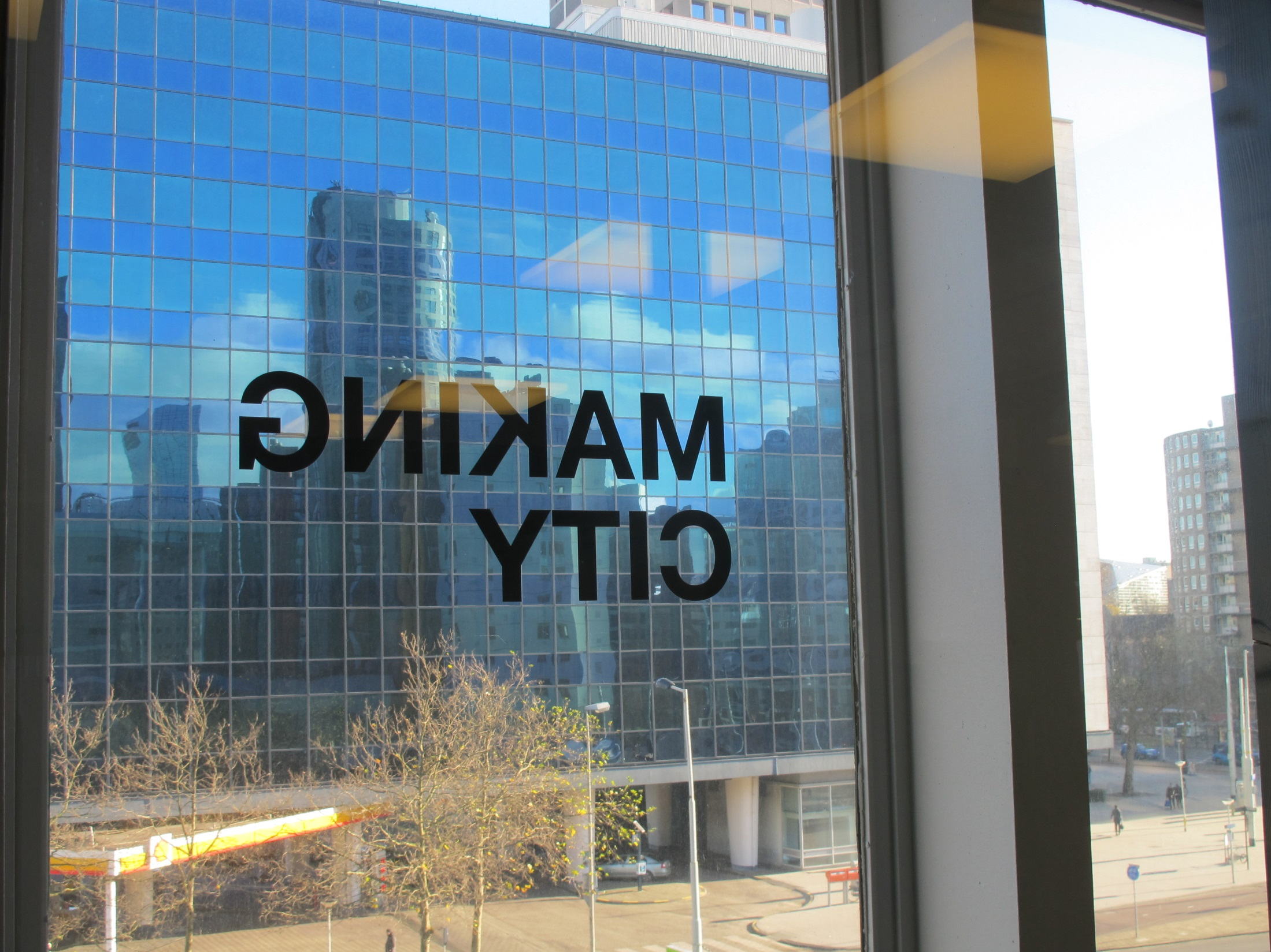
The Global Urban Dream:
Liveability + Sustainability + Resilience
(with Efficiency)
Rotterdam

Slide 16
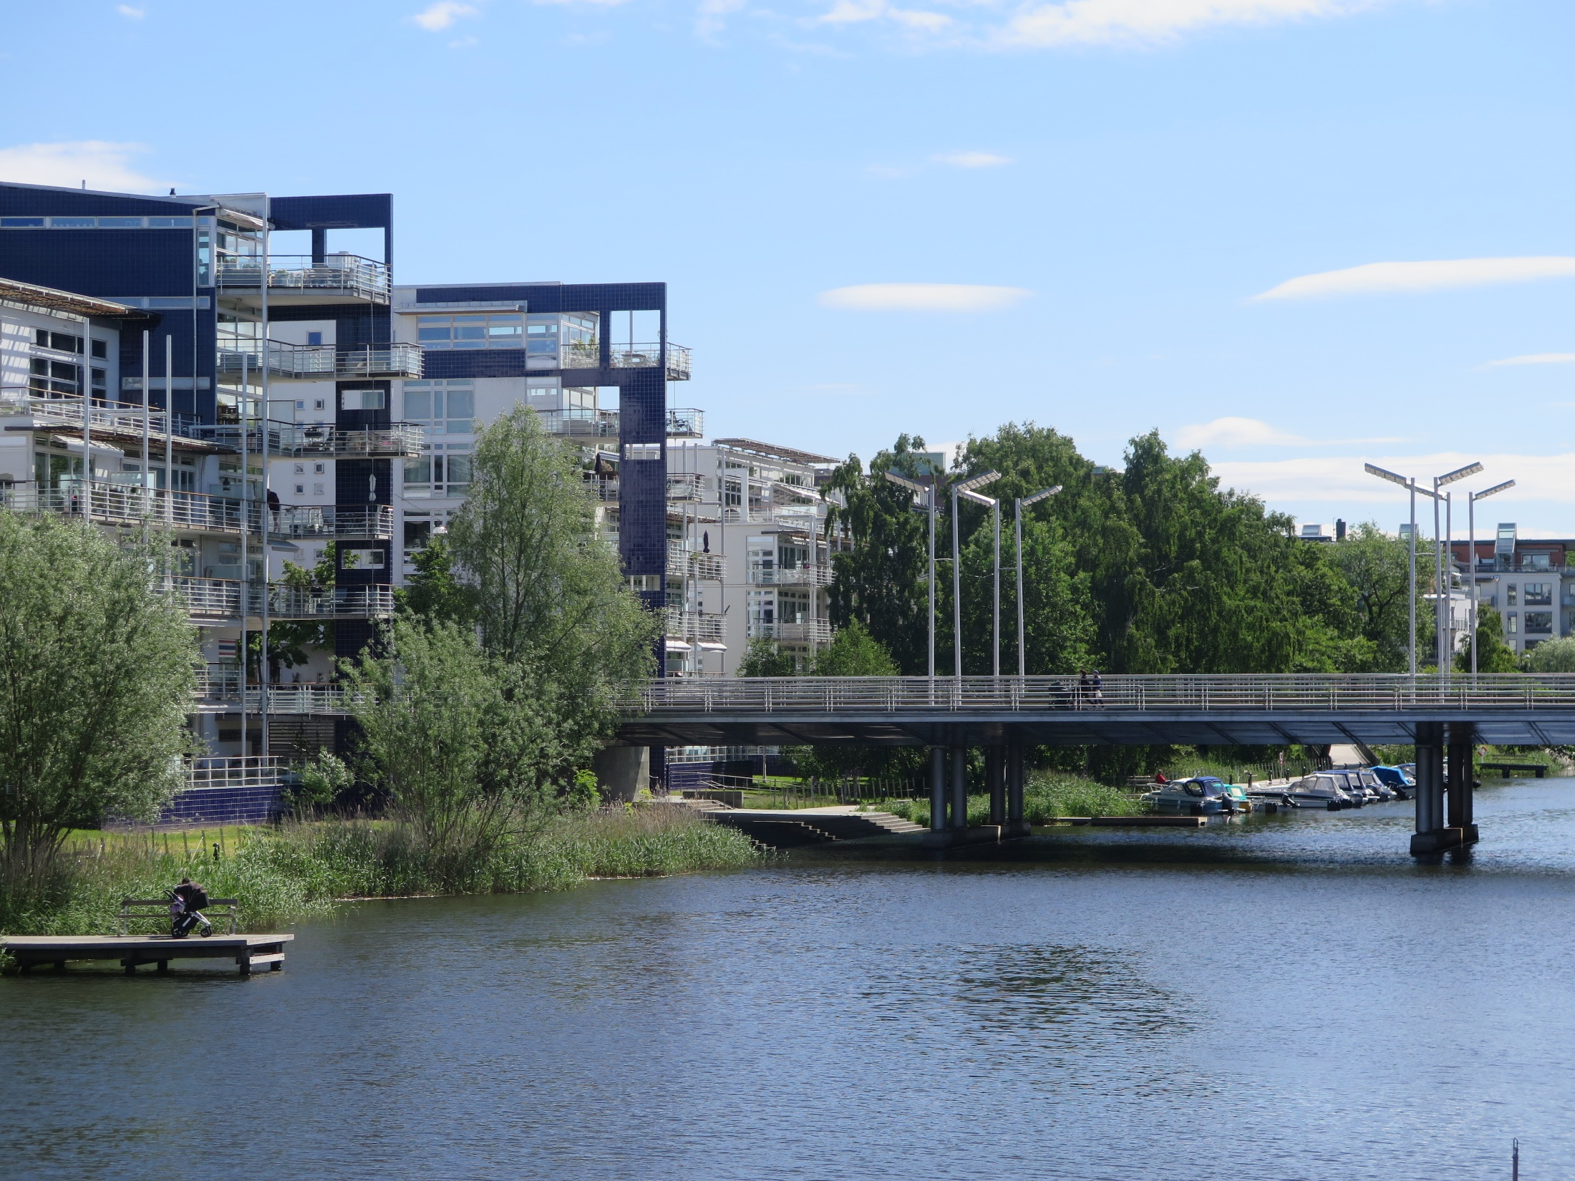
Stockholm – Hammarby Sjostad Nieghbourohood

Slide 17
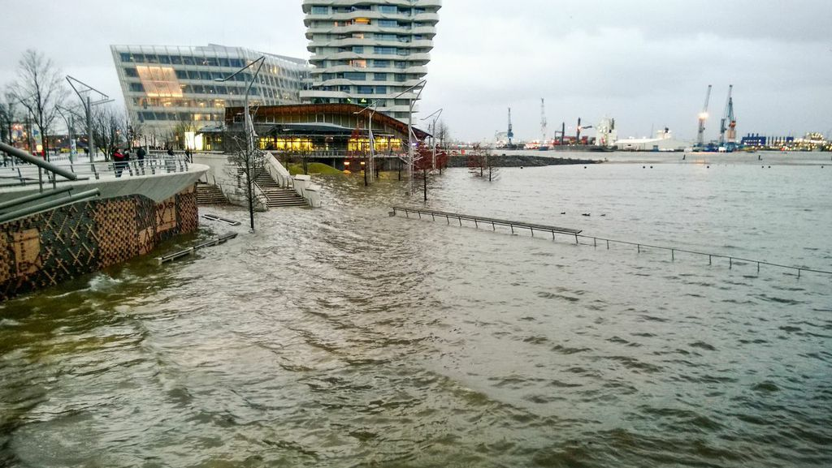
Hamburg – Hafen City Flood Tolerant Design

Slide 18
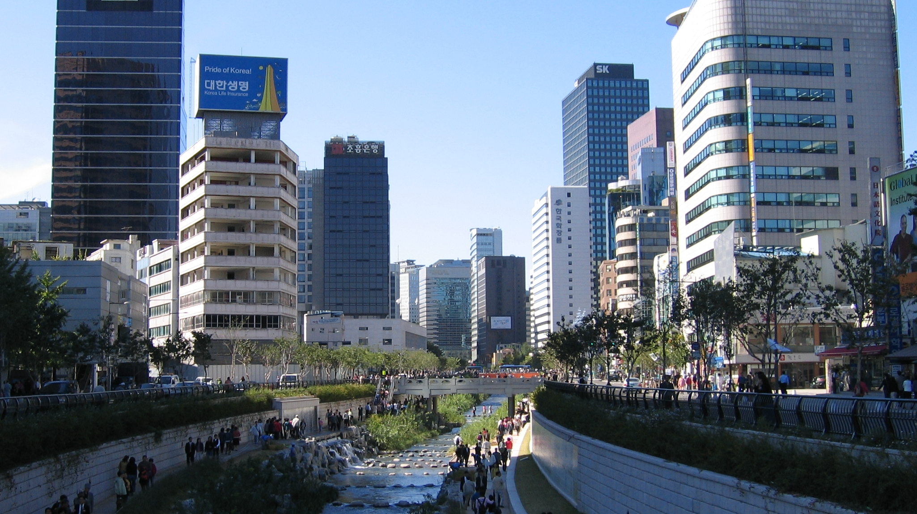
Seoul - Cheonggyecheon

Slide 19
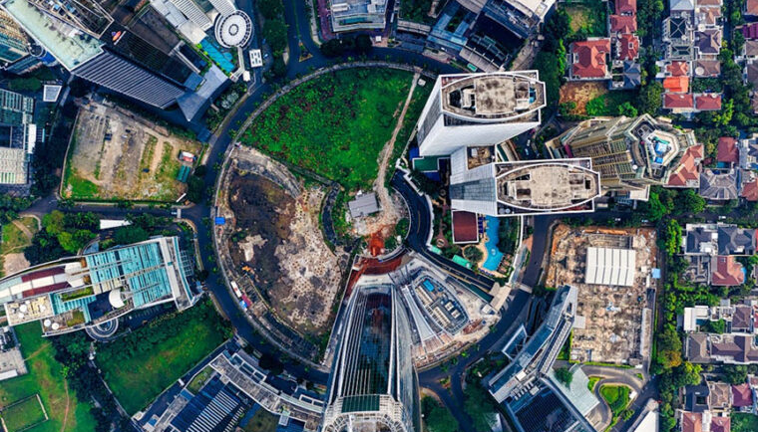
The Spontaneous Urban Trends

Slide 20
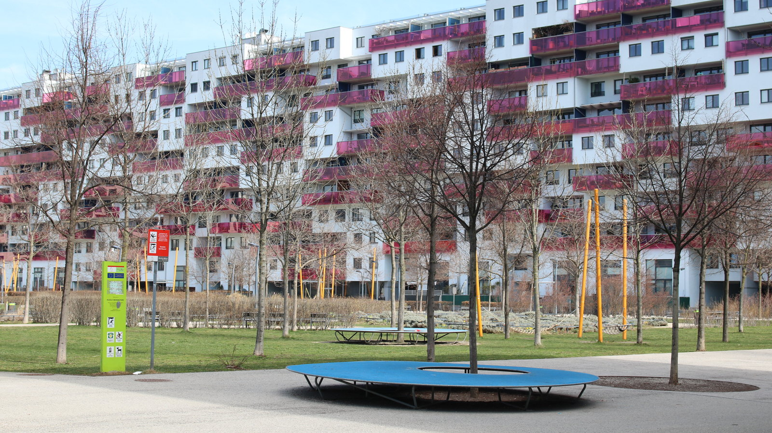
Vienna

Slide 21
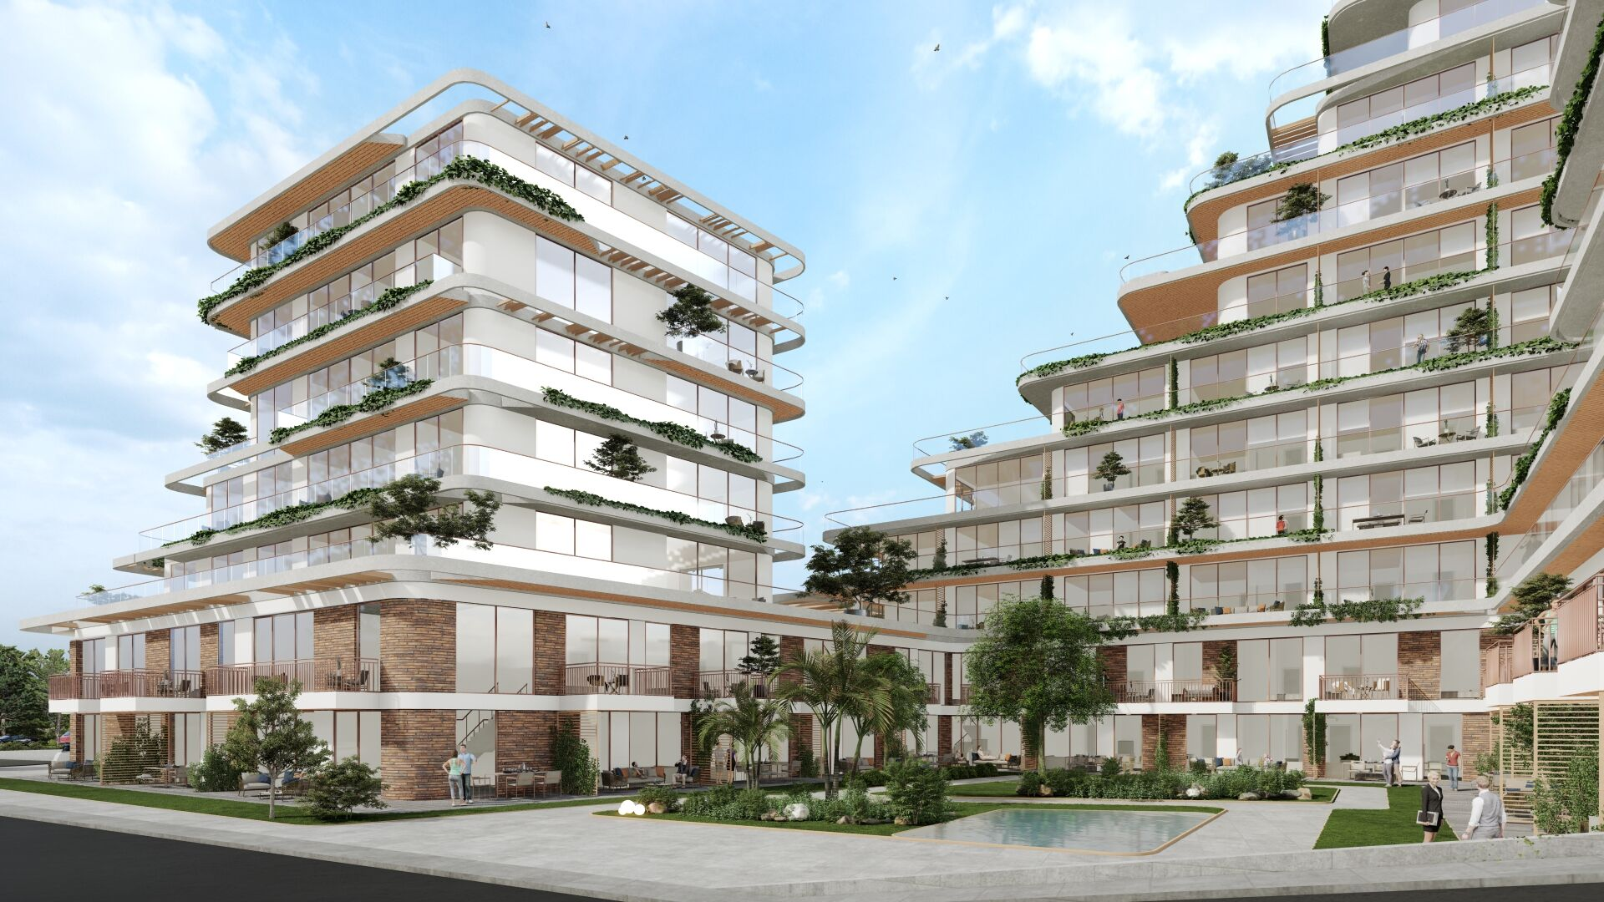
Driver 1:
The Demand
for Flexibility

Slide 22
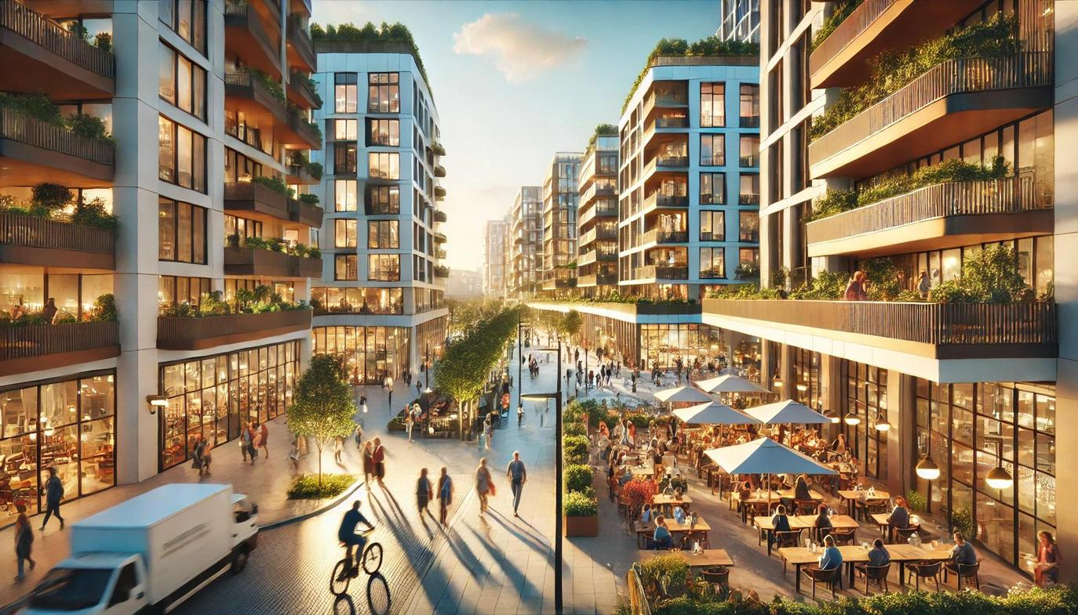

Slide 23
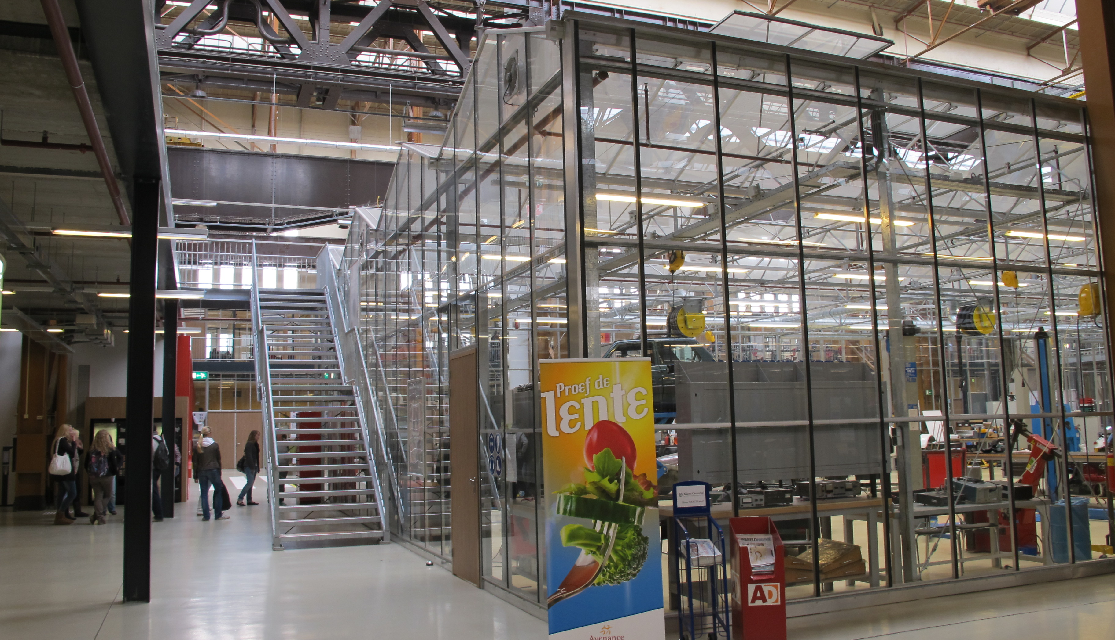
Rotterdam

Slide 24
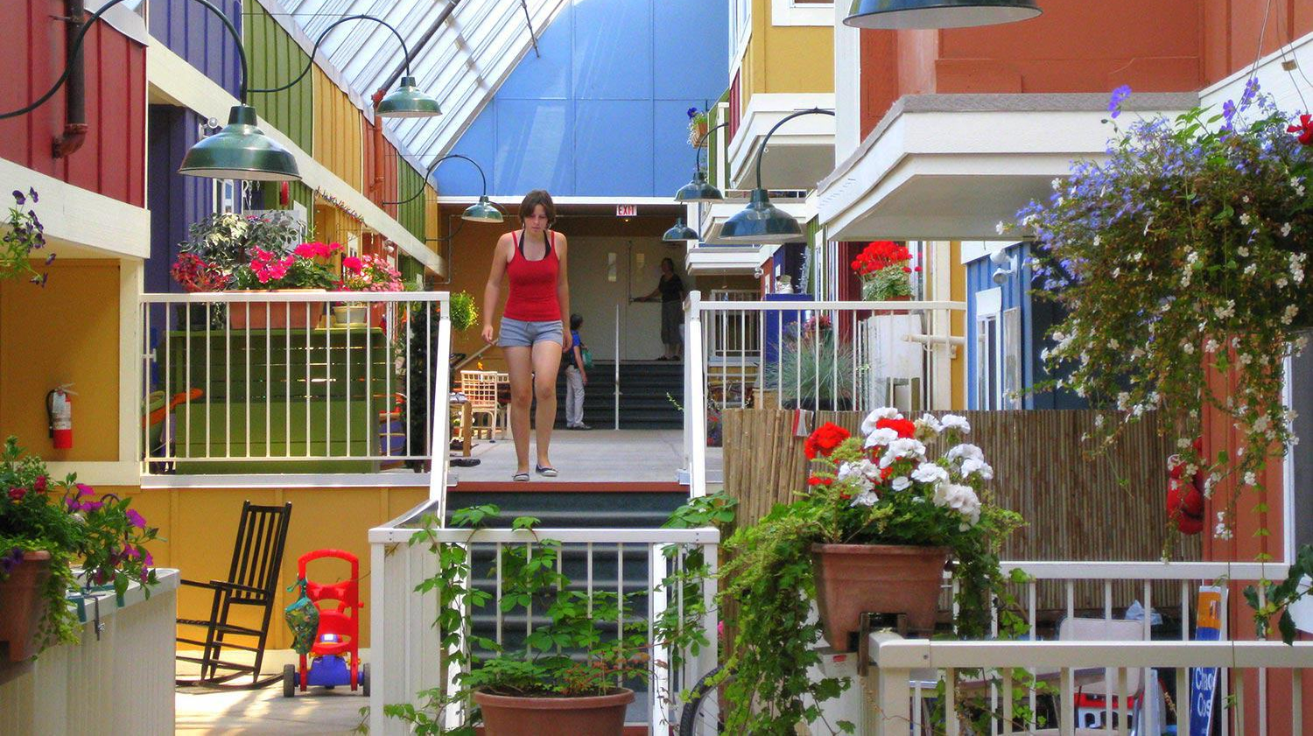

Slide 25


Slide 26
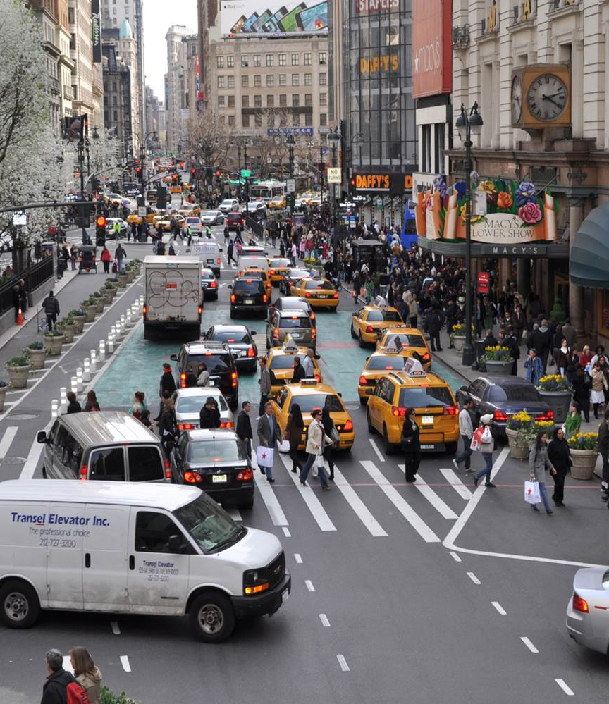
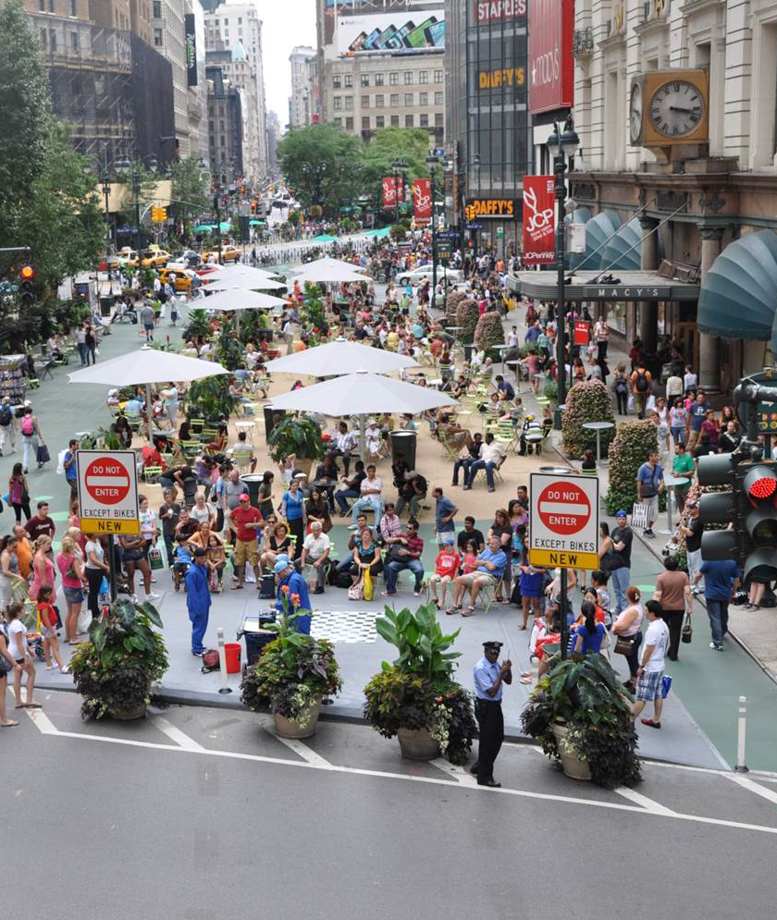
New York

Slide 27
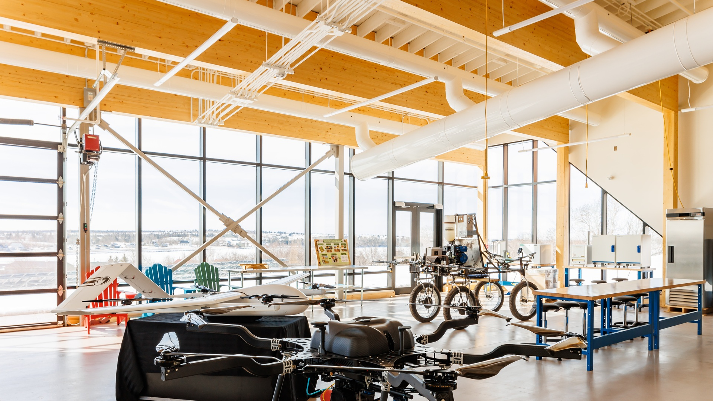

Slide 28
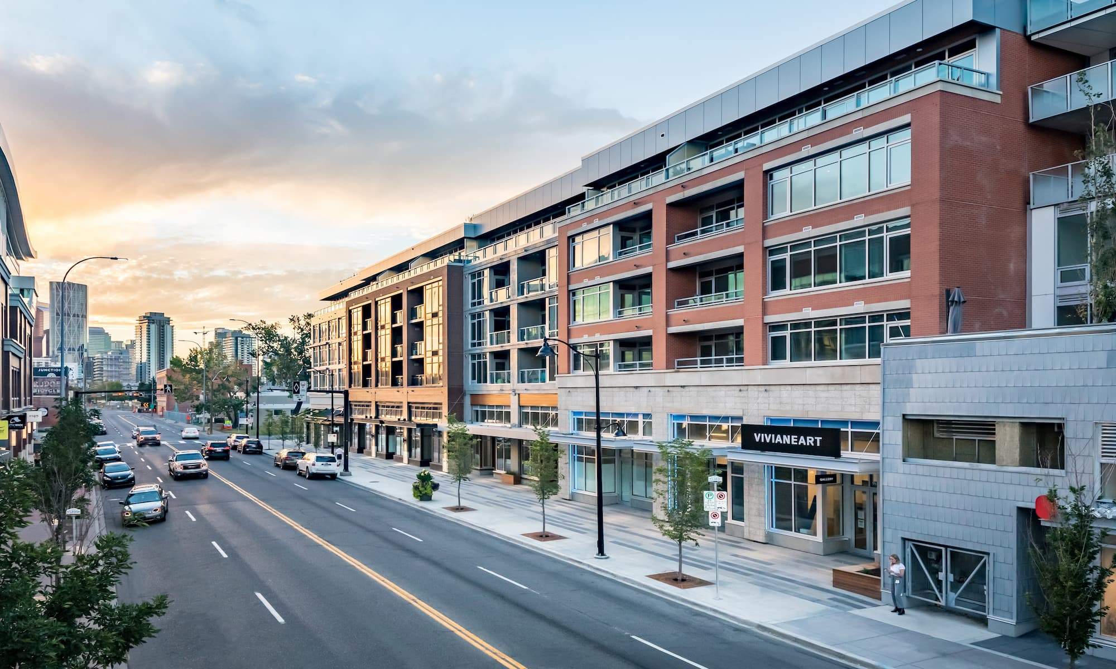

Slide 29
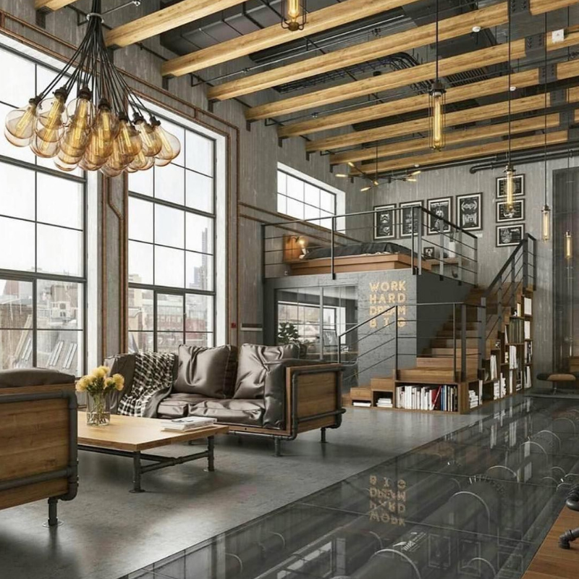
New York

Slide 30
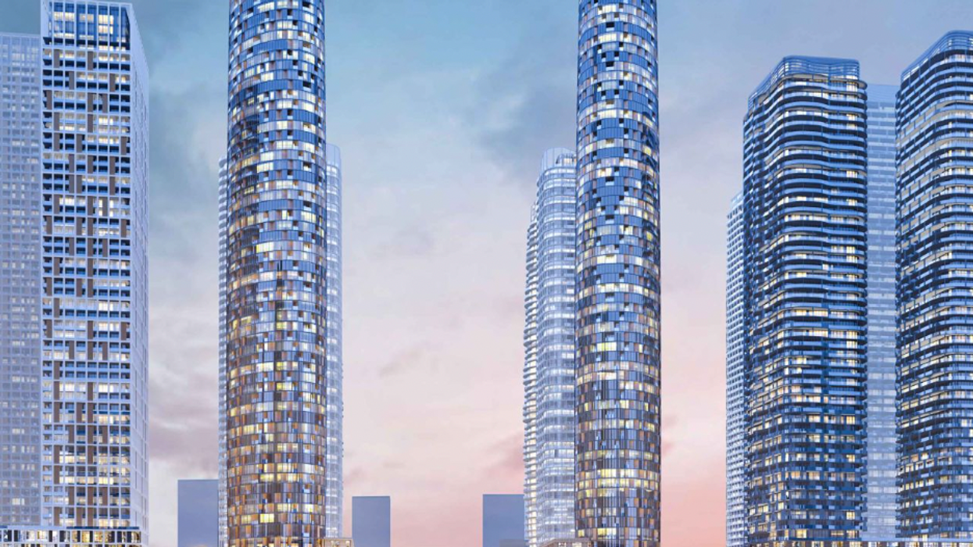
Driver 2:
The Urgency
of Intensification
Toronto - Vaughan

Slide 31
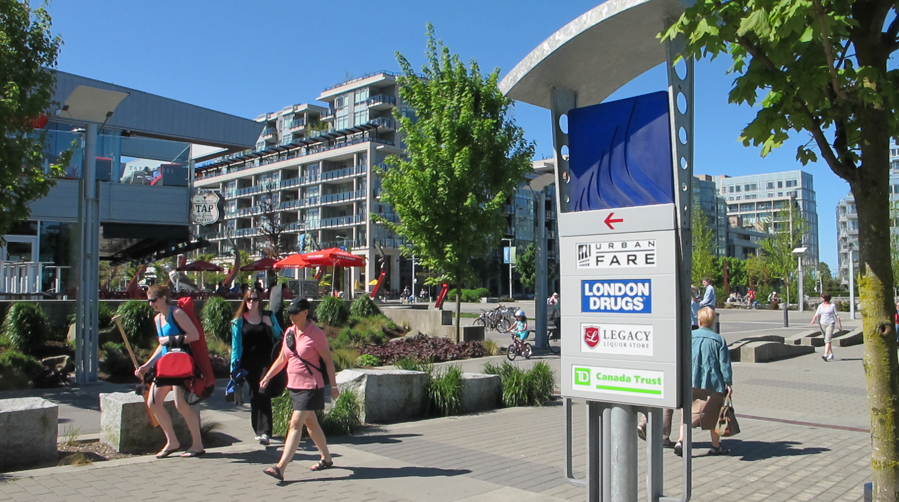
Vancouver

Slide 32
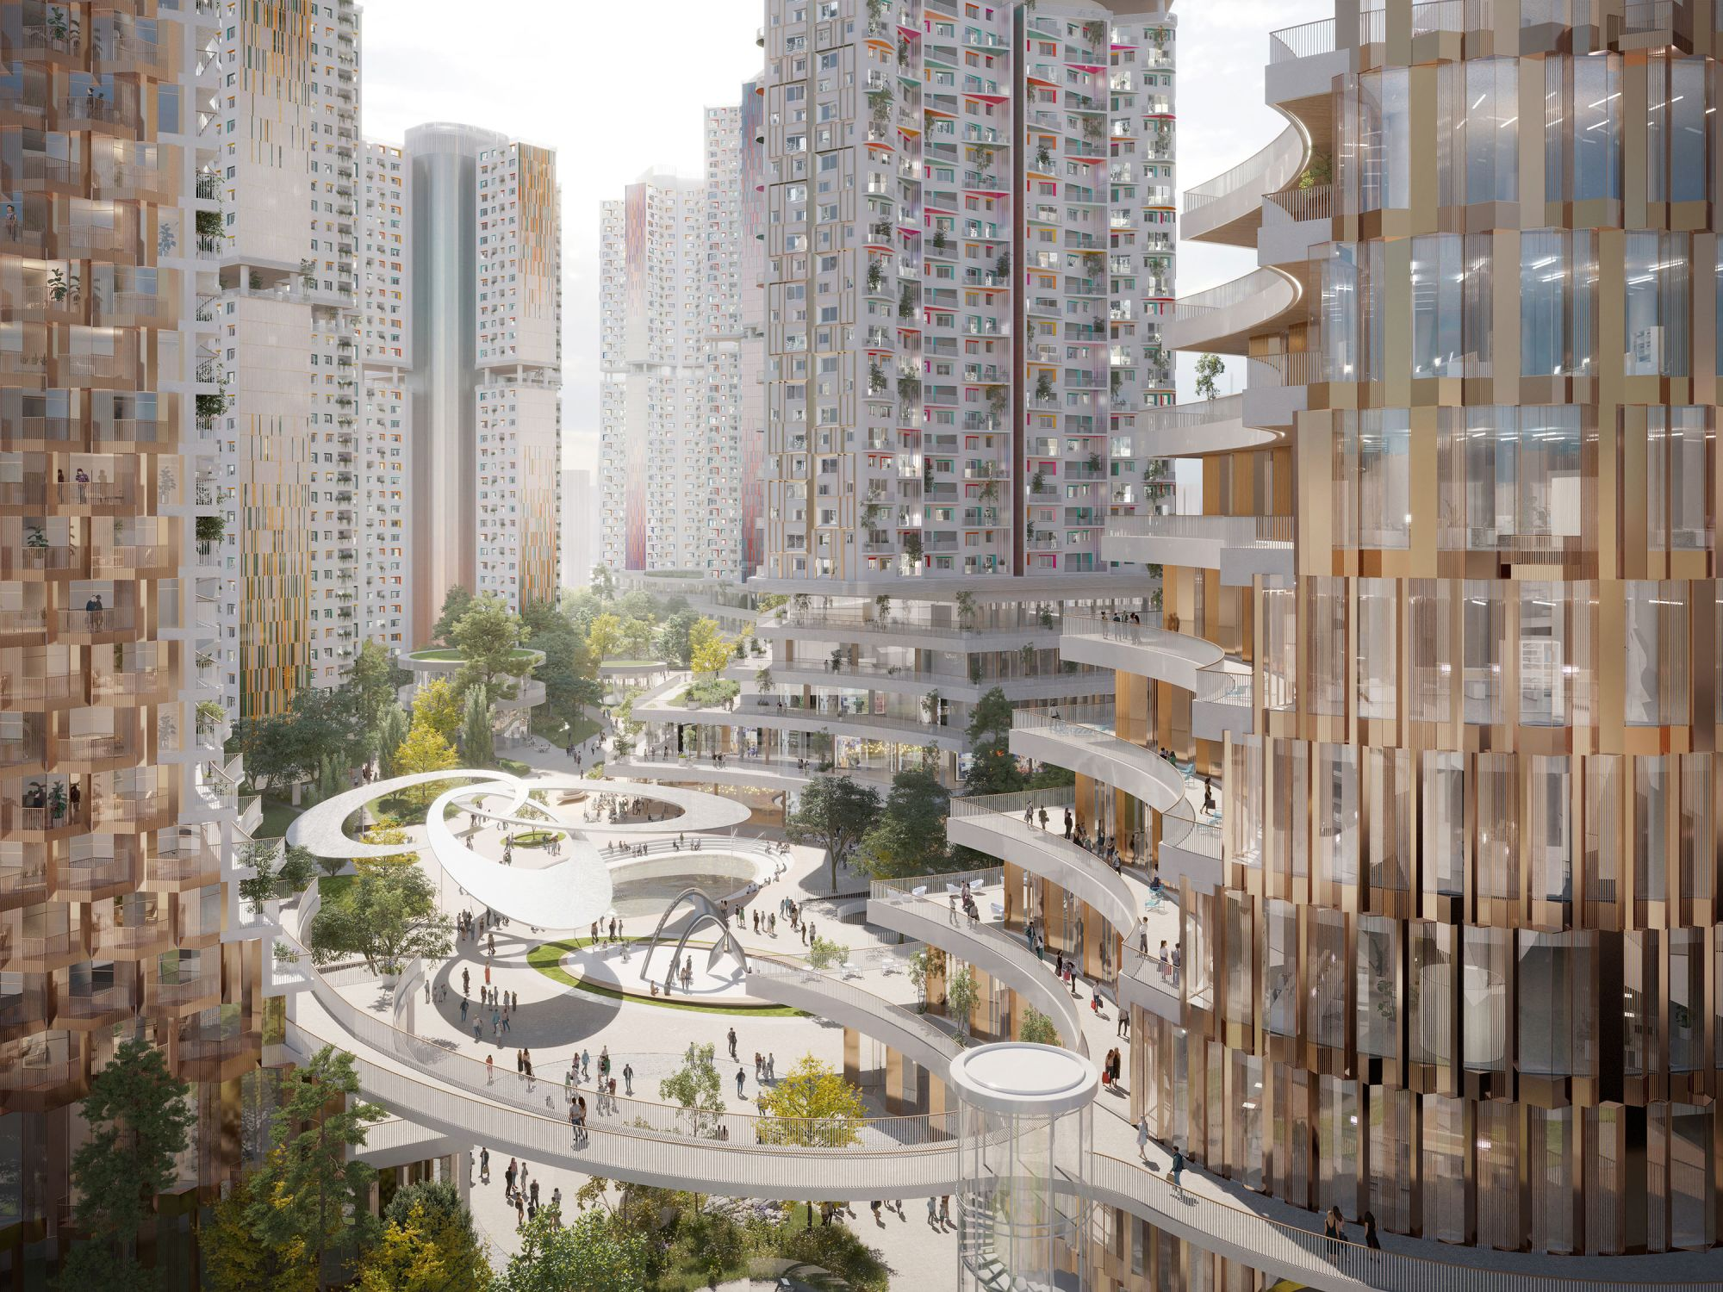
Seoul

Slide 33
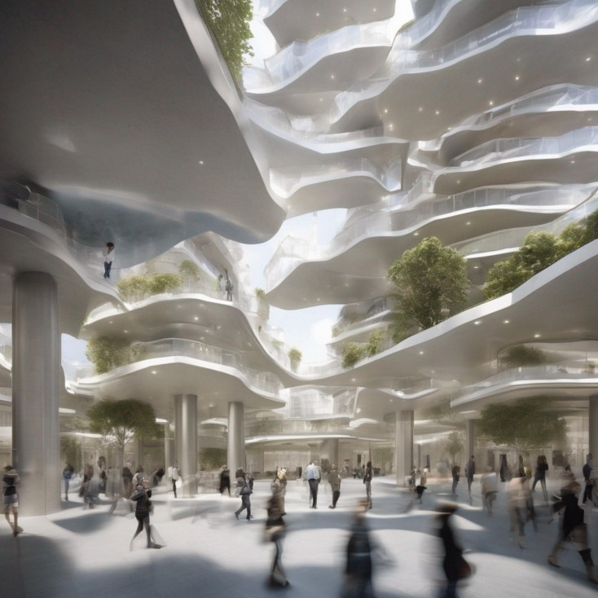

Slide 34
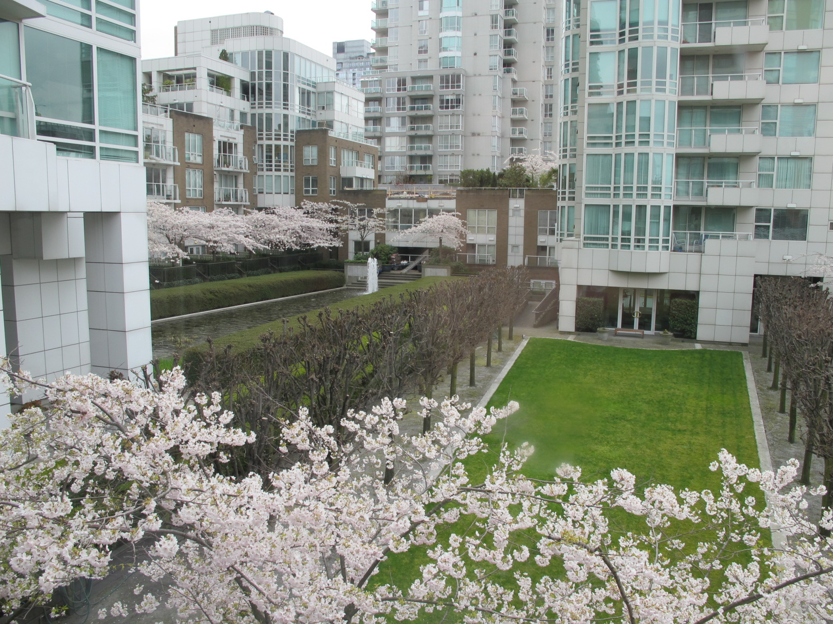

Slide 35

Driver 3:
The Aggressive
Expansion of
Digital Technology

Slide 36


Slide 37
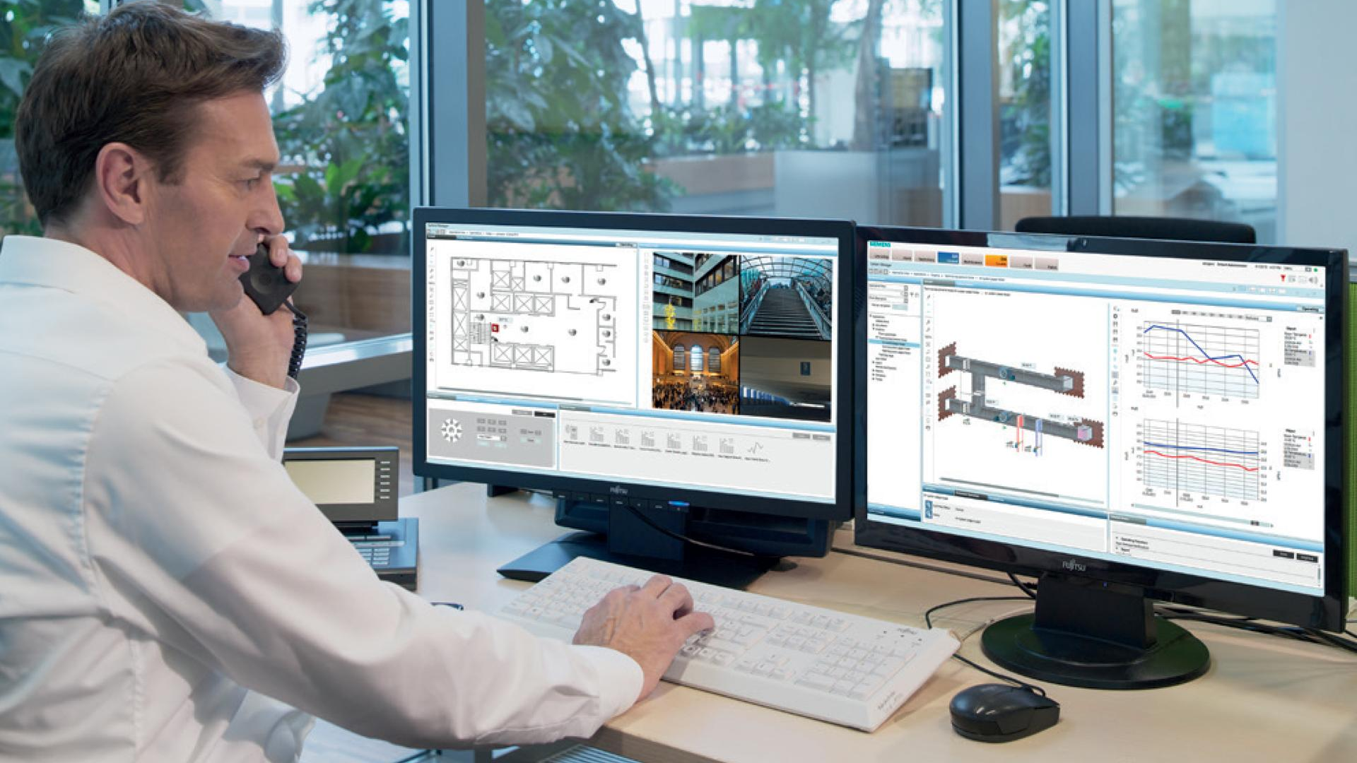

Slide 38
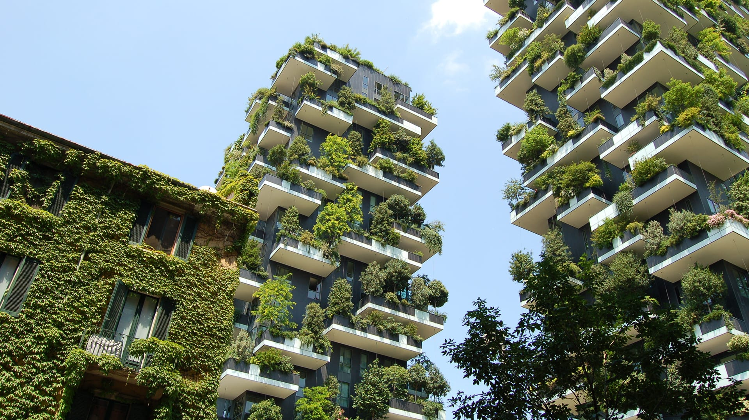
Driver 4:
The Green
Agenda

Slide 39
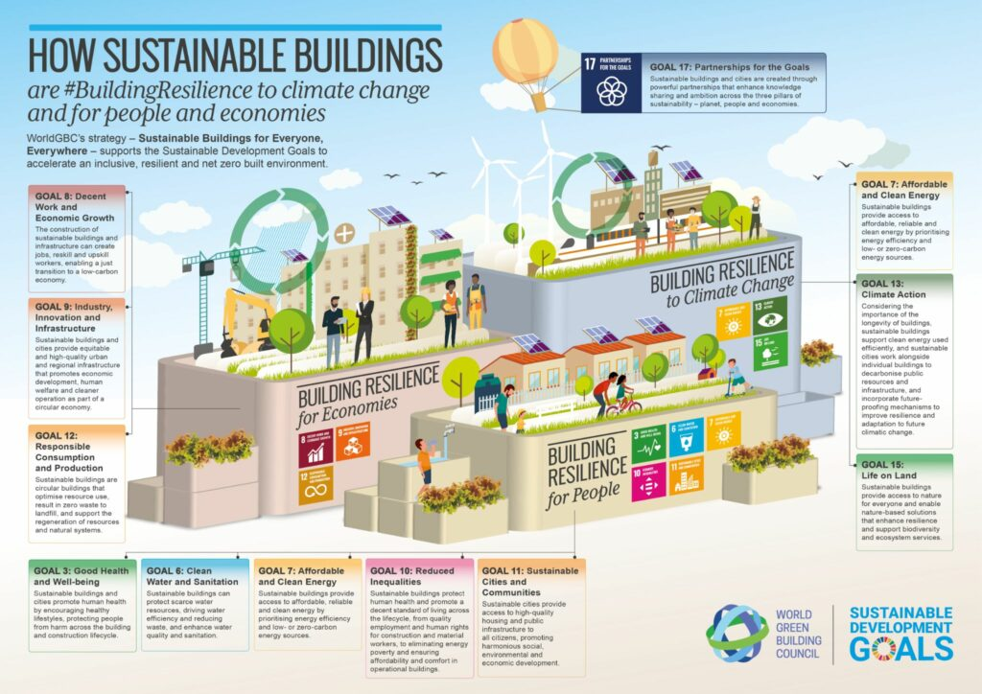

Slide 40
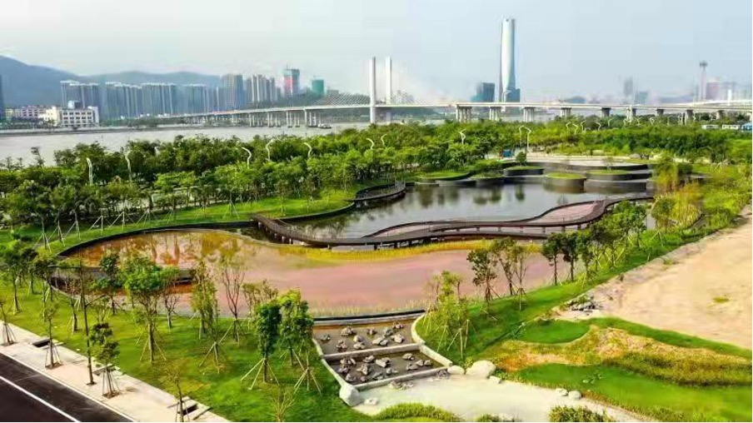

Slide 41
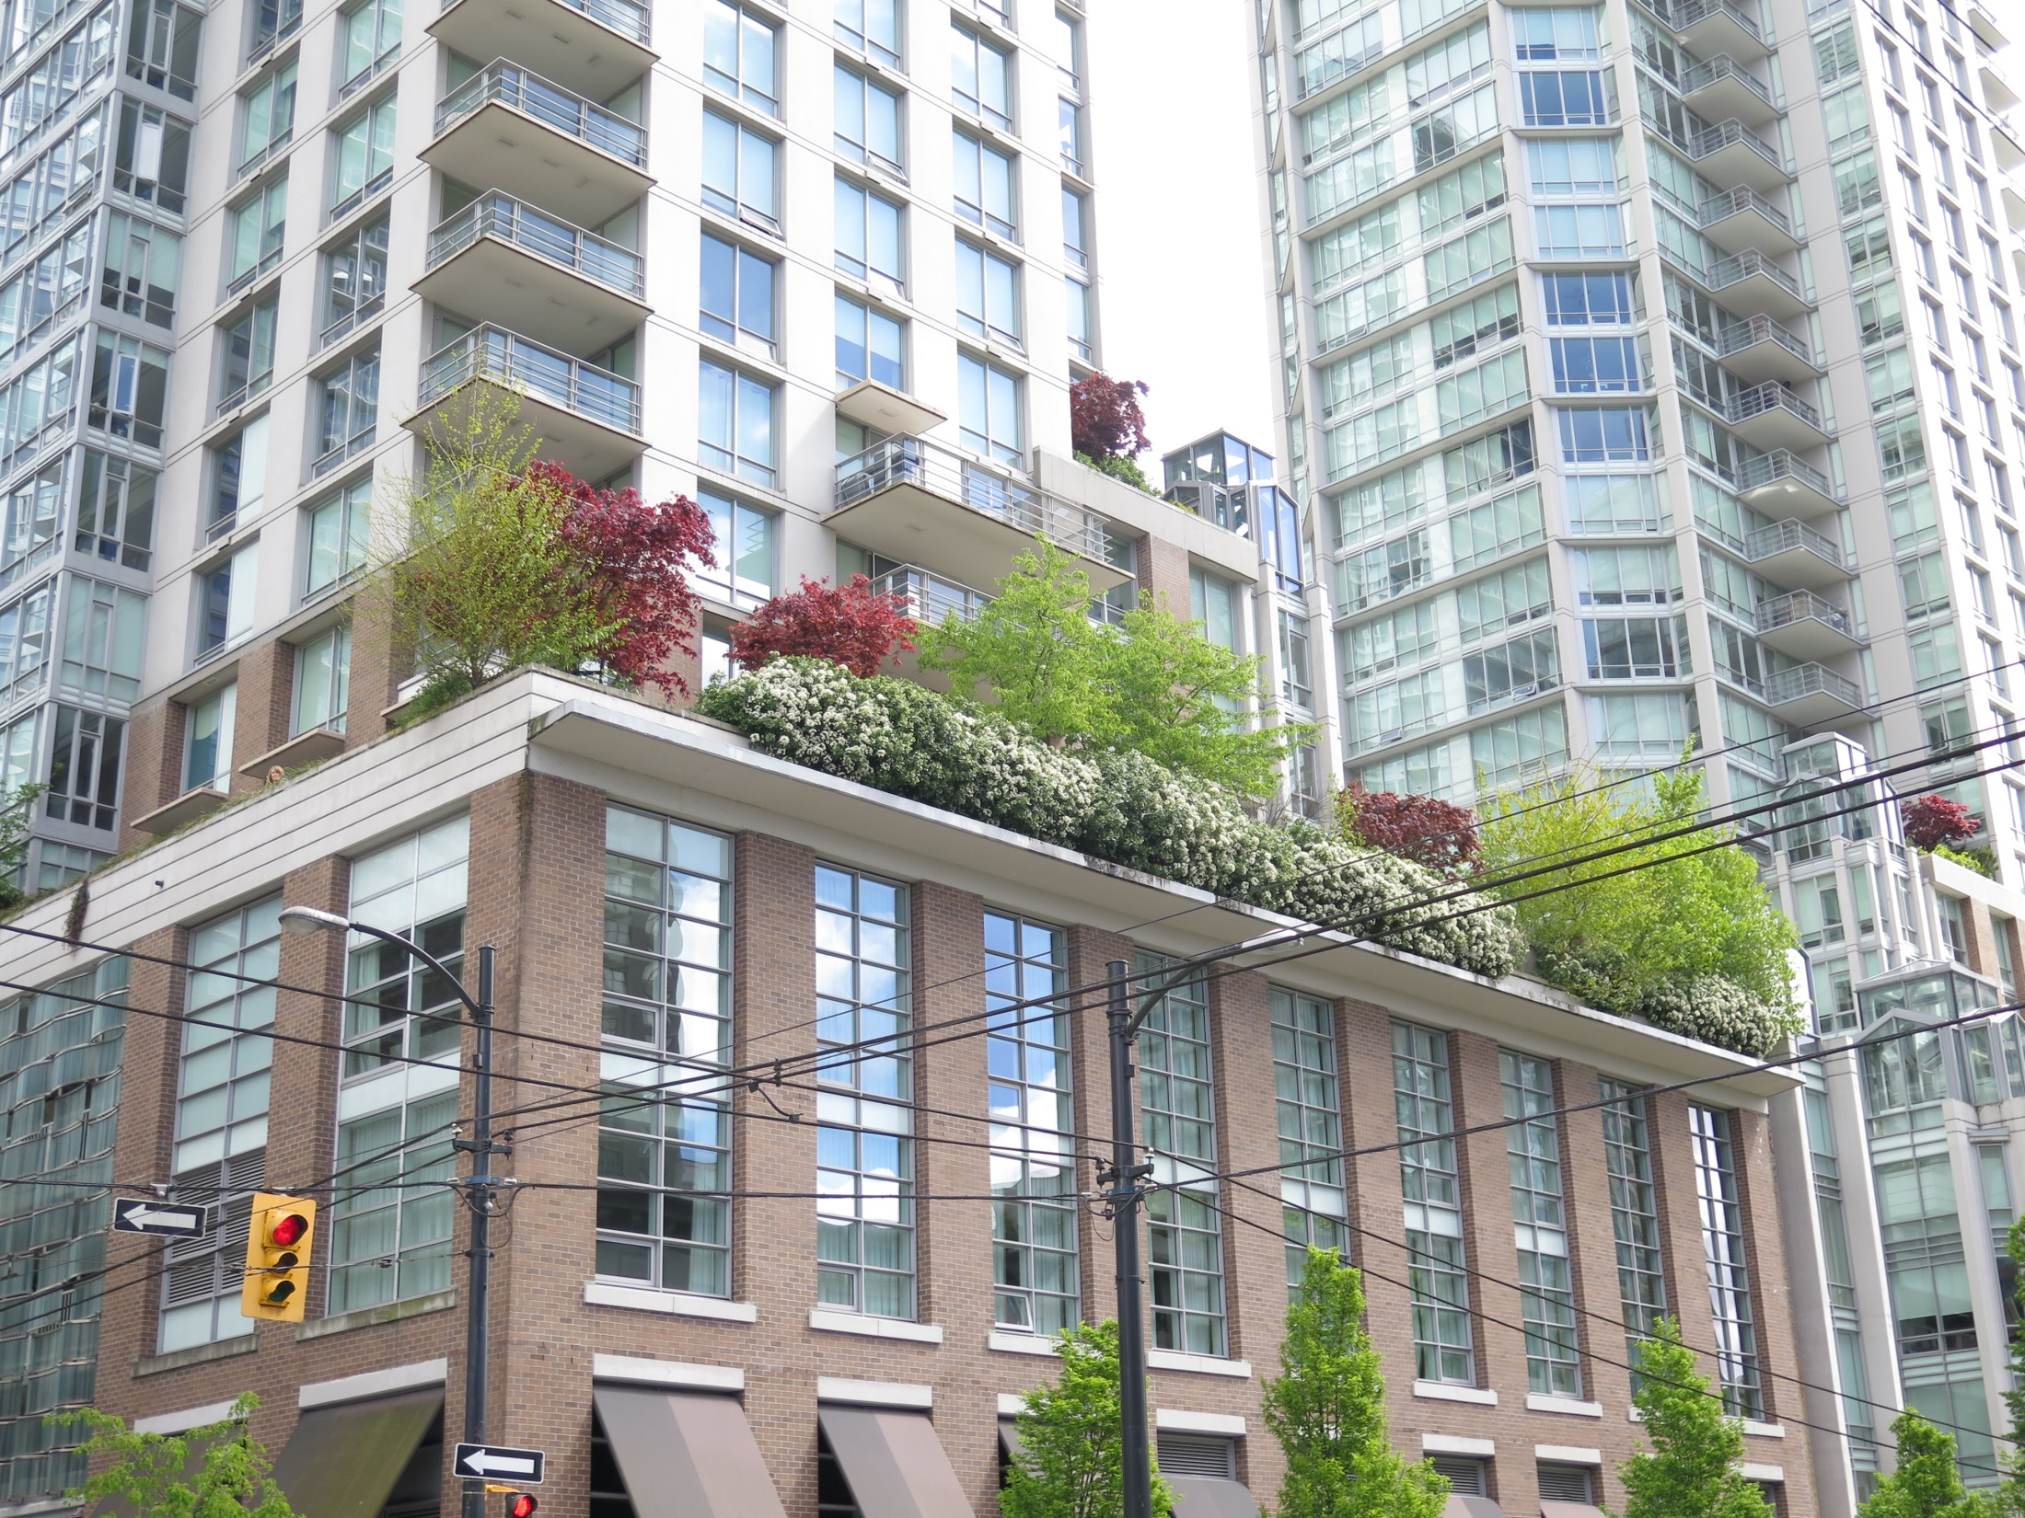
Vancouver

Slide 42
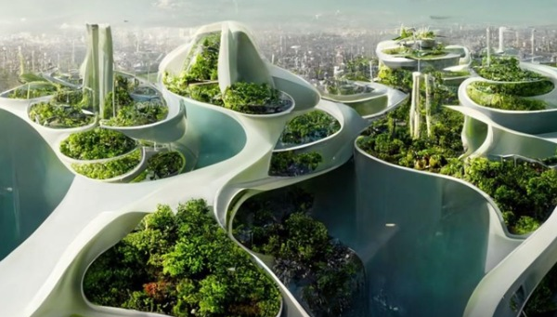

Slide 43
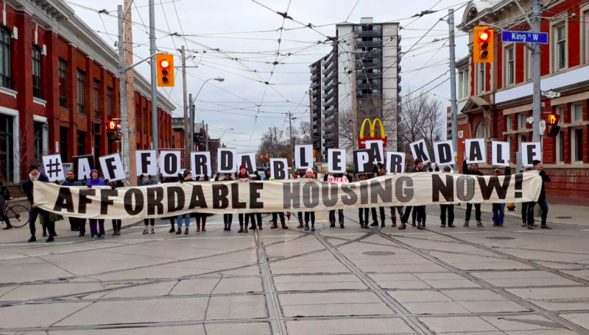
Driver 5. The Search for Building Affordability
Toronto

Slide 44
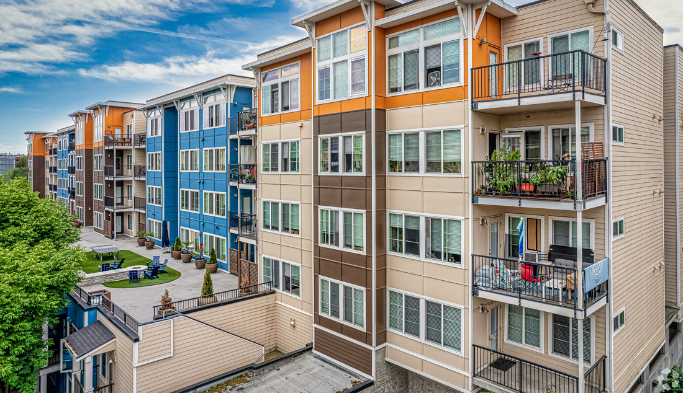
Renton

Slide 45
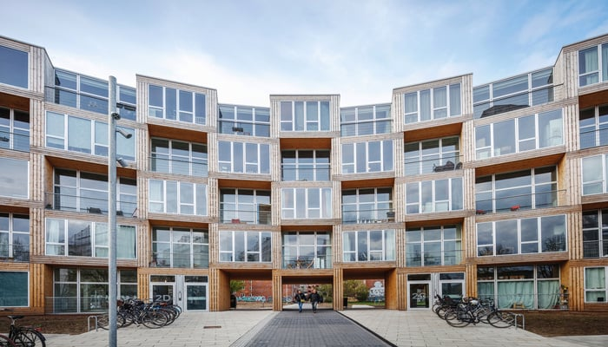
Aarhus

Slide 46
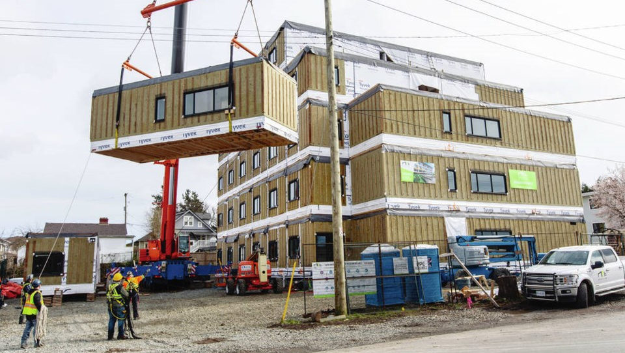
Victoria

Slide 47
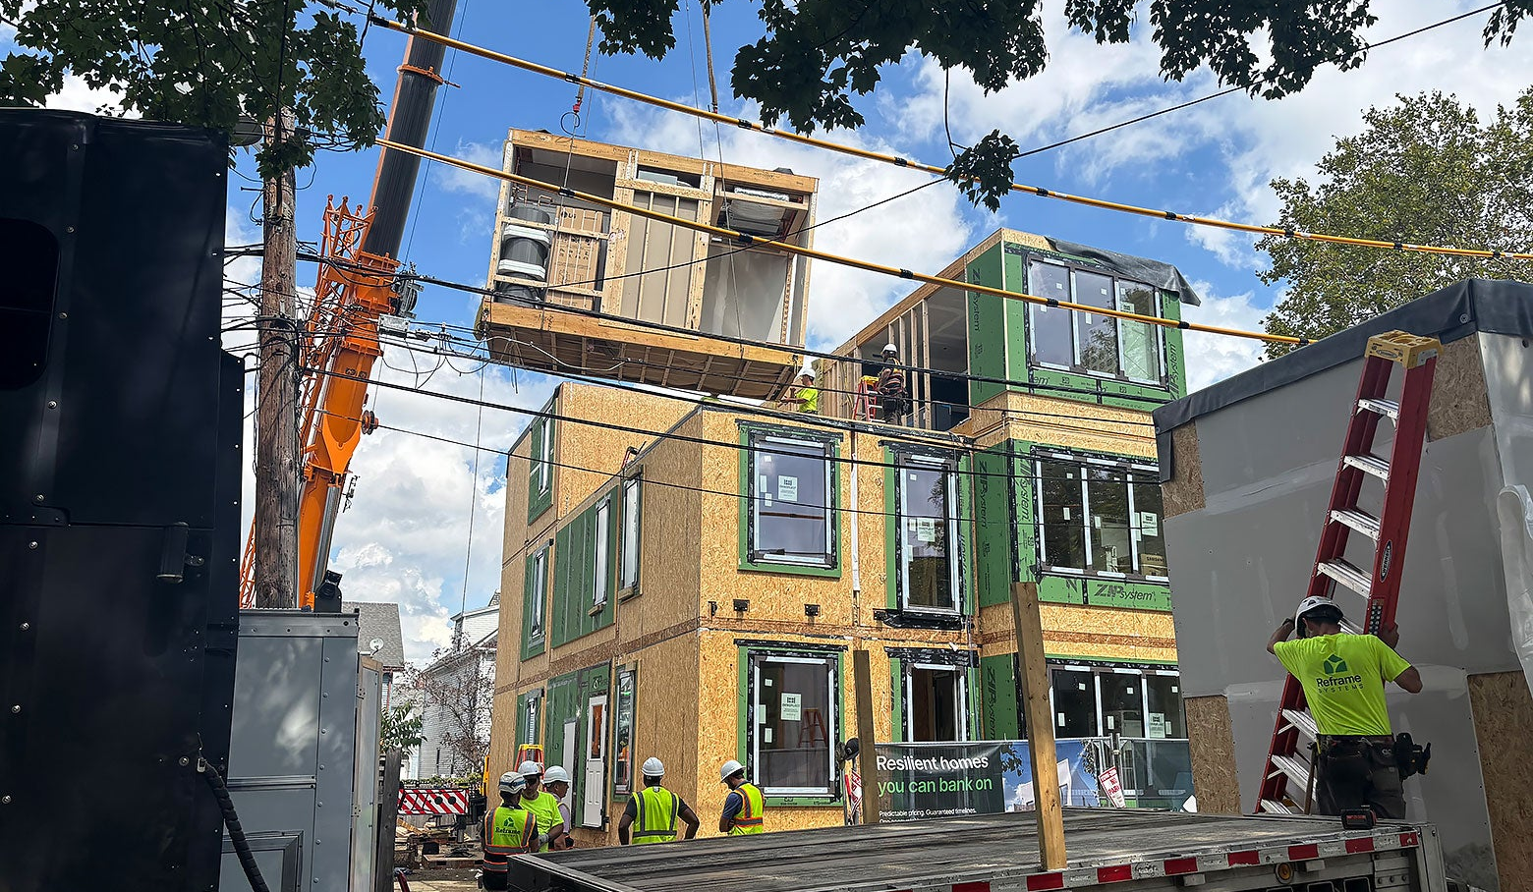
Boston

Slide 48
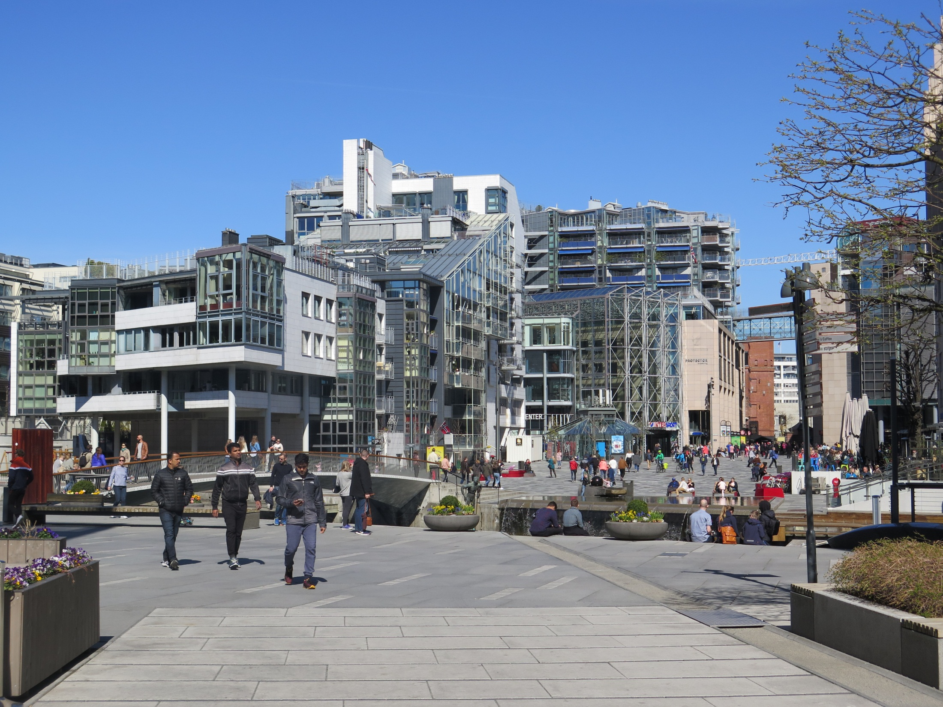
Oslo

Slide 49
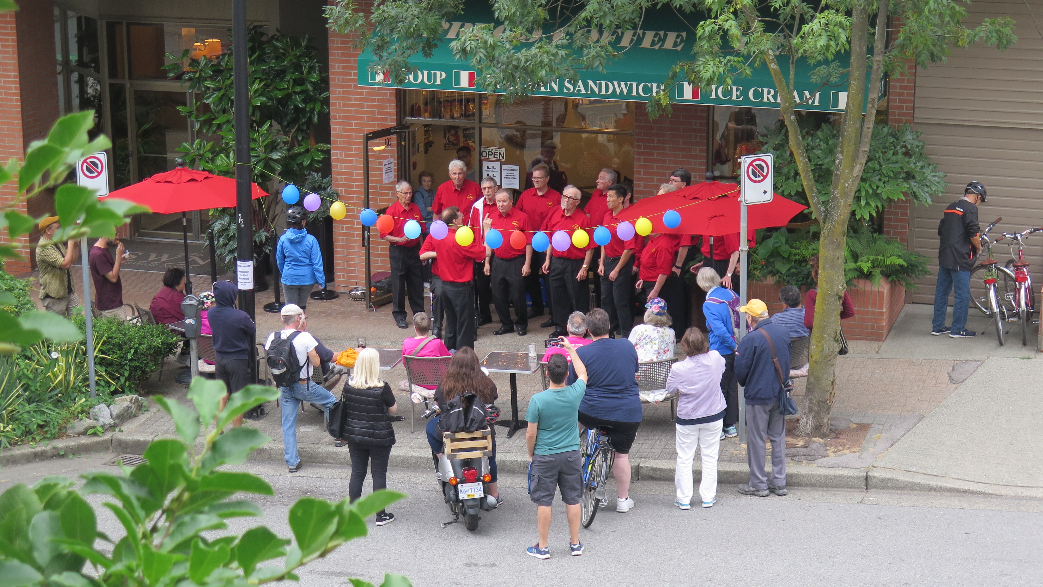
Vancouver

Slide 50
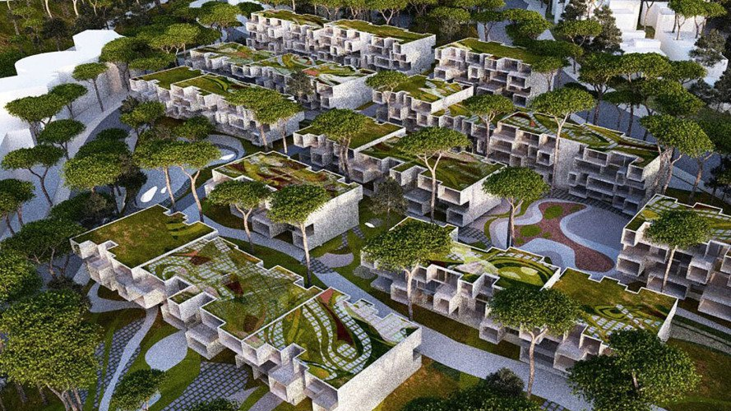

Slide 51
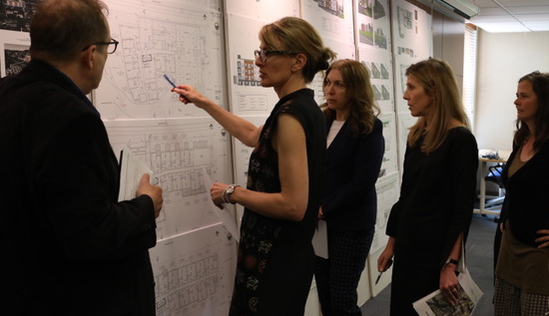
Multi-disciplinary
collaboration

Slide 52
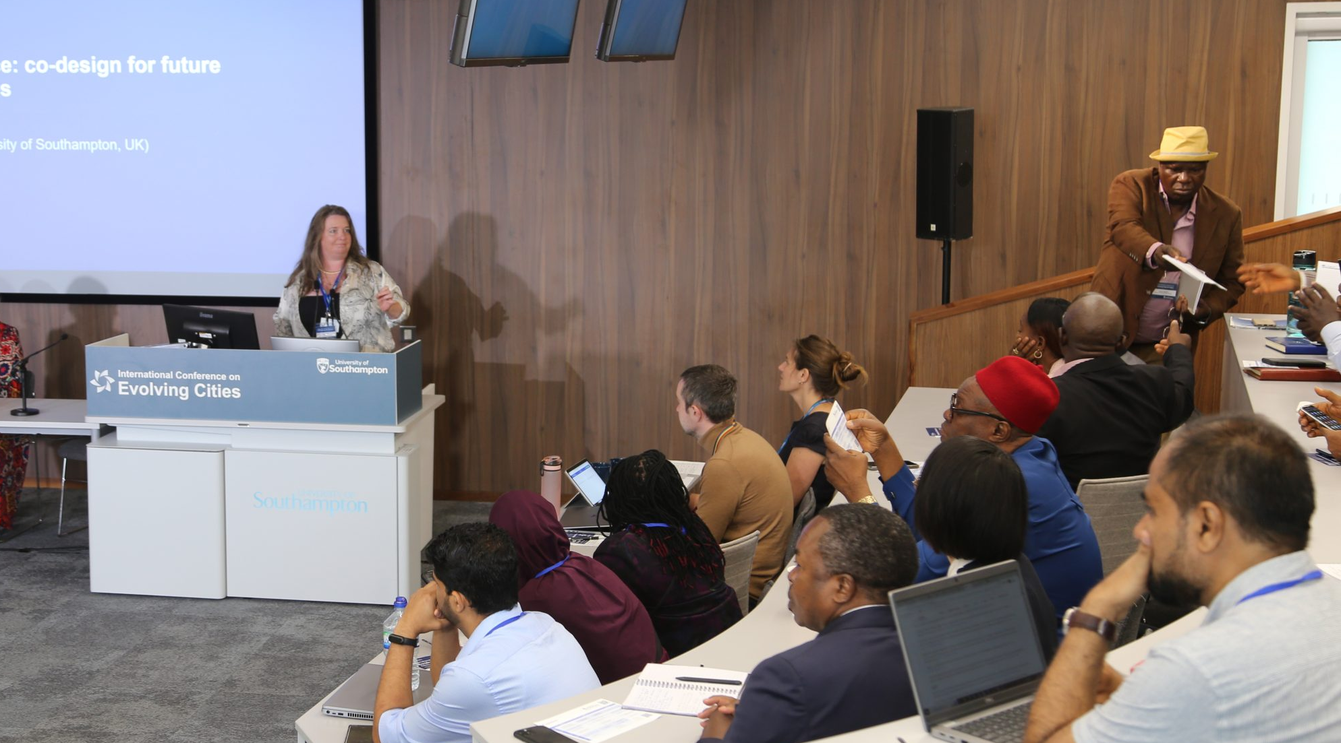
Universalization
of Innovations

Slide 53

Intelligent Public
Engagement

Slide 54


One Example:
Vancouver 2010 Olympics – Athletes Village
… a LEED Platinum community!

Slide 55

…Look Ahead
…Up the Ante

Slide 56


Slide 57

Thank you

Slide 58

Let’s have a conversation….

Slide 59
Oslo

Slide 60
Oslo

