Slide 1
From Code to Construction
Establishing a Clear Process for Wind Uplift Design in Roofing
BCBEC Conference and AGM
November 14, 2025
Jason Guldin, Principal
Sameer Hasham, Principal

Slide 2
Agenda
Introduction
The Why – Why do we care about wind loads and Codes
The Who – Who is responsible for wind load design
The How – How do designers calculate wind loads
Practical Challenges in Current Design Approach
Distinction between Architectural and Structural Components
Recommended approach to resolving gaps in practice
Notes:
Quickly going to comment on a few items to provide context, and set the stage; almost all of what I’m speaking about is related to our building codes and the requirements for designing wind loads and their attachment on roofs and claddings..….Sameer will be taking you through some real world examples / challenges….
Put our name at the bottom of every slide….

Slide 3
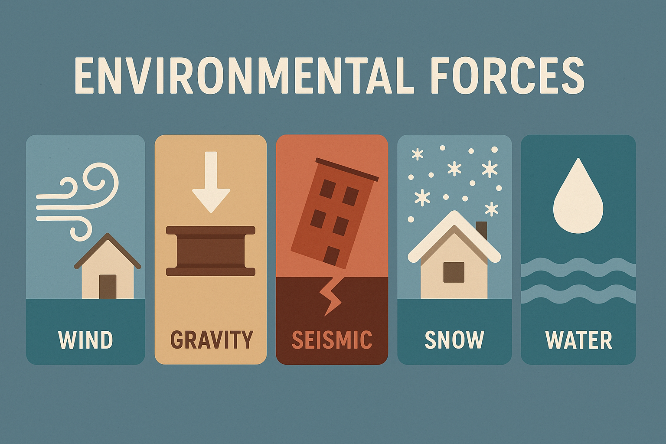
Introduction
1. We should care as much about wind loads related to enclosure components (roofs / claddings), as we do about gravity and other environmental loads.
Jason Guldin | jguldin@rjc.ca
Notes:
consider the following…..
“to provide some context, and framework to this presentation
Gravity is always present, it’s a consistent load, acting in one direction, and if we don’t design correctly…..failure!
Wind however is not always present, it’s inconsistent, acts in basically all directions… but when it does show up in the form of hurricane’s, tyfoons, etc.., it can and can be catastrophic and generate far higher loads than gravity.
“We are not here to tell you how wind pressures react on a building….other than maybe this photo and delivers substantial inward and outward pressure on buildings and their components, and the wind loads are only increasing... In the photo you can also see how stack effect, which can be exacerbated by wind can also place substantial loads on the roof system to stay put.

Slide 4
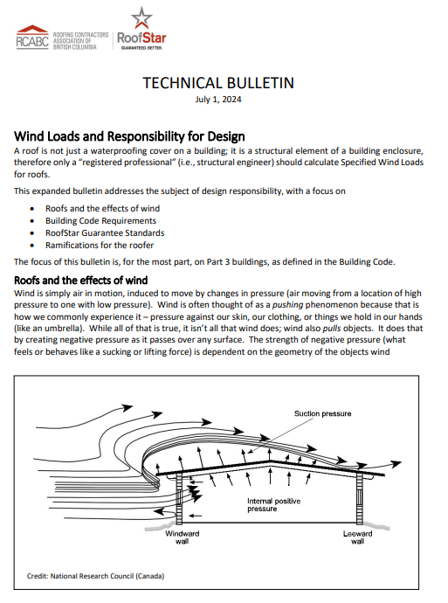
Introduction
2. From our friends at RCABC:
A roof is not just waterproofing, it is a structural component of the building enclosure and therefore, should be designed by a RP,
or be constructed in conformance with Part 9 prescriptive requirements.
(Technical Bulletin titled “wind loads and responsibility for design” dated July 1st , 2024)
Jason Guldin | jguldin@rjc.ca
Notes:
or perhaps, the overarching message for this presentation is best summed up by our friends at RCABC in an article they wrote in 2024,.

Slide 5


Introduction
3. Wind….
- Lacking the attention it deserves...
- Difficult Code interpretations...
- Has lead to confusion and finger- pointing…
4. We’re hopeful this presentation will provide a clearer path, reduce the finger- pointing.
and bring back the Teamwork !
Jason Guldin | jguldin@rjc.ca
Notes:
…COUPLED WITH SOMEWHAT…..!!!

Slide 6
The Why Why do we care about the building code and wind load requirements ?

Slide 7
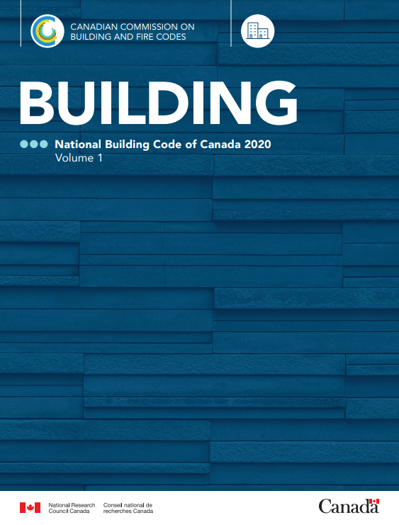
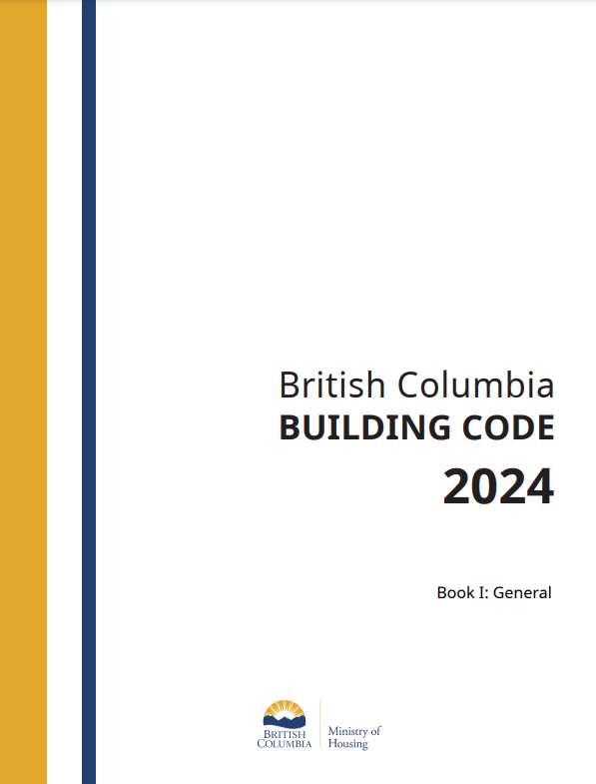
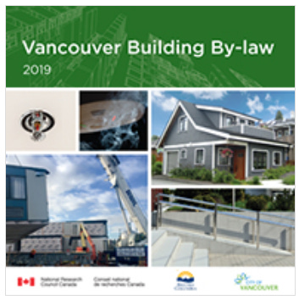
The Why | Why do we care?
Because we have to…it’s the law!
Jason Guldin | jguldin@rjc.ca
Notes:
Besides the damage wind can produce and therefore it’s importance….
Because we have to…!!! These are the building codes that govern our planning, design and construction in BC, and as designers we have no choice but to conform to them…
A few of these standards are mandatory. 2020 national building code., bcbc 2024, 2025, csa 123.21 is 2020 (not mandatory under part 9 but mandatory when working on part 3 buildings….), and csa S520 (all voluntary)
Found in part 9……CSA S520 is a great tool for climate resilience, insurance risk reduction, and community safety, but it’s not a legal requirement unless specified by a local authority.
For the purposes of this presentation we are not really getting into the VBBL but I believe it does align with the NBC and BCBC, with the only difference being they have adjusted wind pressures which appear to be generally lower and more accurately reflect the areas in Vancouver… shows up in appendix C of the VBBL…

Slide 8
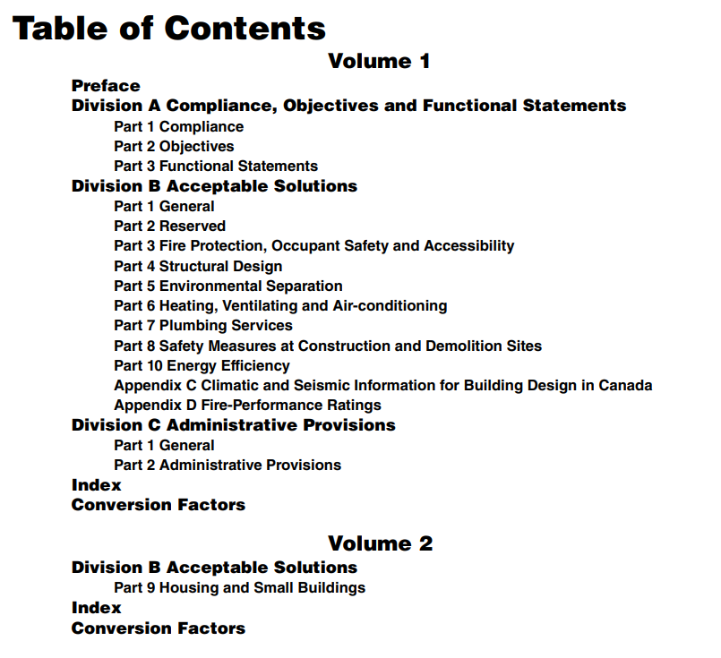
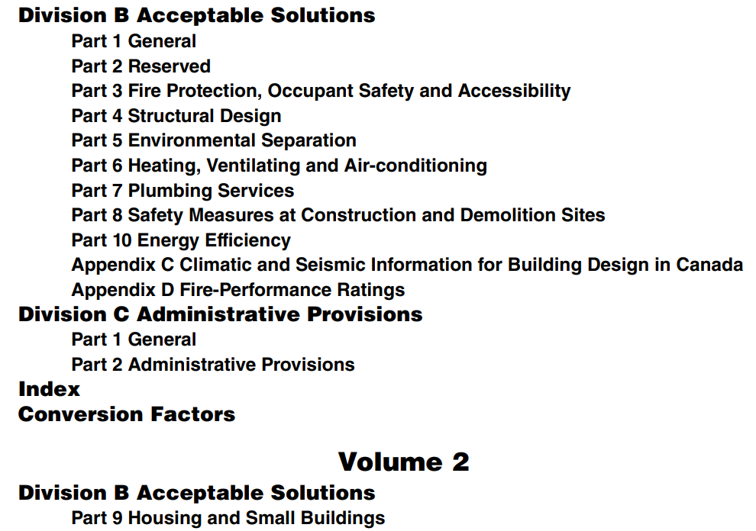
The Why | The Parts of the Building Code
Notes:
Here are the parts of the bc building code.
To later understand the significance of our discussion, we need to start with the basics…
Energy efficiency is top of mind for our new builds and meeting energy efficiency targets and step code requirements, etc.
Appendix C is a solid section that includes commentary and guidelines on climate varability, heatring degree days, snow loads, WIND LOADS, rainfall intensity values, seismic upgrades, etc…

Slide 9
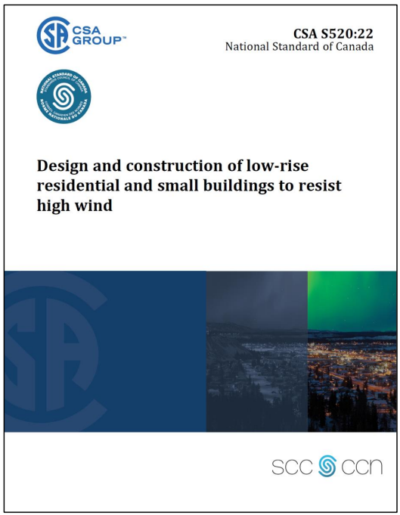
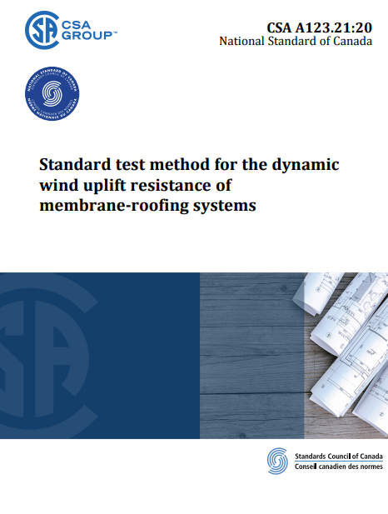
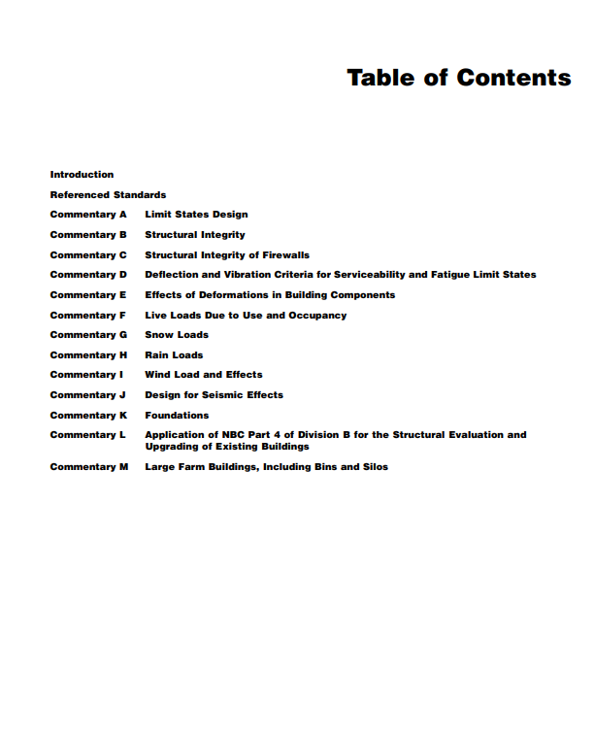

The Why | Supporting Information
Code Referenced standards and design guides for New & Existing Bldgs.
Jason Guldin | jguldin@rjc.ca
Notes:
CSA S520 is a great tool for struct tiedowns, climate resiliency, insurance risk mitigation, and safety, but it’s not a legal requirement unless specified by a local authority.
The NBC 2020 includes commentary A – M. Commentary L is handy….
IEBC is not a recognized standard in BC / Canada but provides good guidelines into designing for roof recovers and performance of enclosure systems as they relate to existing buildings.

Slide 10
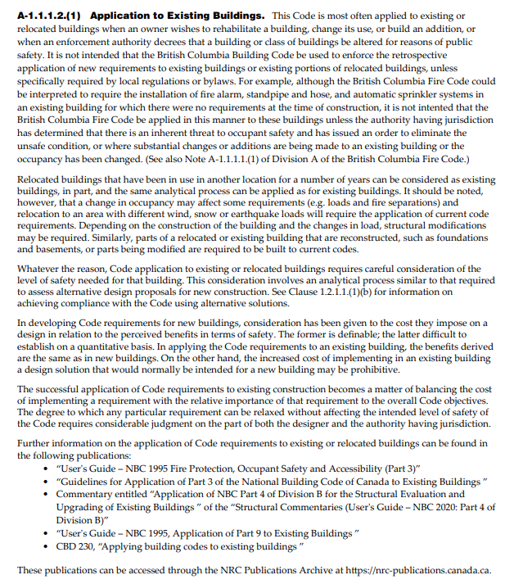
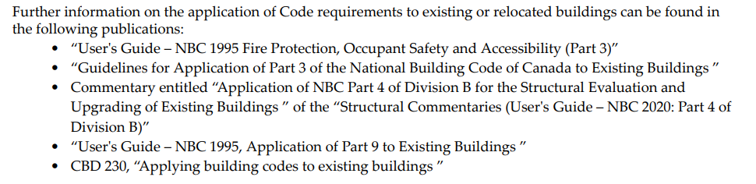
The Why | Supporting Information
Notes:
A1.1.1.2 (1). Application to existing buildings…

Slide 11
The Why | Know your Design Category / Quadrant
New Buildings
Existing Buildings – Rehab and Replacement
A
C
Part 9 – Small buildings / Residential Housing
Part 9 – Small buildings / Residential Housing
B
D
Parts 3
Larger Buildings of all types.
Parts 3
Larger Buildings of all types.
Jason Guldin | jguldin@rjc.ca
Notes:
Know your design quadrant…. Just want to show this simple graphic to illustrate a point…
As Owners, Contractors, and especially designers….we should all know what category you’re designing under when starting a project.
Because depending on what quadrant you land…the wind load design pathway / approach can be different ….. !!

Slide 12
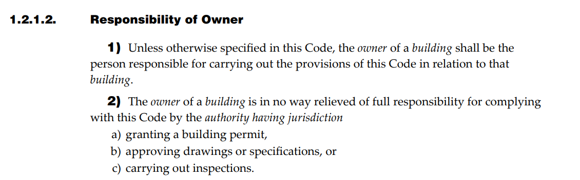
The Why | Choosing a Category / Quadrant (New Builds – Part 9 and 3)
The Designer chooses an appropriate quadrant.
2. What if the designer isn’t confirmed …. Defaults to the Owner.
Jason Guldin | jguldin@rjc.ca
Notes:
Add that worksafe also views this responsibility on a similar way….. If the GC isn’t identified and responsible for safety…..its the Owner. That is a lot of liability.
I ask if the building code applies because there are some cases where the new building is either too remote and not under an AHJ purview; and the code doesn’t apply to many indigenous lands unless adopted by the band council; and can also be combined with community specific bylaws and rules.
3….which part of the code…..9 is prescriptive and 3/4/5 is performance based….
Ask the ryan king question about him designing part 9 house plans, and then not doing field reviews…. His regulatory body doesn’t require it…..and this is what the AHJ does under part 9.
Under 1.2.1.2 – responsibility of owner…..
Responsibility of Owner 1) Unless otherwise specified in this Code, the owner of a building shall be the person responsible for carrying out the provisions of this Code in relation to that building. 2) The owner of a building is in no way relieved of full responsibility for complying with this Code by the authority having jurisdiction a) granting a building permit, b) approving drawings or specifications, or c) carrying out inspections.

Slide 13
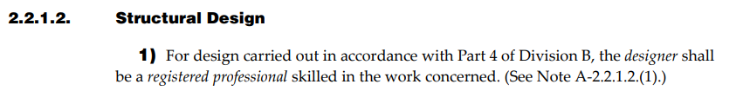
The Why | Choosing a Category / Quadrant (New Builds – Part 9 and 3)
4. For larger complex new buildings (Part 3), the code is clear; design must be a Registered Professional. See code sections:
2.2.7.1 (part 3 - Fire Protection Occupant Safety, and accessibility)
2.2.7.2 (part 3 - Fire Protection Occupant Safety, and accessibility)
2.2.1.2 (Part 4 - Structural)
2.2.5.1 (Part 5 – Environmental Separation).
Jason Guldin | jguldin@rjc.ca
Notes:
If you don’t need a permit, does this mean you can do anything you want? The building code applies to all work under its jurisdiction / perview, regardless of AHJ involvement…. It’s the min legal standard for safety and performance for construction in our province.
The challenge is : no building code police……so hard to enforce, unless work is reported and the claim reviewed.
THIS SLIDE IS MEANT TO REPLACE THE NEXT 3!!!!!
(often a Part 9 building becomes too complicated and exceed prescriptive limits, or has seen too many repeated issues…so AHJ mandates professional oversight.)
Ya ya that’s all well and good but what about wind loads.
Green highlight comments . Also emphasize exceeding the prescriptive limits of part 9….you would be directed to part 4….
Green highlight comments…. If you don’t need a permit, does this mean you can do anything you want? No…..one must follow the requirements of the building code even if no AHJ / permit required.

Slide 14
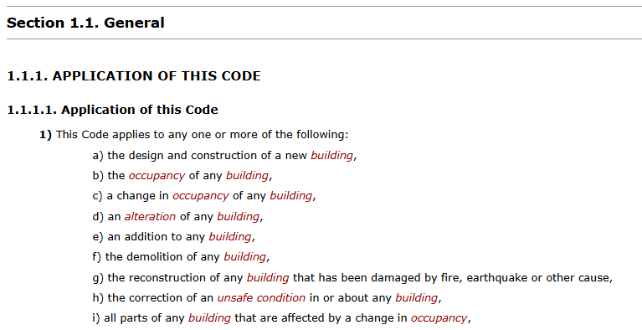
The Why | Choosing a Category / Quadrant (Existing Building Upgrades – Parts 9 and 3)
Does the building code apply to existing buildings?
Jason Guldin | jguldin@rjc.ca
Notes:
Not as straightforward but ok…..we start first with this question…..
Right at the beginning of the entire code under Div A Part 1…it says the above.
Ask the ryan king question about him designing part 9 house plans, and then not doing field reviews…. His regulatory body doesn’t require it…..and this is what the AHJ does under part 9.
Under 1.2.1.2 – responsibility of owner…..
Responsibility of Owner 1) Unless otherwise specified in this Code, the owner of a building shall be the person responsible for carrying out the provisions of this Code in relation to that building. 2) The owner of a building is in no way relieved of full responsibility for complying with this Code by the authority having jurisdiction a) granting a building permit, b) approving drawings or specifications, or c) carrying out inspections.

Slide 15
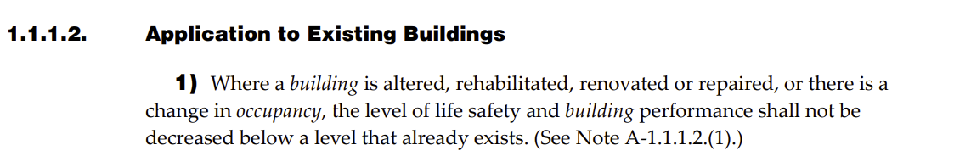
The Why | Choosing a Category (Existing Building Upgrades – Parts 9 and 3)
This clause is saying 2 things:
.1 Don’t make the existing performance worse.
.2 Don’t make the existing level of safety worse.
Jason Guldin | jguldin@rjc.ca
Notes:
It says 2 things:
When an existing building is altered / rehabbed in any way…, OR if there is a change in occupancy.
The owner / design authority must consider 2 things: life safety and building performance; and neither shall drop below a level that already exists.
Confirming whether or not it was wrong to begin with is part of the analysis…. Sometimes doesn’t matter if the roof hasn’t blown away yet in light of confirmation that the whole system was never designed properly in the first place, or a field proof test fails…..
wind loads, this principle does not override the requirement to meet Part 4 standards. Wind uplift can cause catastrophic failure, and the BCBC treats it as a non-negotiable structural load.

Slide 16

The Why | Choosing a Category (Existing Building Upgrades – Parts 9 and 3)
So, to be in compliance with the code regarding alterations to existing buildings …… designers must perform the following:
THE “DON’T MAKE IT WORSE ANALYSIS”
Jason Guldin | jguldin@rjc.ca
Notes:
For the rest of this presentation, we are COINING the phase “don’t make it worse” analysis…
You can see that perhaps the “don’t make it worse” analysis becomes somewhat complicated…. Should wind loads be considered safety
A few things to look at.
Why deviate from standard part 9 wind load requirements or greater... Part 9 afterall is bare min code requirements.
Buying liability.
Insurability issues unless you hide what was done.
AHJ may require permit and then requirements to meet part 9.
You’re not considering future climate wind impacts.
Warranty issues with shingles / roofing. Manufacturer may require certain minimum installation standards, etc..
When in doubt just contractually build it in. …then the direction is clear; if not in contract, the issue is left up to interpretation…

Slide 17
The Why | How to perform the “Don’t make it worse analysis”
1. Applies to both Part 9 and Part 3 existing building upgrades.
2. Consider the two design elements; performance and safety.
3. Does wind load design fall under the safety umbrella?
4. The code provides some guidance on remaining reasonable and practical. Use professional judgement and consider alternative solutions.
5. In my opinion, you’re also considering importance level of the building and its contents, consequence of a leak, liability, Client, etc.
6. Design for future climate resiliency? (elevate design)
7. If not operating within an obvious part of the code, demonstrate why and confirm no warranty, or insurance concerns.
8. Strike a reasonable balance btwn perf, cost, Client, etc…and demonstrate why you arrived at that design decision.
Jason Guldin | jguldin@rjc.ca
Notes:
For the insurance comment….. Give the example of a part 9 building but it requires a FM global and 1-90 standard ……this basically moves you into part 4 of the code.
this should kind of be in the how section but we’re going to do it quickly here….
Wind is associated with safety….
When you come across a existing part 4 building, and you look at the roof and say….I’m gonna keep things reasonable and only design to part 9….. I’ve confirmed part 9 does not make things worse…… is this ok.?
I think the answer is: if you can confirm that the roof was so poor that even upgrading it to part 9 doesn’t make it worse….. it still shouldn’t be done. Never was to code in the first place…. There is some argument that the don’t make it worse principle for wind loads, does not override the requirement to meet either part 9 or Part 4 standards.
Confirming whether or not it was wrong to begin with is part of the analysis…. Sometimes doesn’t matter if the roof hasn’t blown away yet in light of the whole system never being designed properly in the first place, or a field proof test fails….. Now what. Test failed, but roof never blew away yet.
wind loads, this principle does not override the requirement to meet Part 4 standards. Wind uplift can cause catastrophic failure, and the BCBC treats it as a non-negotiable structural load.

Slide 18
The Who Who is responsible to complete Wind load design ?

Slide 19
The Who | Wind load design for New Builds (Parts 9 & 3)
Part 9:
Basically anyone can design their own home. (follow part 9)
If builder / developer; need to have a residential builders license.
Follow wind load tables (1/50) under Part 9 for particular City.
2. Part 3:
Performance based. Design needs to be performed and specified.
Registered Professional for majority.
For wind loads, follow design requirements of Part 4 Struct. Examples.
Jason Guldin | jguldin@rjc.ca
Notes:
Relatively easy.
For part 9 Use the wind Load Threshold
If the 1-in-50-year hourly wind pressure (HWP) exceeds 0.8 kPa, the building falls outside the prescriptive scope of Part 9 and must be designed under Part 4 by a registered professional. [www2.gov.bc.ca]
Right off the hop you have guidance from the AHJ because these need permits.
Also if building for a sale, you’ll need new home warramty, etc,…

Slide 20
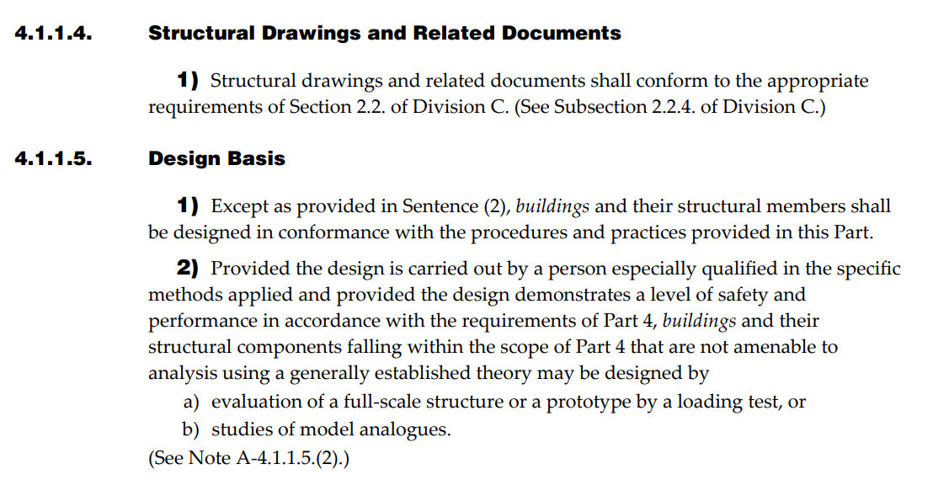
The Who | Wind load design for New Builds (Part 3/4)
Jason Guldin | jguldin@rjc.ca
Notes:
With respect to wind load design….. The code directs you to part 3,….
Lots of preamble and division A (compliance, objectives, and functional statements, etc…)
But it also says this in part 4.

Slide 21
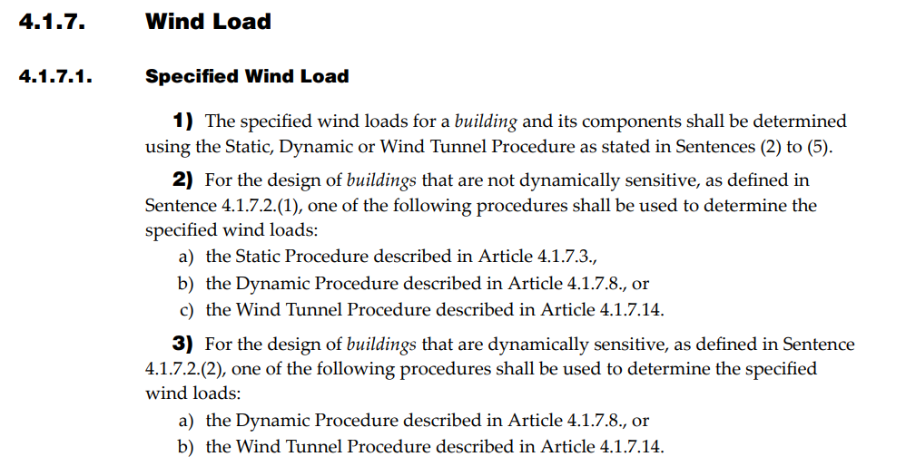
The Who | Wind load design for New Builds (Part 3/4)
Jason Guldin | jguldin@rjc.ca
Notes:
Next up we have:

Slide 22
The Who | Wind load design for Existing Building upgrades (Part 9 & 3)
Who’s the designer? Part 9 = Owner or delegate.
Part 3 = Registered Professionals.
Perform the “don’t make it worse analysis” (for all design elements)
Who can perform this analysis for part 9 upgrades and reno’s?
What about Part 3/4 upgrades and reno’s ?
Confirmed through a combination of requirements:
2.2.7, 4.1.1.5.(2), Clause 1.2.1.1.(1)(b) of Division A.
BC Building Code 2024 and the Guide to the Letters of Assurance - Section 16: Application of Letters of Assurance to Requirements for Existing Buildings.
Jason Guldin | jguldin@rjc.ca
Notes:
The fact that work is being carried out on an existing building does not exempt the project from compliance with Part 3….which requires a designer…..
although the building code is for new builds....it appears as though existing buildings and their renovations under part 4, are not exempt from a registered professional involvement to perform the don't make it worse analysis.
Copilot said:
Copilot
You're absolutely right in your interpretation.
According to the BC Building Code 2024 and the Guide to the Letters of Assurance, existing buildings undergoing renovations under Part 4 (Structural Design) are not exempt from the requirement for registered professional involvement when structural changes are made.
Section 16: Application of Letters of Assurance to Requirements for Existing Buildings
In regards to who can perform this analysis…..IF YOU ARE WORKING ON A PART 4 BUILDING IN ANY RESPECTS…. REGISTERED PROFESSIONALS SHOULD BE INVOLVED. Code isn’t perfectly explicit but the analysis involves a few things: review of safety regarding part 3 buildings, consideration of alternative solutions, performance based so has to be designed. …. That requires a reg pro
There is some argument that the don’t make it worse principle for wind loads, should not apply / or be considered when faced with a very poorly installed roof system’s attachment that was never designed to code in the first place. Just go to part 9 or ¾.
does not override the requirement to meet either part 9 or Part 4 standards.
In regards to the green highlight….. There is some analysis that says wind loads are now so significant that they are considered a safety issue if not brought up to code…..and if this is true, you would have to bring up to part 4 of the code. Hard stop.

Slide 23
The How How to complete Code Compliant Wind Load Design

Slide 24
The How | How to Perform Wind load design
Critical to understand there are 2 steps to designing / specifying wind loads for roofs and cladding systems:
Step 1 - Determine the wind load requirements for the specific site, exposure, building geometry, importance, etc.
Step 2 - Design the attachment of the system to resist the wind load requirements determined in Step 1.
The code provides a pathway for both.
>>> Looking at Part 3 - New Building - Roof >>>
Jason Guldin | jguldin@rjc.ca
Notes:
No. 1 cannot be a generic number or the same value you used on the last job that is “basically the same project”….!!!
When you complete No. 1…..you will have the wind loads your cladding and roof systems must resist…..
The second part is designing the attachment to resist the loads….

Slide 25
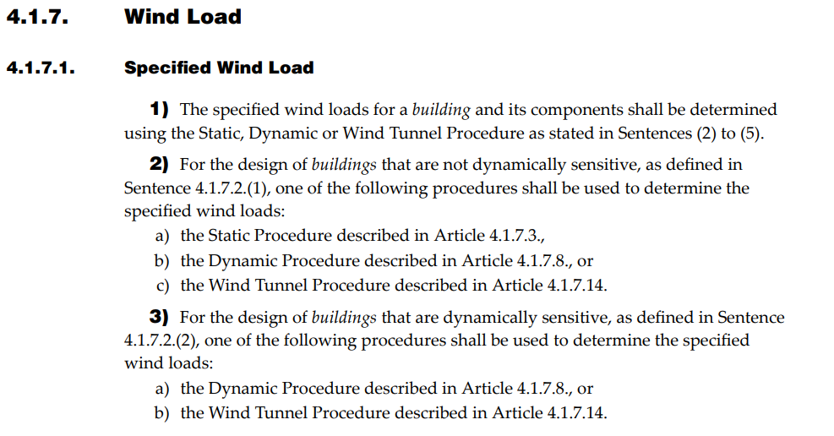
The How | Step 1: Part 4 - Wind load design
Jason Guldin | jguldin@rjc.ca
Notes:
Don’t explain these in this slide……go into detail on the next one….
Part 4 of the BC Building Code (BCBC) does provide three primary methods for calculating wind loads on buildings and structures. These methods are based on the National Building Code of Canada (NBCC) framework, which the BCBC adopts with some provincial modifications. The three methods typically include:
Static (Simplified) Method
Suitable for regular-shaped buildings under certain height and exposure conditions.
Uses predefined wind pressure coefficients and climatic data from Appendix C.
Dynamic (Analytical) Method
Required for tall, flexible, or irregularly shaped buildings.
Involves more complex calculations, including dynamic response to wind.
Wind Tunnel Testing
Used for unique or complex structures where standard methods are insufficient.
Provides site-specific wind load data based on physical or computational modeling.

Slide 26
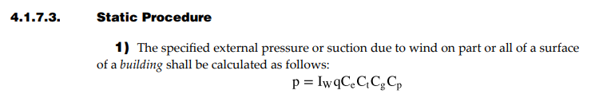

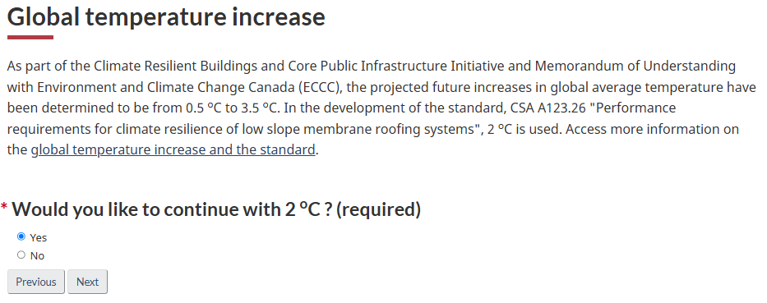
The How | Step 1: Part 4 - Wind load design
Jason Guldin | jguldin@rjc.ca
Notes:
Static is uneventful….ordinary.
Part 4 of the BC Building Code (BCBC) does provide three primary methods for calculating wind loads on buildings and structures. These methods are based on the National Building Code of Canada (NBCC) framework, which the BCBC adopts with some provincial modifications. The three methods typically include:
Static (Simplified) Method
Suitable for regular-shaped buildings under certain height and exposure conditions.
Uses predefined wind pressure coefficients and climatic data from Appendix C.
Dynamic (Analytical) Method
Required for tall, flexible, or irregularly shaped buildings.
Involves more complex calculations, including dynamic response to wind.
Wind Tunnel Testing
Used for unique or complex structures where standard methods are insufficient.
Provides site-specific wind load data based on physical or computational modeling.

Slide 27
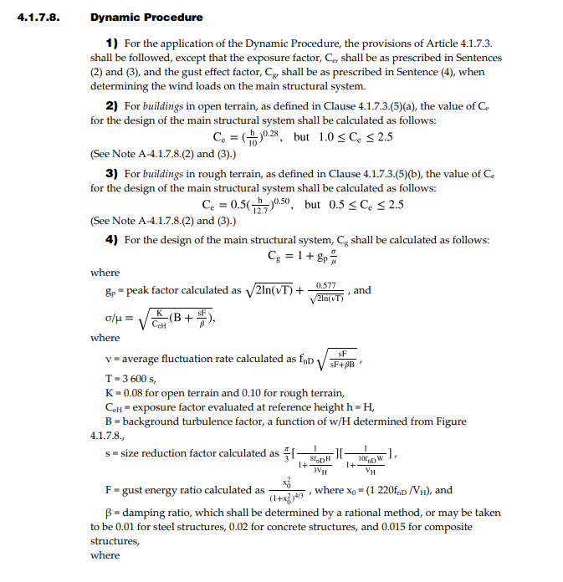
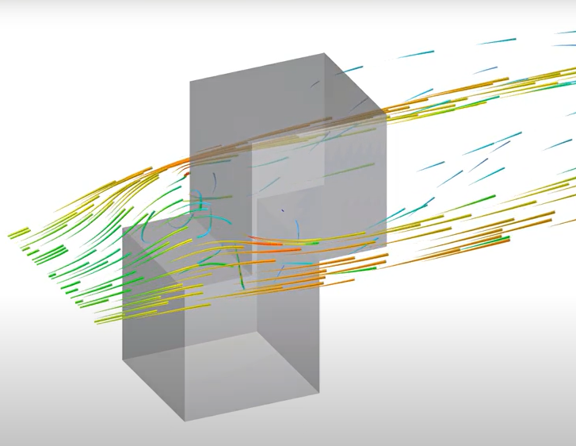
The How | Step 1: Part 4 - Wind load design
Jason Guldin | jguldin@rjc.ca
Notes:
Dynamic (Analytical) Method
Required for tall, flexible, or irregularly shaped buildings.
Involves more complex calculations, including dynamic response to wind.
Static is uneventful….ordinary.
Part 4 of the BC Building Code (BCBC) does provide three primary methods for calculating wind loads on buildings and structures. These methods are based on the National Building Code of Canada (NBCC) framework, which the BCBC adopts with some provincial modifications. The three methods typically include:
Static (Simplified) Method
Suitable for regular-shaped buildings under certain height and exposure conditions.
Uses predefined wind pressure coefficients and climatic data from Appendix C.
Wind Tunnel Testing
Used for unique or complex structures where standard methods are insufficient.
Provides site-specific wind load data based on physical or computational modeling.

Slide 28
The How | Step 2: Part 4/5 Design the Attachment
.1 Part 5 – 5.2. Loads and Procedures.
.2 Part 4 - Structural.
.3 RCABC has several articles on this.
Section 5.2.2 says that the structural attachment of the roof component / assembly can Also be confirmed in 3 ways …
Jason Guldin | jguldin@rjc.ca
Notes:
So now that you have your wind loads…..you design the attachment to resist….

Slide 29
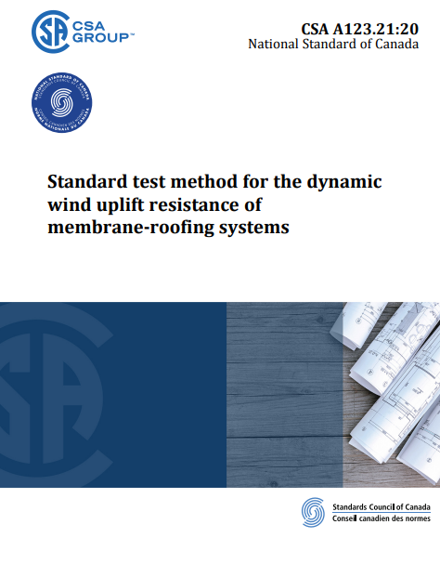
The How | Step 2: Part 4/5 Design the Attachment
1. CSA A123.21
Test method for membrane roofing systems.
Part 5, Section 5.2.2.2, 5.2.2.2.(4), and Note A- 5.2.2.2(4).
Jason Guldin | jguldin@rjc.ca
Notes:
If you have a wind load of 75 PSF for the site and you can find a test report that is in conformance with CSA 123.21…..and the assembly tested is what you need……you can rely on the standard. BUT…..we feel it’s not enough in most cases…..Sameer will tell you why.

Slide 30
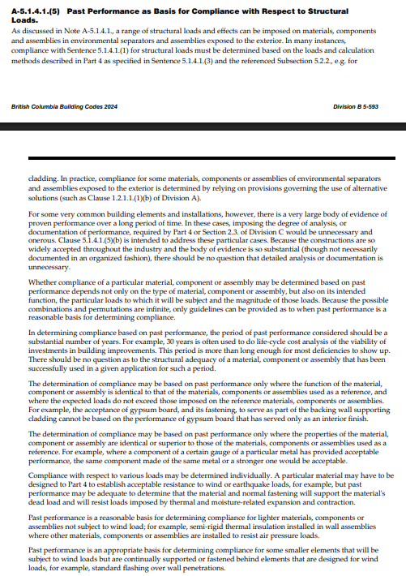
The How | Step 2: Part 4/5 Design the Attachment
2. Proven Past Performance
- See sections 5.2.2.2.(5) and commentary A-5.1.4.1(5)
- Does discuss 30-year timeframe.
Jason Guldin | jguldin@rjc.ca
Notes:
In order for a the registered professional to use the ‘Proven Past Performance’ method to confirm attachment, the reference roof system / building must qualify by having an approximate age of 30 years.”
The powers that be that wrote this section of the code believed that the 30 year timeframe provides enough time for a structural related defect or deficiency to reveal itself show up in the form of a failure …. Any dormant failures to show up…. If it hasn’t shown up in 25 / 30 years…. The system has proven past performance…

Slide 31
The How | Step 2: Part 4/5 Design the Attachment
3. Custom Engineered solution
Section 5.2.2.3.
- Code does not provide a perfectly clear indication of this option but it’s implied through a combination of clauses.
- 2.2.1.2, 5.1.4.1 (struct and enviro loads), 5.2.2 (design procedures), 5.2.2.1, 5.2.2.2, 5.2.2.3, Part 4, etc…
As the designer of the roof system attachment, if you can’t rely on the test data, or proven past performance analysis…
compliance must be demonstrated via Part 4.
Custom engineered solution, prepared by Registered Professional (structural), shown on plans, and sealed, FR’s.
Jason Guldin | jguldin@rjc.ca
Notes:
Explicit….!!
Summary
If CSA A123.21 testing or proven past performance is not available, then Part 5 defers to Part 4, requiring a custom engineered design using wind load calculations.
This design must be prepared by a Registered Professional, typically a structural engineer.
Also keep in mind that in your analysis, you may find that you want to mock up a roof assembly and test it….can help in analysis and custom engineered solution…

Slide 32
A Possible Misunderstanding…
Step 1 – Determine the Project Specific Wind Loads
Part 4 – Struct.
One of the 3 options for design allows Wind Tunnel Testing and Analysis.
Step 2 – Design the attachment of the roof system.
Part 5
One of the 3 options is CSA A123.21 - code mandated wind uplift testing
Jason Guldin | jguldin@rjc.ca
Notes:
Note the emphasis on the font color change….
So we have two things that are both basically titled “wind testing” …and they are completely different things,,. As a designer….don’t conflate the two….
I feel these two items were being conflated and causing confusion in the industry. I’ve experienced issues where the CSA test report for a membrane system was submitted and intended to act as the wind load design under step 1…... It is not….it is a tool that a designer can use to verify that the attachment of the roof system meets or beats wind loads calculated in step 1.
I have a feeling some of us in the industry were submitted CSA test reports and believing they perhaps acted as the structural design under part 4….and perhaps that the same this test report acted as confirmation of step 2….. And the manufacturer or the contractor is responsible for all of this design forevermore….
THEY ARE COMPLETELY DIFFERENT STEPS IN THE DESIGN PROCESS…
The csa standard is a tool that a designer can use to verify that the attachment of the roof system can meet the wind load requirements for the site….

Slide 33
Over to Sameer

Slide 34
Putting Code into Practice Extending Established Design Procedures to Roofing Practices
Notes:
Great! Thanks Jay. So far we’ve done a deep dive into the code and identified specific clauses within the code which outline the design requirements for wind load, particularly as it relates to roofing practice. However, what the code does not do is tell us how to delegate these design responsibilities in day-to-day practice.
I will now walk you through a real case that we experienced recently, which I believe is reflective of what many of us are currently facing, and offer you our recommendation on how we believe our current procedures in façade design can be extended to roofing practices.

Slide 35
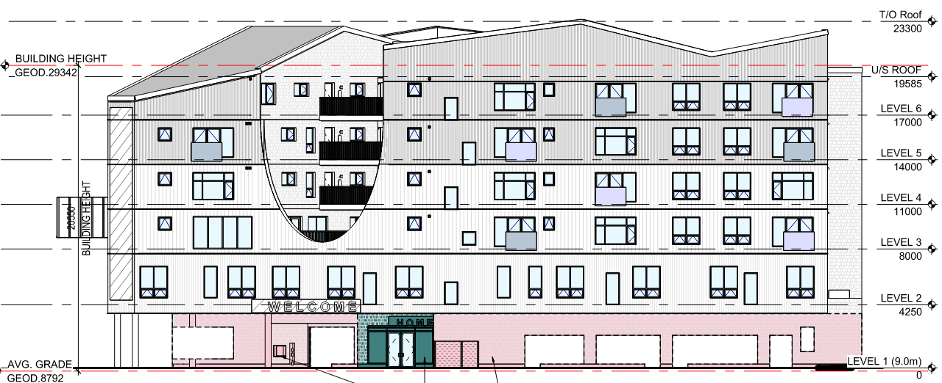
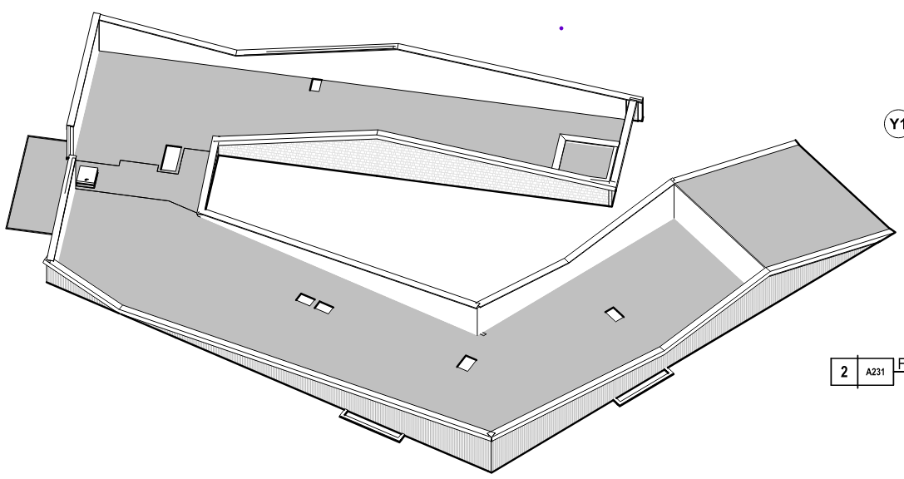
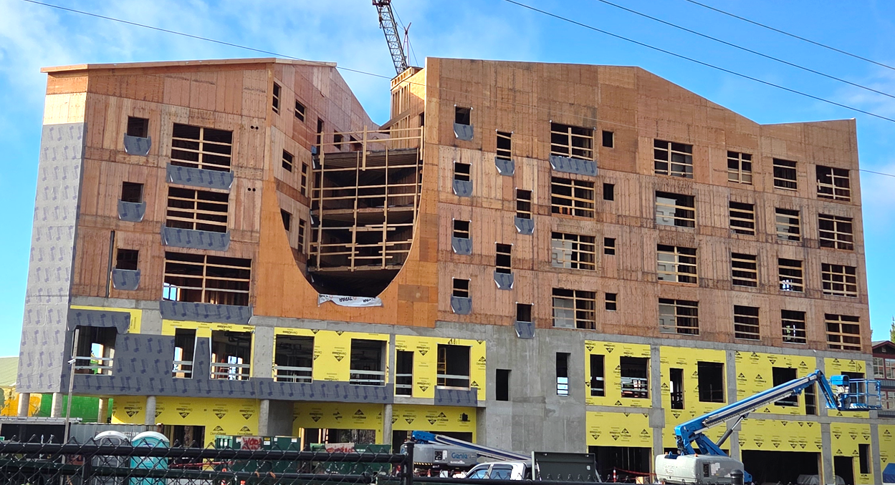
Practical Challenges
Images Courtesy of Jesse Garlic Architecture
6-storey building in Sechelt, BC
Currently in construction
The roof has complex profiles and shapes
Wind load design and responsibility – stuck in a loop
Sameer Hasham | shasham@rjc.ca
Notes:
Here is an actual project that’s currently in construction stage – RJC is involved as the Enclosure Consultant for a new build in Sechelt, BC. As you can see from the images, we’re dealing with complex roofing profiles and configurations.
When discussion about roof uplift came up during construction, we found ourselves stuck in a responsibility loop.

Slide 36
Who’s Doing the Roof Design?
Envelope Engineer
Reviewed roofing submittals
Requested Wind Load compliance
Informs this is not within their scope of work
Suggests the Architect or Envelope Engineer reviews this as part of the bldg. envelope
Structural Engineer
Architect
Sends back the roof submittal package
Requests the Contractor to resubmit with wind load compliance documentation
Contractor
Submits CSA A123.21 test report
States wind load calculations should be verified by the Structural Engineer
Sameer Hasham | shasham@rjc.ca
Notes:
As the envelope engineer, we requested for submittals for wind uplift compliance as part of the roofing submittal package.
The architect requested this from the Contractor who then submitted their manufacturer’s roof test report – the CSA123.21 report – with the caveat: Wind Uplift values for the building should be verified / provided by the Structural Engineer
The Structural engineer then turns around as says this is not in our scope – its is part of the building envelope and should be provided by the Architect or Envelope Consultant.
So where do we go next from here?

Slide 37
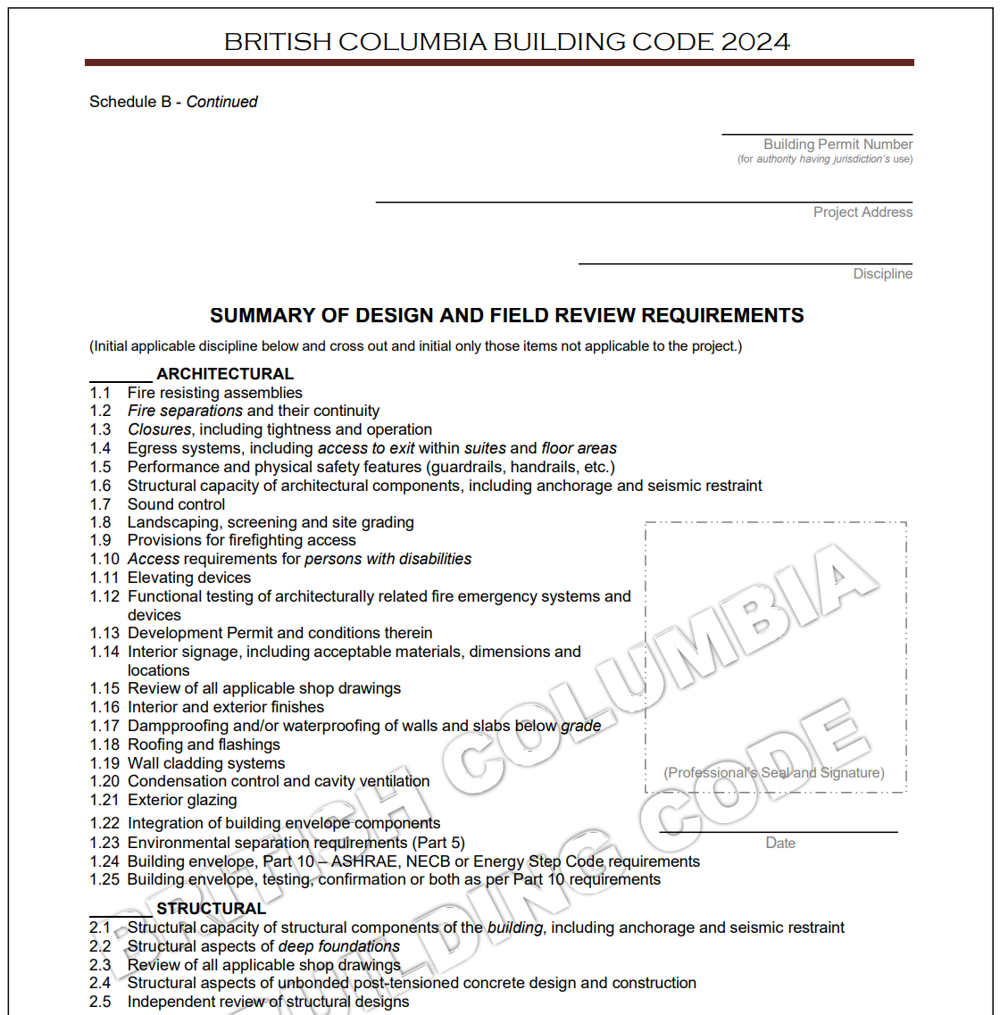



Letters of Assurance
ARCHITECTURAL Components require structural attachment
“1.6: Structural capacity of architectural components, including anchorage and seismic restraint”
Addresses roofing & flashings (but also Wall Cladding Systems and Exterior Glazing
“1.18: Roofing and flashings”
STRUCTURAL Components require structural attachment
“2.1: Structural capacity of structural components of the building, including anchorage and seismic restraint”
Sameer Hasham | shasham@rjc.ca
Notes:
So where do we go from here?
To answer this, we need to drill further into the roles and responsibilities. Specifically, how roles and responsibility are divided in practice.
Let’s look at Schedule B….This the BCBC 2024 version – it is very similar to the Vancouver Building bylaw. Here I want to highlight three key items:
The first is item 1.6: Structural capacity of architectural components, including anchorage and seismic restraint
The second is item 1.18: Roofing and flashings
And lastly, take a look at the Structural Section where Item 2.1 is referring to structural components of the building…with the word “building” italicized. So there is a distinction between Architectural Components vs. building structural components
So what does this mean?

Slide 38
Key Questions to Consider
What are Architectural Components and how do we distinguish them from the Structural Components?
Why does the structural attachment of Architectural Components not fall under the Structural Engineer’s scope of work?
How can we ensure Architectural Components—specifically the roof—receives the attention it requires?
Sameer Hasham | shasham@rjc.ca
Notes:
Let’s consider 3 questions….
Let’s drill into this further. Here are a few questions to consider to really understand where we go from here.

Slide 39
What are Architectural Components and how do we distinguish them from the Structural Components?

Slide 40
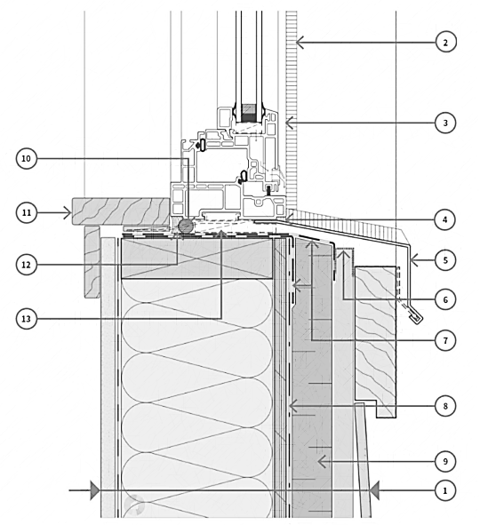
Components: Wall Cladding and Glazing
Architectural Components
Windows (and Doors)
Cladding
Window and Wall Flashings
Strapping / Thermal Clips / Sub-framing
Insulation
Fasteners – screws / nails / insulation pins
Membranes
Image Courtesy of BC Housing Wood Frame Design Guide
Primary Structure: Exterior wall sheathing
Primary Structure: Wall framing
Sameer Hasham | shasham@rjc.ca
Notes:
Here is a detail of a window as it interfaces with the wall.
The primary structure in this case, would be stud wall framing and stops at the exterior wall sheathing. These form the bones of the building.
In this case then, all the components to the right of this yellow line is considered part of the architectural components

Slide 41
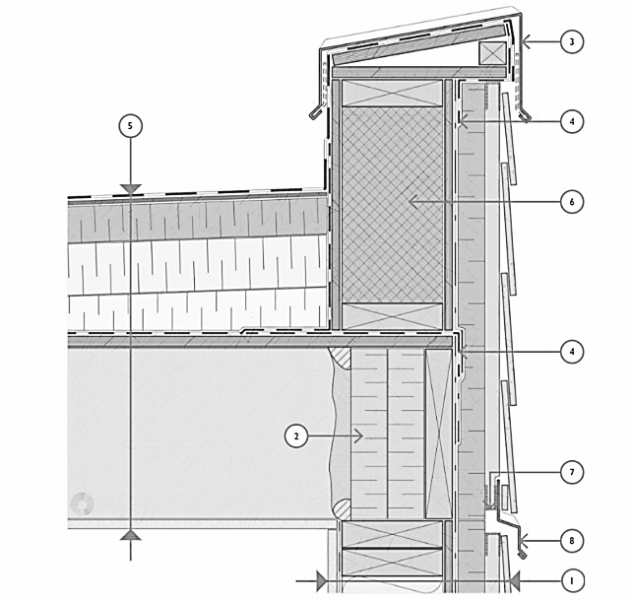
Components: Roofing
What are the roof components?
Parapet blocking
Cap flashings
Membrane base and cap sheet
Insulation & cover boards
Fasteners & adhesives
Anything else attached to the roof e.g. mechanical curbs, solar panels, planters,…
Image Courtesy of BC Housing Wood Frame Design Guide
Primary Structure:
Wall and roof framing
Primary Structure: Roof sheathing
Sameer Hasham | shasham@rjc.ca
Notes:
Similarly, let’s determine what are the architectural components in the roof.
Here is a typical roof parapet detail. In this case, the primary structure again is the structural framing of the roof and parapet wall, and it would stop at the roof sheathing.
So then, all the components to the left of the green line is considered part of the roof architectural components
So we have distinguished a difference between the main building structural components and architectural components.

Slide 42
Why does the structural attachment of Architectural Components not fall under the Structural Engineer’s scope of work?
Notes:
Let’s look now attempt to answer at the second question.

Slide 43
Structural Analysis
Division B, Part 4: “Structural Design” divides wind loads into two broad categories:
Main Structural System: The primary structure that resists overall wind loads and transfers them to the foundation. Frames, shear walls, diaphragms, etc.
Average building wind pressures
Secondary Building Elements: Components and Cladding that must resist localized wind pressures and transfer them to the base building. Windows, doors, cladding, and Roofing.
Localized wind pressures
Sameer Hasham | shasham@rjc.ca
Notes:
The code divides structural analysis into two categories:
First is looking at the main structural system with the intent of how the overall wind loads imposed onto the building is transferred to the foundation. We are talking about the framing, shear walls, diaphragm sheathing, etc.
The second category is specific to secondary building elements. The intent here is looking at how wind loads imposed on components and cladding is transferred to the base building. So these are thing like windows, doors, cladding, roofing etc.
It important to understand and distinguish between these categories. And the reason why is that components and cladding need to be examined in more detail because they face potentially higher localize wind pressures, particularly at concerns and edges. We cannot rely on general notes provided on STR dwgs…these are average building pressures.

Slide 44
Structural Design – Practice Area
Structural Engineer – Base Building Work
Only one base building Structural Engineer designated on a project
Scope generally excludes Architectural Components
Focus is on main structural system – Ensures the building stands up
Delegated Engineer – Secondary Structural Work
Can be more than one Delegated Engineer on a project
Act as supporting engineers for sign-off on architectural components
Focus is on localized analysis – Ensures nothing blows off the building
Sameer Hasham | shasham@rjc.ca
Notes:
Structural engineering overtime has evolved into certain practice areas.
The first being structural engineering services for the base building. There can only be one main structural engineer, who’s focus is on the main structural system. Essentially, they make sure the building stands up. Unless specified in their contract, they typically exclude design of architectural components and cladding.
Therefore, we have in practice, Delegated Engineers who provide engineering support for secondary structural work. There can be more than one Delegated Engineer on a project, and their role is to make sure nothing blows off the building.

Slide 45
Design Responsibility
Who’s designing the Roof?
Glazing Engineer
Cladding Engineer
Structural Engineer
Structural Engineer
Cladding Engineer
Sameer Hasham | shasham@rjc.ca
Notes:
Given that we now know this, here is the situation we are facing…we have a gap in design responsibility.

Slide 46
How can we ensure Architectural Components—specifically the roof—receives the attention it requires?

Slide 47
Who is Designing the Roof?
Envelope Engineer
Structural Engineer
Architect
Contractor
Sameer Hasham | shasham@rjc.ca
Notes:
How do we prevent falling back into this responsibility loop?

Slide 48
Current Procedures for Roofing Design
Architect: Defines performance spec (roof material, aesthetics, durability requirement, testing, warranty, etc.)
Envelope Engineer: Provides technical review of roof details & specs
Structural Engineer: Designs the main roof structure
Contractor: Installs the roofing system
Who:
Step 1: Calculates the specific roof uplift pressures
Step 2: Designing attachment to resist the design wind pressure
Sameer Hasham | shasham@rjc.ca
Notes:
Calculating step 1: specific roof uplift , step 2 the attachment of the system to resist the wind pressures

Slide 49
Proposed Procedures for Roof Design
Architect: Defines performance spec (roof material, aesthetics, durability requirement, testing, warranty, etc.)
Envelope Engineer: Provides technical review of roof details & specs
Structural Engineer: Designs the main roof structure
Contractor: Installs the roofing system
Delegated Design Engineer:
Step 1: Calculates specific roof uplift pressures
Step 2: Designs / verifies attachment details, reviews test data
according to the project specific design
Sameer Hasham | shasham@rjc.ca
Notes:
I think you see where we are headed with this in terms of our recommended approach to solve the challenges we have
What we are proposing and what would have resolved the issue is to have a Delegated Design Engineer engaged to provide uplift pressures and any details necessary

Slide 50


At What Stage Should the Delegated Roofing Engineer be Engaged?
Approach 1: Early Stage Design
Delegated Engineer is engaged at the beginning of design phase
Delegated Engineer calculates wind load requirements and issues details for attachment
Their design is then incorporated into the Tender package
Contractors price the work based on the accurate design details
Proactive, avoids schedule delays and claims for extra costs
Approach 2: Later Stage Design
Contractor prices the work based on conceptual design
At construction stage, Contractor engages a Delegated Engineer
Delegated Engineer calculates wind load requirements and issues details for attachment
Contractor submits Sealed Shop Drawings
Slower process, risk of cost increase, possible gaps in design
Sameer Hasham | shasham@rjc.ca
Notes:
You might ask now, when should the Delegated Roofing Engineer be engaged?
Based on our experiences, the delegated engineer is best engaged at early stage design.

Slide 51
Comprehensive Approach
Design should examine all aspects of the roofing
Membrane, insulation, coverboard, adhesives
Parapet flashings
Roof ballast
Mechanical curbs
Pavers and pedestals
Screens
Architectural overhangs
Etc.
Sameer Hasham | shasham@rjc.ca
Notes:
We should be looking at not only the membrane etc.,
***and their attachment…*** Lets give you an example of a comprehensive design for step 1 determining specific wind load
and step 2 , comprehensive attachment to resist wind loads
What about the parapet flashings
Mechanical curbs
Screens
Pavers and pedestals
All of these together need to be considered as they all make up the roof system.

Slide 52

Step 1: Determine Wind Load Pressures
All Roofs are not Equal
Sameer Hasham | shasham@rjc.ca
Notes:
Conceptual design may not always be suitable for all roofs. Back to our example project, this roof has complex configurations that requires more attention to detail
There are parapets that have zero height
parapets that are 20ft tall
there is a step in the roof
there is an opening in the roof that creates a tunneling effect.

Slide 53
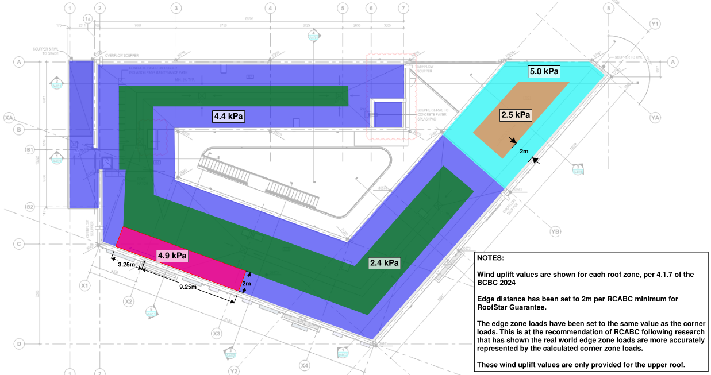
Eg. Step 1: Wind Load Pressures
Sameer Hasham | shasham@rjc.ca
Notes:
When we actually look at the wind loading on this roof, we see various pressure zones – 5 different zones.
The system that was priced for this building doesn’t not actually work and as a result we are currently working on an alternate system that reflects the correct wind demands on the roof.
All that has been considered is the membrane, insulation and coverboard. However, these are not the only components that make up the roof system.

Slide 54
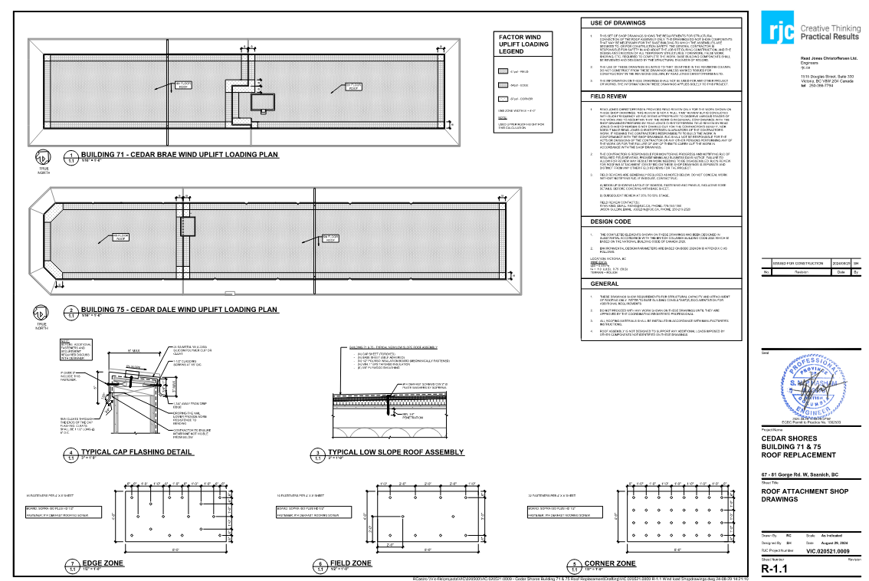
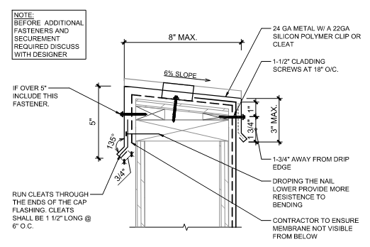
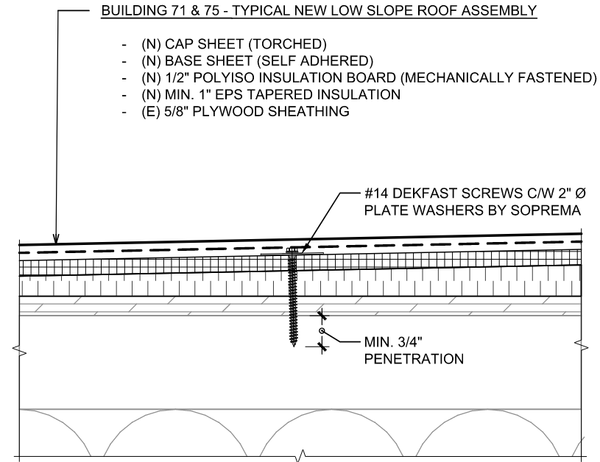
Eg. Step 2: Attachment (Custom Engineered)
Sameer Hasham | shasham@rjc.ca

Slide 55
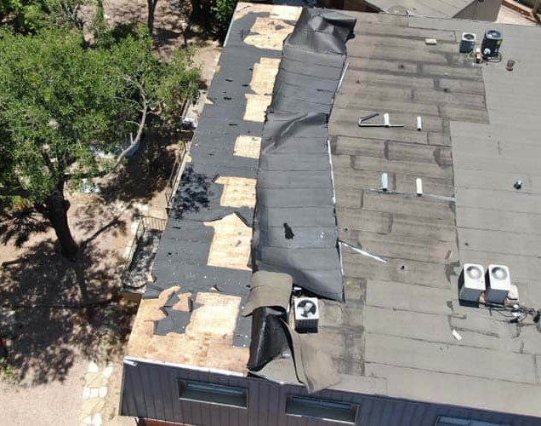
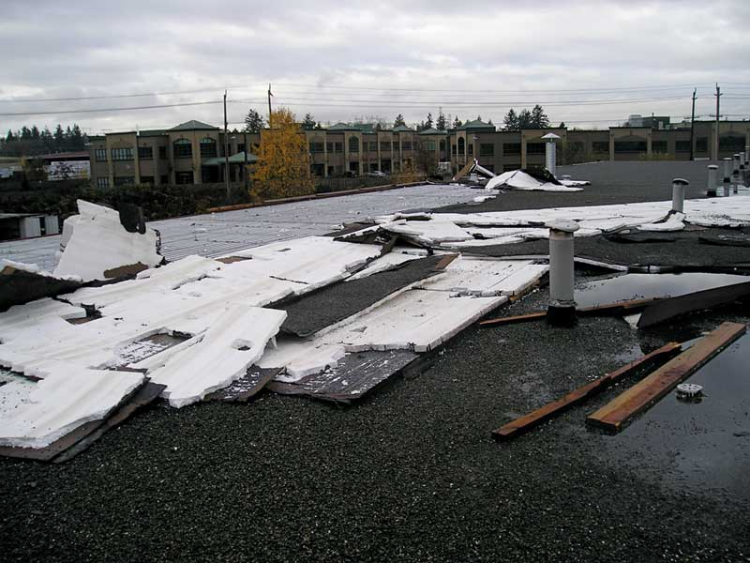
Why?
Sameer Hasham | shasham@rjc.ca

Slide 56
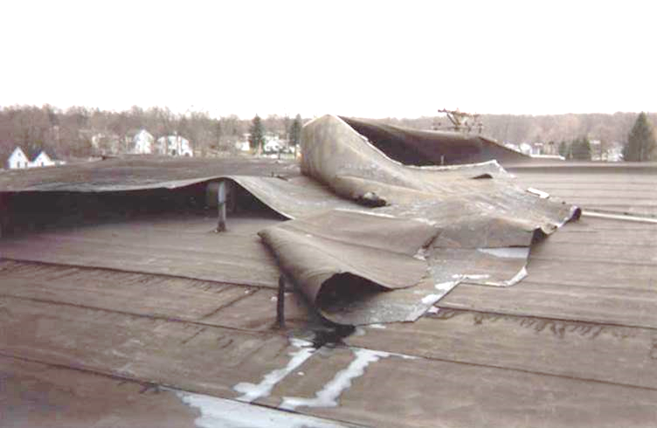
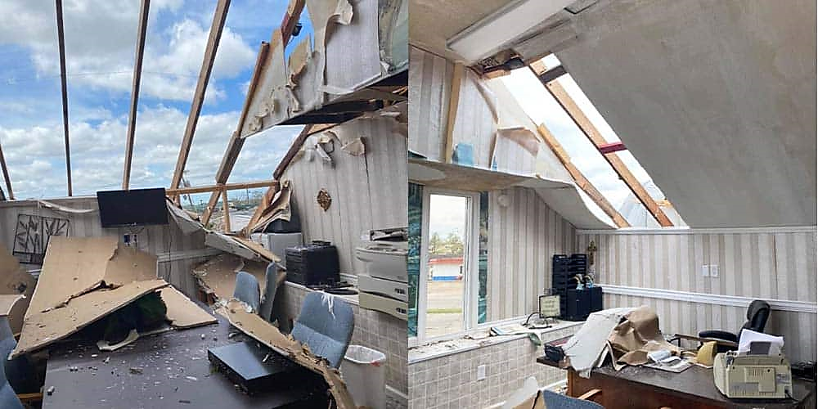
Our Professional Responsibility
Sameer Hasham | shasham@rjc.ca

Slide 57
Questions?

