Slide 2
PROTECTING REINFORCING STEEL FROM CORROSION:
A Comprehensive Analysis of Corrosion Protection Systems Used in Concrete Repair
Presented by
Wesley Narciso
Notes:
Look at audience – Five on dice.
Show confidence in delivery.

Slide 3
presentation Outline
BACKGROUND
Why Focus on this Research
What’s Missing in Current Industry and Academic Literature
Methods of Protecting Reinforcing Steel
Types of Metal Bar Corrosion Protection Systems
RESEARCH METHODOLOGY
Sample Materials, Types and Preparation
Method of Induced Corrosion
ANALYSIS AND RESULTS
Application
Visual Examination
Metallurgical Testing
Electrochemical Testing
Mechanical Testing
CONCLUSIONS AND FUTURE WORK

Slide 4
BACKGROUND
Why focus on this research
Twice as much concrete used in construction around the world than the total of other building materials, including wood, steel, plastic and aluminum combined (Cement Association of Canada).
Unfortunately, “the annual outlay for repair and rehabilitation has outstripped the cost of new infrastructure construction” (Li and Herbert, 2012).
The American Society of Civil Engineers (ASCE) estimates that $2.2 trillion is needed over the next five years for repair and retrofit (starting 2012) – the estimated costs for Asia are $2 trillion (Li and Herbert, 2012).
To make matters worse, concrete repairs are often short-lived, where almost half of concrete repairs need to be further re-repaired (Mather and Warner 2003).
Reinforced structures deteriorate (e.g. water, chlorides, decarburization) and restoring them is and will be significant as we densify housing and build more towers/concrete structures.
Contractors and consultants all do this differently and very few base their decisions on test data.
Notes:
Chlorides, decarburization, water and other oxidizing species attack steel, after passive later has been broken down (due to ph of less than 9 or 10)
Overall steel grows 20%.
The small amount of corrosion product is 5 to 6 times it’s original volume.
Stress causes cracking, then eventually concrete spalls off.

Slide 5
Background
Missing in current industry and academic literature
Comparative studies on different types of barrier coatings.
Focus on quantifying the “ring halo effect” or “hot spots”.
Inclusion of galvanic anodes.
Wide range of research on commercial products.
In-depth metallurgical analysis.
Tensile and bend testing of corroded samples.

Slide 6
BACKGROUND
Methods of protecting reinforcing metal
Use better steel - More corrosion resistant reinforcing metal
Protect the Steel - Metal bar corrosion protection systems
Use better concrete - Optimizing chemistry of surrounding concrete
Protect the concrete - Concrete coating and other protective systems
Notes:
Use better steel
Protect the steel
Use better concrete
Protect the concrete

Slide 7
BACKGROUND
Types of Metal Bar Corrosion protection systems
Coatings
Zinc
Epoxy
Zinc-epoxy
Cementitious Coatings
Galvanic anodes

Slide 8
RESEARCH METHODOLOGY
Sample materials
Background
Zinc rich coatings
Sample #1 – Single component organic zinc rich primer (87 wt%).
Sample #2 – Two component solvent based inorganic zinc rich ethyl silicate primer.
Sample #3 - Single component zinc rich primer (83 wt%).
Sample #4 - Single component organic zinc rich primer (90 wt%).
Epoxies
Sample #5 – Three component (epoxy, hardener, cement powder).
Sample #6 – Two component (epoxy and hardener).
Zinc-Epoxy combinations
Sample #7 – Two component (zinc and epoxy).
Sample #8 – One component zinc rich epoxy primer.

Slide 9
RESEARCH METHODOLOGY
Sample materials
Background
Cementitious slurries
Sample #9 – Cementitious slurry utilizing crystalline growth technology.
Sample #10 – Water based epoxy cementitious coating.
Sample #11 – Polymeric bonding mortar using cementitious binders and corrosion inhibitors.
Sample #12 – Three component water-based epoxy resin and cement mix.
Galvanic Anodes
Sample #13 – Galvanic anode #1.
Sample #14 - Galvanic anode #2.
Sample #15 - Galvanic anode #3.
Control Samples
Sample #16 – Polished (bright finish).
Sample #17 – Hot Dipped Galvanized.
Sample #18 – HDG (not encased in concrete and not subject to corrosion cycling).

Slide 10
RESEARCH METHODOLOGY
Sample TYPES
A
B
C

Slide 11
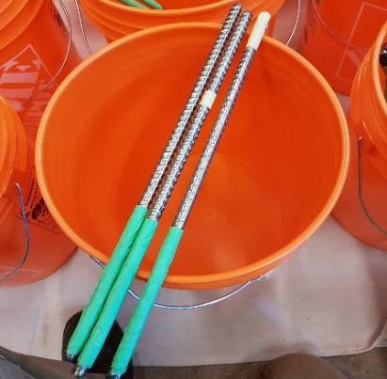
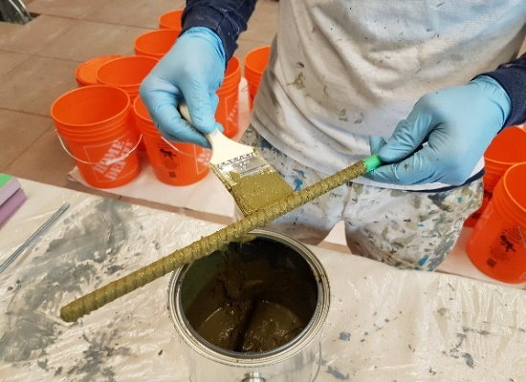
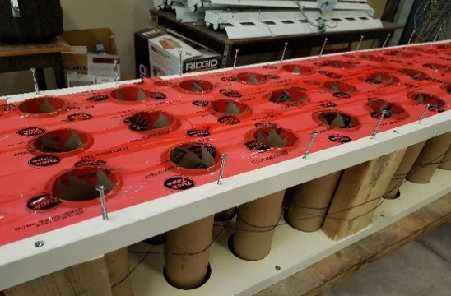
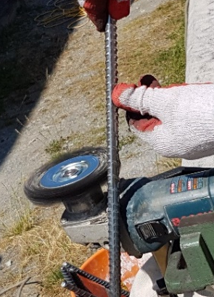
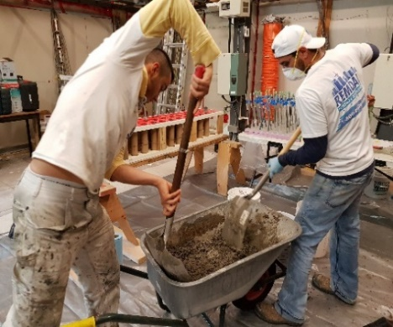
RESEARCH METHODOLOGY
Sample preparation
Background
Notes:
Sample PREPARATION
Cut reinforcing steel bar (3/8” Ø) into 16” sections.
Filed edges, wire brush the surface and clean with acetone.
Applied coatings per sketch shown earlier and installed galvanic anodes.
Allowed for requisite drying and curing of coatings.
Created cylindrical concrete forms to fit around coated steel samples.
Prepared concrete mix (with addition of chloride admixture).
Poured concrete into forms (ensure complete and consistent concrete coverage).
Allowed to cure (28 days) and broke out forms when appropriate.

Slide 12
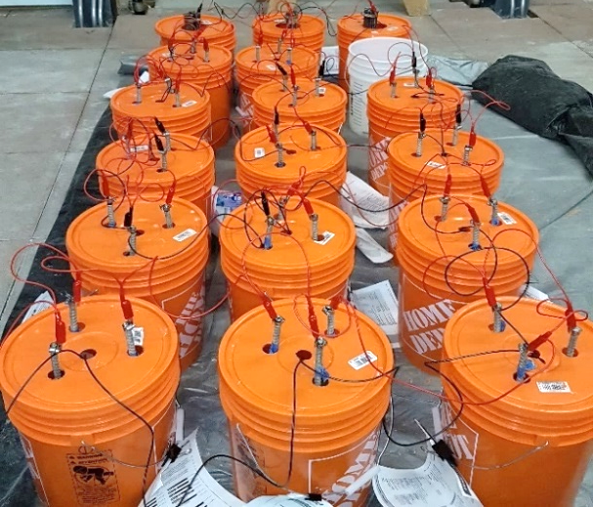
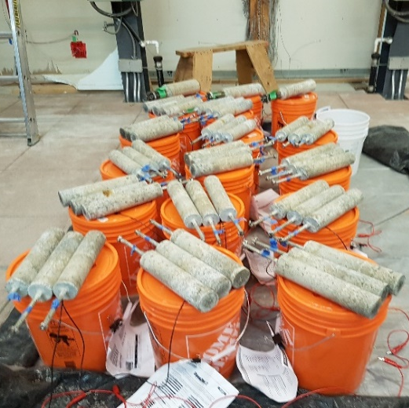
RESEARCH METHODOLOGY
Method of Induced corrosion and testing
Background
Notes:
Method of Induced corrosion and testing
Prepared salt bath (5% chloride solution).
Prepared current inducing setup (1 mA). Why? To accelerate corrosion.
Proceeded with immersion (5 days) and drying (2 days) cycles (5 months total).
Performed galvanic half-cell measurements periodically – approximately every 2 weeks.
Broke open one reference sample (Sample #17) at end of 2 months to observe corrosion.
Broke open one reference sample (Sample #16) at end of 3 months to observe corrosion.
Broke open C samples at end of 4 months.
Broke open the A and B samples at end of 5 months.

Slide 13
ANALYSIS AND RESULTS
Application rating
1 – Worst: lengthy, expensive, smelly, difficult off boatswain chair or swing stage, heightened chance of pre-mature failure, increased risk in safety, high risk for holes and holidays
2 – Below Average
3 – Above Average
4 – Best: quick, cheap, not energy intensive, simple, minimal chance of mistakes, relatively safe, little to no smell, low risk for holes and holidays
Sample | Category | Time and Cost | Tendency for Holes/ Holidays
1 | Zinc | 3 | 4
2 |  | 4 | 4
3 |  | 3.5 | 4
4 |  | 3.5 | 4
5 | Epoxy | 1.5 | 3
6 |  | 1 | 4
7 | Zinc-Epoxy | 2.5 | 4
8 |  | 2.5 | 4
9 | Cementitious | 1.5 | 2
10 |  | 1 | 1.5
11 |  | 2 | 2.5
12 |  | 2.5 | 3
13 | Galvanic Anodes | 3 | 4
14 |  | 3 | 4
15 |  | 3 | 4
16 | Bright Finish | 3.5 | 3

Slide 14
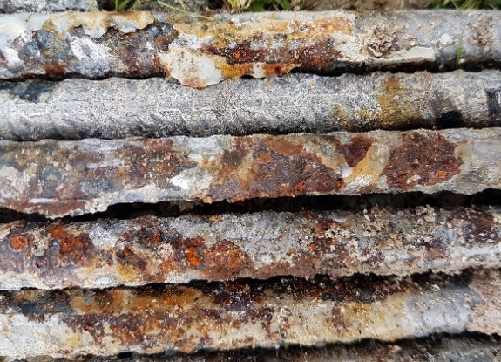
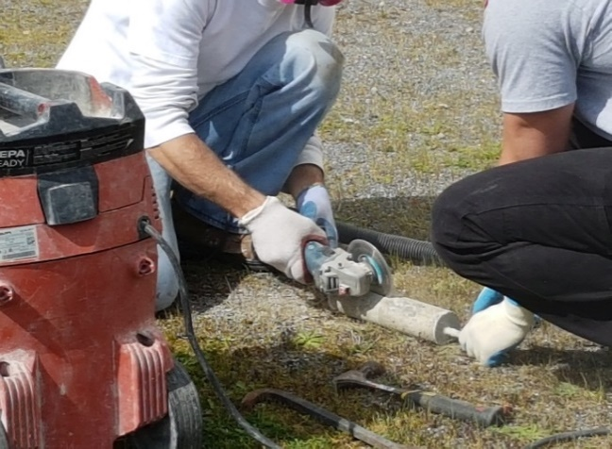
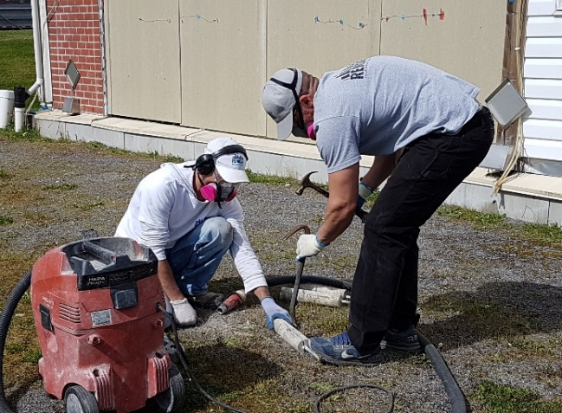
ANALYSIS AND RESULTS
Visual Examination
Background

Slide 15
ANALYSIS AND RESULTS
VISUAL EXAMINATION (SUMMARY)
Zinc
Some localized corrosion.
Still many microscopic grooves and valleys for corrosion nucleation sites to occur.
Epoxy
Concrete did not bond well to it - problematic as delamination occurs.
Problems found in the small nicks and holidays.
Cementitious
Concrete bonded well to it.
However, localized corrosion occurred at the exposed rings and hot zones, possibly creating a scenario worse than prior to concrete repair.
Galvanic anodes
Similar results to the rest of the coating types, with one anode performing quite poorly.
Notes:
Bias alert: visual examination will inherently contain bias based on the reviewer. Some may notice more or less corrosion than someone else.

Slide 16
ANALYSIS AND RESULTS
Metallurgical testing

Slide 17
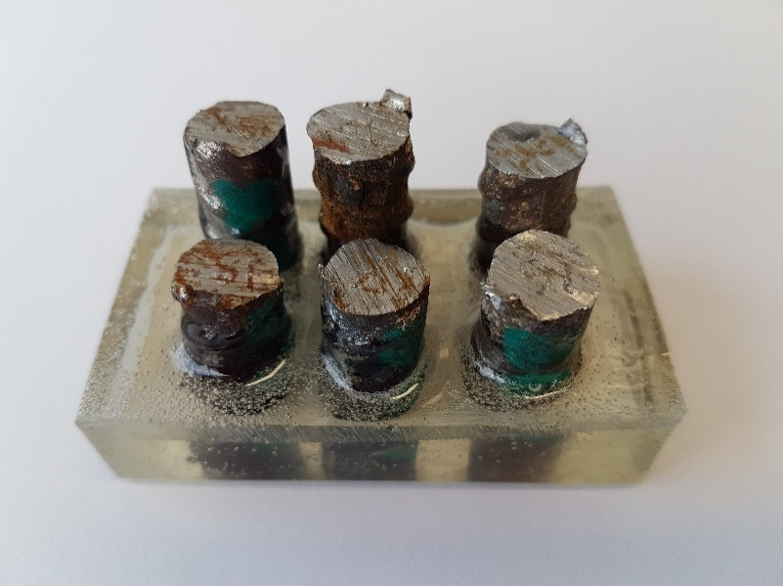
ANALYSIS AND RESULTS
Metallurgical testing

Slide 18
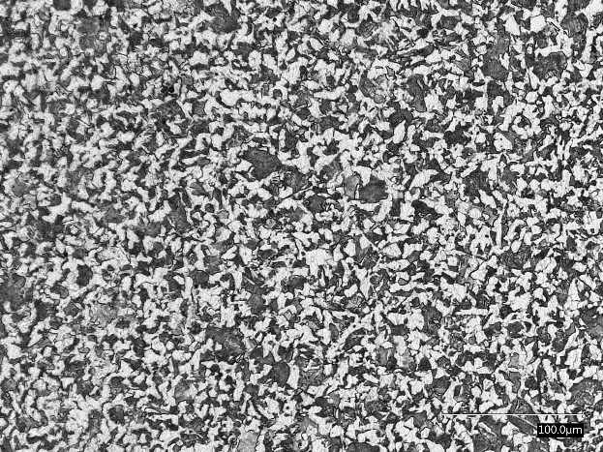
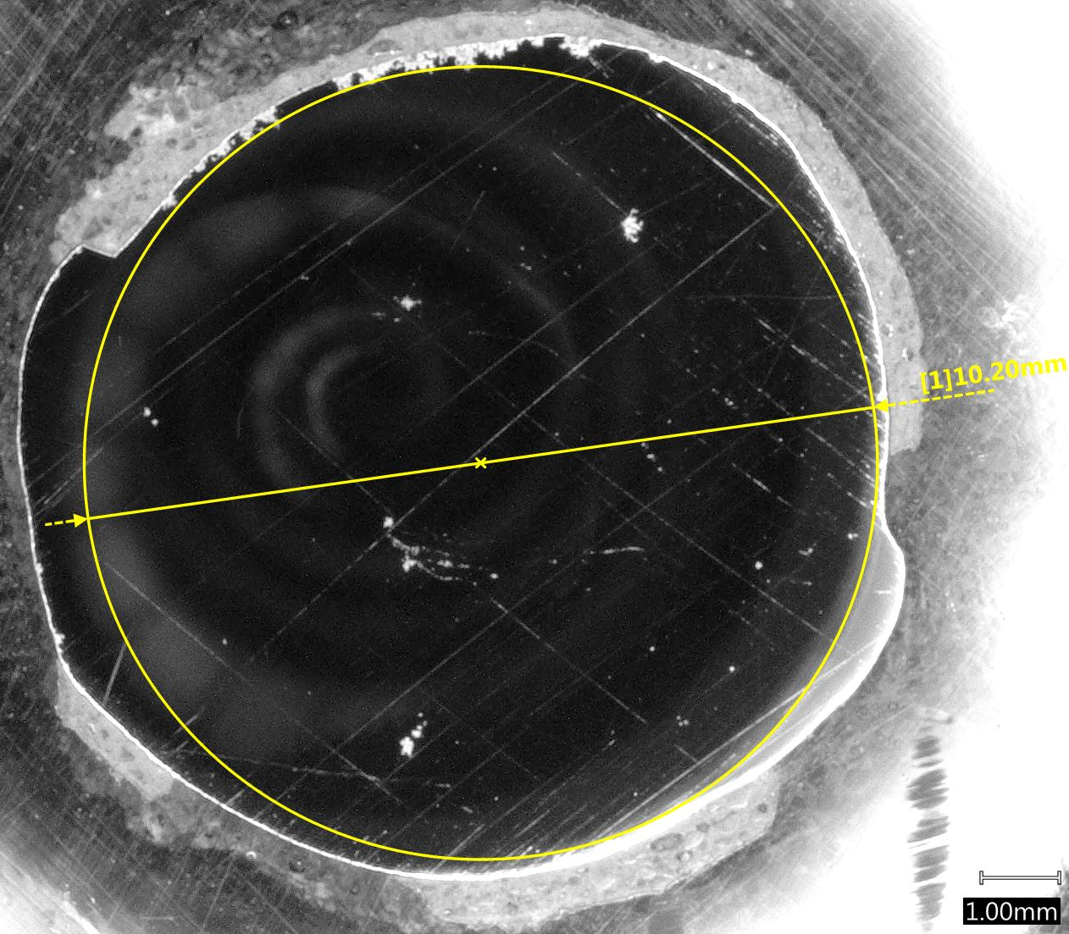
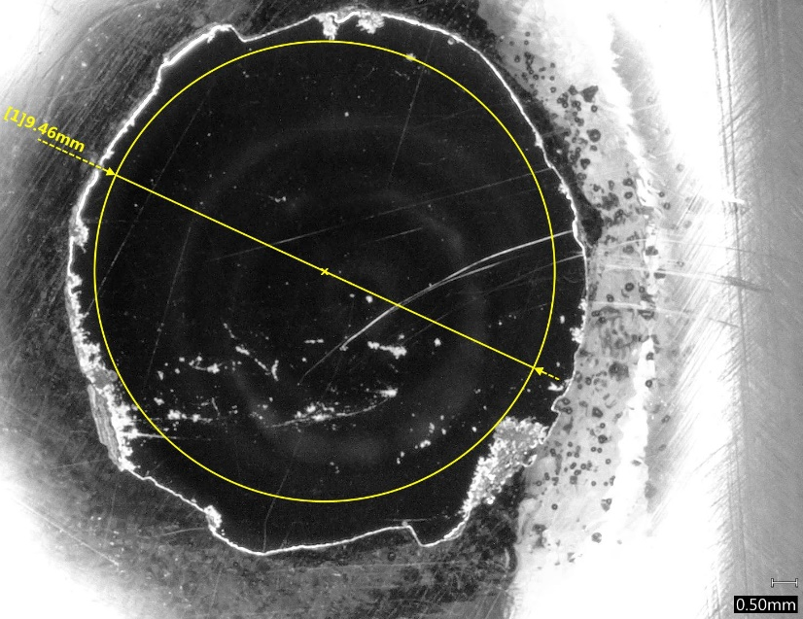
ANALYSIS AND RESULTS
Metallurgical testing

Slide 19
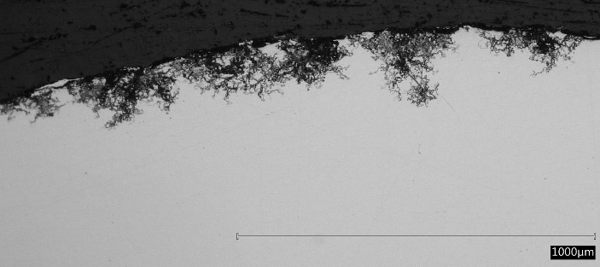
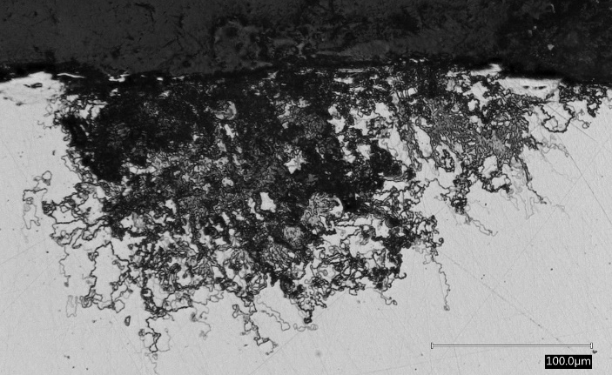
ANALYSIS AND RESULTS
Metallurgical testing

Slide 20
ANALYSIS AND RESULTS
METALLURGICAL TESTING (SUMMARY)
Top performer
Zinc-epoxy
Smallest differential in pitting (coating vs. exposed ring).
Smallest reduction of effective diameters.
Poorest performers
Two component epoxy coating, one of the cementitious coatings and one of the galvanic anodes
Epoxy coatings - more likely to trap moisture due to its impermeable nature; most susceptible to premature corrosion if nicked, scratched or applied improperly.
Cementitious coatings - one showed the most reduction in effective diameters and another showed the most overall pitting.
Background

Slide 21
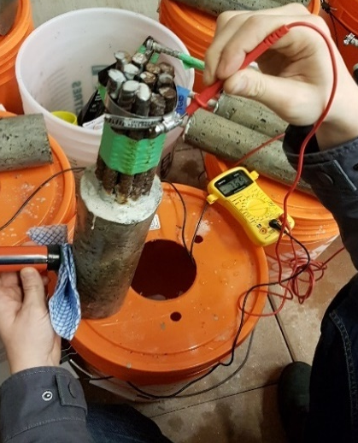
ANALYSIS AND RESULTS
ELECTROCHEMICAL testing
Notes:
Half cell testing was performed to detect whether the reinforcing steel is under active corrosion.
It utilizes a multimeter to measure potential difference between steel and half cell apparatus,
The potential of a reference electrode is known (Cu/CuSO4).

Slide 22
ANALYSIS AND RESULTS
ELECTROCHEMICAL testing (SUMMARY)
Top performers (lowest probability of corrosion activity) - one zinc coating, the epoxy cementitious coating, two of the cementitious coatings and one of the galvanic anodes.
Half-cell measurements may have favoured the cementitious coatings due to their more alkaline nature.
One galvanic anode showed low corrosion activity but ended up with significant corrosion – well protected until anode was completely consumed.
Results were quite scattered and all values were less than -350 mV/CSE.
Tangible conclusions could not be drawn; however, the observations were mostly consistent with other tests within this study.
Notes:
Per ASTM C876 anything under -350mV CSE (Copper Sulphate Electrode) means that the probability of corrosion is over 90%.

Slide 23
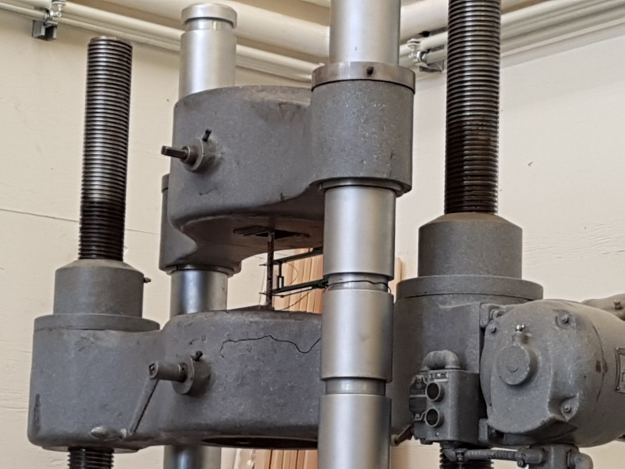
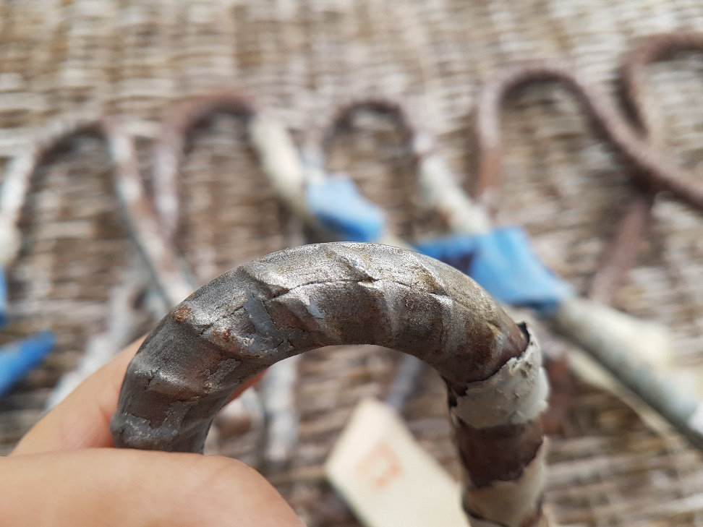
ANALYSIS AND RESULTS
MECHANICAL TESTING

Slide 24
ANALYSIS AND RESULTS
mechanical testing (SUMMARY)
Top performers - zinc, zinc-epoxies and the uncoated (ground down) reference sample.
Poorest performers - one zinc coating, the epoxy-cementitious coating, all but one cementitious coating and both HDG coatings.
Cementitious coating - encourages more non-uniform corrosion
HDG coating only
Not enough to prevent significant pitting.
Not encased in concrete and not subject to corrosion cycling but still pitted as it sat in a bucket - illustrates the real effect that concrete, and its alkaline properties has in protecting steel from corrosion.
Bend testing - only the epoxy coated specimen exhibited small, minor cracking at the outside diameter, which may have been due to small pits opening up.
Sample | UTS (ksi)
1 | 101
2 | 101
3 | 102
4 | 91
5 | 91
6 | 100
7 | 99
8 | 109
9 | 93
10 | 101
11 | 93
12 | 94
13 | 97
14 | 99
15 | 100
16 | 103
17 | 93
18 | 91

Slide 25
CONCLUSIONS
Zinc - epoxy coatings
Best overall corrosion mitigating characteristics.
Physically protective nature of the epoxy and the sacrificial anodic characteristic of the zinc.
No coating (ground down/bright finish)
Performed quite well – second only to the zinc-epoxies.
Smooth surface made it more difficult for corrosion cells to develop.
Requires almost perfect conditions.
Galvanic anodes
Performed reasonably well.
May be considered where access is a challenge and the possibility of hot spotting is unacceptable.
Difficult to directly compare to coatings, especially with hot spotting.
Notes:
Zinc-epoxy coatings showed the best overall corrosion mitigating characteristics - likely due to the physically protective nature of the epoxy and the sacrificial anodic characteristic of the zinc to sacrifice itself and minimize hot spotting.
Somewhat surprising: The ground down, bright finish bar with no coating, anode or any other additional corrosion mitigating system, except for the alkaline environment it existed in, performed quite well – second only to the zinc-epoxies.
Likely due to the relatively smooth surface - making it somewhat difficult for corrosion cells to develop; as oppose to a rougher surface where it is microscopically easier for oxygen differential cells to nucleate.
However, the reality of cleaning the corroded reinforcing steel’s surfaces to a smooth bright finish that we were able to create in controlled conditions is very difficult to achieve in real life - involving a myriad of challenges (access, time, location, weather). Therefore, this strategy should be attempted with caution.
Galvanic anodes performed reasonably well and may be considered where access is a challenge and the possibility of hot spotting is unacceptable. It was and always will be difficult to directly compare galvanic anodes to coatings, especially in hot spotting.

Slide 26
CONCLUSIONS
Zinc
Worthy alternative, especially for those who are very apprehensive about epoxy.
Two zinc samples consistently performed poorly, but if removed from this study, this category would come in second, only to zinc-epoxies.
Stay away from organic based compounds, unless the zinc percentage is high (90+%).
4 coats are ideal, 2 is a minimum.
Epoxy and Cementitious Coatings
Poorest performers.
Epoxy works well when its coating is never compromised, which is almost never the case.
Like epoxy, cementitious coatings are susceptible to holes and gaps and did not adhere well to the steel.
Individual Top Performers
One of the zinc coatings performed the best, followed by both zinc-epoxies and one galvanic anode.
Notes:
Zinc coatings are still a worthy alternative, especially for those who are very apprehensive about epoxy. Two specific zinc samples consistently performed poorly, but if they were removed from this study, the zinc coating category would come in second, only to zinc-epoxies. Also, stay away from organic based compounds, unless the zinc percentage is high.
The poorest performer was the epoxy coating, followed by the cementitious coatings. Epoxy works well when its coating is never compromised, which is almost never the case. Any incident moisture that finds its way to the steel will become trapped and wreak havoc on the steel. Its advantage in impermeability to water is also a disadvantage as it separates the steel from a helpful alkaline environment.
Like epoxy, cementitious coatings were also susceptible to holes and gaps, creating many opportunities for corrosion cells to be created. To make things worse, they did not adhere well to the steel, relative to the other coatings, which means spalling could occur sooner.
With respect to individual overall performers, one of the straight zinc coatings performed the best, with both the zinc-epoxies in the top four and one of the galvanic anodes at third best.

Slide 27
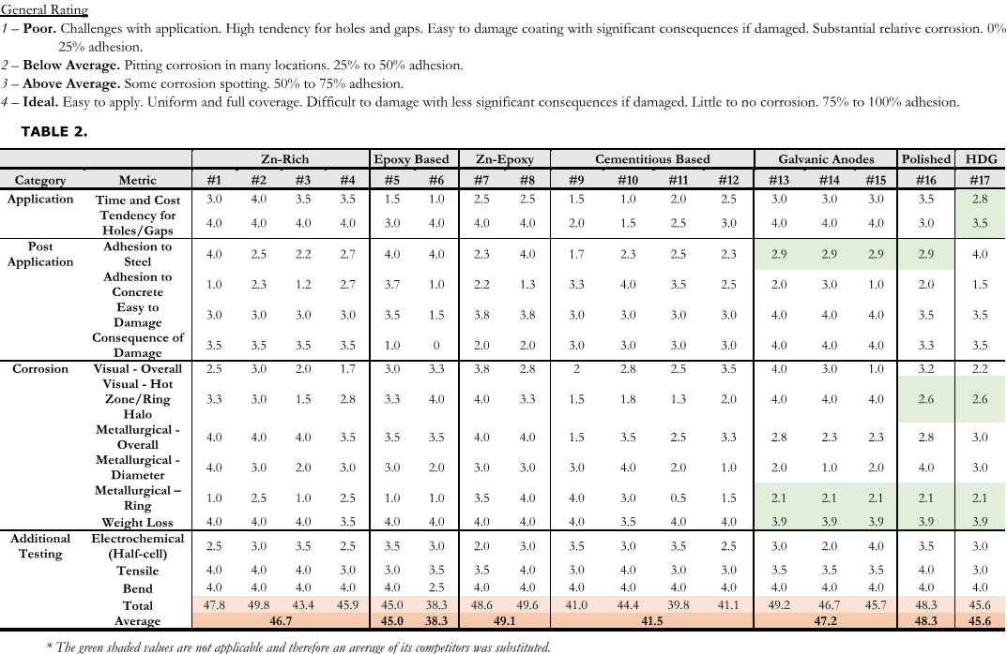
CONCLUSIONS
Notes:
Needs eplanation
This is summary of weighted rubric
Totaling quantitative scores consisting of categories like application, how much it corroded.
Certain results like actual corrosion measured was weighted more than other test results such as electrochemical and bend testing
Totalled

Slide 28
FUTURE WORK
Longer corrosion cycling (1 to 2 years) with potentially with a salt spray environment or higher induced current to accelerate corrosion.
More metallurgical specimens and more tensile tests to provide more definitive data to the results.
Instead of varying the coating, one could test different types of cementitious patch materials, then potentially coatings.
It would be great to see more research on galvanic anodes (e.g. varying steel densities, larger sample sizes/areas). This may need to be performed independent of coatings, which as shown, can be difficult to compare.
Lastly, future researchers can delve into corrosion modelling or life-cycle modelling, possibly extrapolating results from above.

Slide 29
Questions & Answers

