Slide 1
Embodied Carbon: Aligning Customer, Investor, and Regulatory Values for a Sustainable Future
November 15, 2024
Presented by Vincent Delfaud

Slide 2
The Script: “Embodied Carbon Journey”

Slide 3
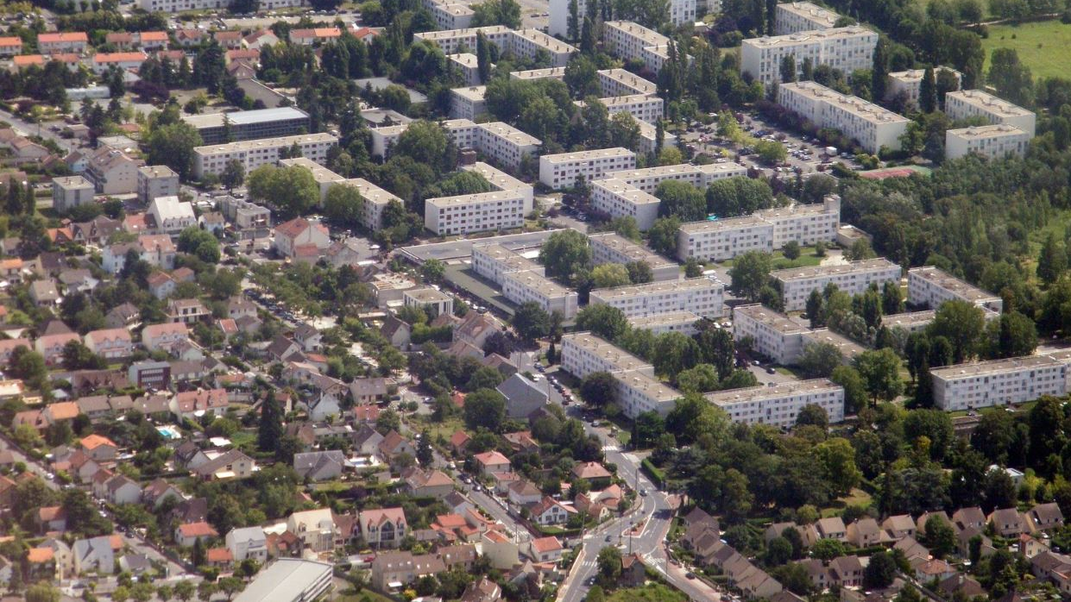

Slide 4
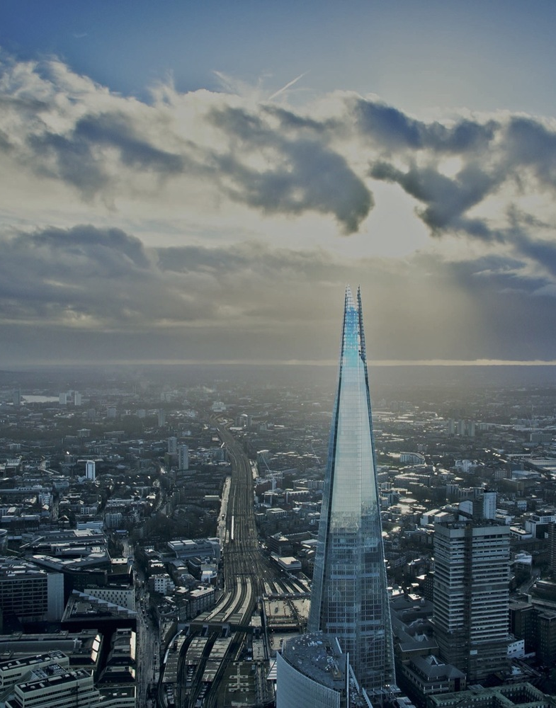
Commercial Developement
Environmental Certifications
2012 – The Shard
2016 - Tour la Marseillaise
2020 - Google Bayview Campus
2023 – The Stack on Melville Street
BREAM “Excellent”
HQE “Excellent”
LEED “Gold”
LEED “Platinum”
LEED “Platinum”
CaGBC “Zero Carbon”
Notes:
Double Skin ventilated façade with “in-cavity” blind / SCM 10% / 40 parking stalls
Deep ext façade integrating solar protections & double-glazed units / 50% SCM / no parking
90% electricity consumed generated on site / largest North America Geothermal system / Net Positive Water
Low emission materials (finishes, insulation) / PV roof panels / limited parking and expensive bike facilities

Slide 5
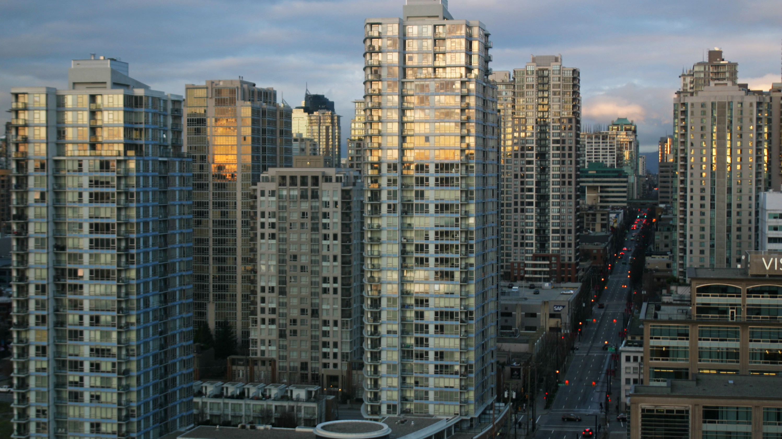

Slide 6
Set the Stage: Global to Local

Slide 7
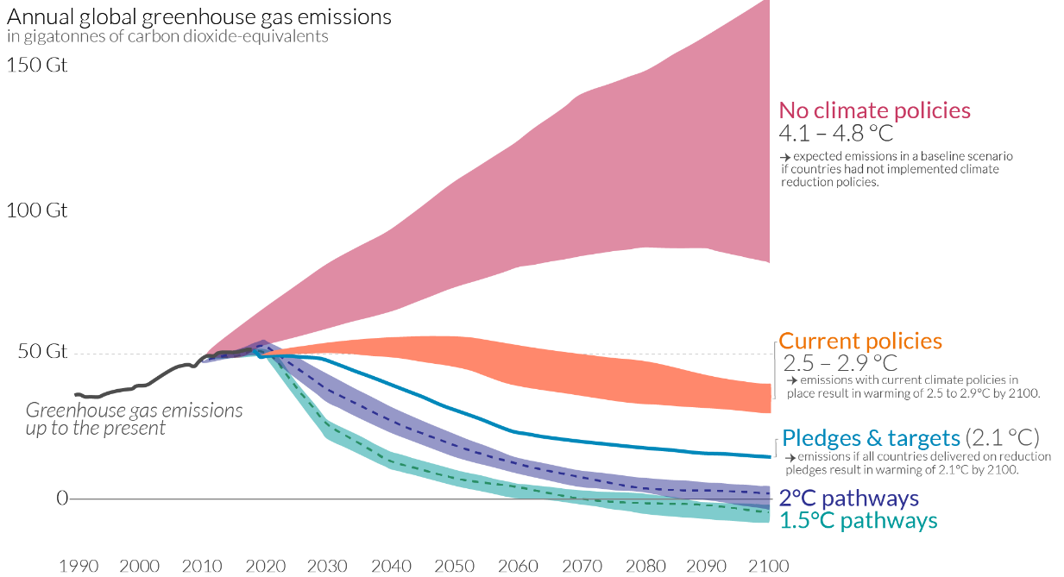
Greenhouse Gas Impact
Notes:
Governments around the globe have committed to the Paris Agreement, which sets out a global framework to limit global warming to well below 2°C and pursue efforts to limit it to 1.5°C.

Slide 8
Government of Canada
Nation wide 40-45% GHG reduction by 2030 compared to 2005 levels.
2030
2030
37% reduction in building GHG emissions.

Slide 9
The Main Cast: Who are the Stakeholders? How do they interact?

Slide 10
The Stakeholders
Federal Government and Municipalities
Financial institutions &
Publicly Traded Corporations
GHG Requirements & Mandates
Reporting Stream Requirements
Businesses (incl. asset owners)
End users (Investors & Dwellers)
Notes:
Governments mandate private-sector compliance. Potential impact on three types of stakeholders.
Name each impact and reporting

Slide 11
“Mandatory reporting requirements for FRFIs will not only impact banks and insurers – but anyone who does business with a bank or insurer.” - MLT Aikins Law Firm (Western Canadian Law Firm)
Notes:
https://www.mltaikins.com/esg/esg-disclosure-rules-for-banks-and-insurers-will-have-significant-impact/

Slide 12
Reporting & Alignment to Policies
Financial Institutions
When?
How are Scopes 1, 2 & 3 Measured?
2024 – Disclose Scope 1 & 2 emissions.
2025 – Disclose Scope 3 emissions.
Loans & Investments
Assets under management
Insurance-associated emissions
GHG Protocol:
A global GHG reporting and accounting standard - updated and revised in 2015.
Taskforce for Climate-Related Financial Disclosure:
Guidelines for analysis and disclosure of climate-related financial risk and opportunity.
Notes:
https://www.osfi-bsif.gc.ca/en/guidance/guidance-library/climate-risk-management
https://www.fasken.com/en/knowledge/2024/03/the-secs-final-rules-on-climate-related-disclosure-and-what-they-may-mean-for-canadian-issuers#:~:text=They%20require%20disclosure%20in%20annual,the%20financial%20impact%20of%20severe
https://dart.deloitte.com/USDART/home/publications/deloitte/heads-up/2024/sec-climate-disclosure-rule-ghg-emissions-esg-financial-reporting

Slide 13
“We will not likely mandate reporting from our customers in the immediate future, but the default data we use to inform our reporting is penalizing compared to the real emissions across our VC.” - Michael Torrance, CSO at BMO Financial Group

Slide 14
The Extras : The Dwellers Impact

Slide 15
Between 130,000 and 225,000 new homes must be built in Canada every year to reach demand.
End Users Dwellers
Residential Construction
Is the highest emitting sub-sector across most provinces.
Build More with Less Impact
The (multi) million-dollar question. How do we build more with less?
Notes:
CMHC
https://www.cmhc-schl.gc.ca/blog/2024/what-canada-potential-capacity-housing-construction#:~:text=With%20the%20current%20resources%2C%20we,far%20beyond%20the%20short%20term.

Slide 16
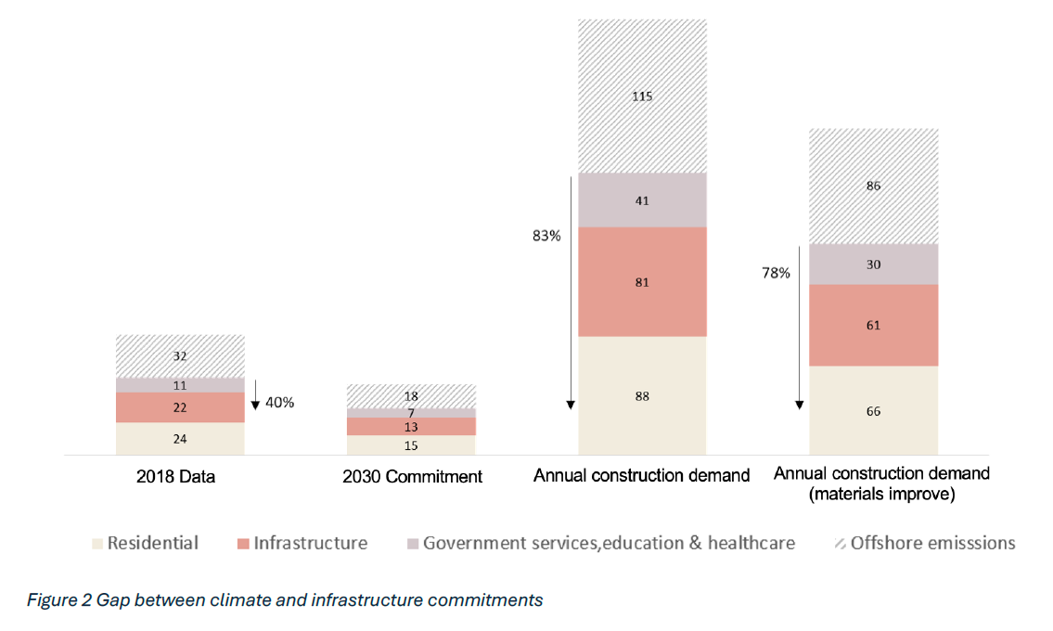
Under current construction practices, Canada reduction targets must be at
83% per home
vs the 40% reduction set today.
Notes:
Under current construction practices (i.e., current material use patterns and emissions intensities), meeting Canada’s 2030 housing affordability and climate commitments requires an 83% reduction in GHG emissions per construction product (i.e., per home) compared to the 40% economy-wide reduction promised in Canada’s international reduction commitments“
https://csbe.civmin.utoronto.ca/research/ghg-emissions-in-canadas-construction-sector/#:~:text=Under%20current%20construction%20practices%20(i.e.,wide%20reduction%20promised%20in%20Canada’s

Slide 17
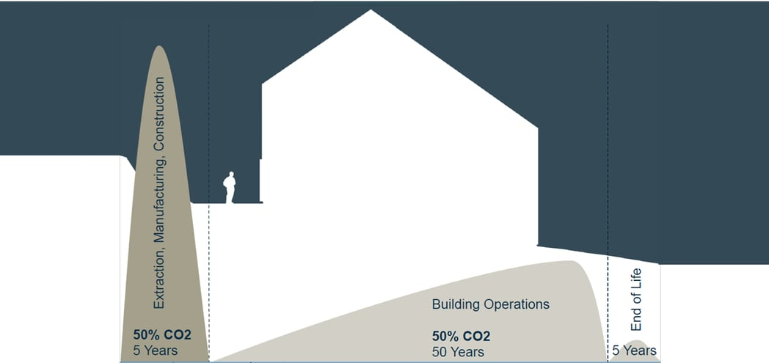
Notes:
https://oneclicklca.com/en/resources/articles/embodied-carbon-vs-operational-carbon#:~:text=The%20operational%20carbon%20footprint%20of,emitted%20during%20the%20construction%20process.
As operational carbon goes down, embodied carbon will account for a larger percentage of total carbon. By the year 2050, almost half of the carbon footprint in new construction will come from embodied carbon. Canada, Sweden, and Norway are already seeing an almost 50/50 embodied carbon vs. operating carbon split.

Slide 18
40% embodied carbon reduction by 2030. Additional Bylaw changes in 2027 & 2030.
January 2025
< 380 kg CO2e/m2
or
10% reduction to baseline
City of Vancouver
5-10% Reduction Common Solutions:
design efficiency & reduced parking (~ 10%)
low-carbon concrete & insulation (~ 10%)
wood construction (~ 20+%)
Up to 5% embodied carbon reduction for optional reporting of a selection of the following:
embodied carbon of optional building elements
project-specific construction process emissions (A4-A5)
use of circularity practices (salvaging, design for deconstruction)
use of products with sustainability, transparency, or health certifications

Slide 19
The Plot Twist: Adopting the right Metric

Slide 20
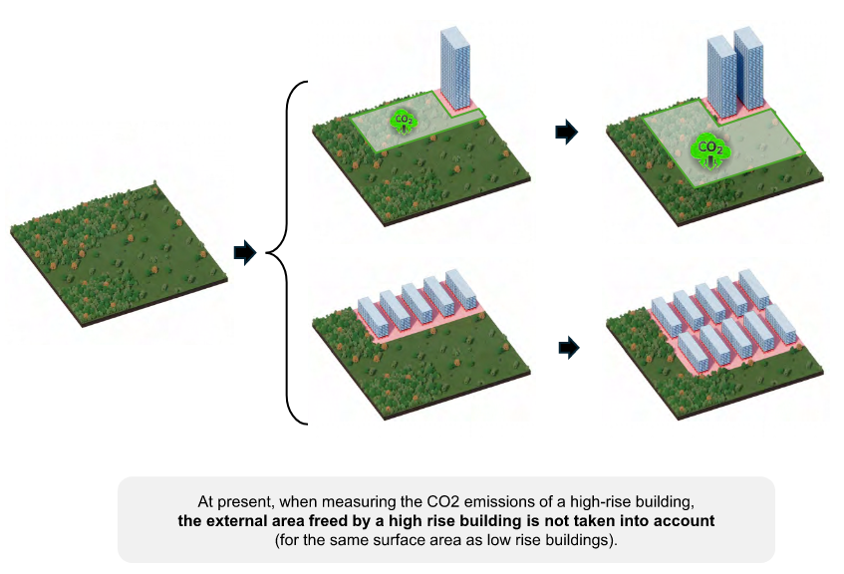
Carbon Impact & Land Value
Aligning Metrics

Slide 21
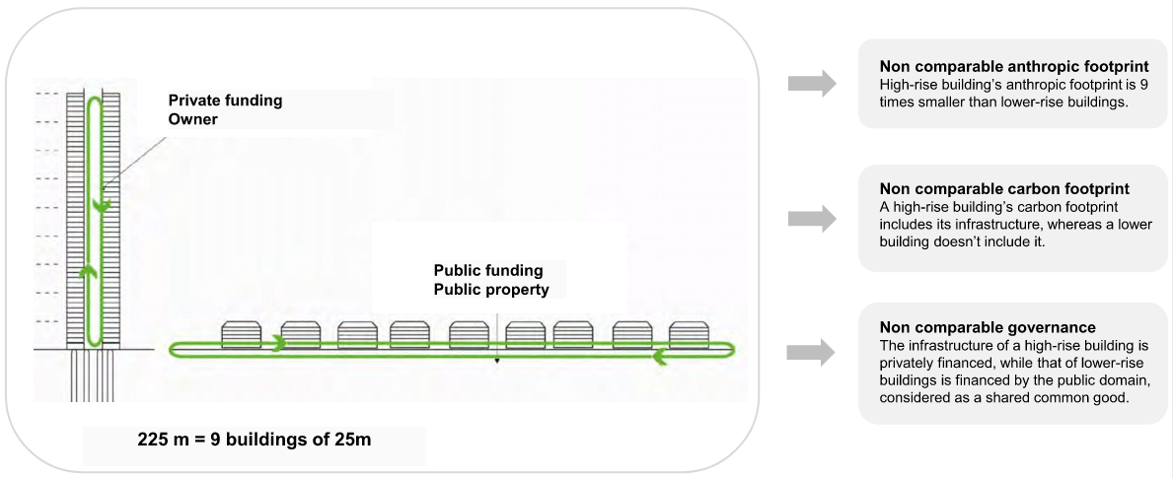
Carbon Impact & Infrastructure Value
Aligning Metrics

Slide 22
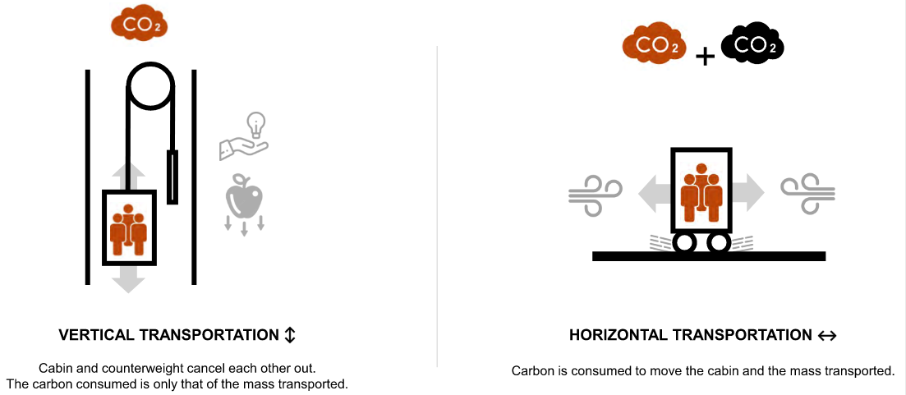
Carbon Impact & Infrastructure Value
Aligning Metrics

Slide 23
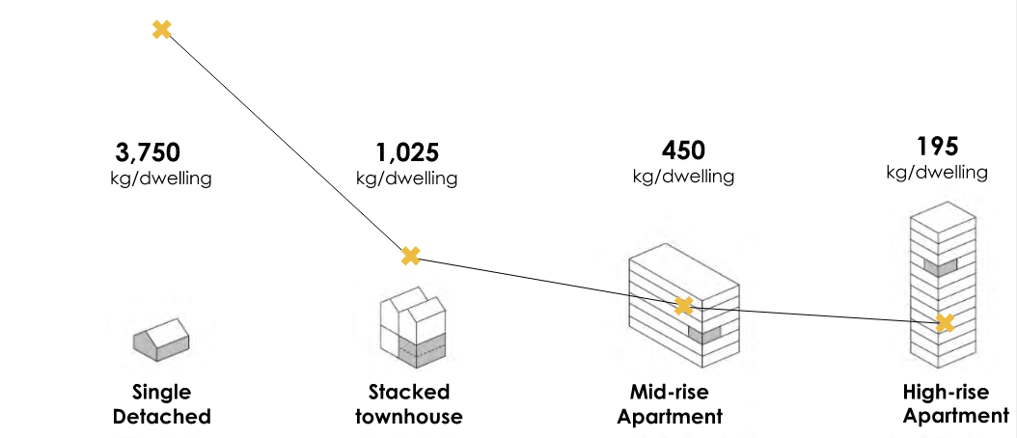
Carbon Impact & Density
Aligning Metrics
Notes:
Marie-Louise Schembri - Sustainability Director, Hilson Moran / UK

Slide 24
Whodunit: Aligning Stakeholders Values

Slide 25
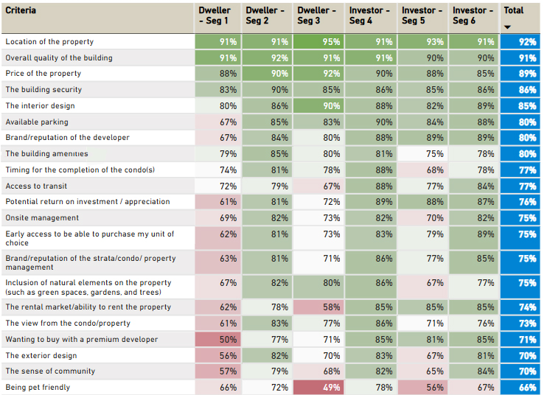
Carbon Impact vs Dweller Value
Value, Value, Value

Slide 26
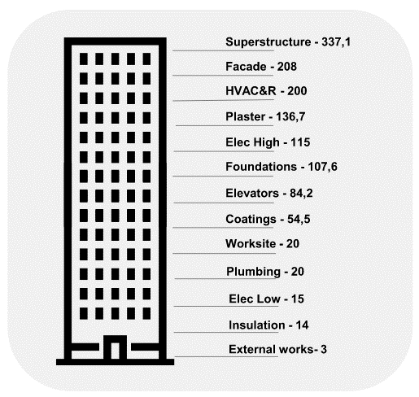
Carbon Impact & Dweller Value
Aligning Metrics
Carbon Value
Dweller Value
30%
20%
15%
0%
0%
0%
15%
1316 Kg CO2 eq
Av. Dweller Value 16%
0%
0%
15%
20%
20%
8%

Slide 27
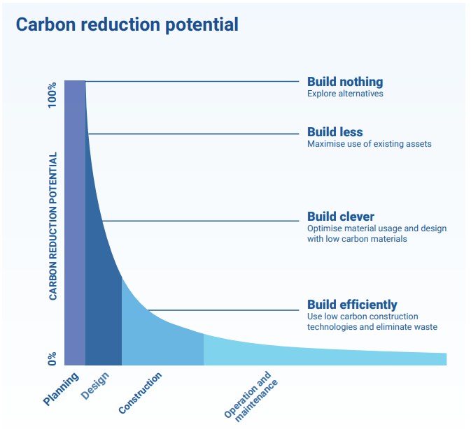

Slide 28
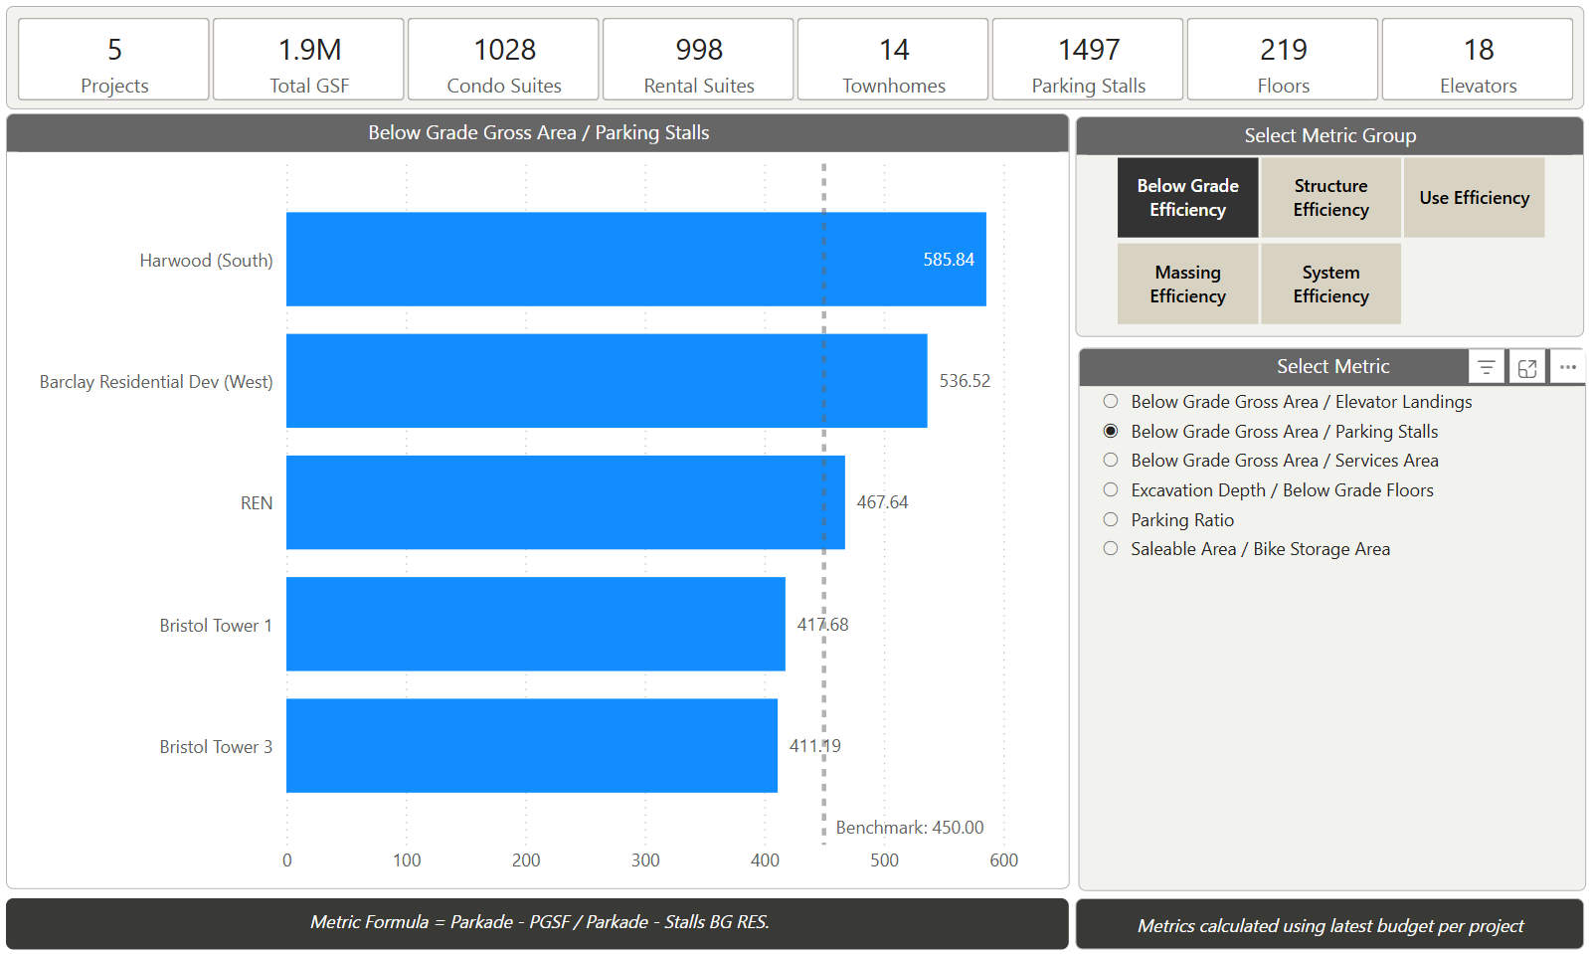
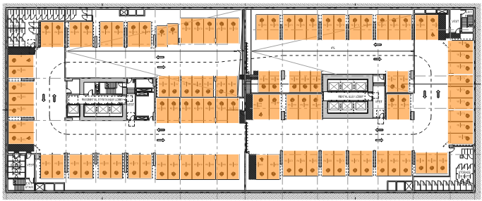
Carbon Impact vs Dweller Value
Aligning Impact – SF per Parking Stall
Rental Van
Condo Van
Rental US
Condo LwMl
Rental LwMl

Slide 29
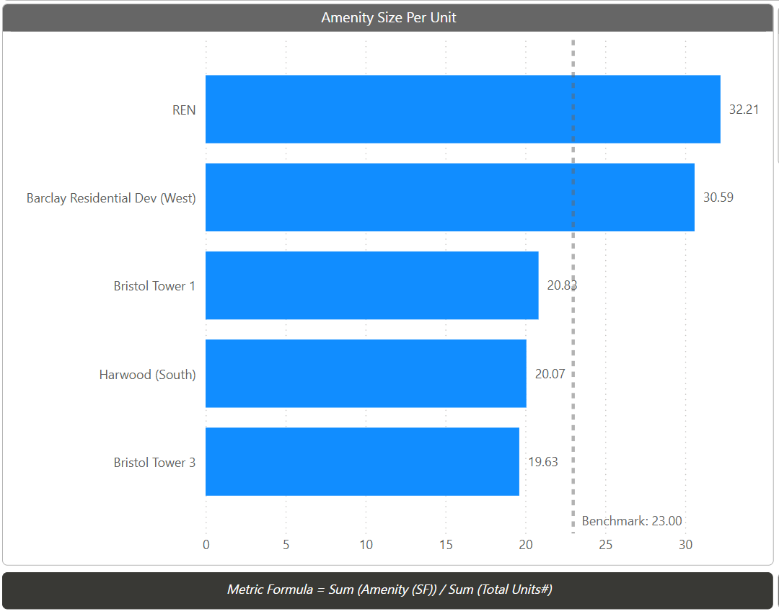
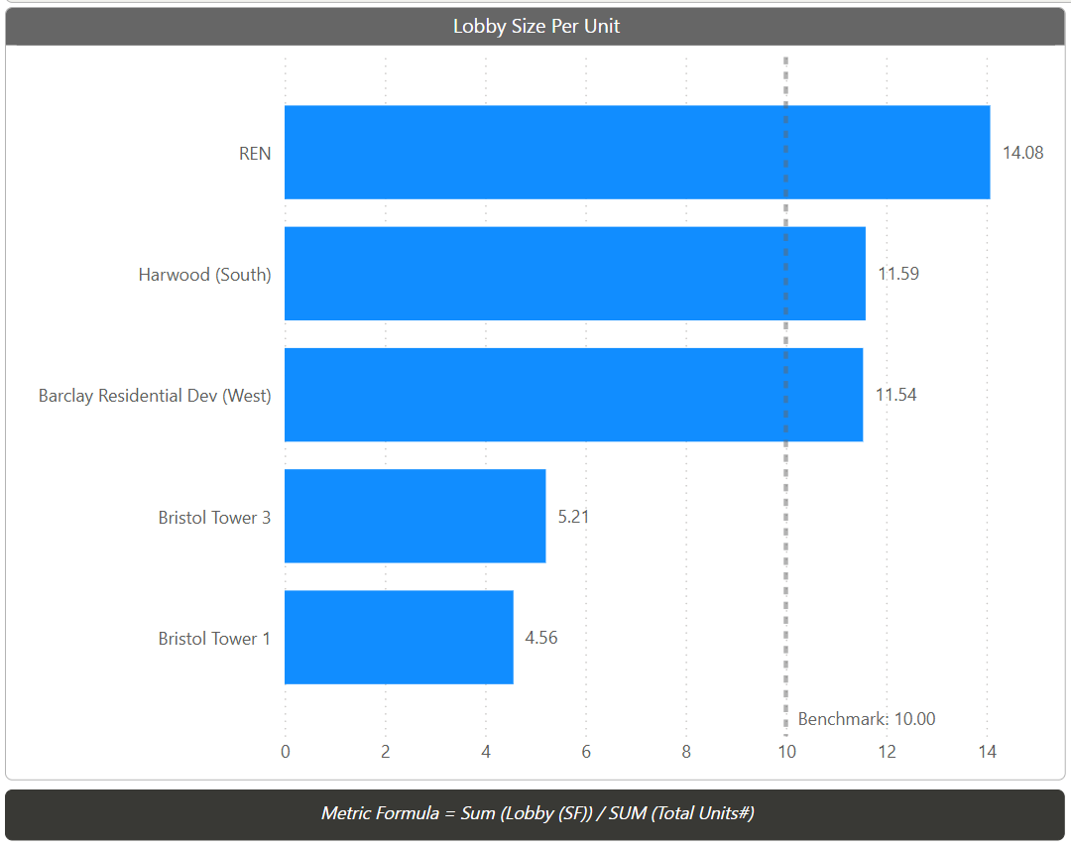
Carbon Impact vs Dweller Value
Aligning Impact – Amenity & Lobby SF per Unit
Rental US
Rental US
Condo Van
Rental Van
Condo LwMl
Condo Van
Rental Van
Rental LwMl
Rental LwMl
Condo LwMl

Slide 30
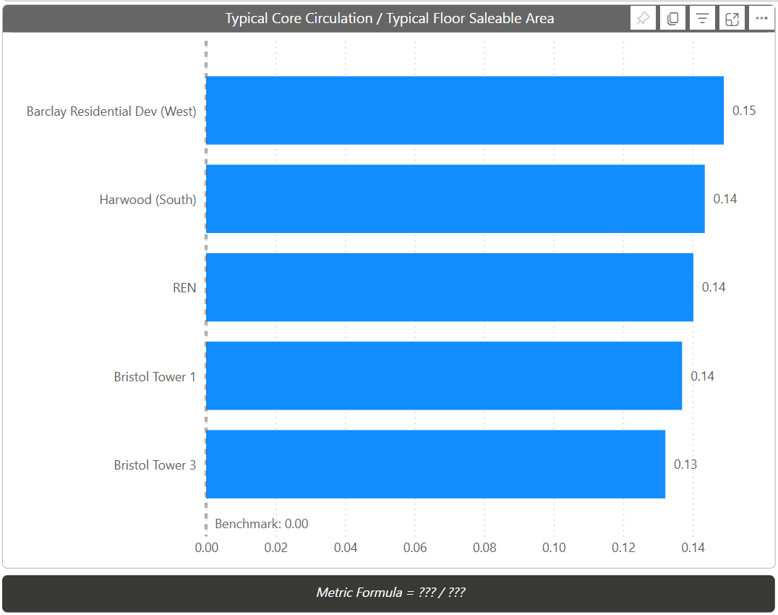
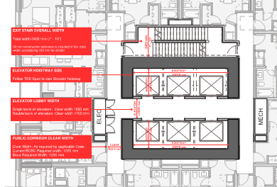
Carbon Impact vs Dweller Value
Aligning Impact – Common Corridor Area Efficiency
Condo Van
Rental Van
Rental US
Condo LwMl
Rental LwMl

Slide 31
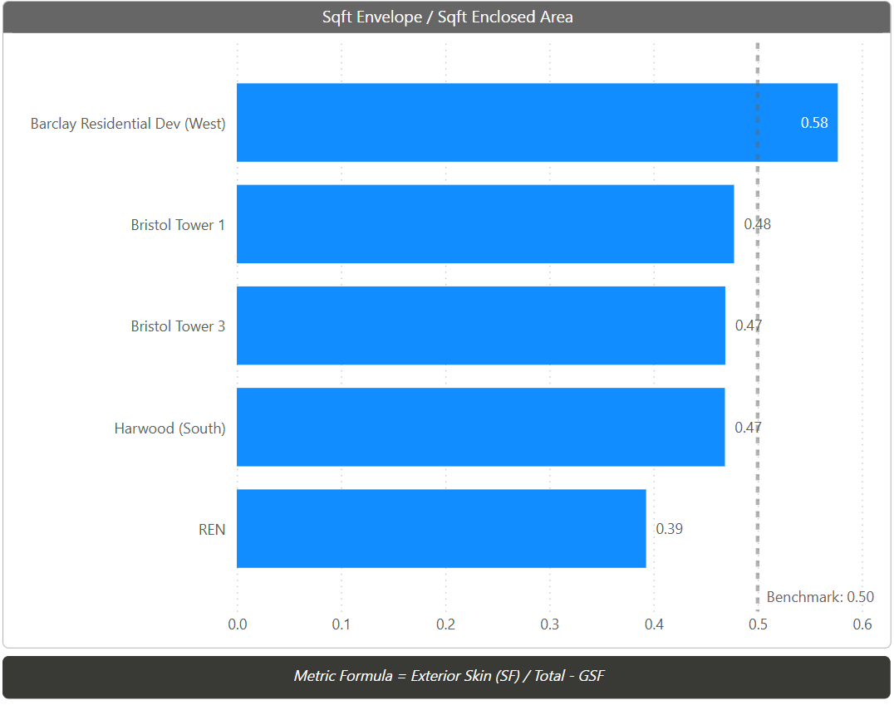
Carbon Impact vs Dweller Value
Aligning Impact – Massing Efficiency
Condo Van
Condo LwMl
Rental LwMl
Rental Van
Rental US

Slide 32
Carbon Impact vs Dweller Value
Aligning Impact
Embodied Carbon Footprint % | Rental US | Rental Van | Rental LwMl | Condo Van | Condo LwMl
Common Corridor | 17% | 15% | 11% | 15% | 10%
Amenity | 3.1% | 2.1% | 2.0% | 1.8% | 2%
Lobby | 1.4% | 1.2% | 0.5% | 0.7% | 0.4%
Façade | 21% | 10.5% | 10.5% | 14% | 10.5%
Parking | 21% | 25% | 22% | 23% | 33%
Housing | 42% | 59% | 56% | 51% | 54%
Overall Efficiency | 75% | 79% | 78% | 74% | 80%
CO2 / Unit | 57 | 63 | 63 | 117 | 60
CO2 / m2 | 600 | 570 | 582 | 590 | 512
GSF/Unit | 1,024 SF | 1,440 SF | 1,020 SF | 1,530 SF | 900 SF

Slide 33
Carbon Impact vs Dweller Value
Aligning Impact
 | VANCOUVER STANDARD | VALUE ALIGNED
# Units | 220 | 220
Net/Unit | 700 | 700
Parking Ratio | 0.45 | 0.45
Parking SF / Stall | 500 SF | 400 SF
Lobby / Unit | 12 SF | 8 SF
Amenity / Unit | 30 SF | 20 SF
Overall Efficiency | 75.00% | 80.00%
Typ Floor Efficiency | 82.00% | 85.00%
GSF/Unit | 1,182 | 1,087
CO2/unit | 55 | 49
EC TOTAL | 11,949 | 10,940
Notes:
Reduction of over 10% with no value reduction from dweller value

Slide 34
Vancouver metrics expanded to “kg of CO₂e per capita” and potentially “per m2 of land used” Vancouver Part 3 buildings clear definitions of “use baselines values”
Takeaway & Suggestion.
City of Vancouver: January 2025
< 380 kg CO2e/m2
or
10% reduction to baseline
Up to 5% embodied carbon reduction for optional reporting of a selection of the following:
embodied carbon of optional building elements
project-specific construction process emissions (A4-A5)
use of circularity practices (salvaging, design for deconstruction)
use of products with sustainability, transparency, or health certifications
Measure and reduce embodied carbon per unit.

Slide 35
“Addressing carbon emissions could turn an existential threat into the greatest commercial opportunity of our age.” - Mark Carney, UN envoy for climate action, Head of Impact Investing at Brookfield AM.

Slide 36
Thank you. Questions?

