Slide 1
On-site fenestration product testing does not end at the specification.
BCBEC Nov 15th 2024
Terry Adamson Technical Director, Fenestration Canada
Notes:
Thank Pat. Mention booth and FC growth. Intro myself

Slide 2
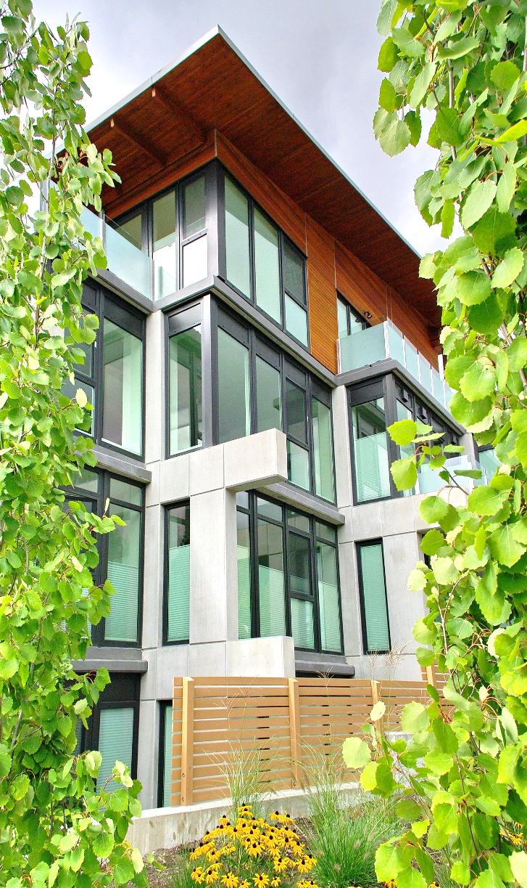
Topics
Reference standards A440.4, A440S1, E1105
Specifications
Failure definitions
Lab versus field testing.
Professionalism and industry regulation
FC task group and FC advisory docs
Industry wish-list
I am going to do my best to not just complain about testing

Slide 3
Reference Standards
There are multiple standards that can be referenced,
CSA A440.4 Window, door and skylight installation
CSA A440s1 Supplement to NAFS
ASTM E 1105 Standard test method for Field Determination of Installed Exterior Windows, Skylights, Doors, and Curtainwall by uniform or cyclic static air pressure differential
AAMA 501 US common testing practice of 2/3 test pressure
AAMA 502 Specification for Field Testing of Newly Installed Fenestration Products
ASTM E331 Standard test method for Field Determination of Installed Exterior Windows, Skylights, Doors, and Curtainwall by static air pressure differential
ASTM E1105 is the most common testing standard referenced.

Slide 4
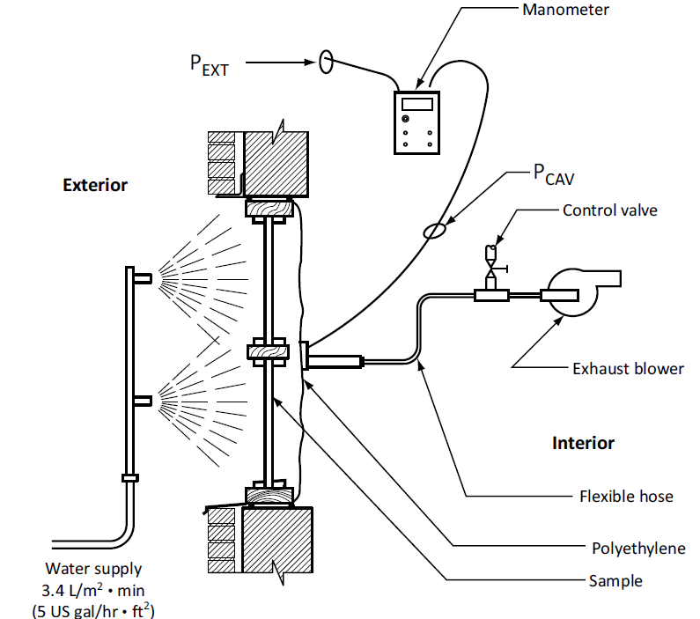
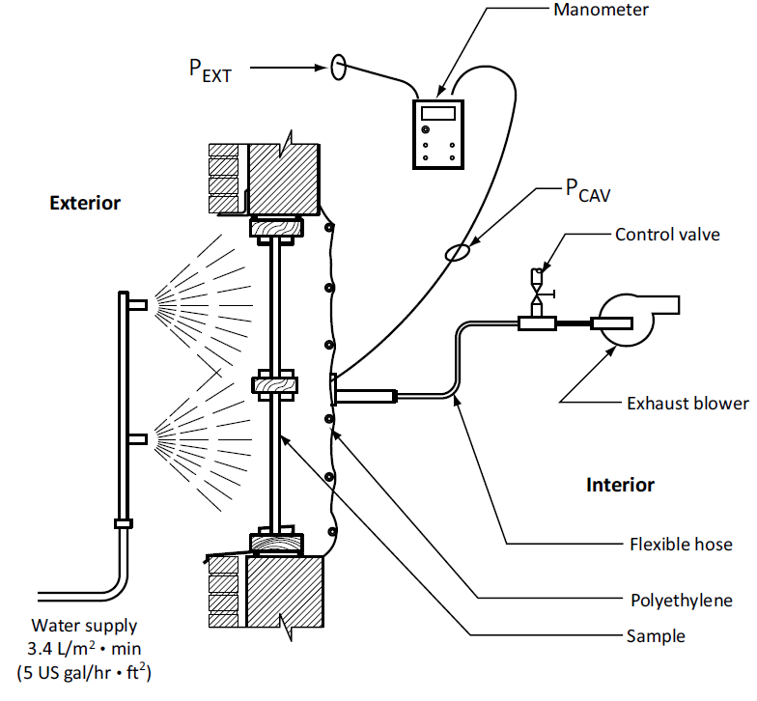
A440.4
A440.4 provides guidance on two water penetration test methods.
Test Method A tests the fenestration assembly only.
Test Method B tests the entire fenestration and installation assembly.
Method A
Method B

Slide 5
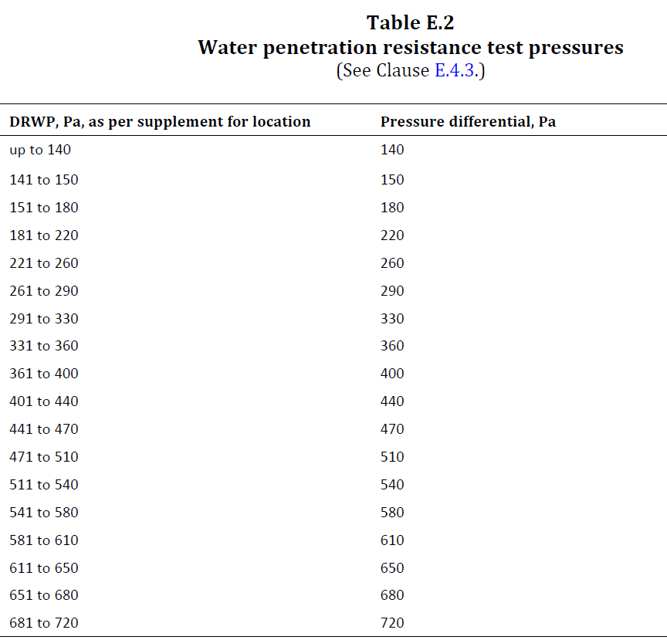
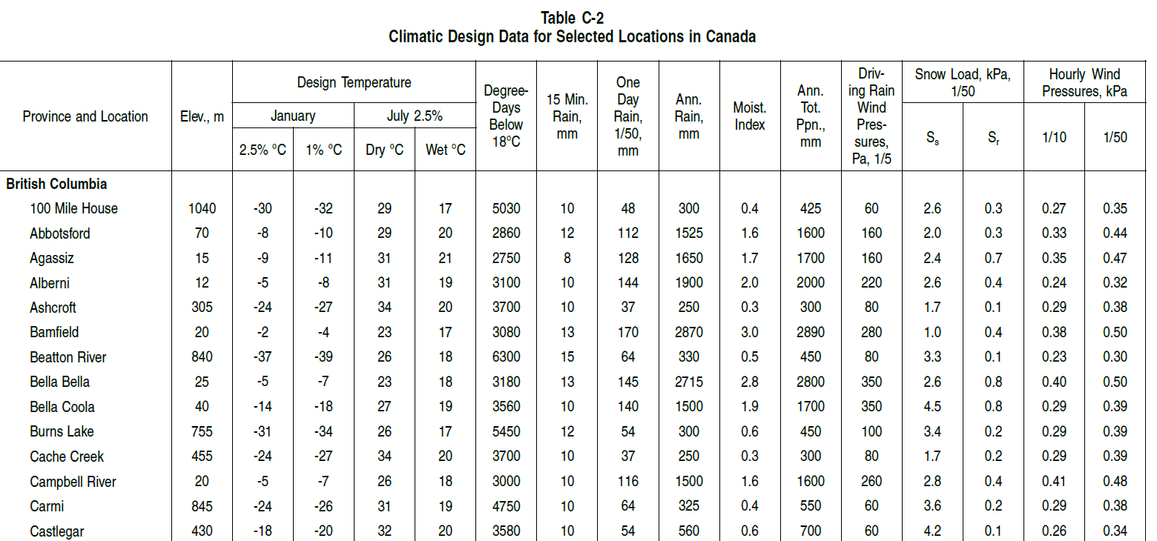
A440.4
A440.4 provides guidance on the level of test pressures to be used.
A440.4 Table E.2 pressure ranges correspond to climatic data pressures found in Table C-2 of the NBC/BCBC.
Per A440.4, water penetration resistance shall be determined in accordance with ASTM E1105 Procedure B (cyclic static pressure).

Slide 6
A440S1
4.2.1 Calculation of specified DRWP
Specified driving rain wind pressure (pr) shall be calculated using the following equation:
pr = DRWP Ce, where
DRWP = reference driving rain wind pressure equivalent to the annual maximum DRWP that has 1 chance in 5 of being exceeded in any one year for low-rise buildings applicable to Part 9 of Division B of NBC 2015 and 1 chance in 10 of being exceeded in any one year for other buildings, Pa
Ce =I
exposure factor, determined in accordance with the following (see Notes 1 and 2):
(h/10)0.28, but not less than 1, where h is the height of the top of the window, door, or unit skylight above grade in meters
Or see Table 1

Slide 7
ASTM E1105
E1105 is an AAMA/ASTM US-published standard for site testing fenestration products for water penetration.
Section 12 defines the two test procedures.
Procedure A.
Maintained water spray with static air pressure differential continuous for 15 minutes.
Procedure B.
Maintained water spray with static air pressure differential cycled at 5 minutes, with one-minute zero pressure periods. The number of cycles is per specification. Typically testing is four cycles but can be specified by the specifier.
Water flow, 5 gph/ft2. A window 5’ x 5’ or 25 sqft receives 125 gallons of water per hour spray.

Slide 8
Specifications
Project specifications will usually contain details for the on-site test criteria.
These are usually based on location, climate data, and project design.
NAFS calculator https://www.fenestrationcanada.ca/calculator A simple online tool with values based on NBC climate data.
A440S1 Climate data. Table 1 requires some calculations.
Specifier. Performance based on their design performance requirements.
AAMA 501 2/3pressure of NAFS product test data.
NAFS test results. Testing pressure based on the performance achieved during in-lab testing.
Which is the best choice for the project, and how is it decided?
Clearly defining the requirements in the project specifications and including them in the contract details is critical.

Slide 9
Failure definitions
The three standards referenced contain failure definitions.
A440.4
Water penetration shall be defined as
any water penetrating the window, door, or unit skylight assembly and causing wetting of the interior room surfaces;
any water passing through the window, door, or unit skylight into the rough opening or assembly adjoining the window, door, or unit skylight below the sill; and
any water remaining trapped in the window, door, or unit skylight assembly after the test pressure has been released.
A440S1
Problems associated with water penetration into, through, and around windows, doors, and unit skylights fall into four basic categories, which include penetration of water
between the frame of the window, door, or unit skylight and the adjoining construction, causing wetting of the building interior;
between the frame and operable sash;
the glass and glazing frame; or
the frames or sashes of adjoining windows, doors, or unit skylights causing wetting of the building interior;
into the window, door, or unit skylight, leading to accumulation within the assembly; and
from the window, door, or unit skylight frame into the wall below.
E1105
water penetration, n—penetration of water beyond a
plane parallel to the glazing (the vertical plane) intersecting the innermost projection of the test specimen, not including interior trim and hardware,

Slide 10
Lab versus field
There can be an expectation that fenestration products will perform the same in the field as they do in lab testing.
It is a reasonable assumption, but the reality can be very different.
In-lab testing is conducted under “perfect conditions”.
The product is often installed very differently than in the field as lab/NAFS testing is to evaluate only the product. Installation of the product is not tested in the lab.
There are no environmental influences like wind pressures, wind gusts, pressure spikes, temperature.
Lab-tested products are new, while in the field, they can experience months of abuse, contamination, and construction damage.
Installation and the surrounding envelope details can significantly impact window performance. Frames can be racked, twisted, not level, not plumb, etc.
Lab performance should never be specified or expected during in-field testing.

Slide 11
Professionalism industry regulation
Currently there is no regulation or oversight on who performs this function.
SCC-accredited test labs are doing in-lab NAFS testing, but accreditation for in-lab testing does not specifically cover on-site testing.
Building envelope businesses perform site testing with virtually no oversight of their qualifications, or those of the testing technician or their equipment.
A pickup truck, a rain rack, a shop vac, a manometer and you too can be in the water penetration testing business.
When test failures can cost manufacturers tens of thousands of dollars this lack of regulatory oversight is of great concern.

Slide 12
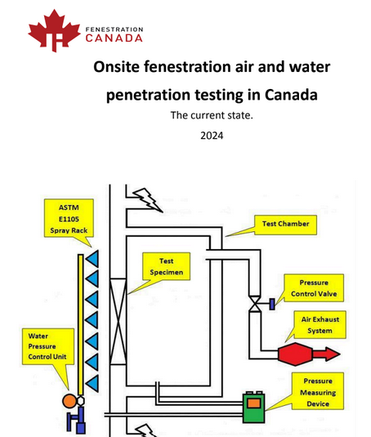
FC task group and advisory documents
Fenestration Canada launched a task group about 18 months ago driven by the many concerns voiced by members over site testing.
In 2024 we published a “Current state” document that drew from member feedback on the challenges in the site testing environment today.
The task group continues to work on two follow-up documents.
Contract language and diagnosing failures.
Preparing for on-site testing.
We hope to publish these in spring 2025.
If you are interested in participating, please reach out.

Slide 13
Industry Wishlist
Clear contract language laying out specifications for on-site testing. Test Method A or B.
Clear contract language related to communication for on-site testing scheduling.
Clear contract language related to testing failures, remediation, additional testing, and who pays.
Clear contract language concerning non-fenestration failures. When the installation fails, do the window face additional testing??? Or vice versa?
Regulated and certified training for on-site fenestration test agencies and technicians.
Regulation for the calibration, certification, and professionalism of test equipment.
A Canadian fenestration site test standard.
CSA A440.8 In-situ testing of fenestration products. In the early stages of development.
Just received word this week on the next steps. I have accepted the role of Chair of the development group starting in December.

Slide 14
Open access Please visit https://www.fenestrationcanada.ca/videos for recordings of our educational content
Upcoming Fenestration Canada events
Pacific Chapter in-person event, Surrey, February 2025
Prairies Chapter in-person event, Edmonton, February 2025
Canadian Glazing Conference, Surrey, April 2025
Spring conference/AGM, Halifax, May 2025
terry@fenestrationcanada.ca

Slide 15
The
Supplier should have right to engage their own env consultant for review
Issues with “new” rainscreen designs and water in the RO. Failure definition would fail this
Key learning objectives
A440.4 stalled
Zhen issues
Current state of onsite fenestration water testing.
--Current water test standard failure definitions and their clarity challenges.
--Site testing fenestration industry wishlist.

Slide 16
Process
On site testing for water penetration has been active in BC for decades, driven in part by the leaky condo crisis.
Fenestration products and their installation are tested in situ as a quality control process during the construction process.
As we move toward rainscreen walls and sill pans is water in the RO still a failure? Who decides that water is a failure?

Slide 17
Installation
Failures can be of the product or of the installation, or both.
Using test methods A and B can be key in determining where the failure is.
The lack of a consistent installation design can make diagnosis difficult.
A440.4 stalled

