Slide 1
Building Envelope Retrofit Abroad: Parallels with New Zealand and Different Perspectives
BCBEC 2024: Renew. Restore. Reinvent. Extending the Legacy of Existing Buildings

Slide 3
My Journey
My Background
Started my career in 2007 in BC (P.Eng)
Relocated to Seattle in 2014 (P.E.)
In 2016, made the move to Auckland (CPEng)
2018 Founded Oculus Architectural Engineering Ltd.
Team of 20 - 10 of which are Canadian

Slide 4
My Journey
Why New Zealand?
Some previous building science stuff happening in NZ
Transferable skills and qualifications
Friendly immigration policies – Working Holiday Visa
Great weather
Less MAGA
Impact

Slide 5
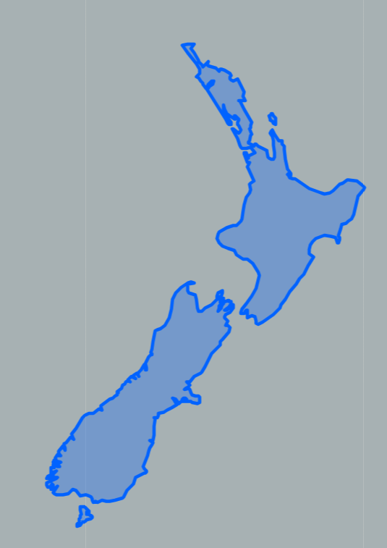
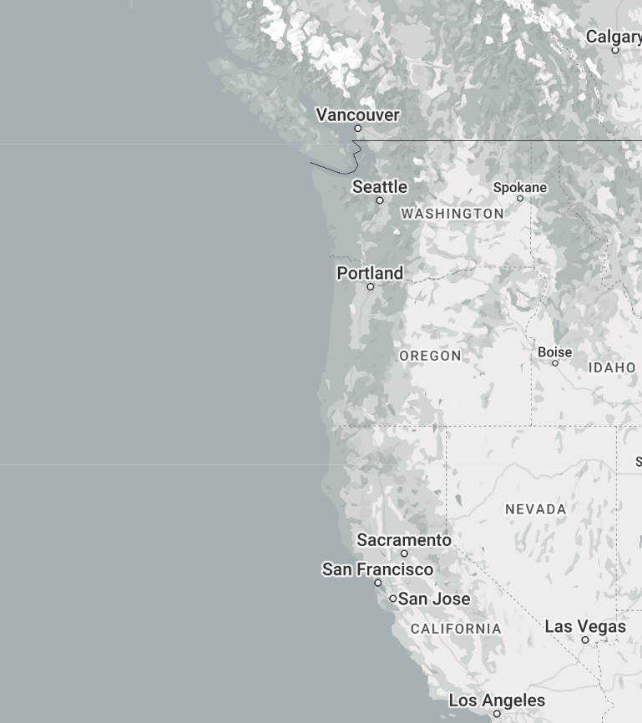
Climate

Slide 6
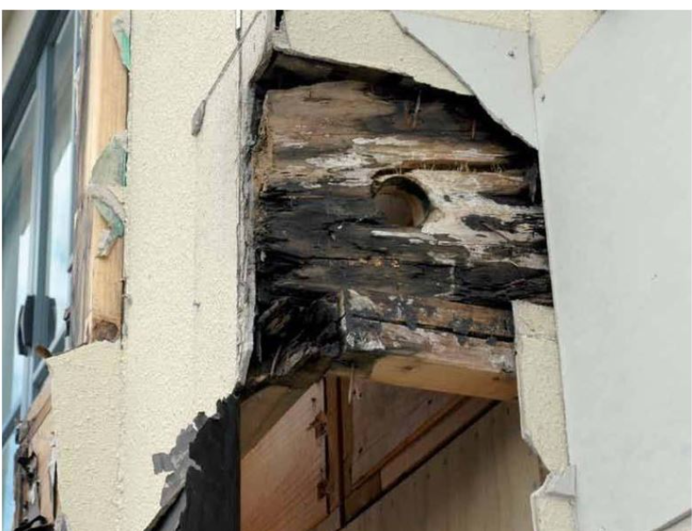
Leaky Homes

Slide 7
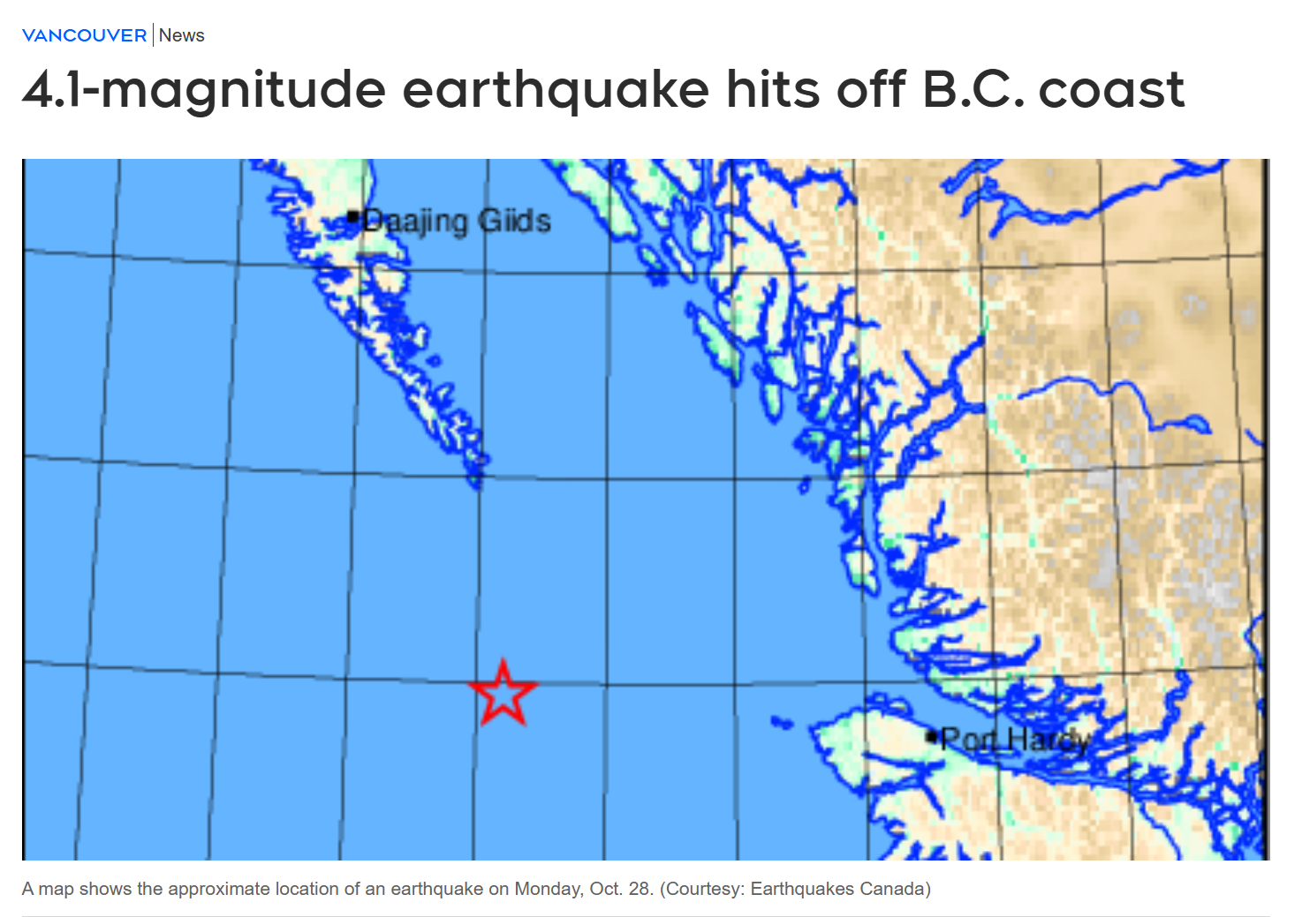
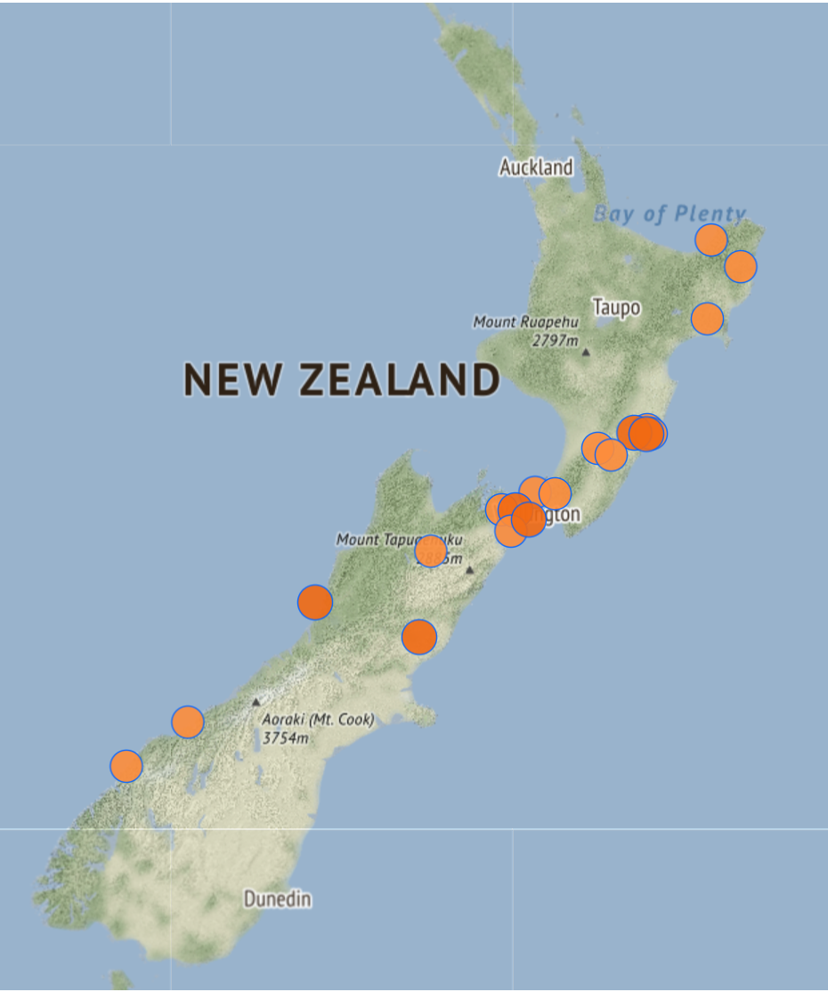
Seismic

Slide 8
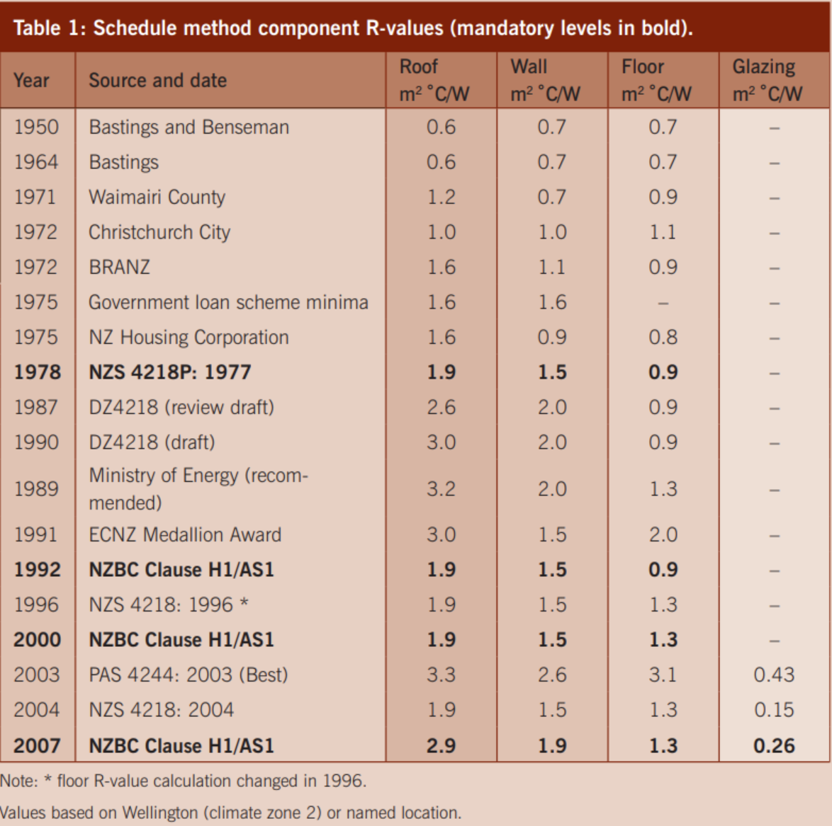
Key Insulation Milestones

Slide 9
Key Insulation Milestones
1978 - First building code requirement for insulation
2007 - Double glazing,
- R1.9 wall,
- R2.9 roofs
- Thermally broken window frames,
- R2.0 Walls
- R6.6 Roofs

Slide 10
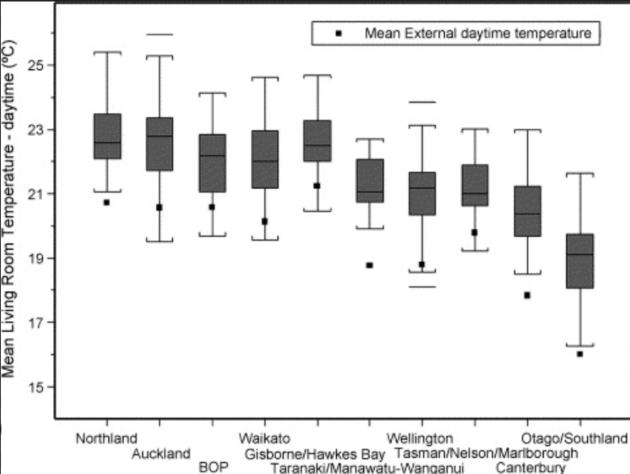
Uninsulated Houses
>800,000 or 55% of homes in NZ are uninsulated
Roof and floor insulation is considered a selling feature
Chronically underheated or unheated

Slide 11
Average Energy Use
Average NZ House:
8,500 kWh / year total energy use (TEUI Actual)
Average house 175 square metres
~ 50 kWh / sqm *yr
$2,500 / year
Heating and Cooling:
~15% = 7.5kWh/sqm*yr (TEDI Actual)
~45kWh/sqm*yr predicted
Friendly climate and cultural norms overestimate energy use significantly
Houses are not maintained at 20C
No code requirement for heating

Slide 12
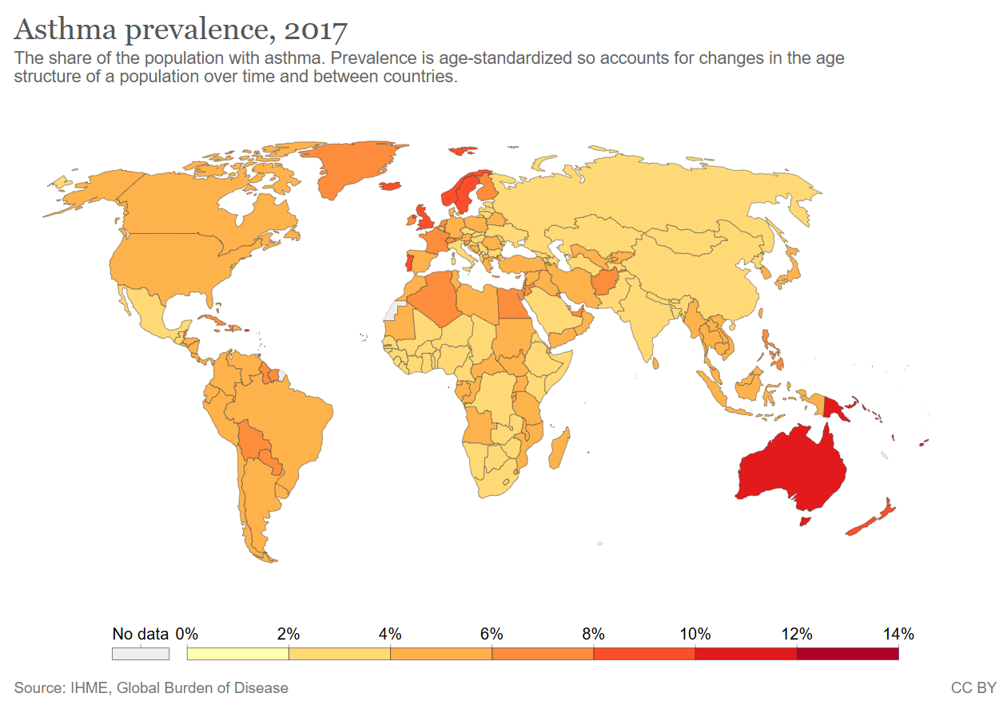
Asthma

Slide 13
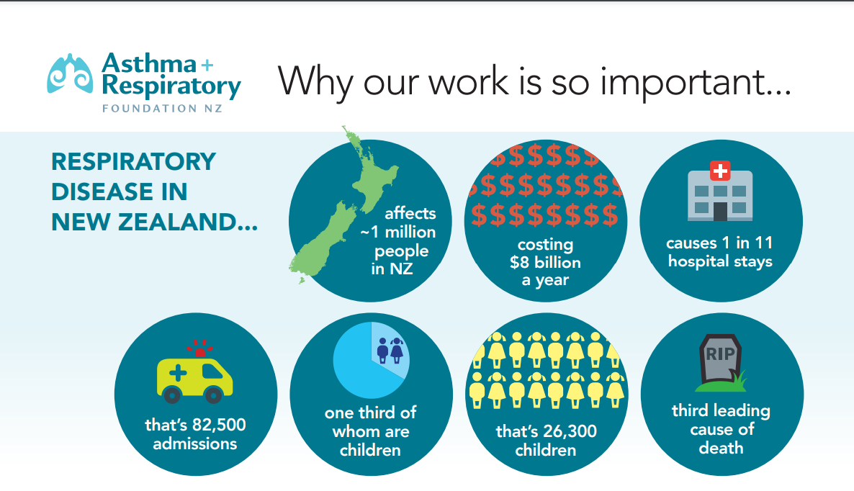
Asthma

Slide 15
Number 8 Wire
The internet is only 1 generation old
Culture is still dominated by ‘what’s available’ mentality
Number 8 wire
Preference for what’s been done before or readily available

Slide 16
Timber Frame Walls
90X45 (2X4)
Radiata Pine
H1.2 treated
Nogs and Dwangs
Sheathing optional (bracing)
No vapour barriers
Prenail (offsite modular)
R2.0 (R11.35)

Slide 17
Prenail Frame and Truss
>~90% of new houses start in a ‘factory’ setting
Walls and trusses

Slide 18
Roofing
>90% of roofs are metal
<5% asphalt shingles
<5% membrane roofs
Metal on battens
Absorbent underlay
Safety mesh

Slide 19
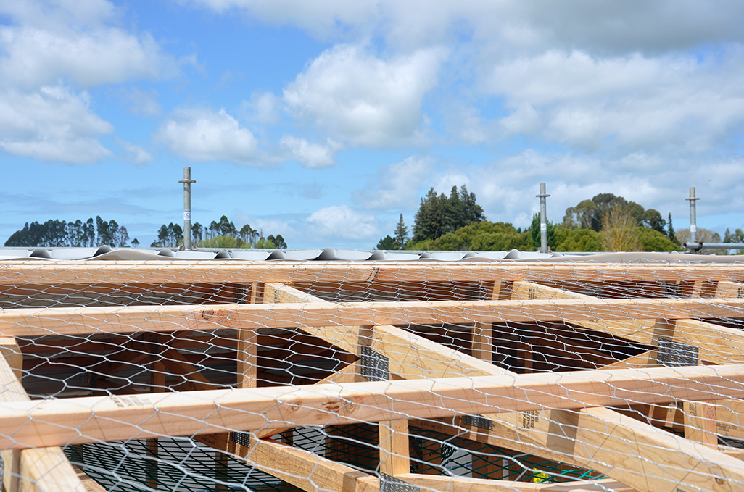
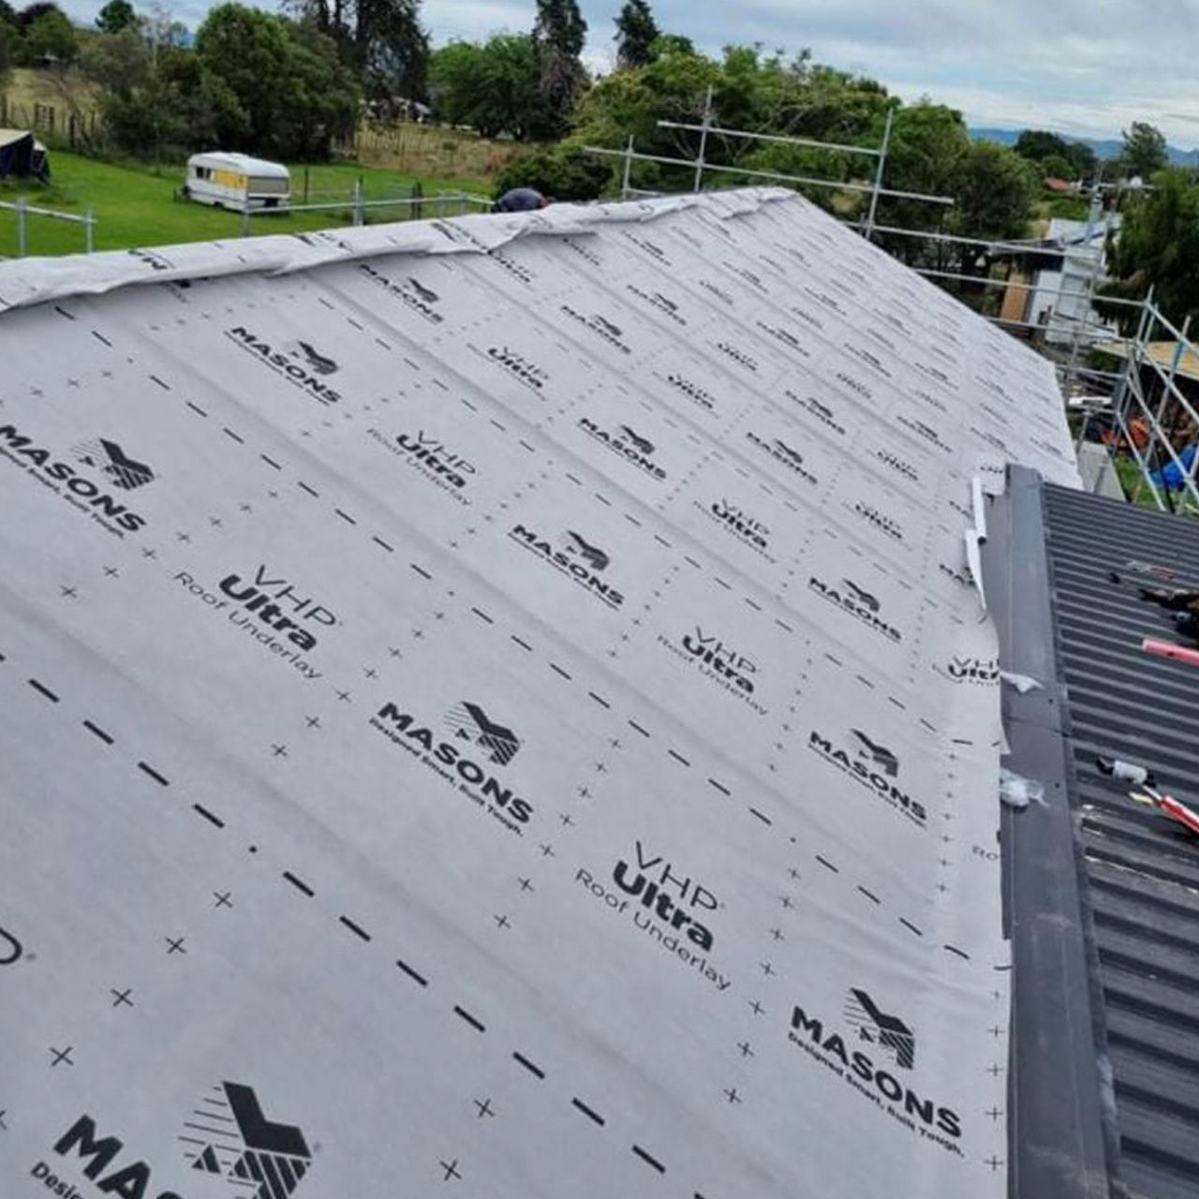
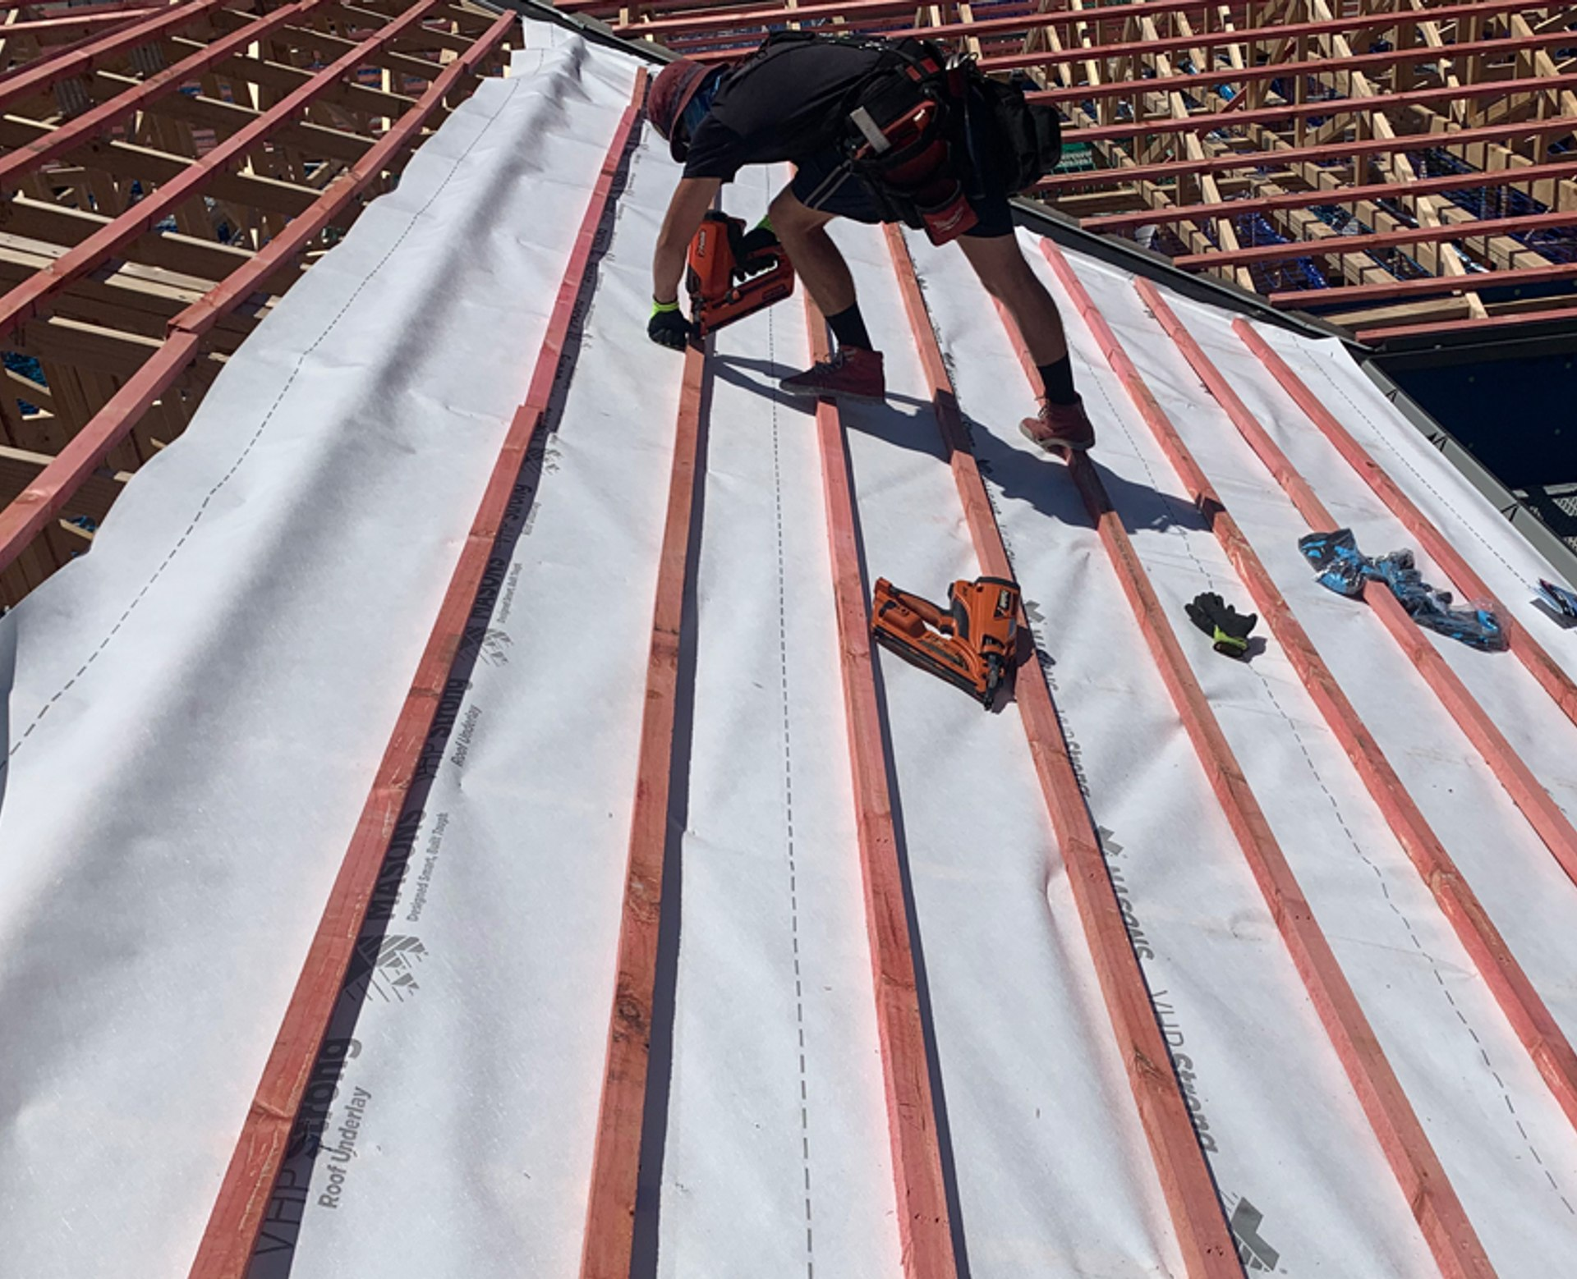

Slide 20
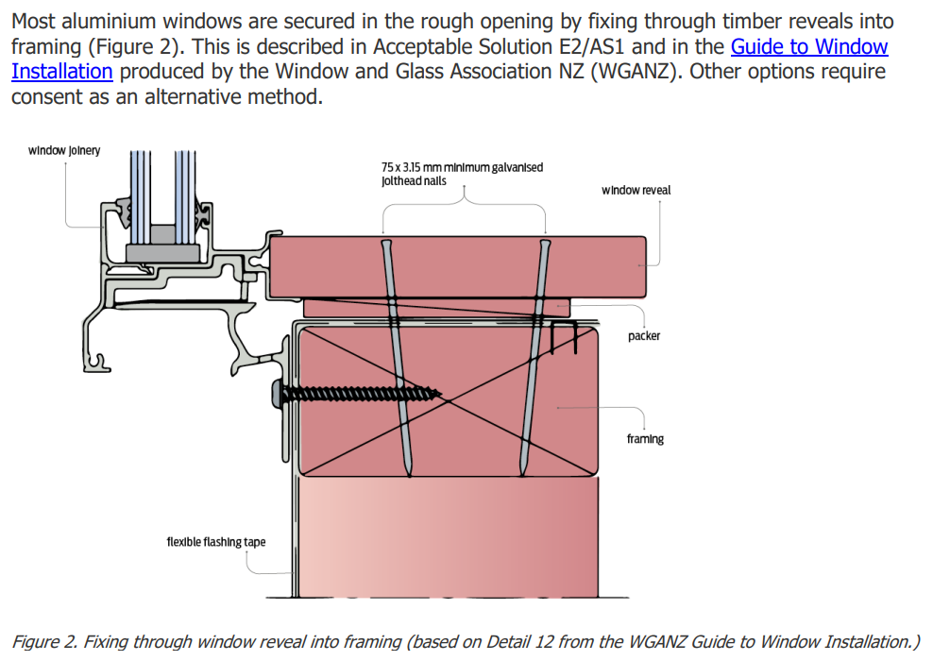
Windows
>90% of windows are aluminium
Until 2024 these were non-thermally broken
Double glazed
Window reveals are stapled to the frame
Supported by WANZ bar

Slide 21
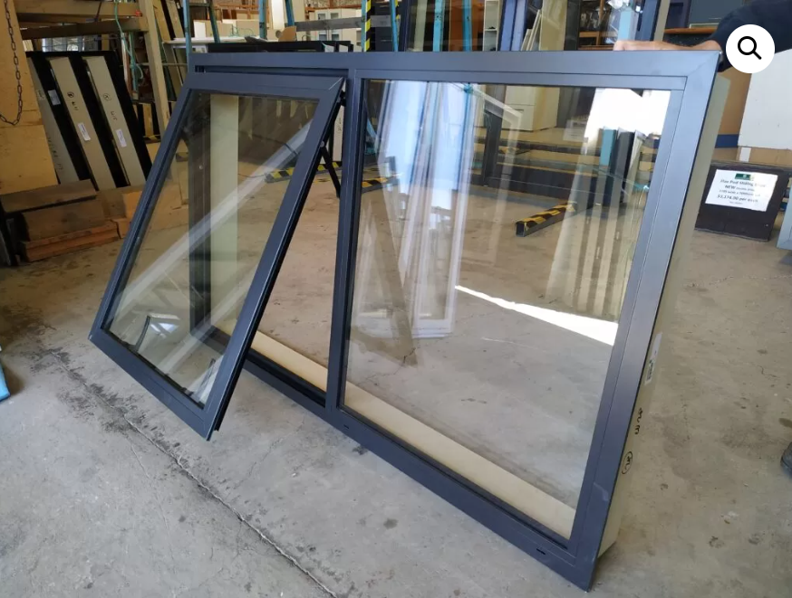
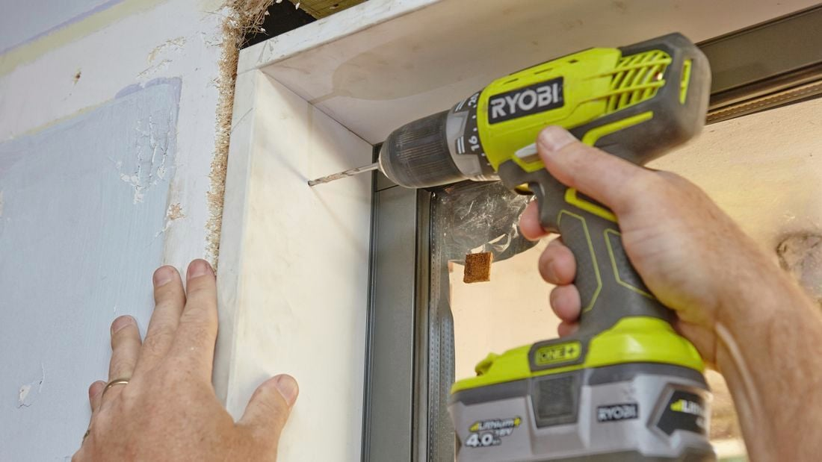

Slide 22
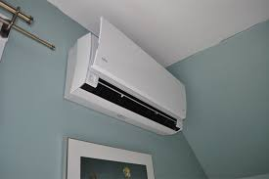
HVAC
Air source heat pumps are the primary heating source for new homes
Provides cooling too
Some intermittent exhaust fan requirements
Minimum window opening sizes

Slide 23
Same Answer to Different Questions

Slide 24
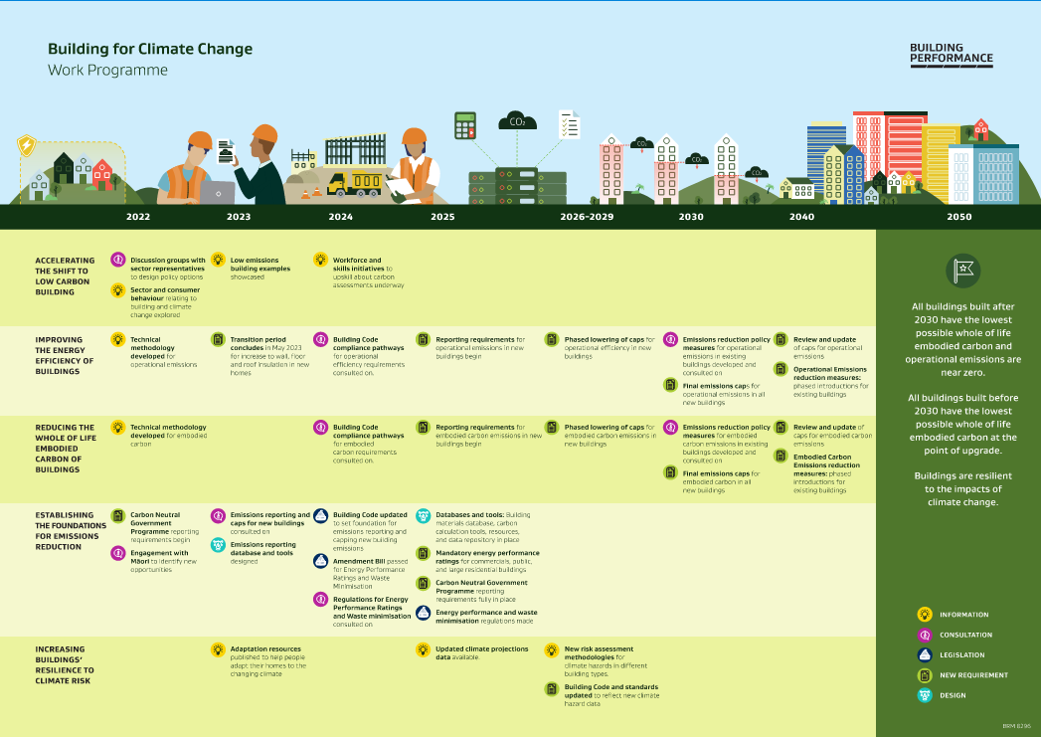
Building for Climate Change

Slide 25
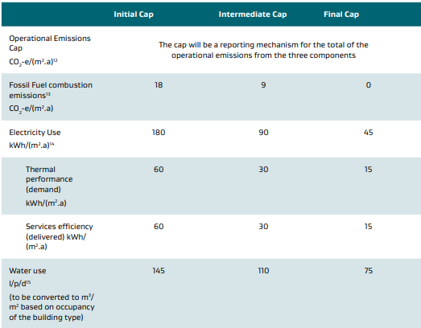
Operational Efficiency Caps
2026 2028 2030
= Passive House
= Current Industry Standard (w heat pumps) (TEDI)

Slide 26
NZ Challenge

Slide 27
Where to Find Us?

