Slide 1

Introducing the BCIT Hybrid Test Method for Assessing Sound Insulation by Windows
Nazanin Souri, MASc, NFRC ACE
Won Ohm, PhD.
Maureen Connelly, PhD.
Omid Tamanna, MEng., P.Eng.
Notes:
Good morning, everyone! My name is Nazanin Souri, and I am thrilled to be here today to present my Master’s thesis titled “Introducing the BCIT Hybrid Test Method for Assessing Sound Insulation by Windows”
As a recent graduate with a Master of Applied Science in Building Science from BCIT, I am eager to share my research and its potential impact on our industry.
Currently, I am working at Bendini as a Project Manager, for supplying and installation of aluminum windows. Additionally, I am an NFRC ACE-approved calculator
I appreciate your time and look forward to any discussion following the presentation. Thank you!

Slide 2
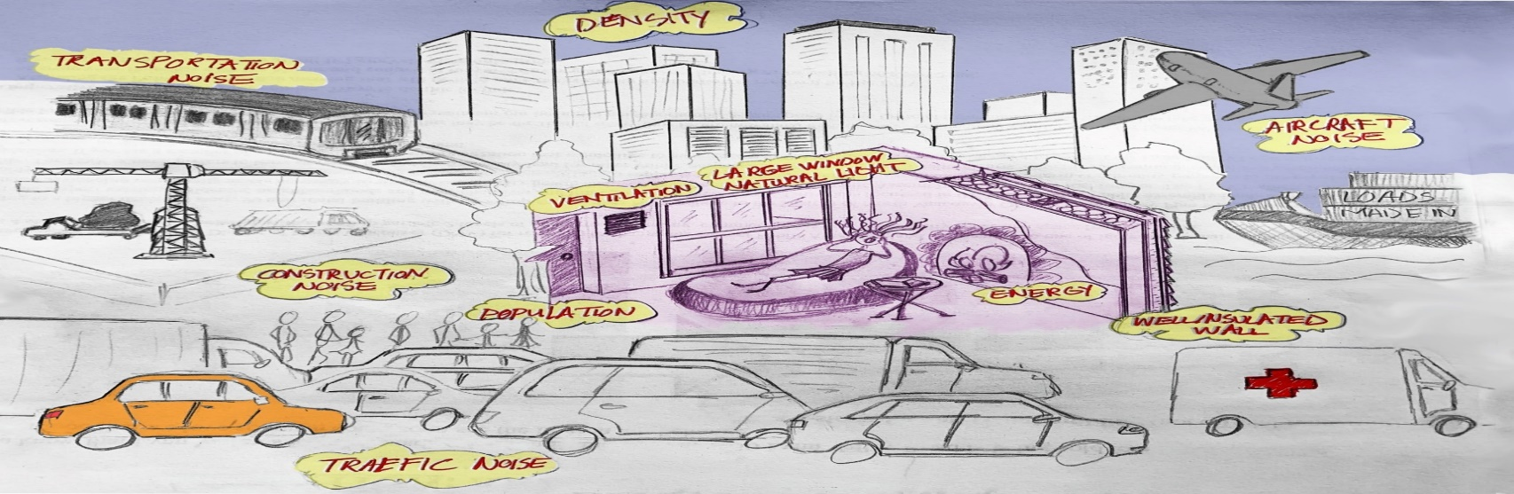
Noise
Noise Pollution and Health Risks
Noise Pollution:
  More than just an inconvenience.
  Significant health risk.
Regulations:
  Established by relevant organizations.
  Aim to maintain safe noise levels for all.
Notes:
Noise pollution isn’t just an inconvenience - it’s a health risk. To combat this, related organizations have established regulations to keep noise at safe levels for all.

Slide 3
Single Number Rating
ASTM
  STC – Sound Transmission Class, ASTM E413
  OITC – Outdoor to Indoor Transmission Class, ASTM E1332
ISO
  R_{w} - Weighted Sound Reduction Index
Notes:
In building and architectural acoustics, Single‐number ratings such as STC and OITC, have been widely used to evaluate the sound transmission properties of windows.
In order to calculate these single-number ratings we need to obtain the transmission loss data over some specific length of the frequency spectrum

Slide 4
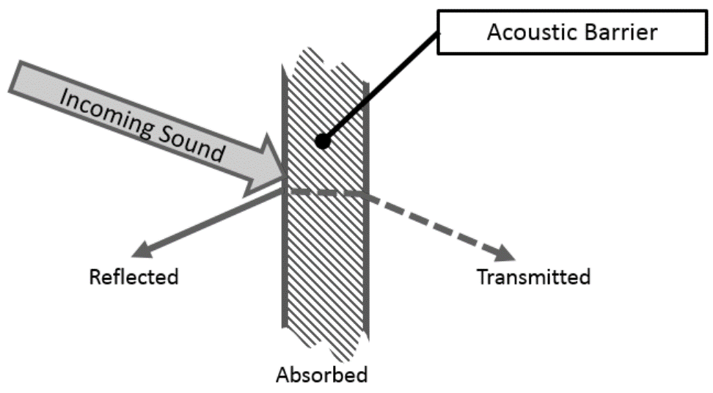
Transmission Loss (TL) – Sound reduction index (R)
The sound transmission loss (STL) through a building component is the logarithmic ratio between the total incident power on the test specimen (P_{in}) relative to the total transmitted power (P_{tr})
It shows how well the building element blocks sound. It is influenced by several factors such as material properties, the sound frequency and angle of incidence.
Notes:
The sound transmission loss (STL) shows how well the building element blocks sound. It is influenced by several factors such as material properties, the sound frequency and angle of incidence.

Slide 5
Transmission Loss (TL) – Sound reduction index (R)
Prediction modeling
Standard test methods:
  ASTM E90 - Standard Test Method for Laboratory Measurement of Airborne Sound Transmission Loss of Building Partitions and Elements
  ISO 10140.1 – Measurement of sound insulation of building elements
  ISO 15186.2 – Measurement of sound insulation of building elements using sound intensity
  ASTM E966 - Field Measurements of Airborne Sound Attenuation of
  Building Facades and Facade Elements
Notes:
This data can be derived from the theoretical modeling methods, or obtained from standard test methods such as two reverberation room methods, sound intensity methods, or Field measurement methods

Slide 6
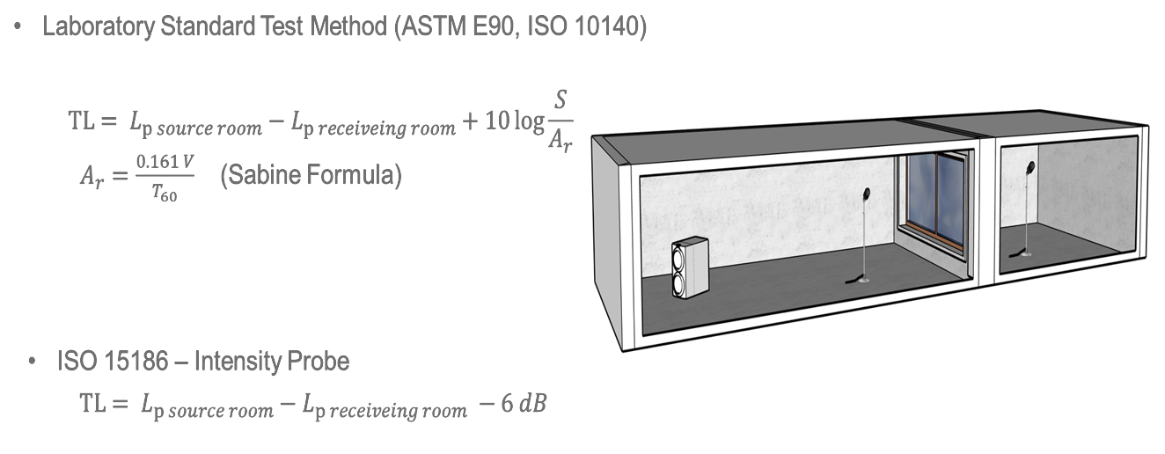
Standard Measurement Methods
Notes:
At the time of my thesis, only one facility in Canada, in Ottawa, was available to perform the ASTM E90 standard test. Very recently we have this facility at BCIT as well.
Other methods such as field measurement methods or intensity methods, required one reverberation room or enclosure in either the source or the receiving side.

Slide 7
Limitations for standard test methods
Creating two or even one reverberation room or enclosure that meets the minimum standard requirements for diffused field and cut-off frequency is challenging and costly
limited numbers of available standard laboratory facilities
Project funding and time limitations
Too many combinations of assemblies at the early stage of research.
Notes:
Using the standard test methods have the following limitations: ………..بالا یادت نره
Therefore, we decided to create our hybrid test method at least for the early stage of the researches.
This method was originally suggested by my first supervisor, Dr. Maureen Connelly and it’d been used in some research projects and master theses before me.

Slide 8
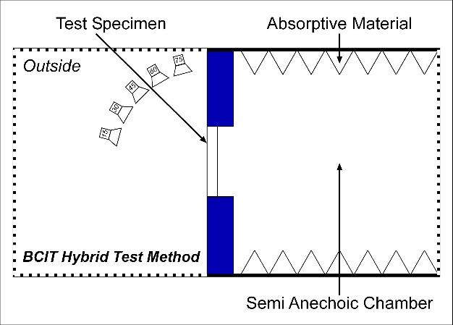
BCIT Hybrid Test Method Benefits
Eliminates the requirements for diffused field and sound absorption measurement on the receiving side by using the Intensity measurement method according to ISO 15186-2.
Eliminate the requirements for diffused fields at the source side by using the ASTM E966 method (Speaker in different angles of incidents, and averaging the results)
Notes:
The BCIT hybrid test method is not completely new. It integrates two standard methods for the receiving side and the source side.
It Eliminates the requirements for diffused field and sound absorption measurement on the receiving side by using the Intensity measurement method according to ISO 15186-2.
and Eliminate the requirements for diffused field at the source side by using the ASTM E966 method

Slide 9
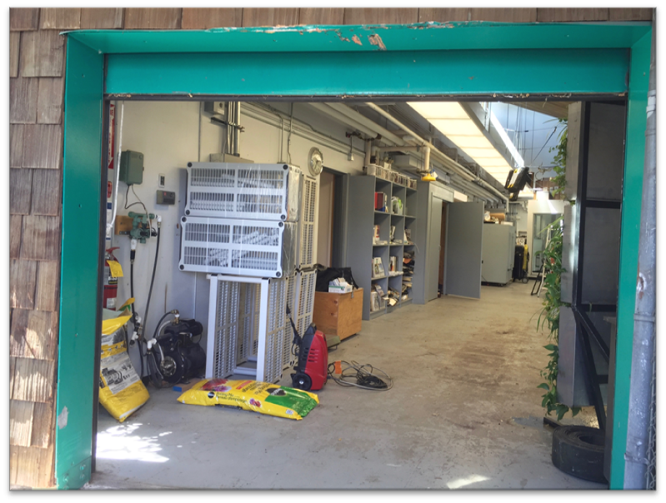
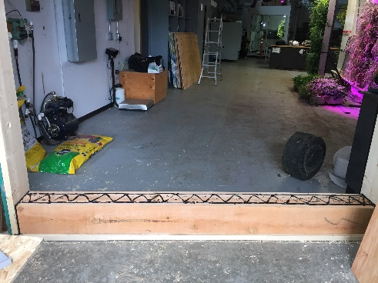
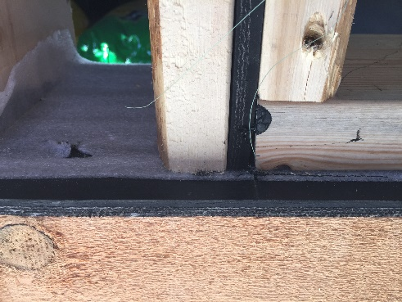
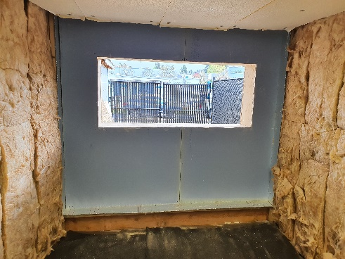
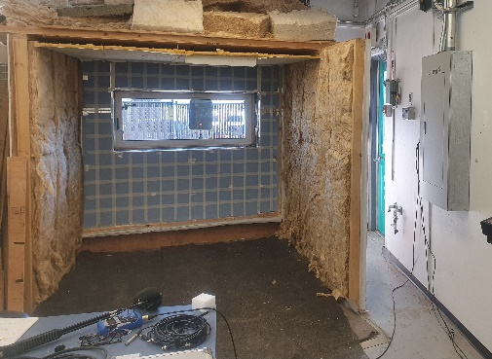
BCIT Hybrid Test Method
Measurement
Notes:
Here is a step-by-step procedure for our hybrid test method : We had a 7’ by 8’ garage door opening at our loading bay in our lab.
First, we made a frame inside that opening, Then, the frame was acoustically sealed and isolated from the rest of the building by using rubber and elastic materials. Then we built an oversized high-performance filler wall inside the opening and the window installed on this wall. we tested the filler wall to make sure the sound transmission loss through the filler wall is at least 10dB more than the windows in all frequencies.

Slide 10
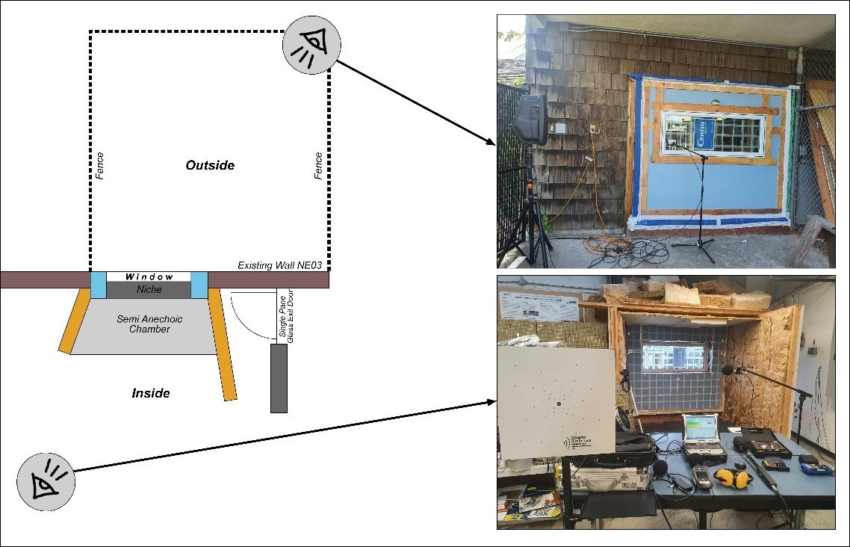
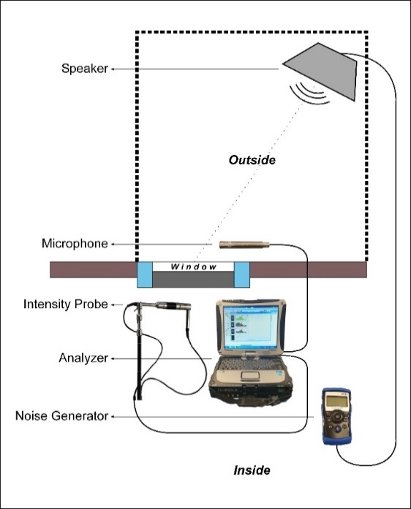
Overview of the BCIT Hybrid test Method procedure and instrumentation:
BCIT HTM Instruments and their Interconnections:
Notes:
On the interior side, as depicted in the Figure, a partial enclosure was constructed, consisting of two side partitions and a ceiling. This enclosure was designed to reduce irrelevant noise and reflections and to have a semi anechoic chamber.
The method can be divided to two main sections :exterior measurements and the interior measurements that are done sequentially.
For the source side measurements we need a speaker and a microphone and for the receiving side measurements we need an intensity probe.
All the transducers were connected to a 4-channel Soundbook, and we used SAMURAI software for measurement and data analyses.

Slide 11
Source side Measurements
To comply with the ASTM E966 standard, the following factors were considered and checked:
Outside background noise
Characteristics of speaker
Direction, height and distance of Speaker from window surface
Outside sound pressure level variation
Measurement duration
Position of the measurement points across the window's surface
Notes:
For the source side measurements and to accurately determine the loudspeaker positions for each sound incidence angle as per the ASTM E966 standard, these factors were considered and checked: …

Slide 12
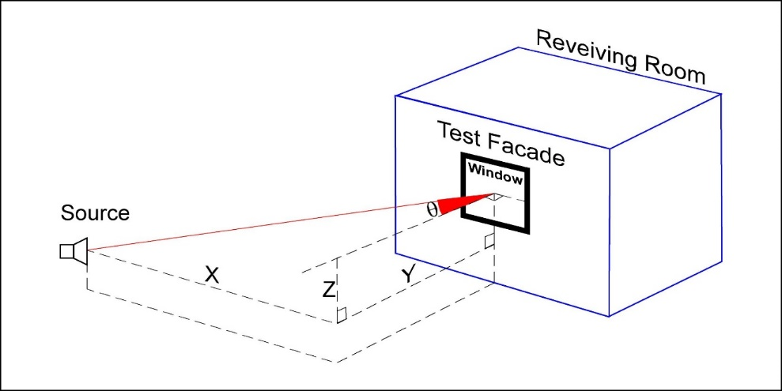
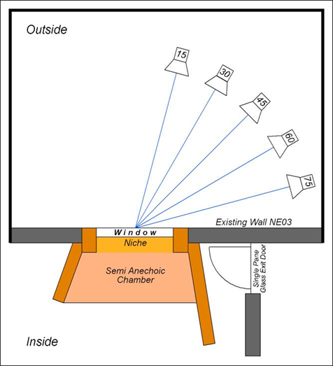
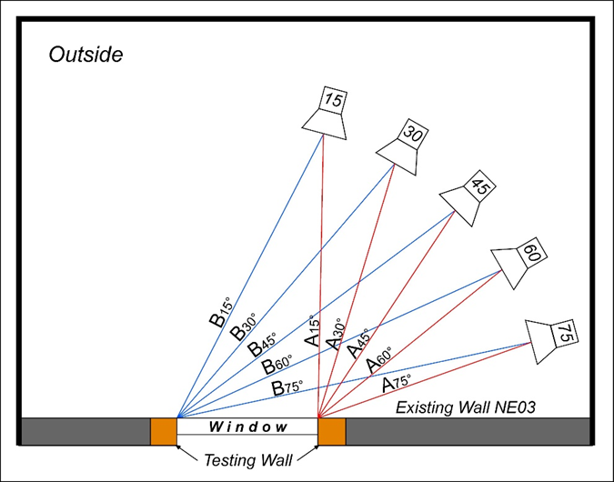
Source side Measurements
Notes:
In our outside measurements:
Multiple sound incidence angles for the source side were considered to be able to compare our results with those obtained in a diffuse sound field, as mentioned in the ASTM standard.
Also, the volume of the speaker was adjusted to achieve at least 10 dB above the ambient noise on the receiving side.

Slide 13
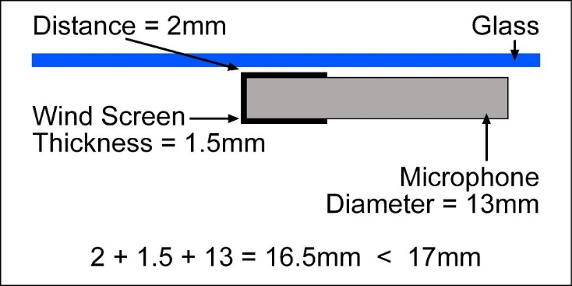
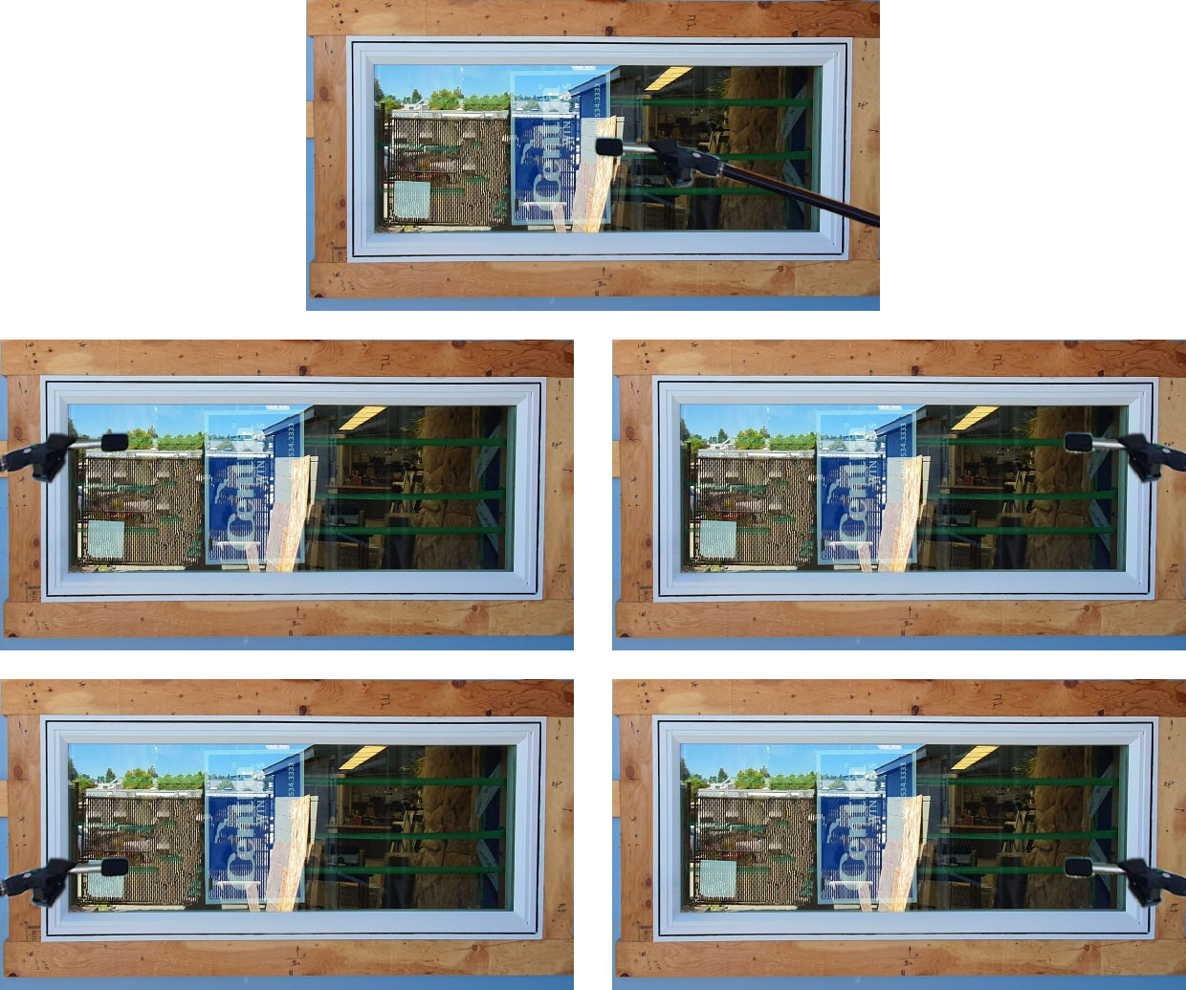
Source side Measurements
Microphone positions:
Notes:
The flush microphone method, as described in the ASTM E966 standard, was used for positioning the microphone. This method is noted for its repeatability.

Slide 14

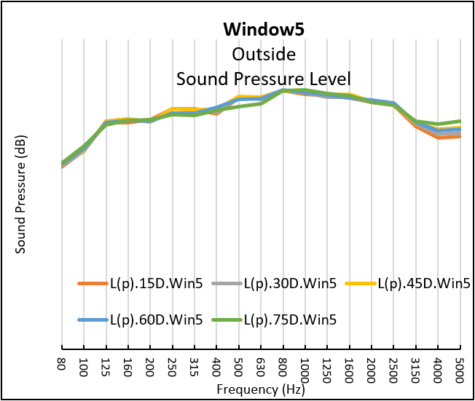
Source side Measurements
Outside Sound Pressure Levels:
Measurements of the exterior sound pressure level for a window test:
Notes:
Last step, measurements were conducted and averaged, to obtain the source side sound pressure level for each speaker position.

Slide 15
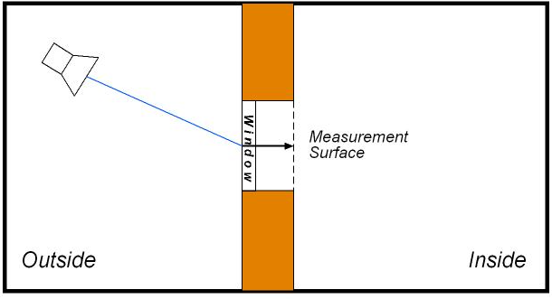
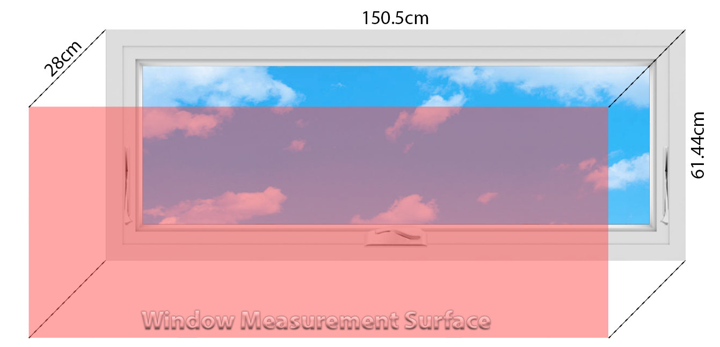
Receiving Side measurements
      All the requirements of ISO 15186 have been verified as follows:
      Distance of the measurement surface from the window
      Distance between measurement lines
      Probe movement speed and direction
      Operator positioning relative to window and probe
      Interior background noise level
      Surface pressure-intensity indicator
Notes:
For our interior measurements, we used an intensity probe and Scanning method was applied
All the requirements of ISO 15186 have been verified in the receiving side measurements as follows:
Distance of the measurement surface from the window, Distance between measurement lines, Probe movement speed and direction, Operator positioning relative to window and probe, Interior background noise level, Surface pressure-intensity indicator

Slide 16

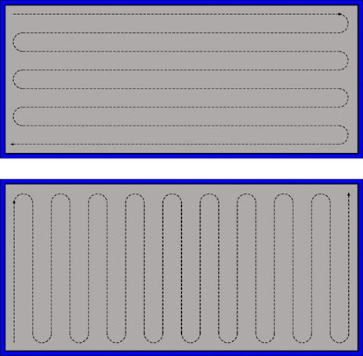
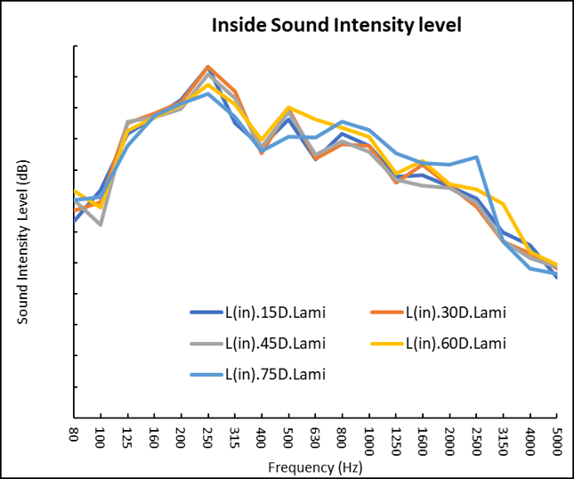
Receiving Side measurements
The two final accepted measurements of the interior sound intensity level were arithmetically averaged:
Interior sound intensity Level for each position of the loudspeaker for the window test:
Notes:
We verified the initial data against ISO 15186-1 to ensure consistency. Once all criteria were met, we averaged the measurements to get the final interior sound intensity level for each speaker position.

Slide 17
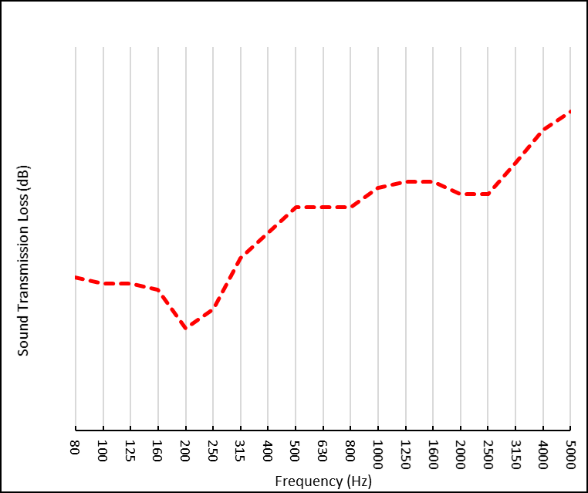
Sound Transmission Loss
Conducted all source side and receiving side measurements
Calculated sound transmission for each speaker position
Averaged sound transmission for all angles
Derived the final transmission loss curve for the tested window
Notes:
After completing all source side and receiving side measurements and calculations, we derived the transmission loss curve for the tested window. and methodology is done

Slide 18
Results
      Tested windows provided by Centra windows
Name | Series name | Frame type | Glass 1 width | Air space | Glass 2 width
Annealed | 2900 | Casement Window | 3.9 mm Annealed | 9.8 mm | 5.7 mm Annealed
Laminated | 2900 | Casement Window | 6 mm Laminated | 8 mm | 5.7 mm Annealed
Win 2 | 2600 | Casement Window | 5.7 mm Annealed | 8 mm | 5.7 mm Annealed
Win 3 | 2600 | Casement Window | 6 mm Laminated | 8 mm | 5.7 mm Annealed
Win 4 Foam | 2600 | Casement Window | 6 mm Laminated | 21 mm | 6 mm Laminated
Win 5 | 2600 | Casement Window | 6 mm Laminated | 21 mm | 6 mm Laminated
Win 6 | 2600 | Casement Window | 6 mm Laminated | 8 mm | 5.7 mm Annealed
Win 7 | 2600 | Casement Window | 6 mm Laminated | 21 mm | 6 mm Laminated
The effect of the following variables on the sound transmission loss of tested windows were analyzed:
Critical frequency
Mass air mass resonance frequency
Glass thickness
Distance between the glass panes
Laminated glass
Symmetrical glazing
Notes:
This is the list of tested windows used in this thesis and were provided by Centra Windows. The aim was to verify that the BCIT Hybrid Test Method is consistent with theoretical predictions and previous studies regarding: critical frequency, mass air mass resonance frequency, glass thickness, distance between the glass panes, laminated glass, and symmetrical glazing.

Slide 19
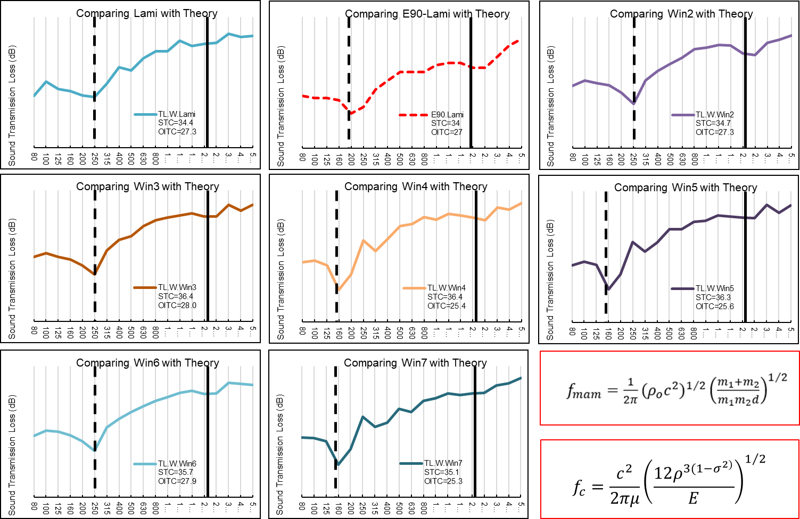
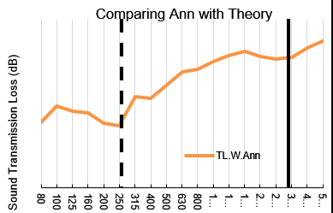
Critical Frequency and Mass Air Mass Resonance Frequency
Consistency with the theoretical prediction for $f_{c}$ and $f_{mam}$
Notes:
The sound transmission loss curves of the tested windows is displayed here. Also, mass-air-mass resonance frequency and the critical frequency of each window, calculated based on Quirt's equations, are indicated on the graphs. These results show a notable consistency between our measurements and the theoretical predictions.

Slide 20
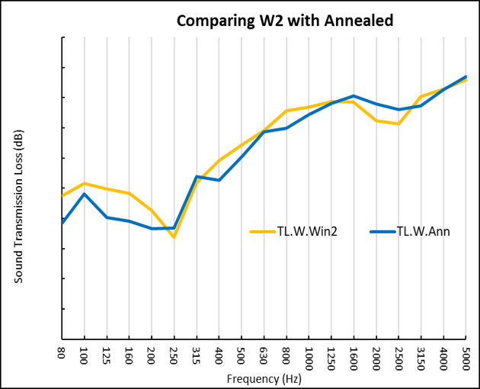
Results: Mass Law-Glass Thickness
Comparing Window 2 with Annealed
The interpane space of window 2 is approximately 2 mm less than BCIT Annealed
Window 2 had greater mass compared to BCIT Annealed (mass-law & critical frequency)
Window 2 had almost the same interpane space compared to BCIT Annealed (Mass-air-mass resonance frequency)
Window 2 had symmetrical glass panes compared with BCIT Annealed (deeper dips)
Notes:
In this slide, we compared these two tested windows. Window 2 depicted by yellow color in the graph, had greater mass and a thicker glass pane. The result showed better performance between the mass air mass resonance frequency and critical frequency for this window. This complied with mass law.
This window had symmetric glass panes, same glass thickness. Our measurenment esults showed lower transmission loss in both mass air mass resonance frequency and critical frequency. This complied with the previous studies.

Slide 21
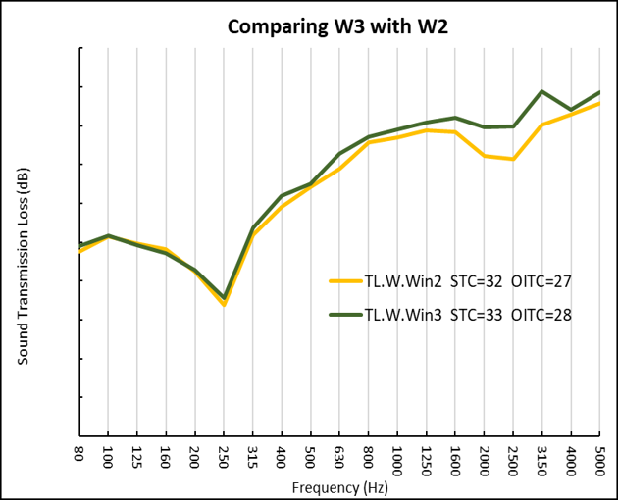
Results: Effect of laminated glass
Comparing Window 2 and Window 3:
  Window 2: Symmetric double-glazed with both panes annealed.
  Window 3: One laminated pane and one annealed pane.
Common Factors:
  Same air gap distance.
  Similar glass thickness.
Impact of Laminated Glass:
  Laminated glass improves performance through its damping effect.
Notes:
By comparing Window 2 and Window 3, we can see from the table that both windows are identical, except that Window 3 has a laminated glass pane. Theoretically, this improves performance around the critical frequency due to its damping effect. Our measurements obtained the same result.

Slide 22
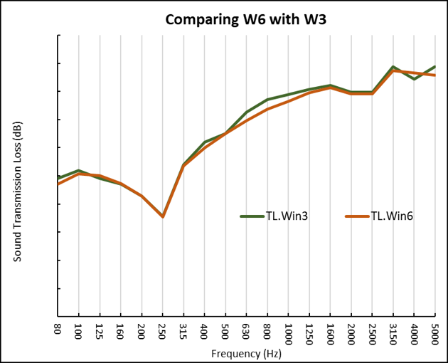
Results: Repeatability
Comparison of Windows 3 and 6:
Both have identical specifications for their IGUs and frames.
Sound transmission loss (STL) measurements show almost identical graphs.
Demonstrates the repeatability and reliability of our testing method.
Notes:
In terms of method repeatability, Windows 3 and 6 have identical specifications for their IGUs and frames. Our measurements show that the sound transmission loss graphs for these two windows are almost identical. This demonstrates the repeatability and reliability of our testing method.

Slide 23
Conclusion
BCIT Hybrid Test Method:
Accurately depicts effects of:
Glass pane thickness
Air cavity depth
Laminated glasses
Symmetrical glazing
On the sound transmission loss curves of double-glazed windows
Advantages:
Reliable
Cost-effective
Accessible
Suitable for early stages of product development
Future Steps:
Continue refining the BCIT Hybrid Test Method.
Compare results with the E90 standard method.
Notes:
The study showed that the BCIT Hybrid Test Method accurately depicts the effects of key variables for double-glazed windows. Therefore, the BCIT Hybrid Test Method is a reliable, cost-effective, and accessible method for testing sound transmission loss in the early stages of product development.
Thanks to our new ASTM E90 chambers at BCIT, I am continuing to work with BCIT to enhance this method and directly compare its results with the ASTM E90 standard for double and triple windows.

Slide 24
Thank you
Notes:
Thank you for your time and attention today. I look forward to any questions or further discussions.

