Slide 1
November 15, 2024
Social Housing Retrofits:
Using Energy Modelling for Existing Buildings
Using Calibrated Energy Models for Retrofit Planning
Maddy Kennedy-Parrott | M.Eng., P. Eng., CPHD (she/her)
Building Science Engineer

Slide 2
AGENDA
Context
Energy Analysis for Existing Buildings
Case Study Buildings
Methodology
Results
  Building Retrofits
  Energy Analysis
  Costing
Lessons Learned

Slide 3
Context
1
Let’s get inspired!

Slide 4

We all need to be more like Monte.
Notes:
As I’m sure most of you know, we lost an incredible force of nature earlier this year. A few weeks before he died, I’d actually asked Monte if he wanted to do this presentation with me, as I know his company was working on a few similar projects. Anyone who has been coming to BCBEC for a while knows that Monte could take his half hour up here and turn it into a bit of magic that could convince everyone in this room they could conquer any problem, even one as big as climate change. I already told my coworkers this, but I’m going to tell all of you, too: there’s not a person on earth who can fill the hole that Monte left in our industry, and so we all need to step up and do our best to harness that same energy – and I’m going to try to do that today.
But if I’m not doing a great job, just close your eyes and pretend that I’m a poorly-dressed, ambiguously-aged ball of energy who looks like they probably know their way around a sailboat. That should help.

Slide 5
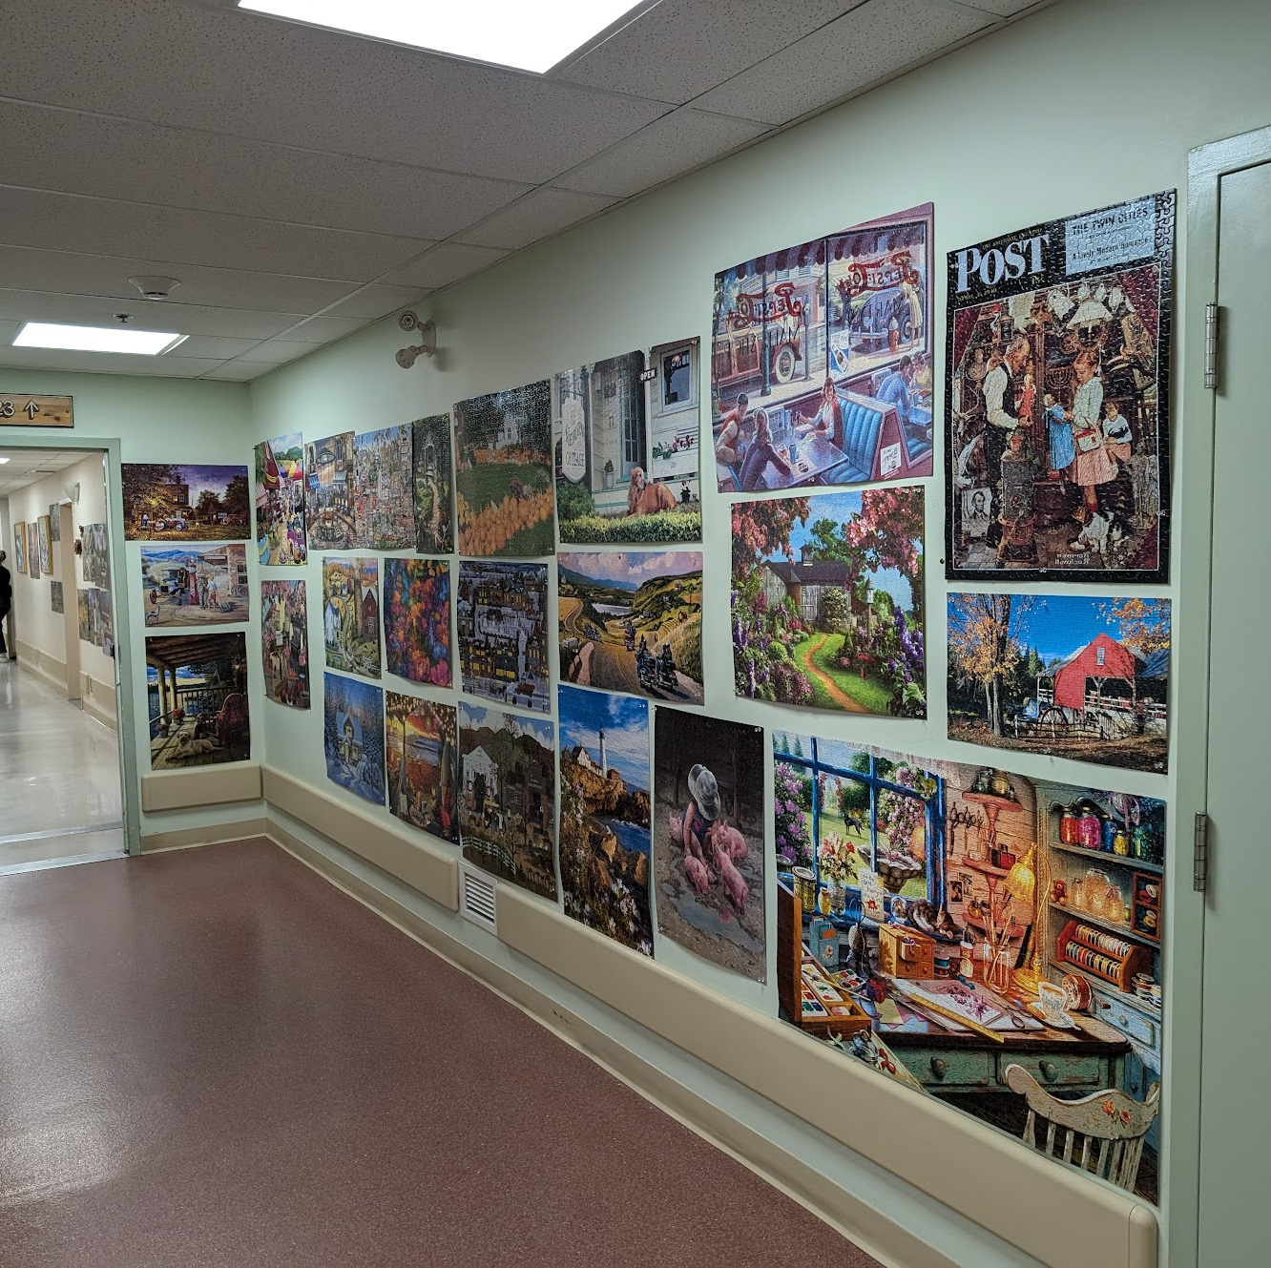
SOCIAL HOUSING
Significant number of social housing units in Canada
  5.4% of Canada’s housing stock (almost 1 million units)
  100,000 units in BC
Most have major systems at or approaching end of service lives
800 million in deferred maintenance for the non-profit housing sector
Costs of major retrofits are already high, and climbing
Notes:
There’s a lot of folks who live in social housing. A lot of those folks are in Canada’s lowest income bracket, and a lot of those folks are seniors or those with disabilities.
The social housing stock in Canada is aging, and many of these buildings are in dire need of renewals – major systems are being limped along just for one more year, structures are deteriorating, and major assemblies are failing. There is almost a billion dollars of deferred maintenance in this building sector already, and as the cost of construction soars, the backlog is getting even worse.
I want to reframe this:
The folks who live in social housing are already a fairly under-supported group of people in our community. On top of their struggles with making ends meet and meeting their own basic needs, in this economy? they are also living in buildings that have been neglected due to lack of funding.
A lot of us here today are engineers, and I want to remind you all of the first item in our code of ethics: Hold paramount the safety, health, and welfare of the public.
It is our duty to help the people who live in these buildings, and that’s why I’m here today: to share what we’ve learned through this process, so that it is easier for all of you to help these buildings and the people that live in them.

Slide 6
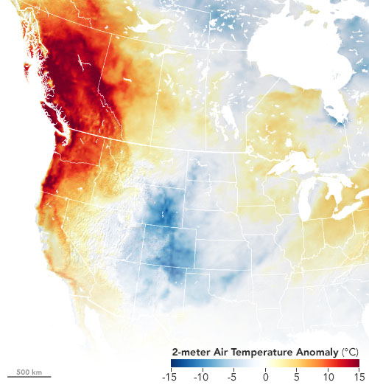
CANADA’S CHANGING CLIMATE
Adaptation
We’ve made our bed and now we must lie in it.
Adding cooling to existing buildings
Climate-resilient retrofits
Mitigation
Do not make the climate crisis worse.
BC Climate Change Accountability Act
Canadian Net-Zero Emissions Accountability Act
June 27th, 2021
Notes:
I’m really not going to harp on about climate change today – that’s not what I’m here for.
But I do want to frame this talk in the context of those buzz words we all hear about climate change and buildings – the ideas of mitigation and adaptation.
Adaptation is the idea that our climate change is real, and we must learn to live with impacts of that – be it heat domes, wildfires, atmospheric rivers, or polar snaps.
Mitigation is the idea that we already have a climate crisis on our hands, and it is our duty to the planet and those who live on it to not make it worse.
Adaptation is driving two major things in the context of buildings in BC: the need to add cooling to existing buildings, and the need for retrofits that build our climate resiliency in the face of all this wacky weather.
In Canada, mitigation is legislated – we are committed to reduce our emissions, in BC and Canada-wide. We cannot just throw more energy at our adaptation problems, and buildings should plan to reduce their operational emissions in support of these reduction goals.

Slide 7



RETROFIT FUNDING PROGRAMS
Enabling adaptation in the name of mitigation
The goal of many retrofit funding programs is to help fund renewals that can help with both climate adaptation and mitigation.
There are an incredible amount of different and overlapping incentive funding programs available in BC and Canada… describing them all would be another presentation entirely.
But they all share common elements:
Energy Study Funding
Energy & Emissions Targets
Rebates
Full rebates
Low-interest loans
Incremental costs
Renewables
Determine the most effective and valuable retrofits for the building
Energy Savings
Emissions Reductions

Slide 8
Energy analysis of existing buildings
2

Slide 9
How do we measure energy use (and therefore savings) of retrofits?
Can’t we just do the same thing we do for new construction?

Slide 10

WARNING: THE FOLLOWING SLIDES ARE BORING.
“Boring things are still important” – Chili Heeler

Slide 11
COMPLIANCE MODELS AND THE PERFORMANCE GAP
PSA: Compliance energy models do not predict energy use (or at least, not well)
But that’s okay - they are not meant to!
They are compliance and benchmarking tools.
Energy Models are indeterminate:
Far more inputs than outputs
Subjective (two modellers = different results)
Easy to manipulate
For compliance modelling, many inputs are standardized so policymakers can fairly compare two buildings’ energy results:
Occupant behaviour
Weather
Lighting
Internal Gains
Elevator equipment
Airtightness(ish)

Slide 12
COMPLIANCE MODELS AND THE PERFORMANCE GAP
The performance gap:
The difference between actual building energy use and energy use predicted by the energy model
If compliance energy models aren’t the answer, how can we estimate how much energy we can save?

Slide 13
HOW MUCH CAN I SAVE WITH X?
It depends on X.
X = Simple Measures
X = Complex Measures
  Straightforward energy savings calculations
  Minimal interactions with other systems
  Reliable desktop analysis
Complex energy savings calculations
Many interactions and knock-on effects
Typically requires energy modelling
Lighting upgrades
In-suite or small-scale equipment replacement

Slide 14
HOW MUCH CAN I SAVE WITH X?
It depends on X.
X = Simple Measures
X = Complex Measures
  Straightforward energy savings calculations
  Minimal interactions with other systems
  Reliable desktop analysis
Complex energy savings calculations
Many interactions and knock-on effects
Typically requires energy modelling
Lighting upgrades
In-suite or small-scale equipment replacement
    Whole-building systems
    Demand reduction (enclosure upgrades)

Slide 15
ENERGY AUDITS
Level 1
What are those energy savings calculations?
Level 1:
  Review of utility data (12 months minimum)
  High level site visit to review major systems
  High level (DR-equivalent) mechanical system assessment
  Spreadsheet analysis with standard assumptions
  Identifies “free” energy-savings measures (within O&M budget)
  Identifies measures worth further analysis for the owner’s review
As usual, ASHRAE’s got a standard for that.
ASHRAE 211
Provides guidance for completing energy audits, including how to report and analyze retrofit options.
Each level builds on the previous, to expand on the energy auditing process.

Slide 16
ENERGY AUDITS
Level 2
What are those energy savings calculations?
Level 1 plus:
  Detailed on-site review:
    Equipment nameplate data
    On-site airflow measurements
    Review of O&M procedures, controls, etc.
    Confirmation of enclosure assemblies
  Spreadsheet analysis using informed building-specific assumptions
  Energy end-use breakdowns for more targeted retrofit recommendations
  Recommendation of retrofits complete with energy savings calculations, costing, economic analysis
As usual, ASHRAE’s got a standard for that.
ASHRAE 211
Provides guidance for completing energy audits, including how to report and analyze retrofit options.
Each level builds on the previous, to expand on the energy auditing process.

Slide 17
ENERGY AUDITS
Level 3
What are those energy savings calculations?
Level 2 plus:
  Measurement & verification of energy savings calculations
    Calibrated model (without ‘calibration targets’) OR
    Minimum 2-week on-site metering of specific systems considering retrofits
  Updated Cost and Cost Savings of EEMs (using calibrated model/calibrated system)
  Life Cycle Costing Assessment
  Risk Assessment
As usual, ASHRAE’s got a standard for that.
ASHRAE 211
Provides guidance for completing energy audits, including how to report and analyze retrofit options.
Each level builds on the previous, to expand on the energy auditing process.

Slide 18
CALIBRATED ENERGY MODELS
The existing building energy model
Start with a typical compliance model.
Modify standardized inputs based on observations of the building:
  Mechanical/Electrical Systems
  Enclosure
  Occupant Behaviour
  Airtightness
  Weather
Compare model’s predicted energy use to utility bill data – how close is close enough?
  ASHRAE Guideline 14 (& IPMVP) calibration criteria typically used
Tweak inputs one at a time, repeating Steps 2 and 3 as necessary until calibration targets are met.

Slide 19
CALIBRATED ENERGY MODELS
The existing building energy model
What does all this work actually get you?
A model that accurately reflects the building’s operation & energy use and can be used for a variety of additional analyses:
  Predict energy savings of complicated retrofits with a high degree of confidence.
  Overheating studies and climate-resiliency analysis

Slide 20
Case Study Buildings
3

Slide 21
CASE STUDY PROJECTS
688 units
Max of 170
Min of 10
7 housing providers
Existing Building Summaries
11 projects targeting CMHC Canada Greener Affordable Homes Grant
2 projects targeting Affordable Housing Fund
14 buildings
low-income affordable housing
seniors housing
transitional housing
Most built between 1980-1990
One 1911 heritage building
420,000 square feet

Slide 22
CASE STUDY PROJECTS
Existing Building Summaries
Construction |  |  |  | Primary Heating |  |  |  | Ventilation
 | 92% | wood frame with batts | wood frame with batts |  | 54% | electric baseboards |  |  | 54% | makeup air unit
 | 8% | concrete with rigid |  |  | 38% | hydronic baseboards
 | 8% | concrete with rigid |  |  |  |  |  |  | 46% | exhaust-driven
 | 8% | concrete with rigid | concrete with rigid |  | 8% | in-floor radiant |  |  | 46% | exhaust-driven
Windows |  |  |  | Cooling |  |  |  | Domestic Hot Water
 | 62% |  | aluminum |  | 62% | none | none |  | 77% | gas-fired
 | 38% |  | vinyl |  | 38% | portable ac units | portable ac units |  | 23% | electric
 | 38% |  | vinyl

Slide 23
Methodology
4
Where theory meets real buildings

Slide 24








INFORMATION GATHERING
  Document Review
  Site Visit
Assemblies
Equipment
Spot measurements
Metering
  Interviews
  Tenant Survey
Existing building drawings
Utility data
Maintenance manuals
Previous reports
Testing/balancing
Building owner
Building wants, needs
Building manager
Tenant issues
Building history
Building operator
Controls
Occupant behaviour
Schedules
Setpoints
Comfort issues
Building history
Notes:
Document review first
Tenant surveys
site visit
Interviews to confirm findings

Slide 25



MODELLING
  Initial Model
Compliance Model
Mameplate data from site visit
  Utility Data Analysis
Consolidate
Organize
  Consultant reviews
Enclosure
Mechanical
Electrical
Optimize the process
Early consultant involvement
Perfect is the enemy of good
First, fix the things that are broken, for a fair comparison
  Calibration
Tweak inputs as needed to calibrate
  Adjusted Baseline
Code-minimum upgrades
Notes:
My first calibrated energy model was my masters thesis, and now I do them regularly and cringe that it took me so long
This process gets faster and easier with experience
Involving more consultants earlier means better input data from the outset
“Perfect” calibration can be difficult – know when to call it good enough – I had to learn this the hard way, with much urging
Adjusted baseline is about fixing things that are broken, for a fair comparison

Slide 26



ANALYSIS AND RETROFIT PLANNING
  Energy Conservation Measures
  Retrofit Bundles
  Costing
Most effective retrofits
Energy savings
Emission reductions
Prioritization
building needs
project goals
Bundle measures
Energy savings
Emission reductions
Energy cost savings
Determine project costs
Class C+ estimate
Hard & Soft Costs
Contingencies
Notes:
Package individual ECMs into bundles based on building owner wants, needs, budgets
Determine individual energy savings & emission reduction potencial of each ECM
Calculate energy cost savings associated with bundles

Slide 27
Results
5
I HOPE YOU LIKE GRAPHS

Slide 28
ENERGY SAVINGS & EMISSIONS REDUCTIONS
Multiple Scope Options Carried
Recommended + High Performance
PV is good for the “last few miles”
Fuel-switching virtually guarantees emissions reduction goals
Initial EUI & energy savings potential
 | Emissions Savings |  | Energy Savings |  | Targets
 | Recommended Scope |  | Recommended Scope |  | Energy Savings
 | High Performance Scope |  | High Performance |  | Emissions Reductions
 | PV Generation
Notes:
PV is helpful for hitting energy savings targets
- 25% is easy, 50% is harder, 70% is very difficult – PV helps to offset this for that last few percent (typically 5-10 max) don’t rely on it

Slide 29
ENERGY SAVINGS
70% energy savings target: close to Passive House upgrades required
Energy-cost-conscious tenants may struggle to access funding
Good improvements still to be made
Notes:
or note which of these buildings are heated by electric baseboards, the cost of which is borne by the tenants, not the affordable housing provider - this is a big energy equity piece...so these buildings struggle to hit the targets (and therefore access funding) because tenants are paying for their own heat and there's a good chance the buildings are therefore underheated, which can cause other problems like condensation and premature failure of assets..
Often, when social housing tenants are responsible for their own utility bills, they are more frugal with their energy use than an average tenant to keep costs as low as possible.
Step code TEUI target is 60

Slide 30
COMMON RETROFIT MEASURES
Frequency of recommendations
Recommended Retrofits
High-Performance Retrofits
Recommended retrofit scope
  Highest priority retrofits
  Cost-effectiveness
  Disruption to tenants
High-Performance retrofit scope
  More comprehensive retrofits
Insulation
  Exterior mineral wool insulation
  Replacement roofs
  Spray foam interior insulation
  Below grade insulation
Windows
  High performance fiberglass frames
Heat Recovery
  HRVs in suite or in makeup air
Airtightness upgrades
  Additional targeted upgrades

Slide 31
COMMON RETROFIT MEASURES
Frequency of recommendations
Recommended Retrofits
High-Performance Retrofits
Recommended retrofit scope
  Highest priority retrofits
  Cost-effectiveness
  Disruption to tenants
High-Performance retrofit scope
  More comprehensive retrofits
Lighting
  LED replacements
DHW
  Heat pump systems
Renewables
  PV on roofs
Ventilation
  In-suite HRVs/ERVs
  Makeup air
Heating/Cooling
  Heat pump systems

Slide 32
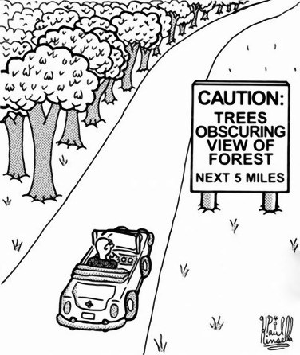
MODELLING
Remember why we’re doing this
It’s not just about energy and emissions!
There are other very good reasons for retrofits, often these reasons are more important to tenants & owners.
    Address deferred maintenance backlog
    Climate resilience
    Long term durability
    Thermal comfort

Slide 33
RETROFIT COSTING
Total Project Costs
Class C+ costing
  Should be better than Class D
  Particularly for enclosure elements
More than just project cost!
  Project costs including contractor markups
  Enabling measures
  General conditions
  Contingency allowances
  Consultant & permitting fees
Notes:
Garden court and Packard house don’t have BAU because they had lower energy savings targets so the planned retrofits were essentially code minimum/business as usual (not like for like)
Antkiw- a ton of enablement measures
Bethune/Centre/Alderbrae are all 3-storey townhouse units (bigger units, higher costs)
Up to $85k/suite or 80% of the total project cost (whichever is less)
Orange = BAU
Green = recommended cost
Purple = HP cost
- Costing is far more critical for enclosure vs. mechanical (bulk of costs, more potential hidden costs)

Slide 34
RETROFIT COSTING
Annual Energy Cost
Annual energy costs
Longer-term analysis shows higher savings
  Inflation
  Increased energy costs
  Carbon taxes
Notes:
Dark blue = adjusted baseline
Orange = recommended retrofit
Light blue = HP

Slide 35
Lessons Learned
6

Slide 36
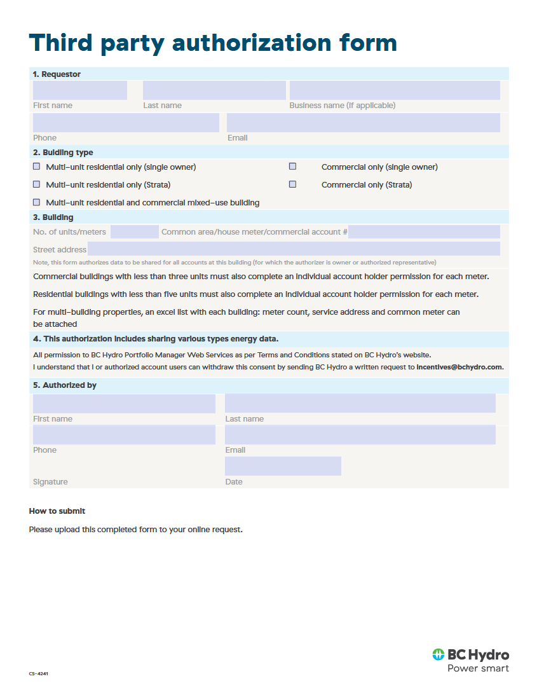
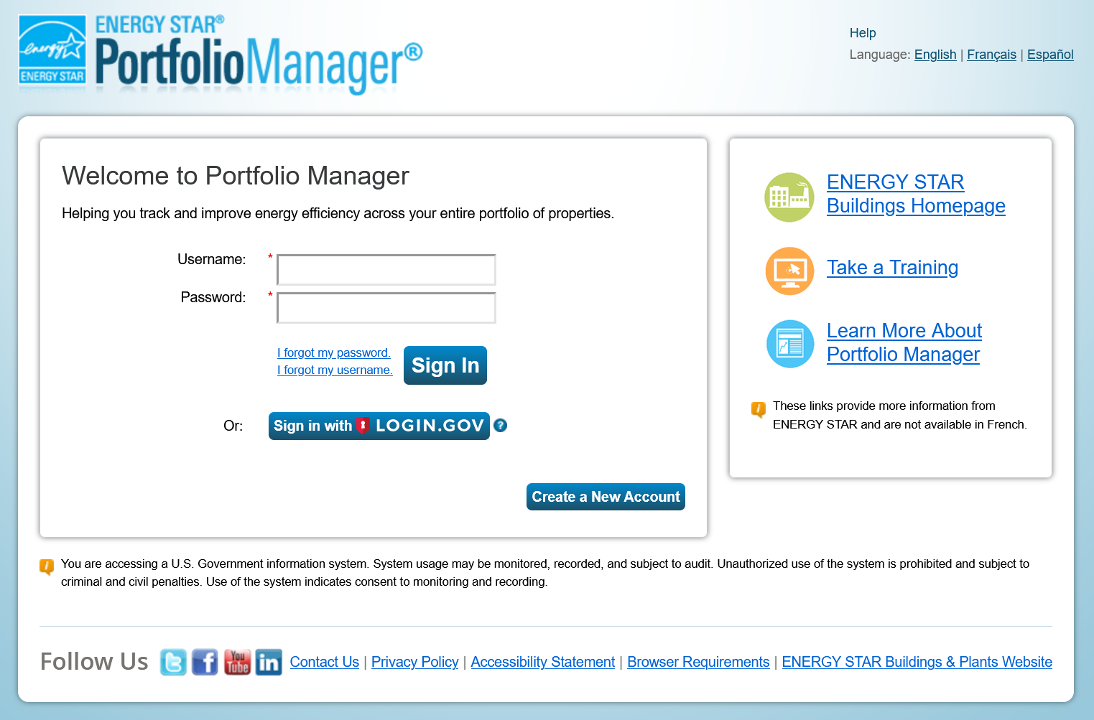
CHALLENGES
Utility Data
Energy Star Portfolio Manager
  Electricity from BC Hydro
  Natural gas from FortisBC
Information needed from building owners
  Recent common area bill(s)
  Third party authorization form
  MURB code (for suite aggragating)

Slide 37

CHALLENGES
Electrical Capacity Upgrades
Central Panel Upgrades
  Not as expensive as you think
  Centralized mechanical system upgrades mean more flexibility
Suite Panel Upgrades
  More costly than central panel upgrades
  Wiring associated drives up costs
  Triggered by decentralized systems

Slide 38
WARNING: THE FOLLOWING SLIDE IS BORING.
“Boring things are still important” – Chili Heeler
Notes:
Uh oh, she’s back….

Slide 39
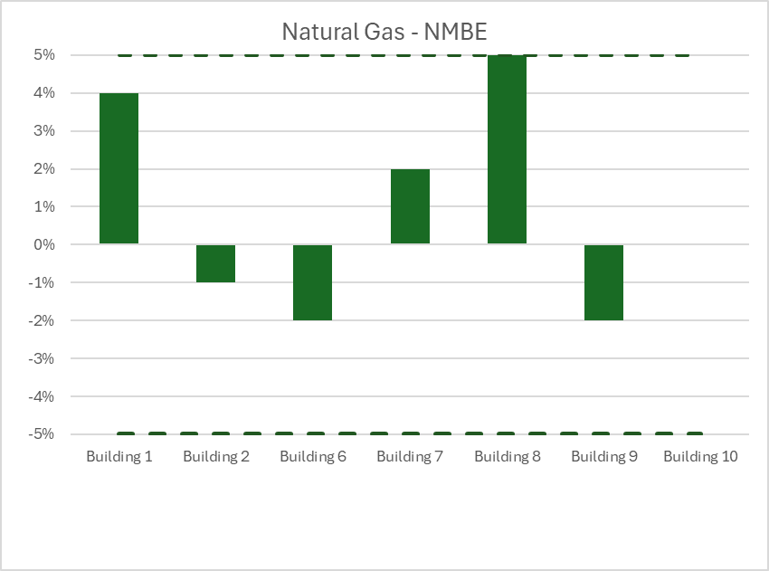
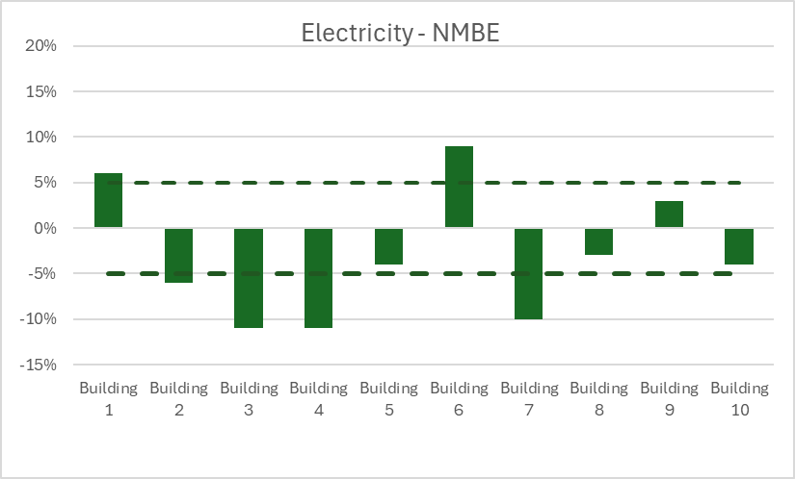
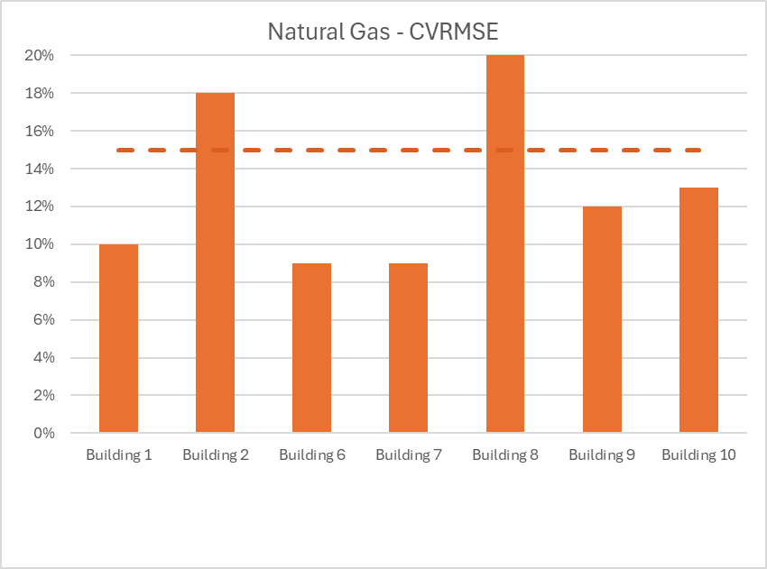
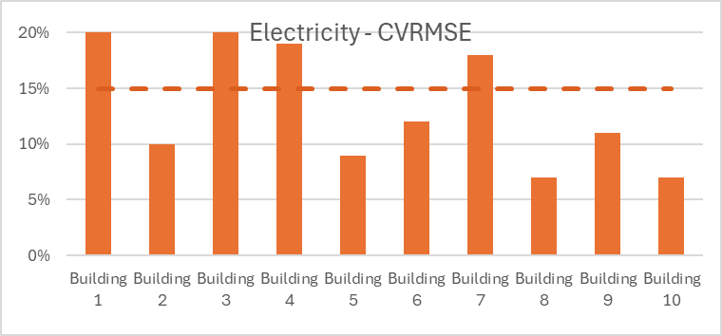
CALIBRATION
Calibration Metrics
Calibration metrics used by ASHRAE Guideline 14:
NMBE (normalized mean bias error): the average forecast error representing the systematic error of a forecast model to under or overforecast.
CVRMSE (coefficient of variation of the root mean square error): indicates instability in the observed relationship between variables in the baseline period.
Notes:
These metrics are pretty dry statistics – I think about them often and I still have trouble wrapping my head around what they mean.
But essentially, they determine if the energy model output you’re getting is reliable. Is your over-estimation of energy use in December cancelling out an under-predicting in April? Or are you fairly even across the board?
All of this is to show you that you can spend a lot of time here – I have. Trying to make it perfect, within the official guidelines of “calibrated” – but ultimately, you don’t really need to. Because this is where we ended up with our calibrations:

Slide 40
CALIBRATION
Existing Building Summaries
Even though we were off, even though we weren’t “perfectly calibrated” for every building… we got pretty dang close.
Level 3 energy audits don’t require Guideline 14 calibration criteria be met. They’re a good guideline, but not a law.
Level 2 versus Level 3 energy audits.
We scaled back on some inputs
  Lighting/plug load audits
  Destructive testing
  Occupant surveys
Notes:
Several projects had existing Level 2 analyses
Level 3 is better at predicting impacts of load reduction

Slide 41
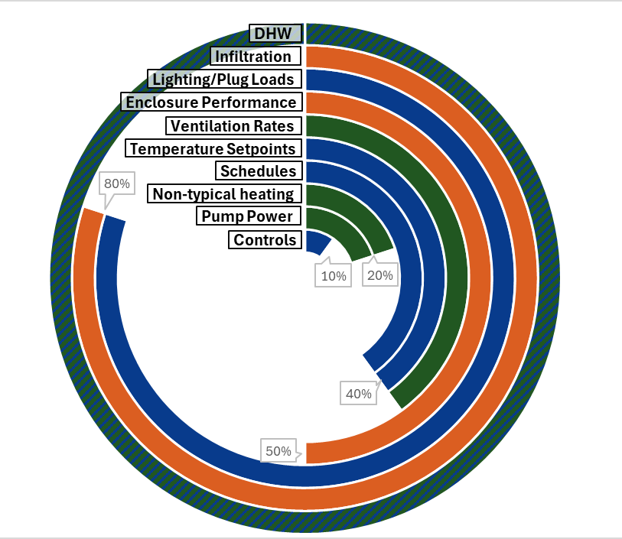
CALIBRATION
Frequency of calibration steps
Inputs that were modified to achieve calibration.
Occupant behaviour (blue)
Mechanical systems (green)
Enclosure performances (orange)
Wishlist inputs
Airtightness testing
  Publish results!
DHW metering
Ventilation rates
Notes:
Electricity
challenges with all-electric buildings
Natural Gas
-brookland & 815 5th ave – challenges
-DHW
-Hidden energy (DHW recirc/leaks)

Slide 42
TO RECAP
Remember why we’re doing this
Retrofit work is expensive
It’s very needed, and the longer we wait, the more expensive it gets.
There is a lot of funding available
We can help alleviate the cost of these much-needed retrofits.
There are tons of people in this room who have experience navigating all of this work.
We should be connecting and sharing this knowledge: the more we do, the cheaper it gets, and the more we can help the buildings and people who need it most.

Slide 43
THANK YOU!
Mkennedy-parrott@rdh.com
And a massive thank you to everyone at RDH who made these projects happen!

