Slide 1
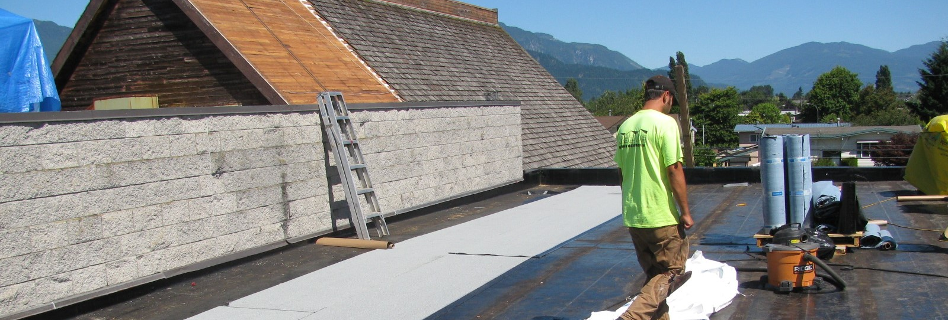


Replacement Roofing Options
November 15th, 2024

Slide 2
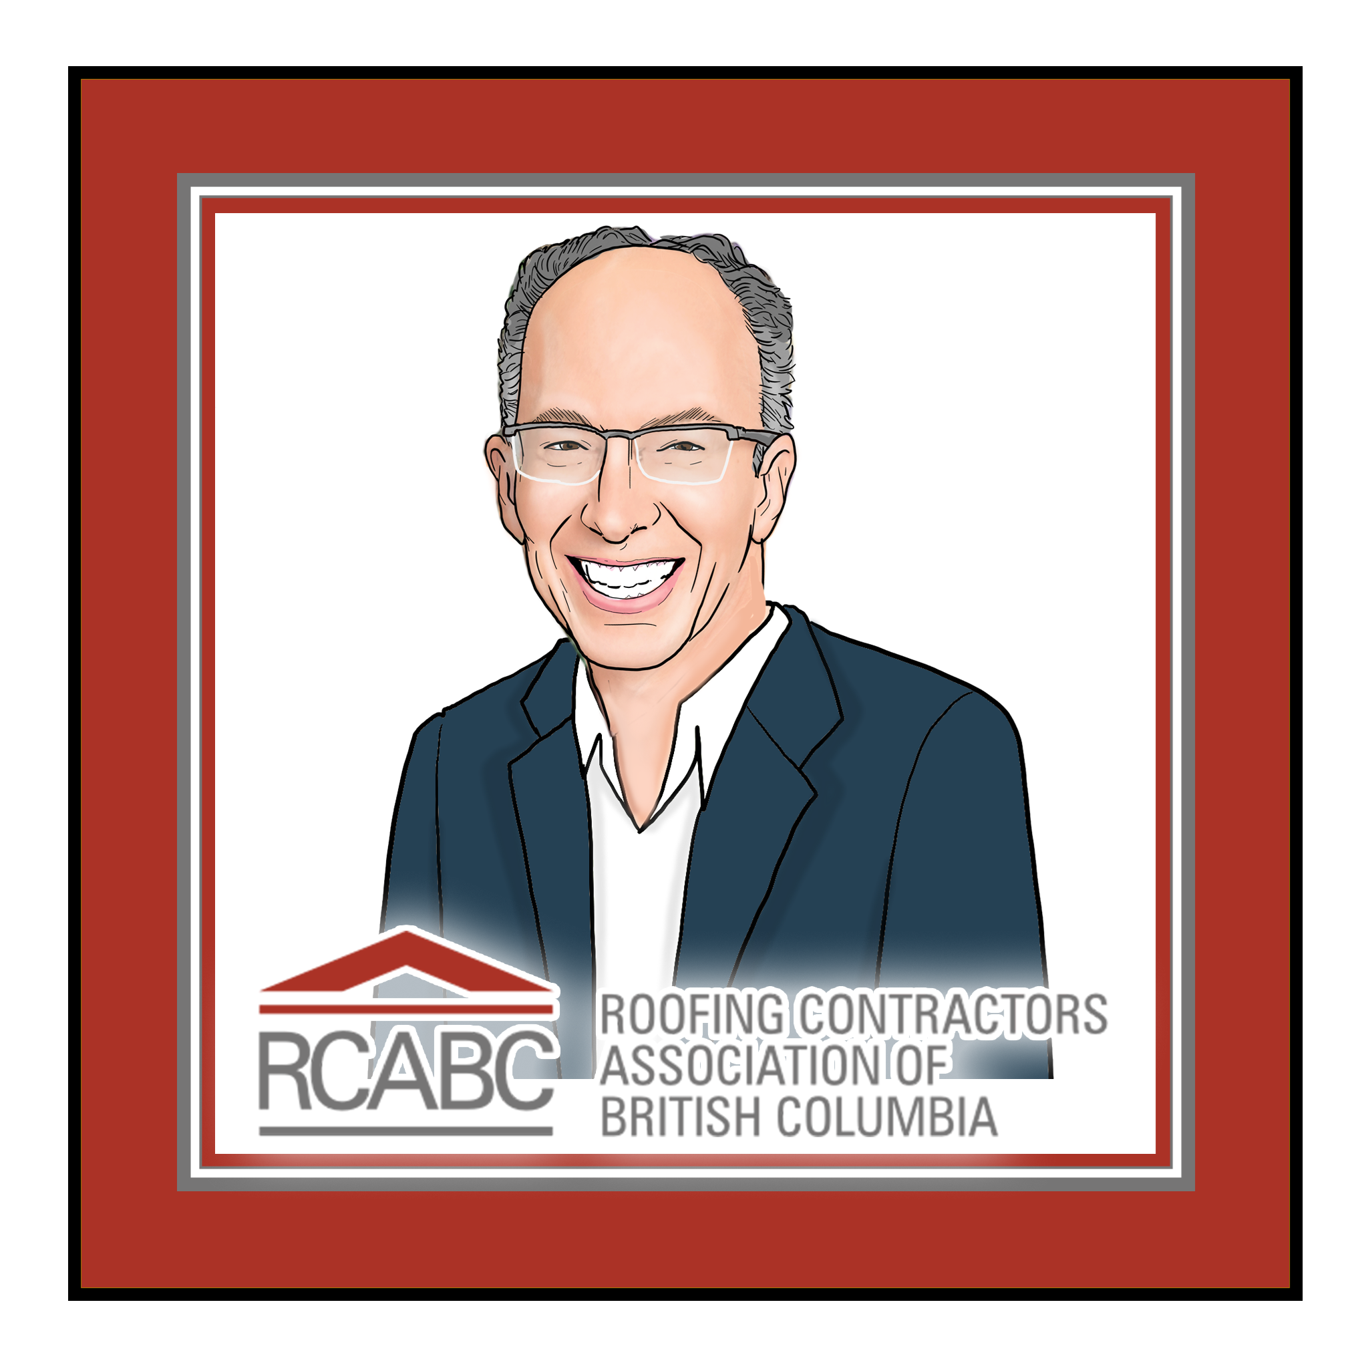

Introduction
Laurence Matzek
Director, RoofStar Guarantee Program
39 years in roofing industry
  9 years at RCABC in current role
  30 years as a roofing contractor

Slide 3
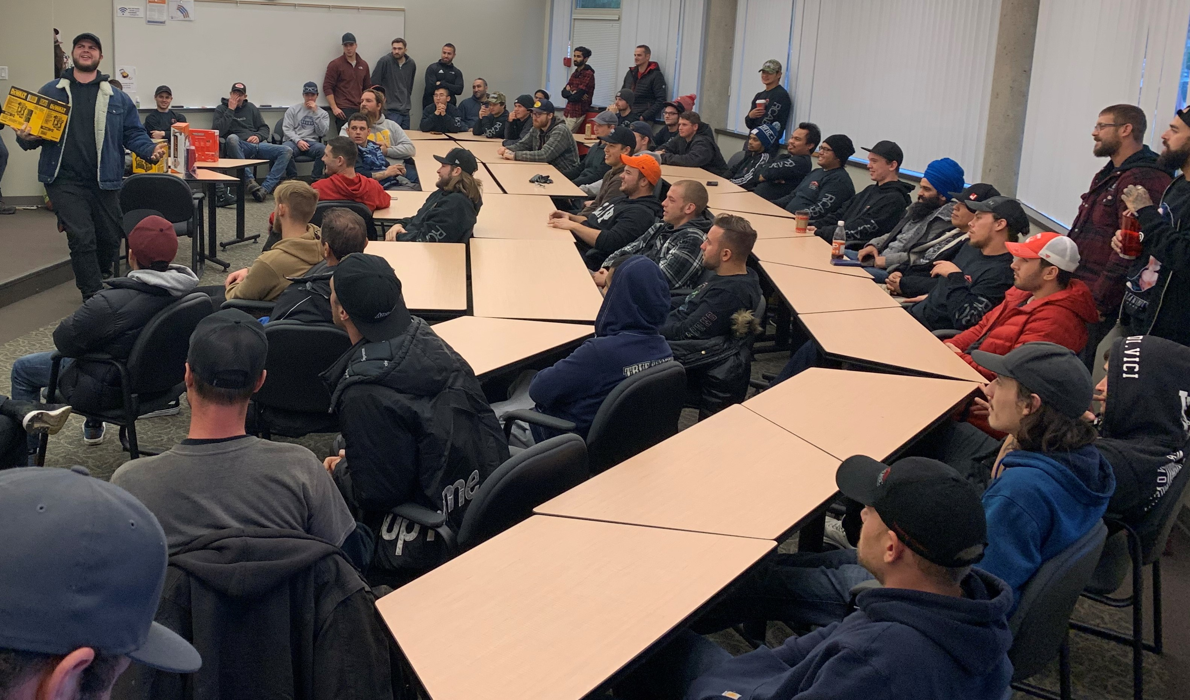
RoofStar Guarantee Program
Your support of the RoofStar Guarantee Program allows us to support the roofing industry
  Educational Sessions
  Technical Training (Apprenticeship)
  Safety Training
  Research Projects
  Building Code and Standard Development
RCABC
Technical
Membership

Slide 4
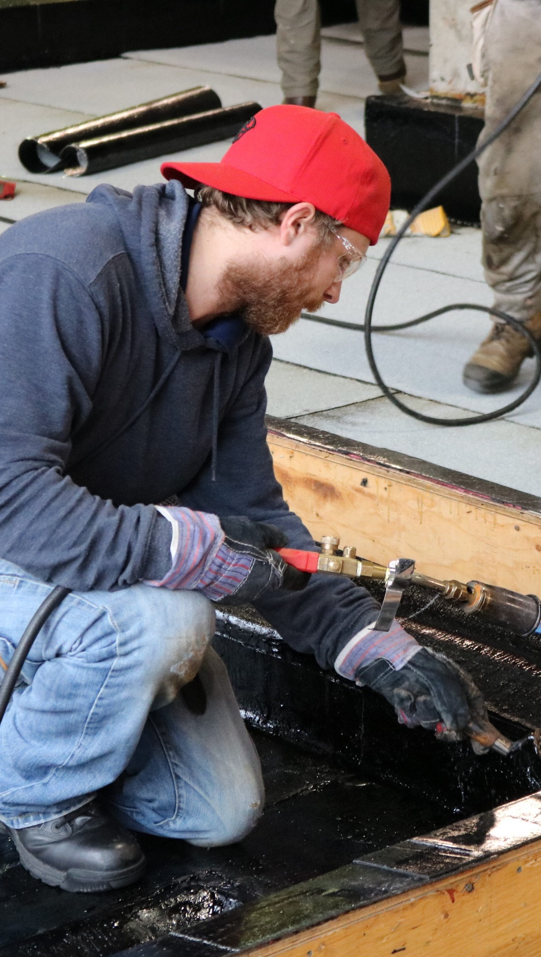
Agenda
Code Requirements
RPM Replacement Roofing Standards
  Full System
  Partial System
  Recovering
Replacement Roofing Trends
Questions

Slide 5
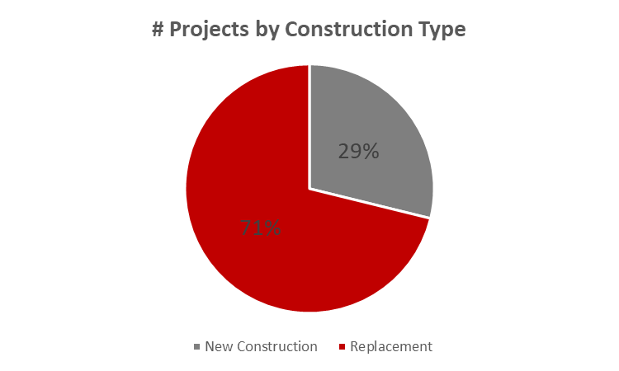
New vs. Existing Buildings

Slide 6
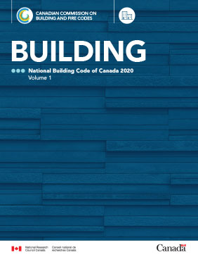
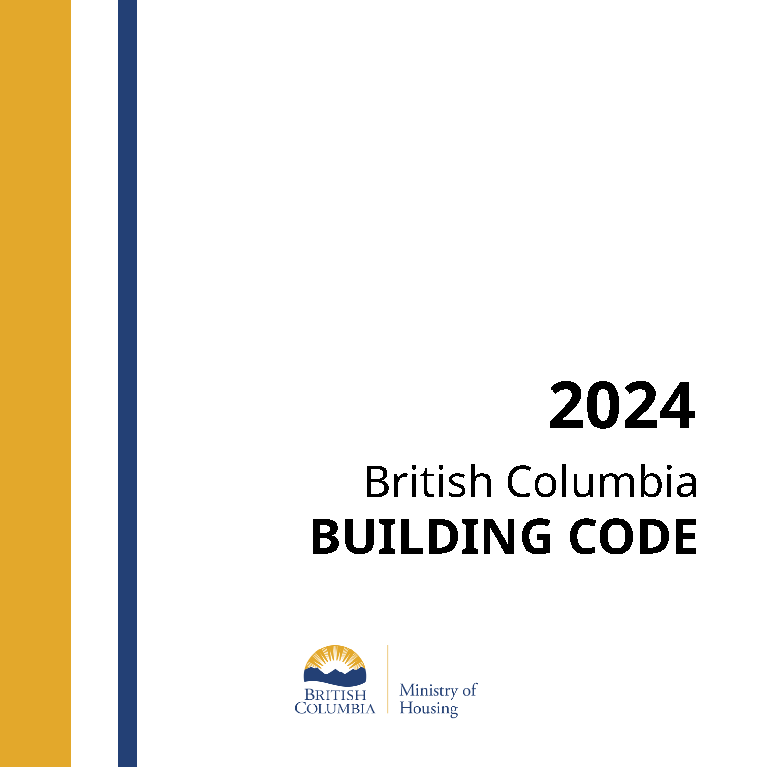
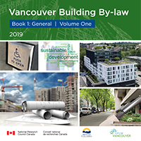
Code Compliance
What does the Building Code say about existing buildings?
NBC
BCBC
VBBL

Slide 7

Code Compliance
Book 1, Division A, Part 1,
1.1.1.1. Application of this Code
1) This Code applies to any one or more of the following:
….
d) an alteration of any building,
….
Alteration means a change or extension to any matter or thing or to any occupancy regulated by this Code.

Slide 8
Code Compliance
Book 1, Division A, Part 1,
1.1.1.2. Application to Existing Buildings
1) Where a building is altered, rehabilitated, renovated or repaired, or there is a change in occupancy, the level of life safety and building performance shall not be decreased below a level that already exists. (See Note A-1.1.1.2.(1).)

Slide 9
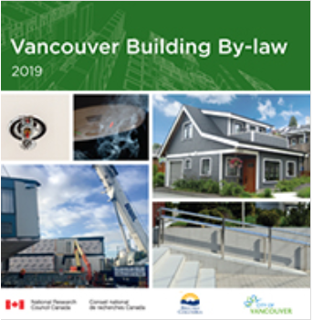
Code Compliance
  Division B, Part 11 – Existing Buildings
  Roof fire ratings
  Building Energy and Emissions Performance

Slide 10
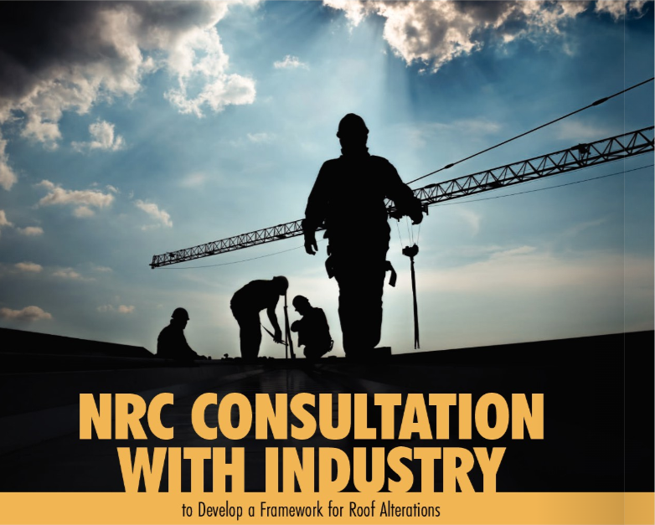
Code Compliance
NBC plans to include Roof Alterations (reroofs) in a future code change
For more information read
Roofing BC
  Fall 2022, Pages 16 - 21

Slide 11

Code Compliance
Roof Alterations design elements to include:
Wind Uplift
Drainage
Thermal Resistance

Slide 12
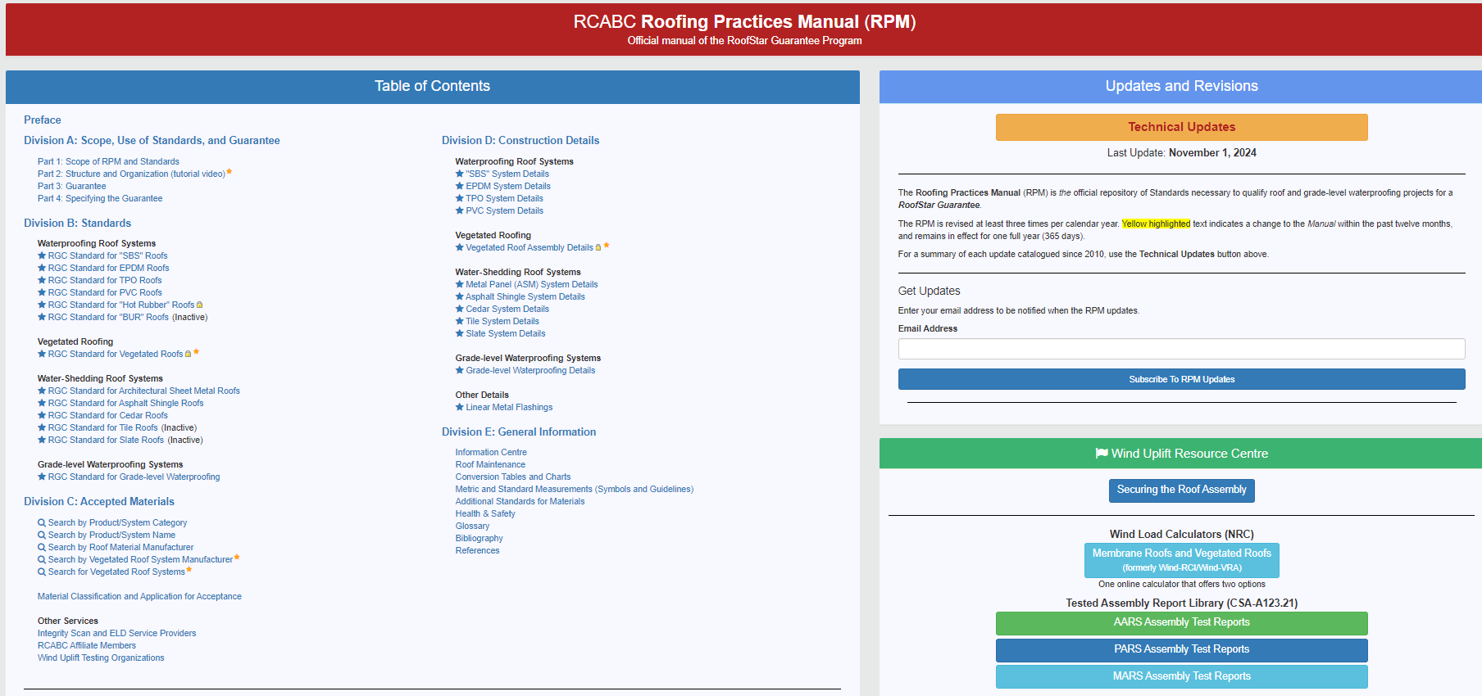
Roofing Practices Manual (RPM) rpm.rcabc.org

Slide 13
RoofStar Guarantee Standards
Support or exceed:
  NBC
  BCBC
  VBBL
  CSA Standards (A123 is for roofing)
  Must meet or exceed wind uplift design loads

Slide 14
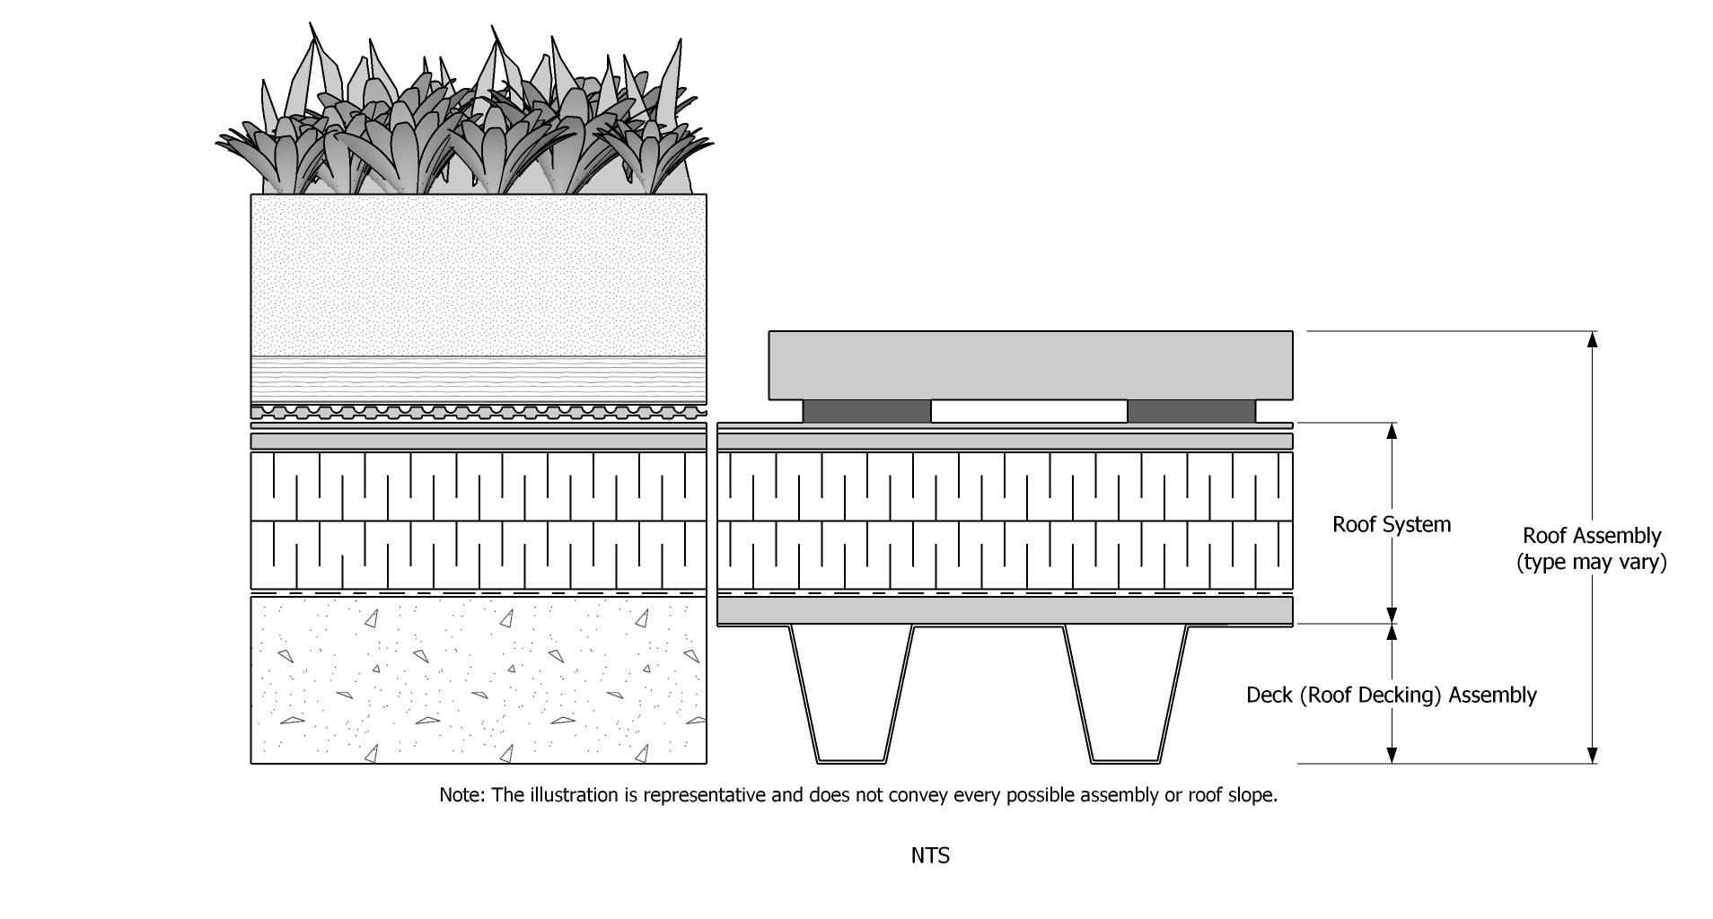
Definitions

Slide 15
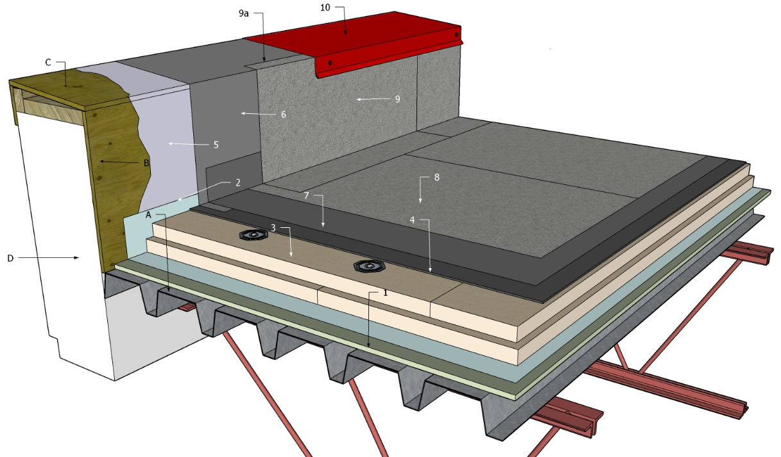
Common Roof Systems
Conventionally Insulated Roof System
Common for membrane or waterproofing roof systems
May be used for ASM roofs (water-shedding system)

Slide 16
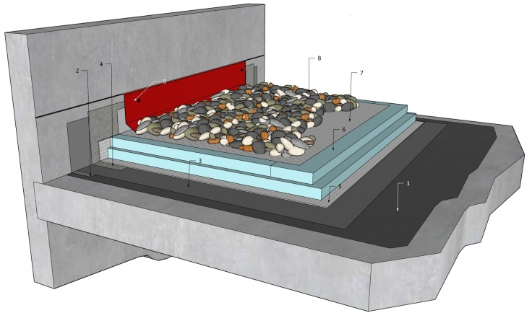
Common Roof Systems
Protected Roof Membrane Assembly (PMRA or IRMA)
Common for membrane or waterproofing roof systems

Slide 17
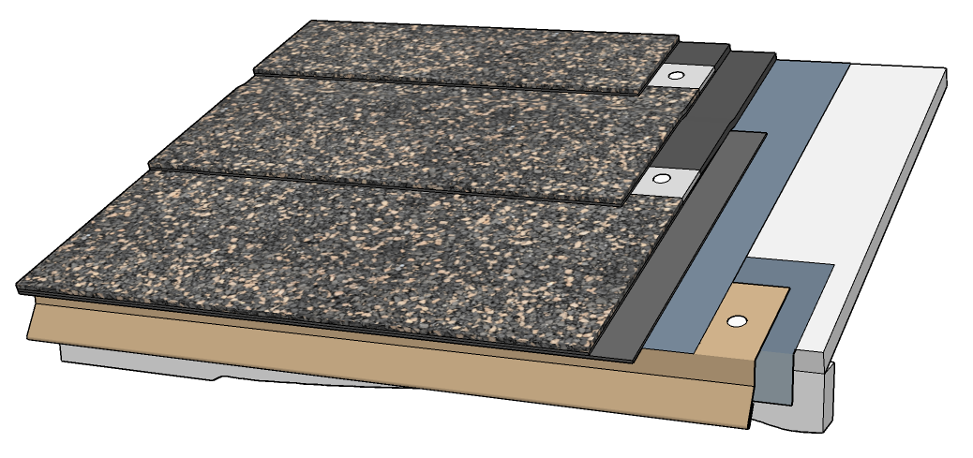
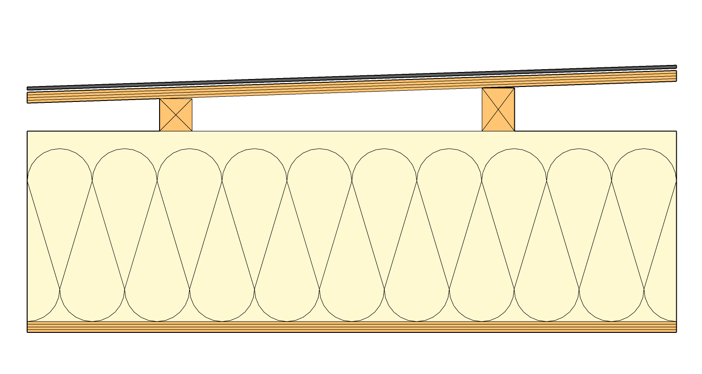
Common Roof Systems
Uninsulated Roof System (uninsulated above the deck)
Common for water-shedding roofs
Older wood frame waterproof roofs

Slide 18
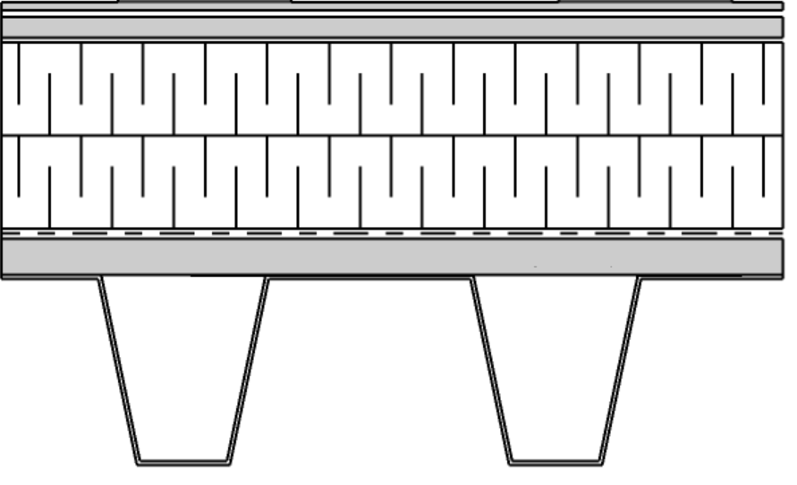
Roof Replacement Options
Complete Roof System Replacement
The complete removal and replacement of all roof system and metal flashing materials
Article 1.1.4.2
Common for Conventional & Uninsulated

Slide 19

Roof Replacement Options
Complete Roof System Replacement
Partial Roof System Replacement
The removal and replacement of the roof membrane and metal flashing materials
Article 1.1.4.3
Common for Conventional & PMRA

Slide 20
Roof Replacement Options
Complete Roof System Replacement
Partial Roof System Replacement
Membrane Recover
Installing a new membrane system over an existing membrane system
Article 1.1.4.4 / 1.3.3.4
Variance Required
Applicable to all roof system

Slide 21
Roof Replacement Options
Complete Roof System Replacement
Partial Roof System Replacement
Membrane Recover
Membrane Coating
Material applied over the existing membrane
Not covered in our program

Slide 22
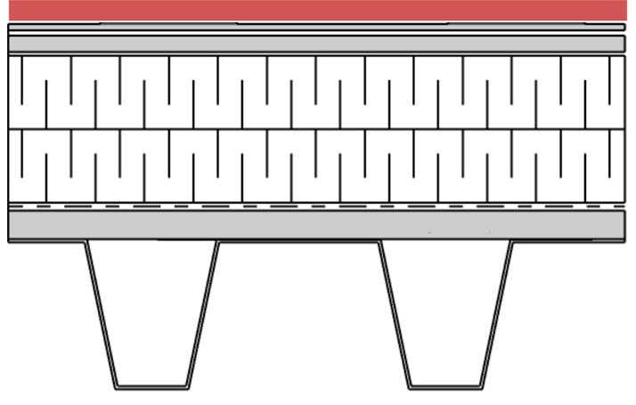
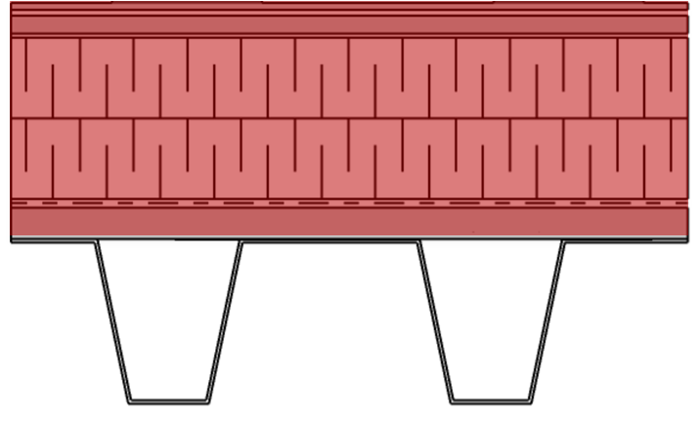
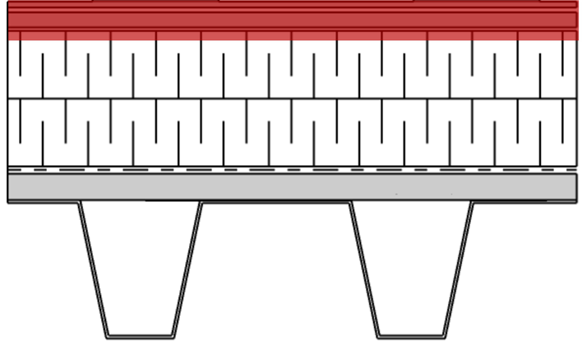
Roof Replacement Options
Which system do you choose?

Slide 23

Design Considerations
Building Owner’s expectations
Budget

Slide 24
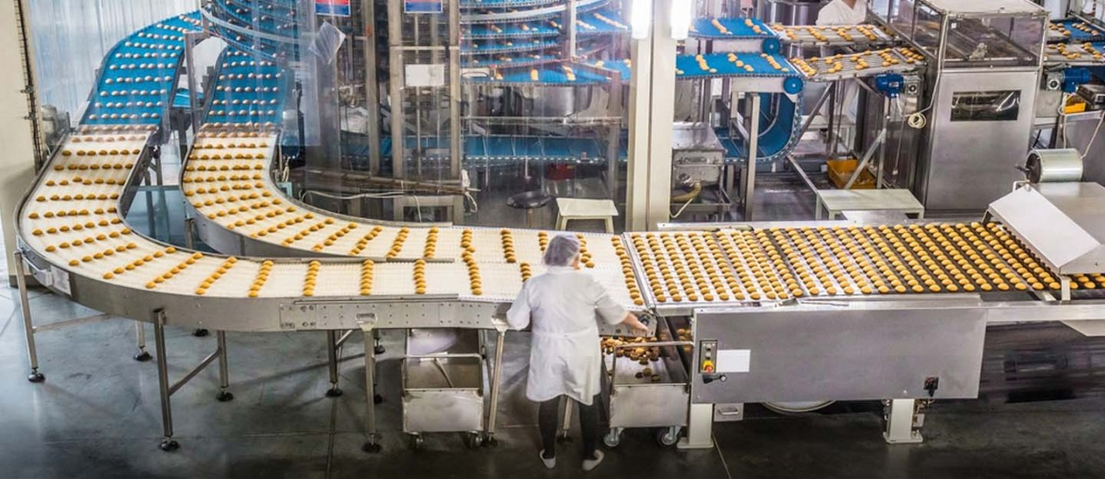
Design Considerations
Building Owner’s expectations
Budget
Sensitive building operations
Noise & smell tolerance

Slide 25
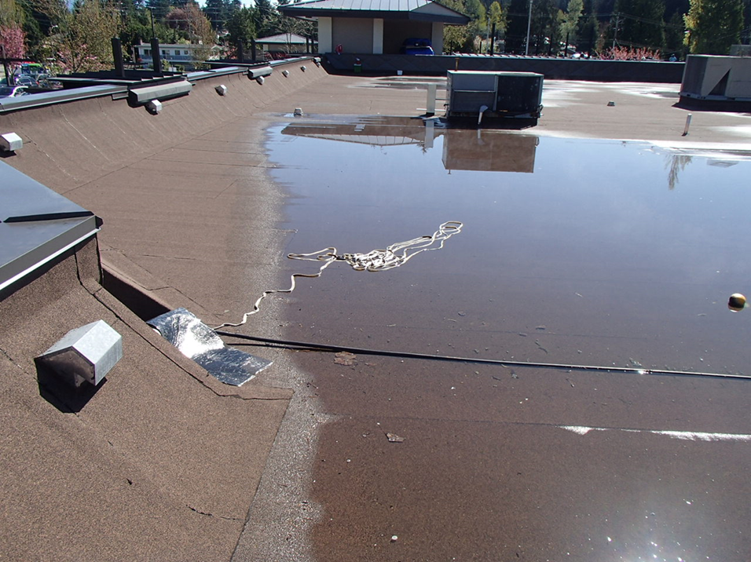

Design Considerations
Building Owner’s expectations
Budget
Sensitive building operations
Noise tolerance
Upgrades
  Seismic
  Insulation
  Drainage

Slide 26
Design Considerations
Building Owner’s expectations
Budget
Sensitive building operations
Noise & smell tolerance
Upgrades
  Seismic
  Insulation
  Drainage
Future use
  Green Roofs
  PV

Slide 27
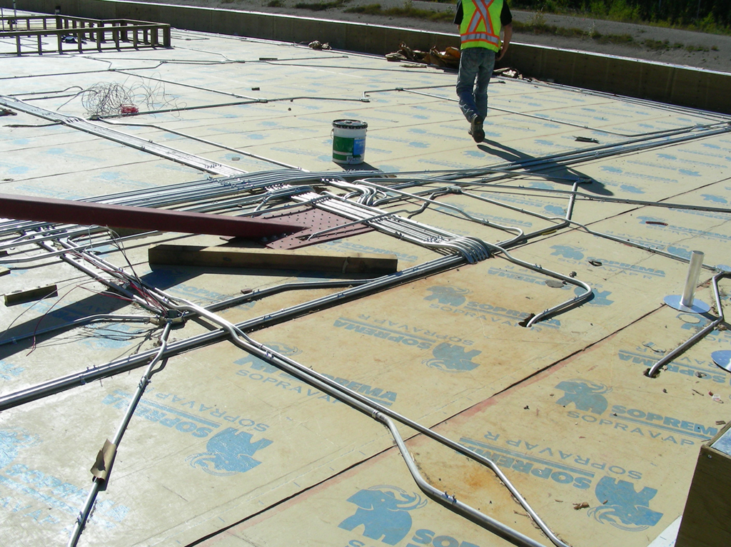
Design Considerations
Building Limitations
Conduit on, in or under the roof deck

Slide 28
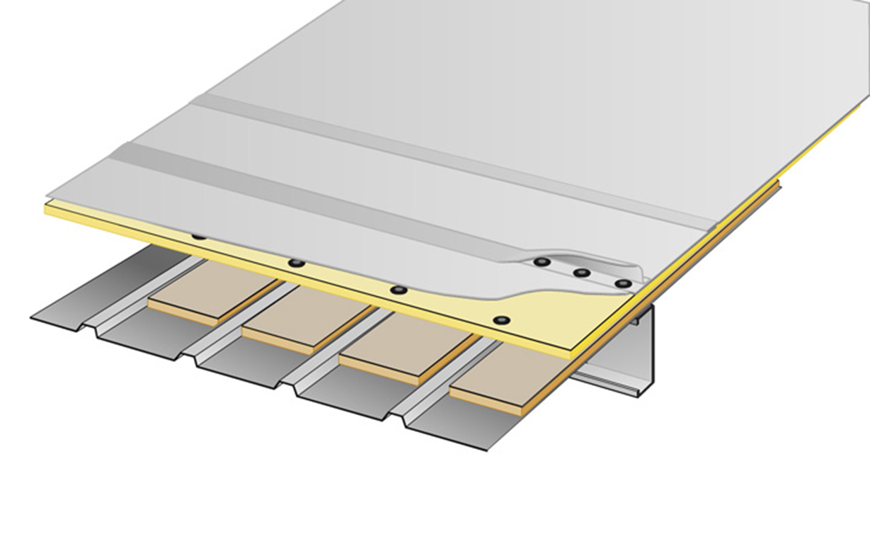
Design Considerations
Building Limitations
Conduit on, in or under the roof deck
Additional weight capacity may trigger a structural review

Slide 29
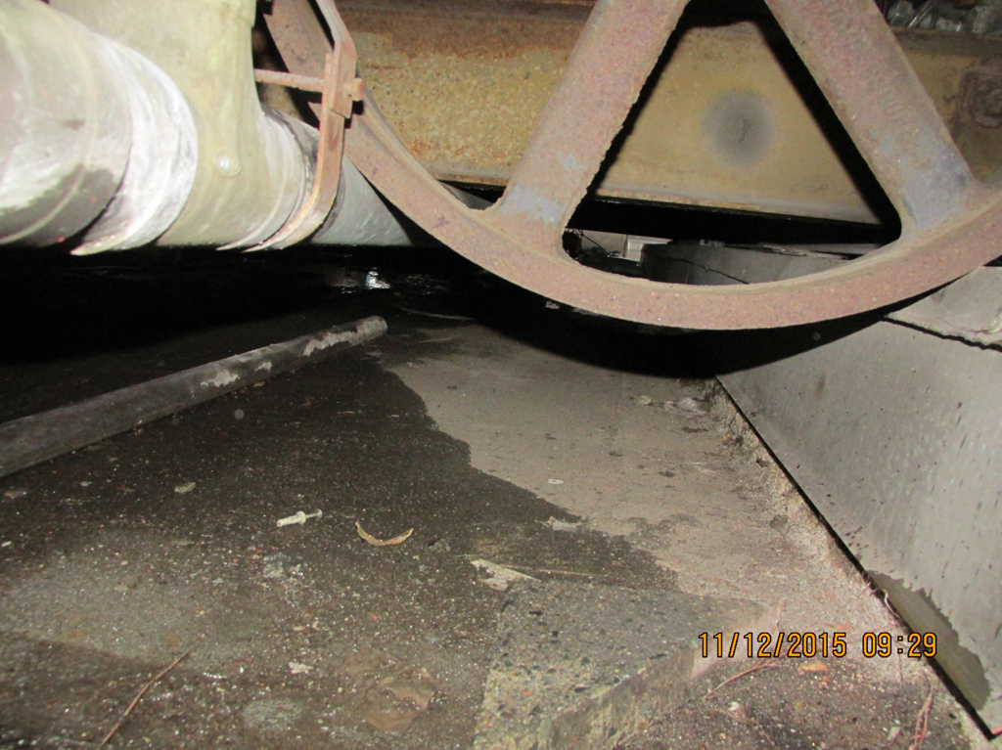
Design Considerations
Building Limitations
Conduit on, in or under the roof deck
Additional weight capacity
Mechanical Equipment
Low Door Openings

Slide 30
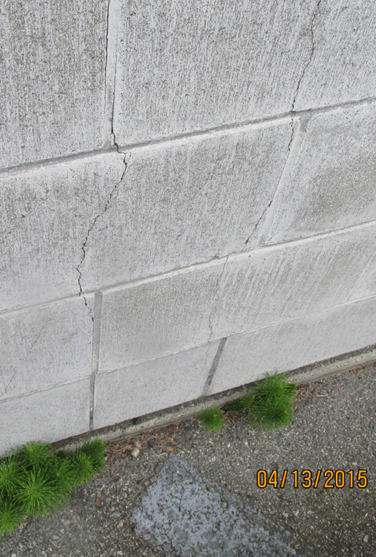
Design Considerations
Building Limitations
Conduit on, in or under the roof deck
Additional weight capacity
Mechanical Equipment
Low Door Openings
Other building components that may also leak
  Walls
  Skylights
  Chimneys
  Mechanical Equipment

Slide 31
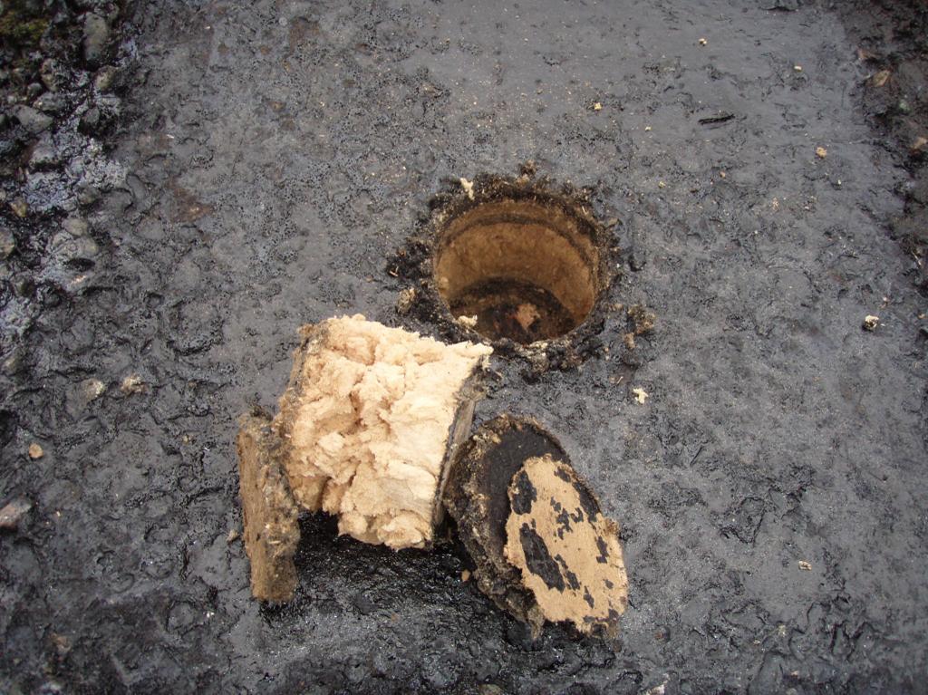
Design Considerations
Determine the condition of the existing roof assembly
Hazardous materials survey (WorkSafeBC)
Cut Tests will influence the design options and minimizes surprises (extras) during construction

Slide 32
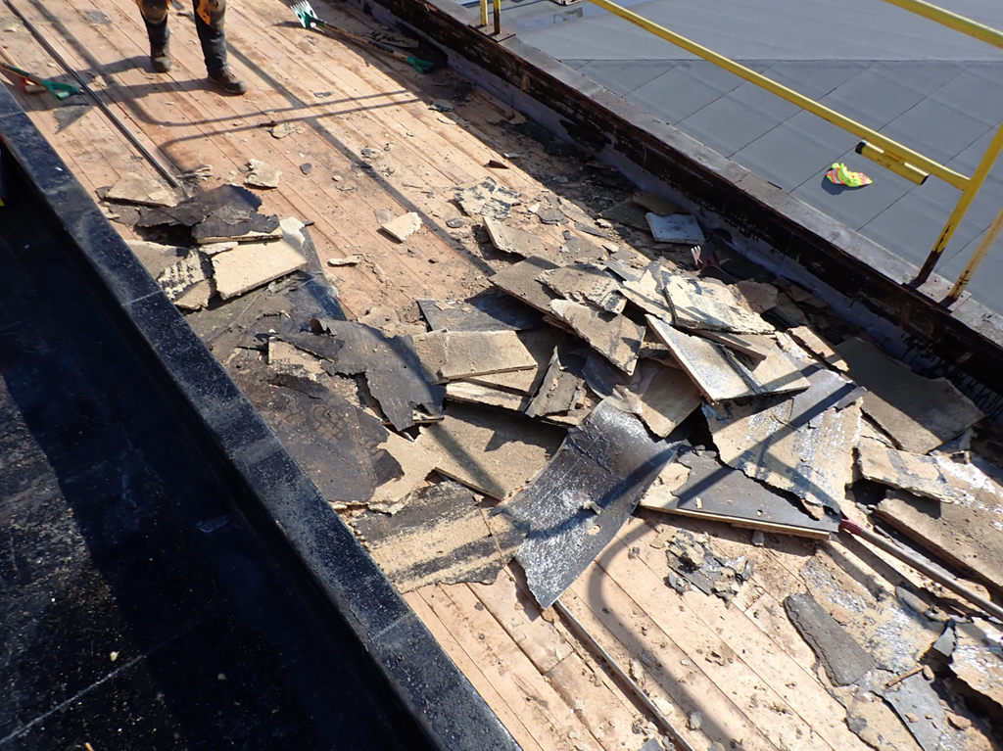
Design Considerations
Determine the condition of the existing roof assembly
Hazardous materials survey
Cut Tests
Roof Deck type & condition
Air Leakage

Slide 33
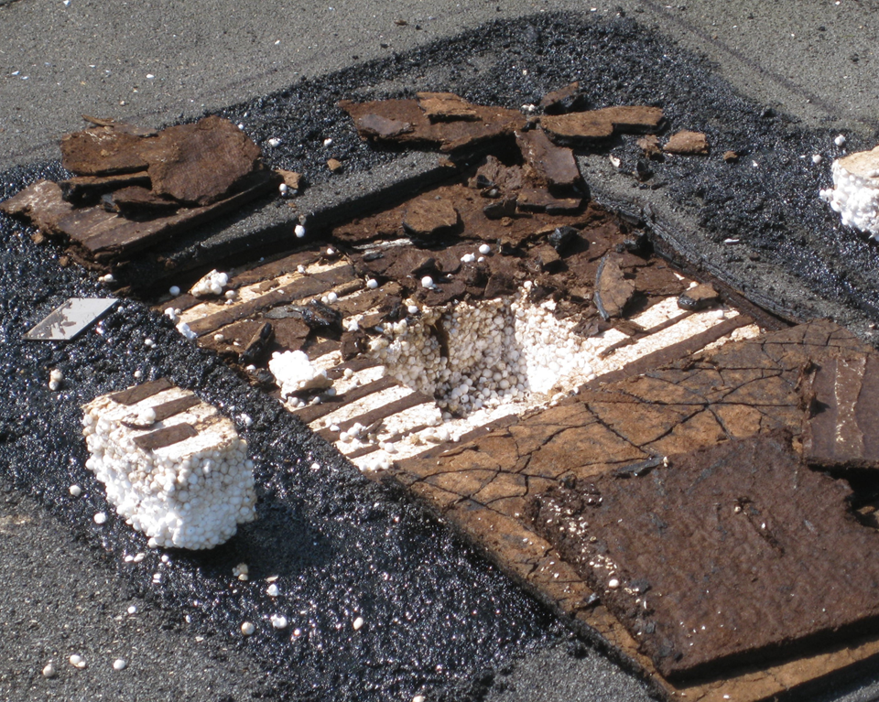
Design Considerations
Determine the condition of the existing roof assembly
Hazardous materials survey
Cut Tests
Roof Deck type & condition
Air Leakage
Leak history / wet materials
Reuse of materials

Slide 34
Roof Replacement Options
Pros & Cons for each option

Slide 35
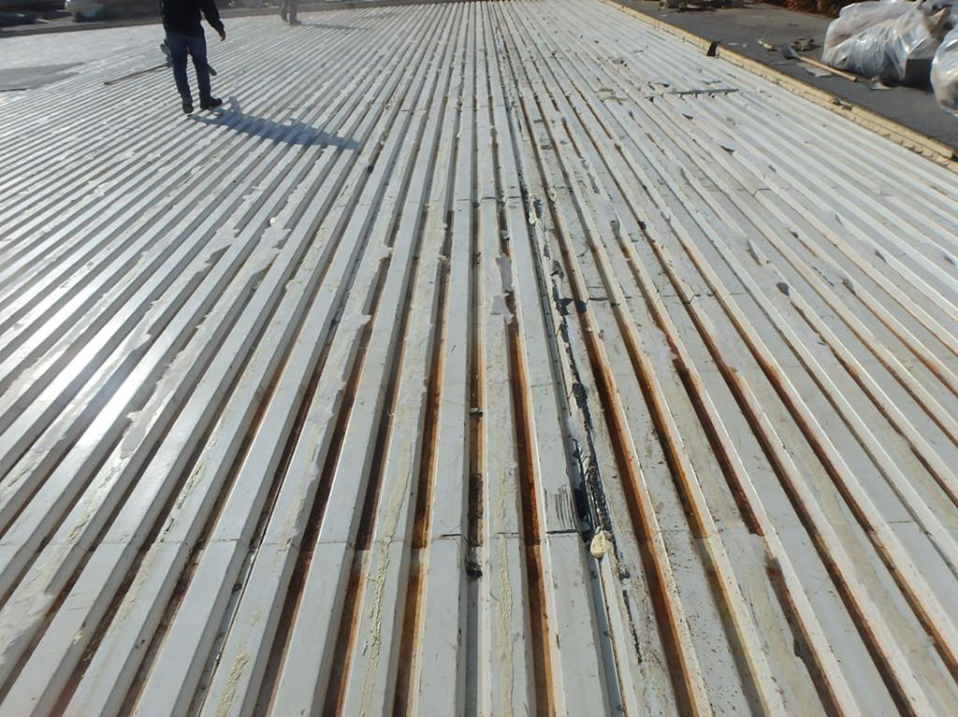
Roof System Replacement
Pros
Deck condition is confirmed
AVB Control layer can be installed / improved
Possible to upgrade insulation / slope for drainage
All New Materials
Optimum Performance

Slide 36

Roof System Replacement
Cons
Cost
Existing materials headed to landfill
Dust and small debris may enter space below

Slide 37
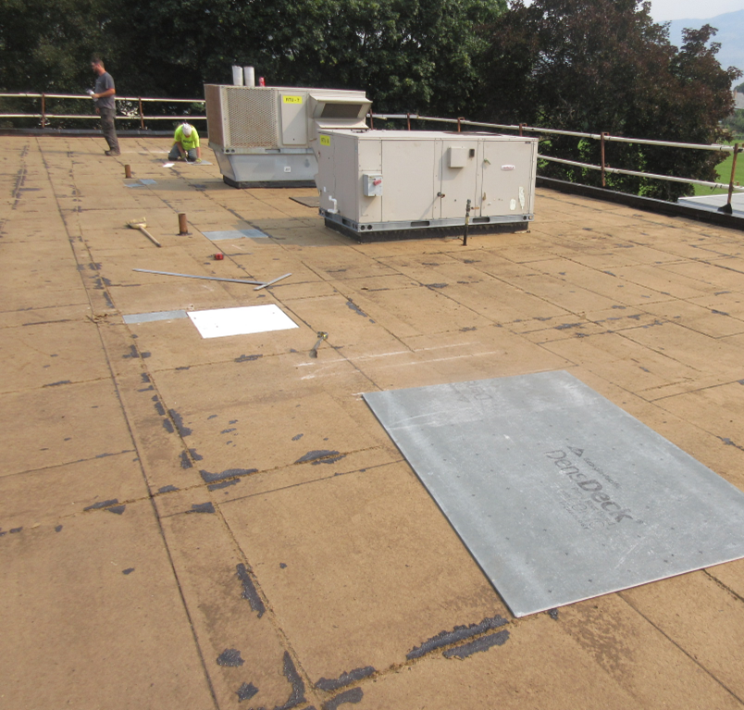
Partial Roof System Replacement
Pros
Cost effective
Reuse of existing materials
Visual review / replacement of existing insulation / overlay
Disposal is minimal
Dust and small debris is reduced
Possible to upgrade insulation / slope

Slide 38
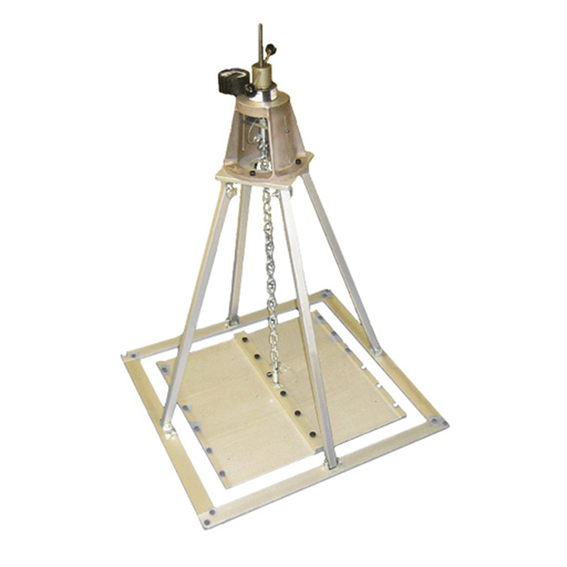
Partial Roof System Replacement
Cons
No review of roof deck
No review of existing AVB or insulation layers
No CSA A123.21 Tested Assemblies available. Field pull tests may be required

Slide 39
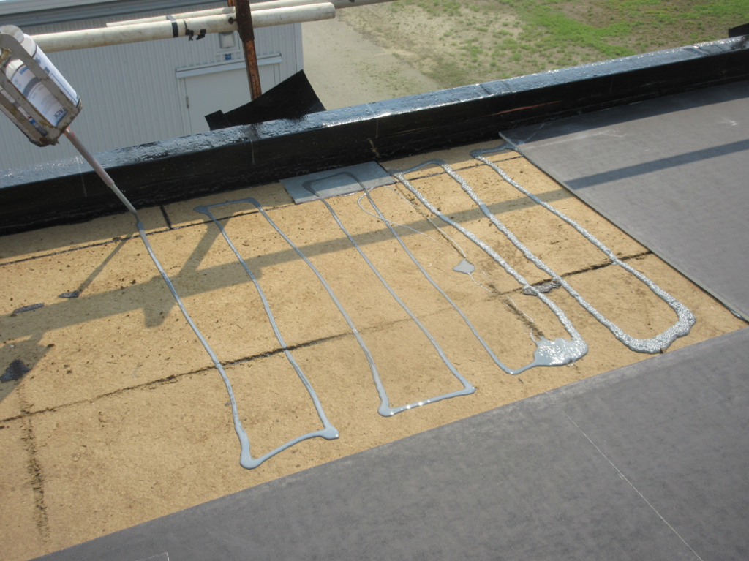
Partial Roof System Replacement
Cons
Adhering to existing fiberboard.
Field pull tests should be considered

Slide 40
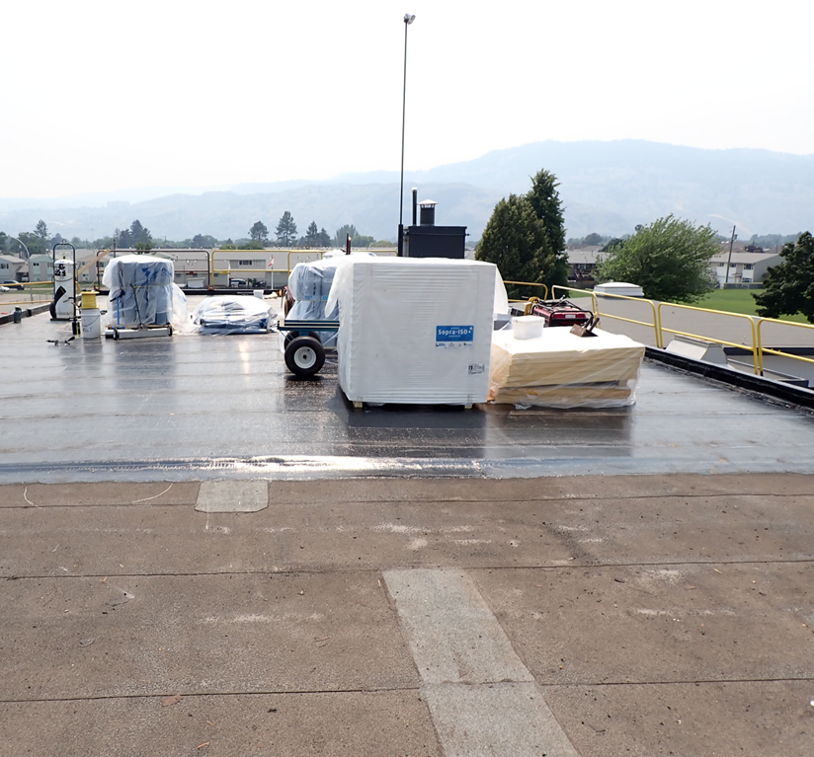
Membrane Recover
RoofStar Standards requires
  Moisture scan / cut tests to confirm existing assembly is dry
  Grid cut existing roof (conventionally insulated systems)
  Overlay board
  Removal of membrane flashings
  Replace all roof penetration flashings
  Variance request
  Confirm roof system securement

Slide 41
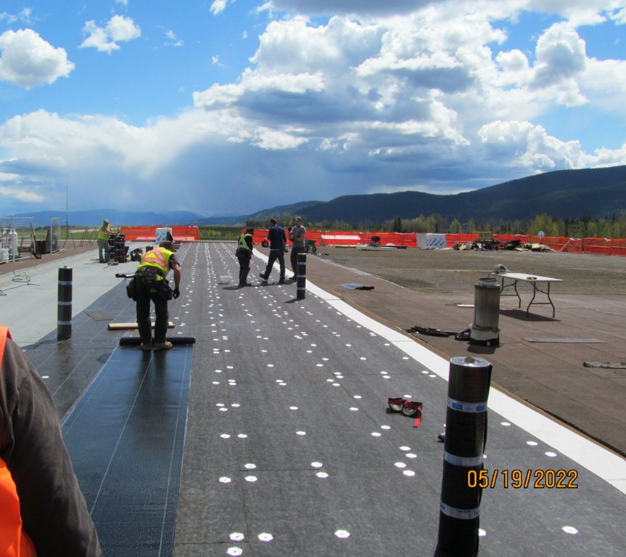
Membrane Recover
Pros
Last choice for replacement work, when full or partial roof system is not practical
Most cost effective
Option when existing membrane can’t be easily removed

Slide 42
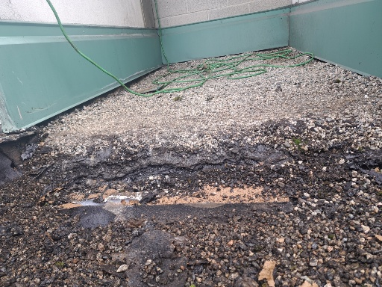
Membrane Recover
Cons
Weight
No review of the existing roof assembly (only cut tests)
No CSA A123.21 Tested Assemblies available. Field pull tests may be required
Requires existing membrane preparation
Limited to one application over an existing roof

Slide 43
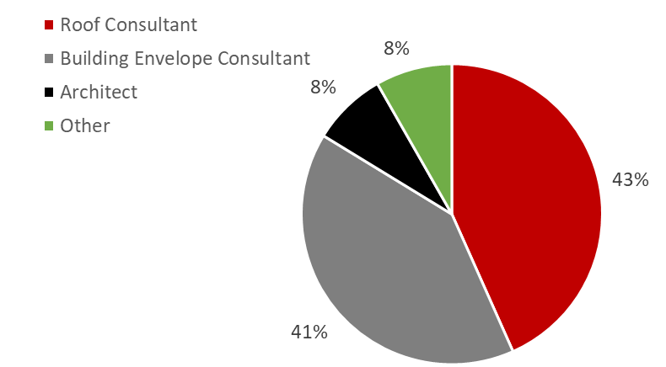
Replacement Roofing Trends
Design Authority
Last 4 years
# of Projects
Other:
  Manufacturer
  Roofer
  Owner

Slide 44
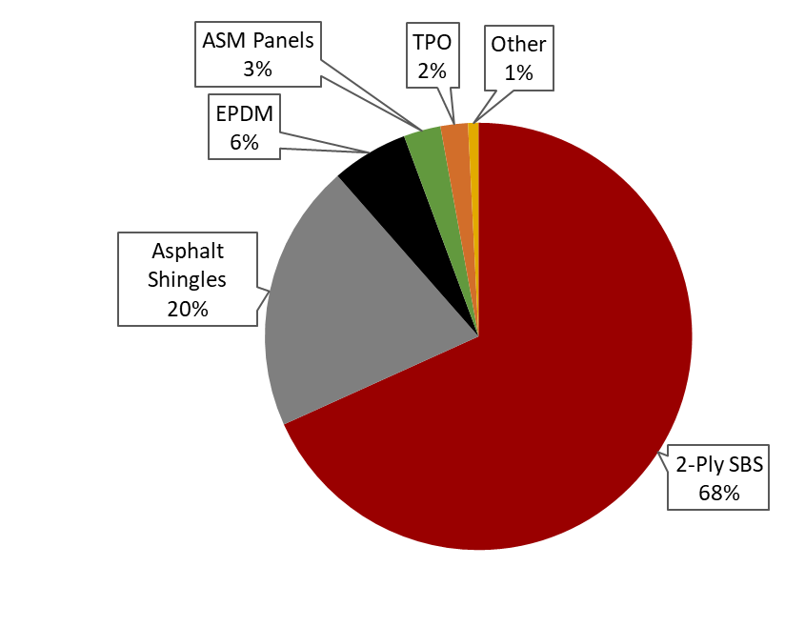
Replacement Roofing Trends
Roof System
Last 4 years
# of Squares
Other:
  3-ply SBS
  Cedar
  PVC
  Hot Rubber
  PMMA

Slide 45
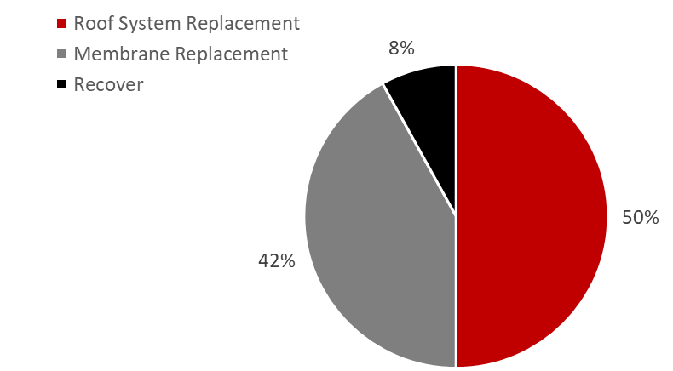
Replacement Roofing Trends
Roof Assembly
Last 4 years
Waterproofing Roof Systems (flat)
# of Projects

Slide 46
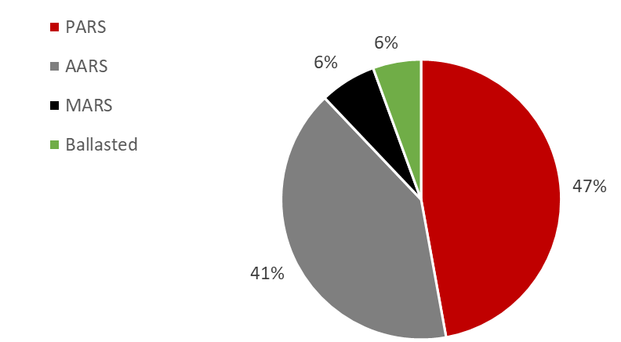
Replacement Roofing Trends
Roof Securement
Last 4 years
Waterproofing Roof Systems (flat)
# of Squares

Slide 47
Questions
Staff available to assist:
  Laurence Matzek, Director, RoofStar Guarantee Program
  laurence@rcabc.org
  James Klassen, RoofStar Technical Advisor
  jklassen@rcabc.org
  Doug Wells, RoofStar Technical Advisor
  dwells@rcabc.org
  technical@rcabc.org

