Slide 1
Impact of Climate Change and Ventilation Strategies on Moisture Management and Durability of Cross-Laminated Timber Walls
Dipendra Paneru and Phalguni Mukhopadhyaya
Department of Civil Engineering
University of Victoria
2024 BEBEC CONFERENCE & AGM

Slide 2
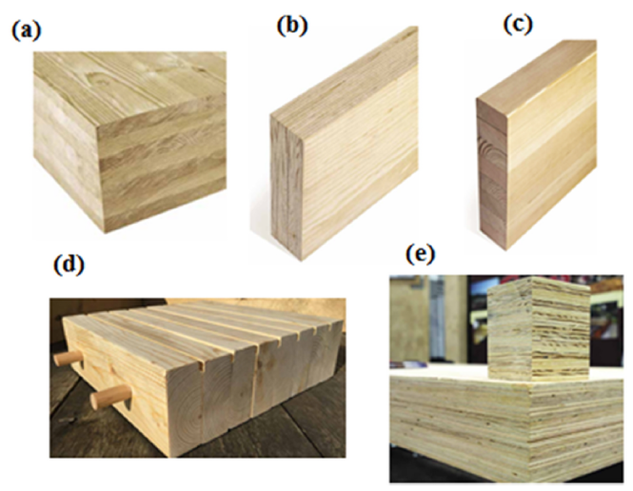
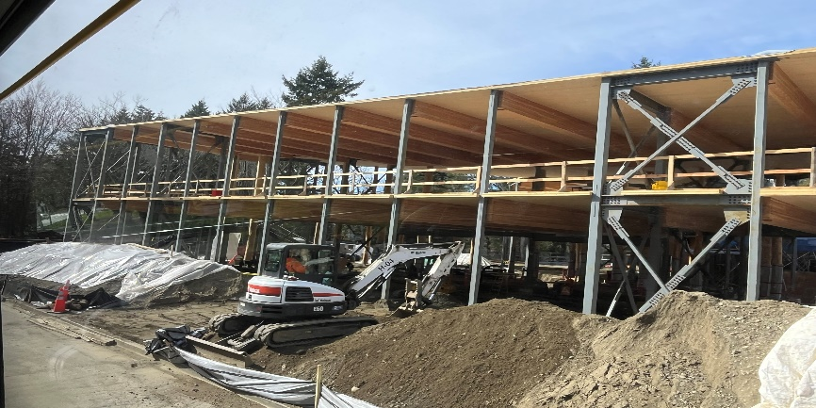
Mass Timber?
Different Types of Mass timber product (Ayanleye et al., 2022)
National Centre for Indigenous Laws and Fraser Building,2024
Why Moisture Performance ?
Special care during production, transportation, and construction,
Moisture levels compromise the structural integrity,
Dimensional instability,
Thermal efficiency and hygrothermal performance.
Poor moisture management reduces a building's energy efficiency, affects its durability, and negatively impacts indoor air quality.

Slide 3
"Mass timber buildings demonstrate unique hygrothermal behaviors, with their drying capacity and mold growth potential ,being significantly influenced by climate conditions and design parameters.”
QUESTION?
“How do extreme weather conditions and ventilation rates affect the hygrothermal performance, drying potential, and mold growth susceptibility of cross-laminated timber (CLT) walls?”

Slide 4
Why is climate change considered?
Changing precipitation patterns affect building moisture dynamics (Reidmiller et al., 2017).
Building standards often overlook future climate scenarios (GAO, 2016).
Precipitation influences heating/cooling needs, impacting hygrothermal performance (Andrić et al., 2017).
Leads to mold growth risks, necessitating adaptive designs (Cornick & Dalgliesh, 2003).
Schematic diagram showing the impact of weather on building envelope
Notes:
Text size change

Slide 5
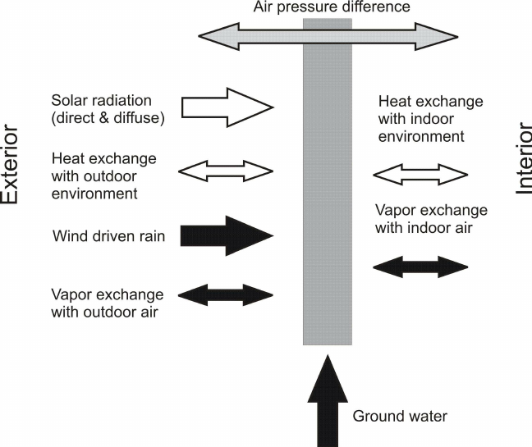
Hygrothermal Analysis Tool
WUFI simulates coupled heat and moisture transport in building materials.
Based on Fourier's Law (heat conduction), Fick's Law (vapor diffusion), and Darcy's Law (liquid transport).
Kelvin’s Law for capillary movement in porous materials.
Uses real climate data to model moisture and heat flow.
Photo Credit: Kuenzel et al., 2009

Slide 6
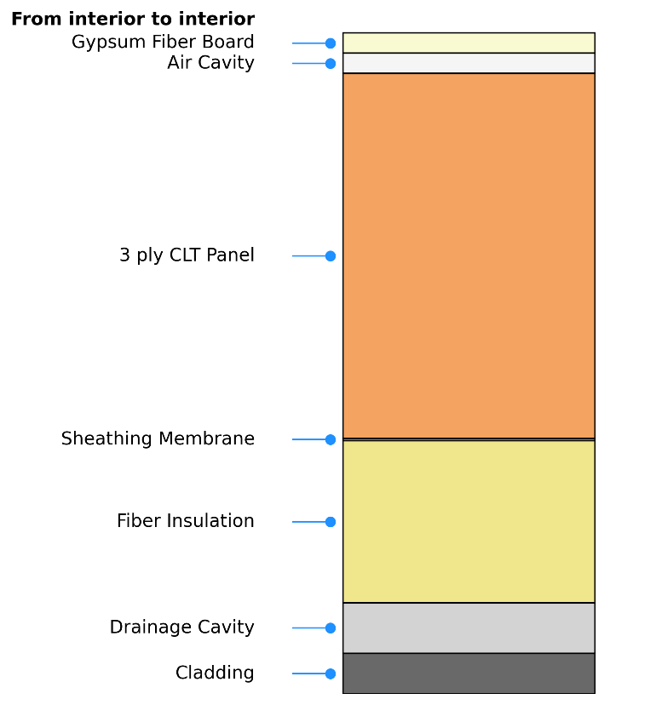
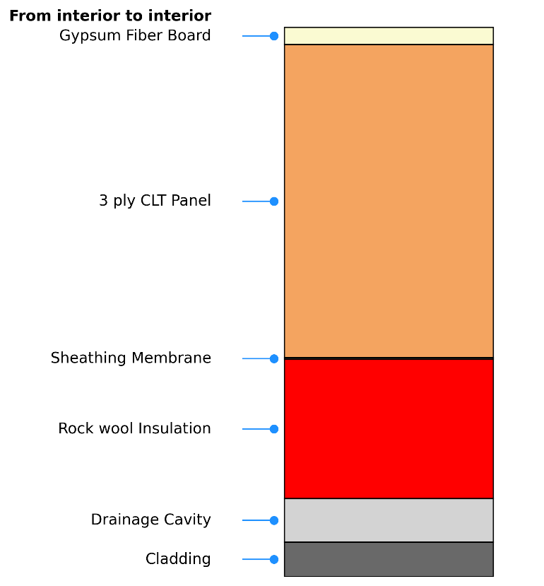
Hygrothermal Modelling
Interior
Exterior
Schematic diagram showing the section of wall 1(Left) and Wall 2(Right) assembly with 3 layer of CLT.

Slide 7
Climate Data
National Research Council Canada (NRC) and WUFI database.
Included Moisture Reference Years (MRY) and ASHRAE Year 1 data.
Based on Representative Concentration Pathways (RCP’s)- Radiative forcing value 8.5 W/m² by 2100.
Futuristic Data
G0.5- 2003-2029
G1.0-2014-2040
G1.5-2024-2050
G2.0-2034-2060
G2.5-2042-2068
G3.0-2051-2077
G3.5-2064-2090

Slide 8
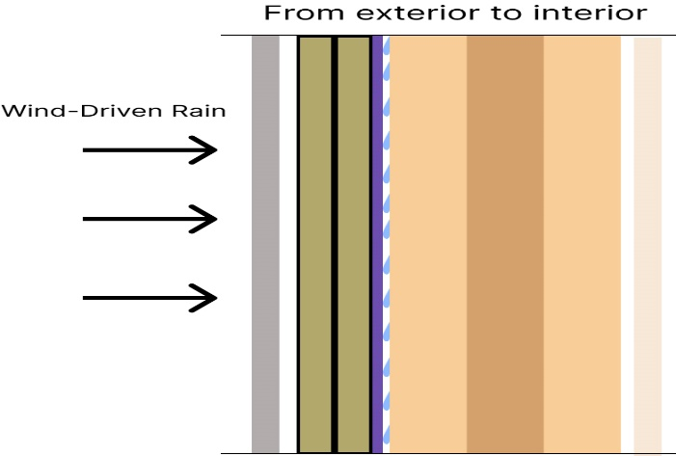
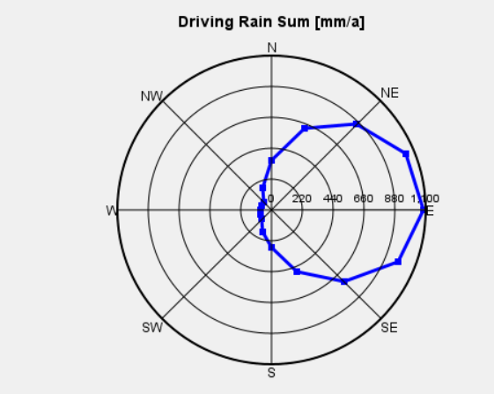
Boundary Conditions
Ventilation
Moisture Source
Diagram for boundary conditions
Direction of WDR in Vancouver as a rose diagram in WUFI

Slide 9
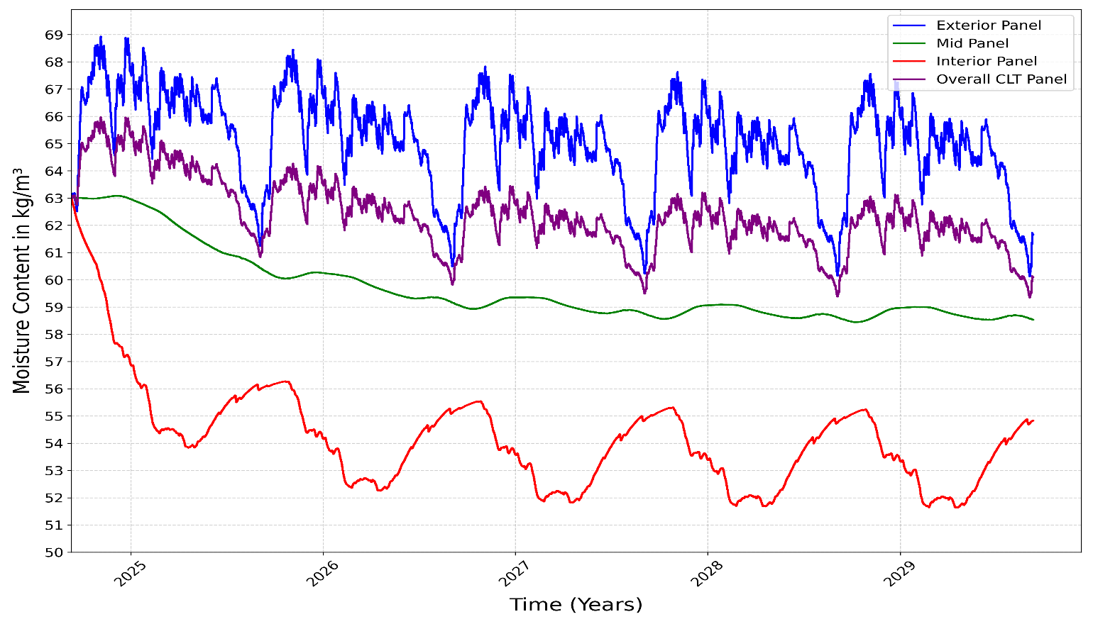
Hygrothermal Analysis
Moisture variation of 3 layers CLT panel in Vancouver city with futuristic climate condition (G1.5).

Slide 10
Drying Potential
First-order decay model, capturing the exponential decline of moisture content (Bennamoun & Ndukwu, 2022; Simpson, 1993).
Dependent on material properties, temperature, and relative humidity.
First-Order Decay Model Equation;
$MC(t)=Xe+(Xo−Xe)∗e^{\frac{−t}{td}}$
t_{d}=drying time constant
Future warmer and wetter climates significantly reduce drying capacity, with Td increasing by over 600% under low ventilation rates.
Higher ventilation rates enhance drying potential across all climates, reducing drying time by up to 80%, with the effect being most pronounced in humid regions.

Slide 11
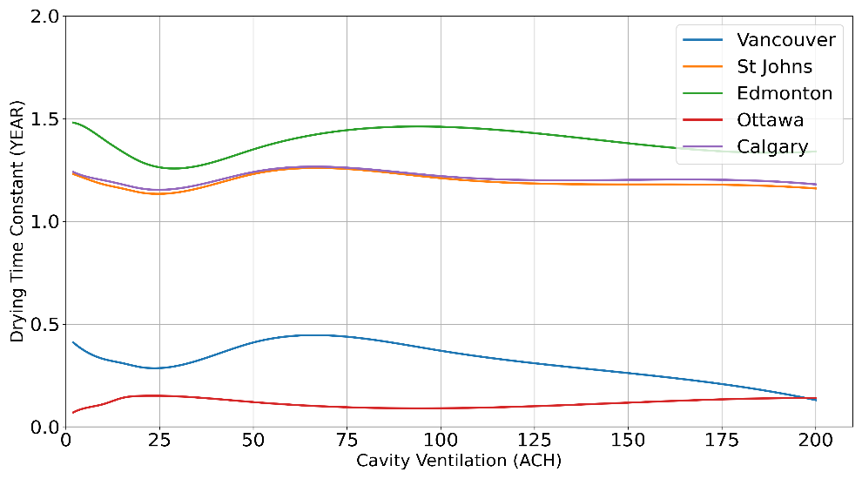
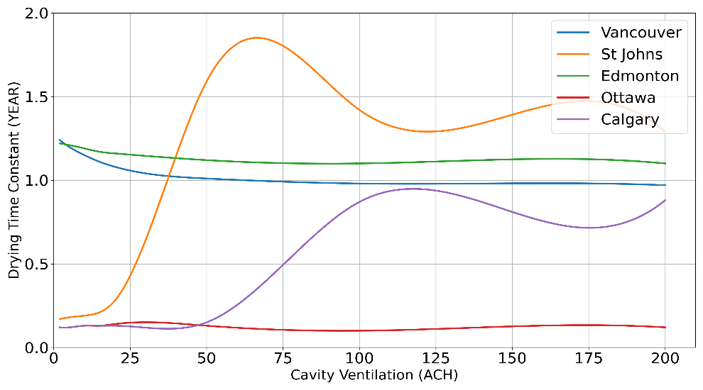
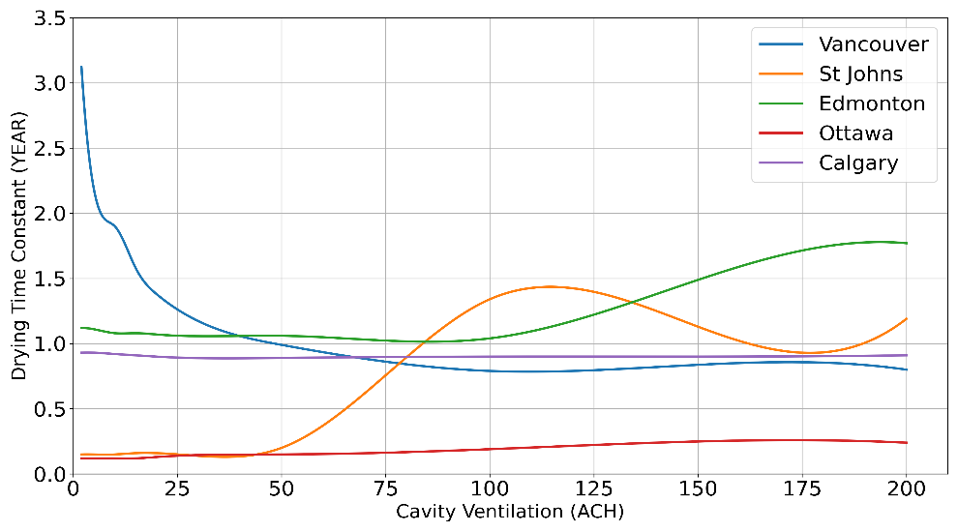
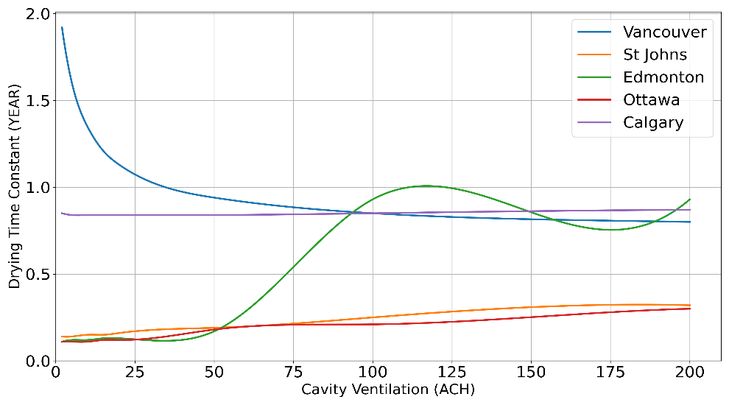
(a)
(b)
(c)
(d)
Drying time constant in different climatic data a)ASHRAE-1 b)Historical c) G1.5 and d) G3.5

Slide 12
Mold Growth
VTT model to predict mold growth
On a scale from 0 (no growth) to 6 (heavy mold growth)
$$\frac{dM}{dt}=\frac{1}{7∗exp(−0.68lnT−13.9lnRH+0.14W−0.33SQ+66.02)}∗k_{1}k_{2}$$
M -Mold index
T - Temperature
RH- Relative humidity
W -Factor for wood type (0 for pine, 1 for spruce)
Humid climates like Vancouver and St. John’s experience an increase in Mold Growth Index of up to 184% under future scenarios.
Increased ventilation rates (2-200 ACH) reduce mold growth by up to 98%, demonstrating ventilation's critical role in mitigating mold risk.

Slide 13
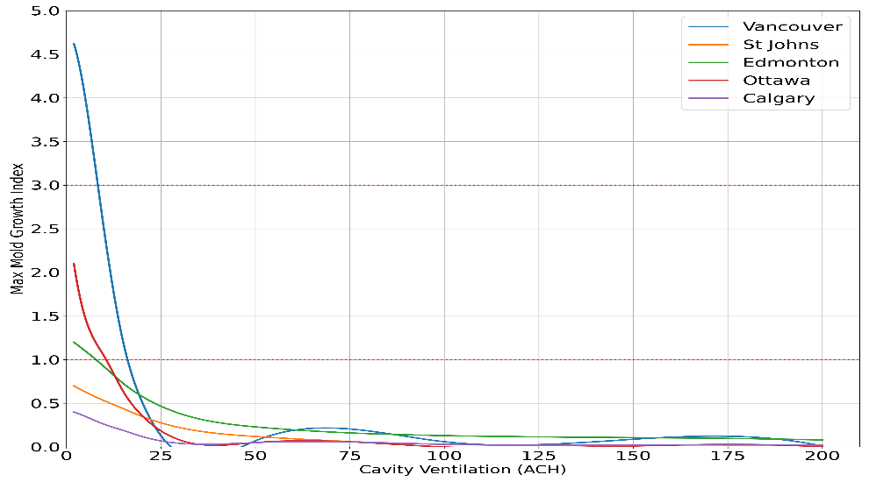
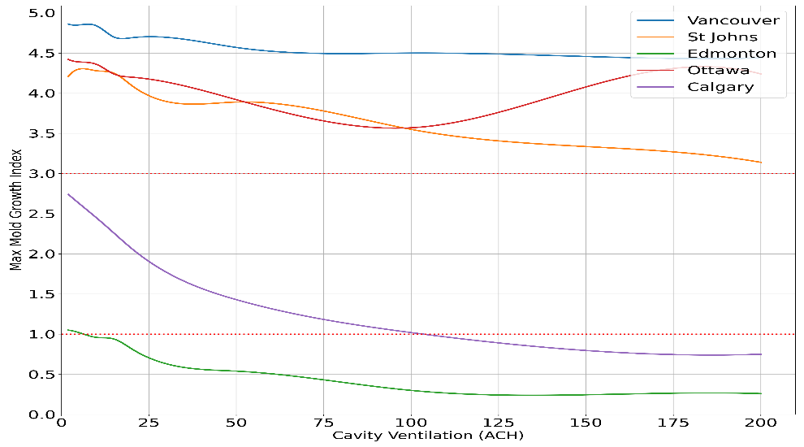
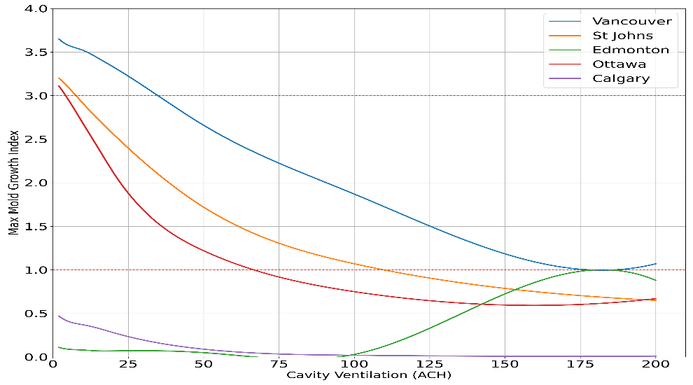
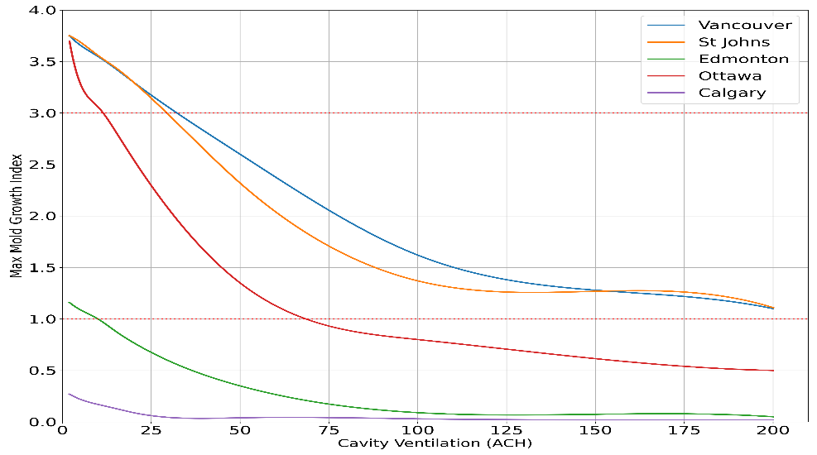
(a)
(b)
(c)
(d)
Mold growth index in different climatic data a)ASHRAE-1 b)Historical c) G1.5 and d) G3.5

Slide 14
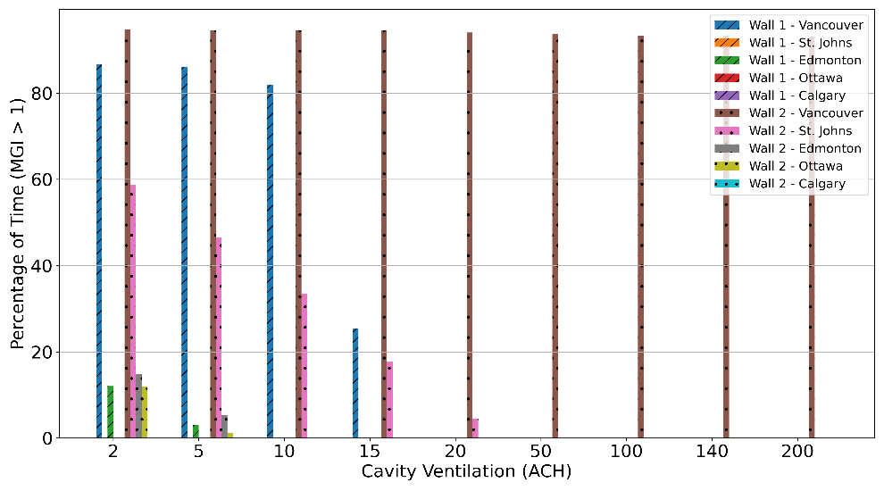
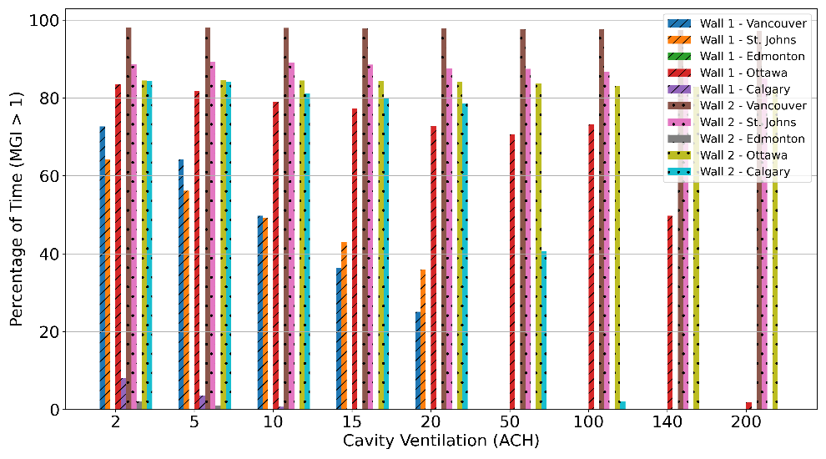
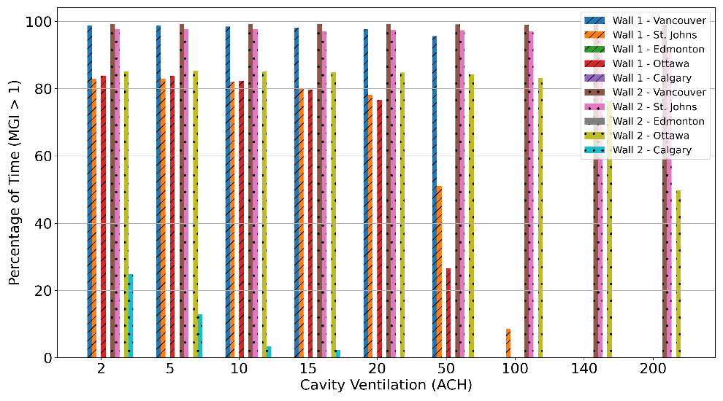
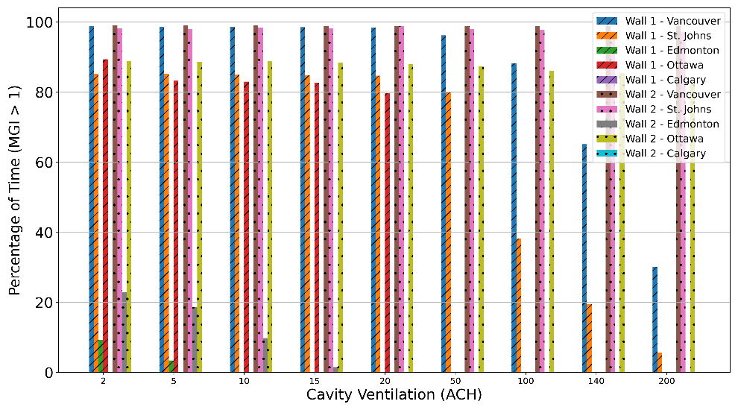
(a)
(b)
(c)
(d)
% of Time for which Mold Index >1 in different climatic data a)ASHRAE-1 b)Historical c) G1.5 and d) G3.5

Slide 15
THANK YOU dipendrapaneru@uvic.ca

