Slide 1

An accidental building scientist
Technology, disruption and people
Betsy Agar | Buildings Director, Pembina Institute
November 15, 2024
Notes:
Recovering building science engineer
Squamish and Musqueam
Honoured and humbled
Accidentally became a building science engineer
Ontario
McMaster
Structural engineering degree
Oldschool courses
Drysdale
Ontario Masonry Training Centre
Mic-dropped
42

Slide 2
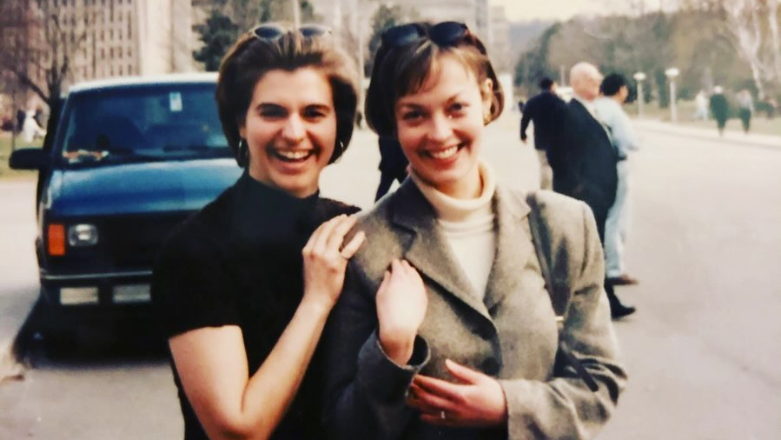
Notes:
1997
Yellow pages
Canadian building science forebears
Ontario Building Envelope Council’s Beckie award
20-something enthusiasm fizzled
Stopped practicing.
Fast forward 10 years
Cap U ‘fun’ degree
Carbon Talks
Renewable Cities
Building science contributing to Canada’s energy transition
Building program director’s shoes at the Pembina Institute.

Slide 3
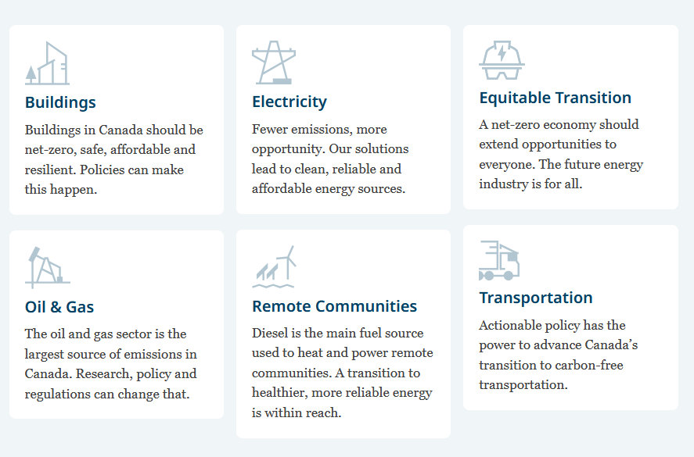
Buildings
Electricity
Equitable Transitions
Oil & Gas
Transportation
Remote Communities
Notes:
Clean energy think tank
Across Canada
Justice is subjective and time-stamped
Hope
Kids
Jon Stewart
Daughter
Seniors
Peers coming of age
Social glue
Unprecedented good and b
Unprecedented bad
Judicious use of slides

Slide 4
Notes:
Psychrometric chart and material data sheets
Pre-Revit or PHPP
Leaky condos
Vapour retarders
Imperfect air barriers
Bulk water
Sick building
Envelope only
Energy and carbon performance models
Integration of passive and mechanical
Integration with auxiliary services

Slide 5
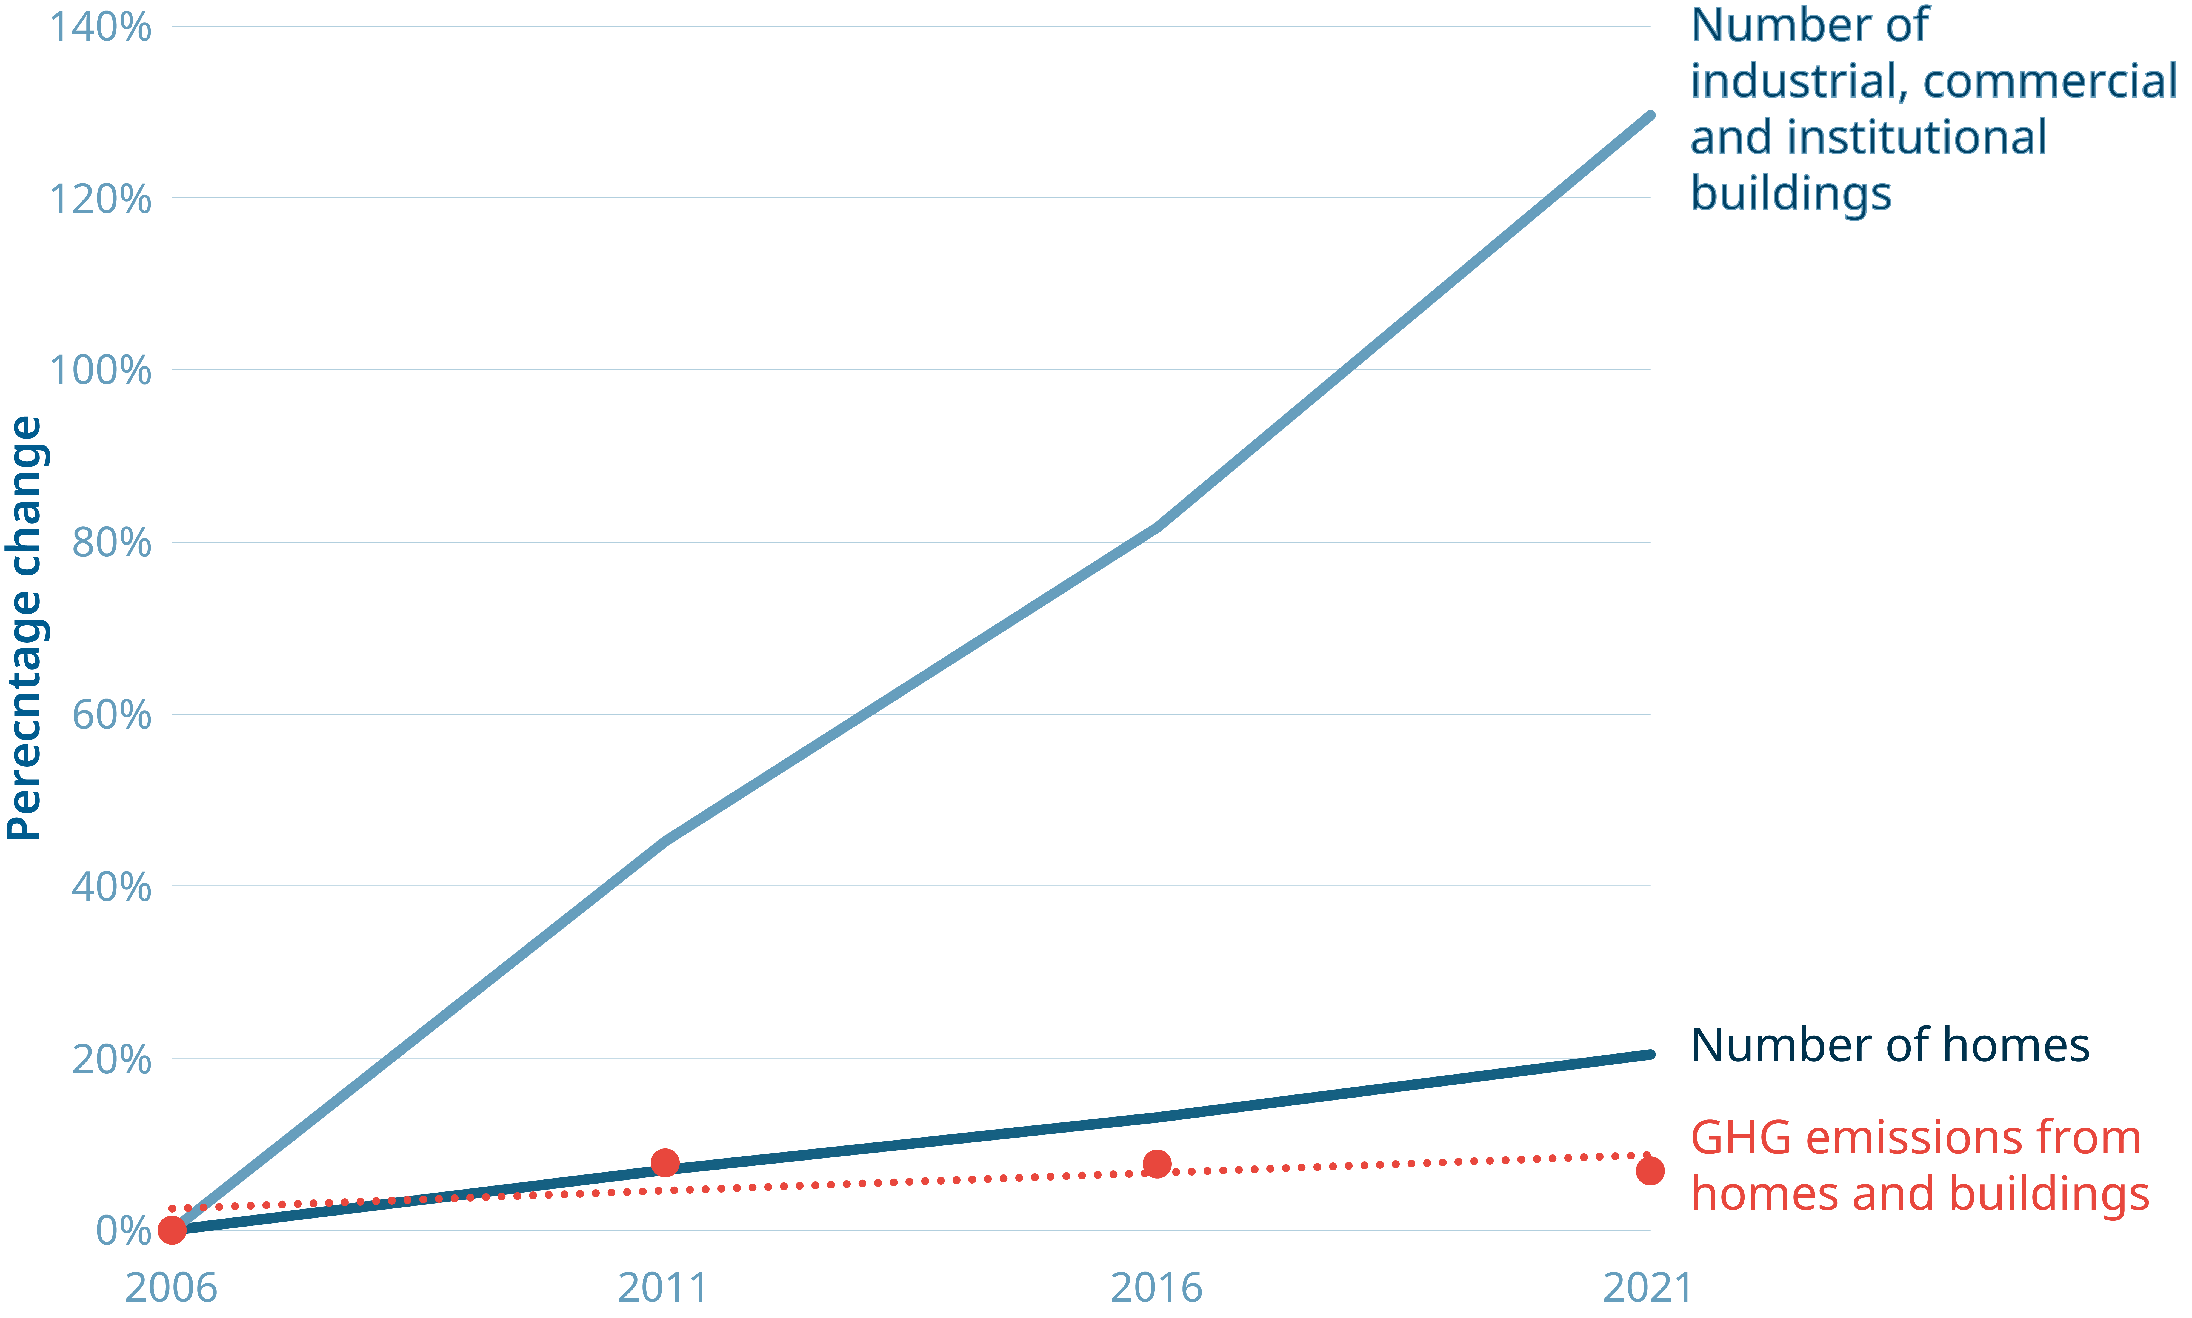
Growth ≠ GHGs
140
120
100
80
60
40
20
0
Number of
ICI buildings
% change
Number of homes
GHG emissions from homes and buildings
2006 2011 2016 2021
Notes:
Decoupling GHGs from new construction
Monty Paulsen at PH
Low-C materials with PH
Gov and mfrs investing
Lost Monty
ESC

Slide 6

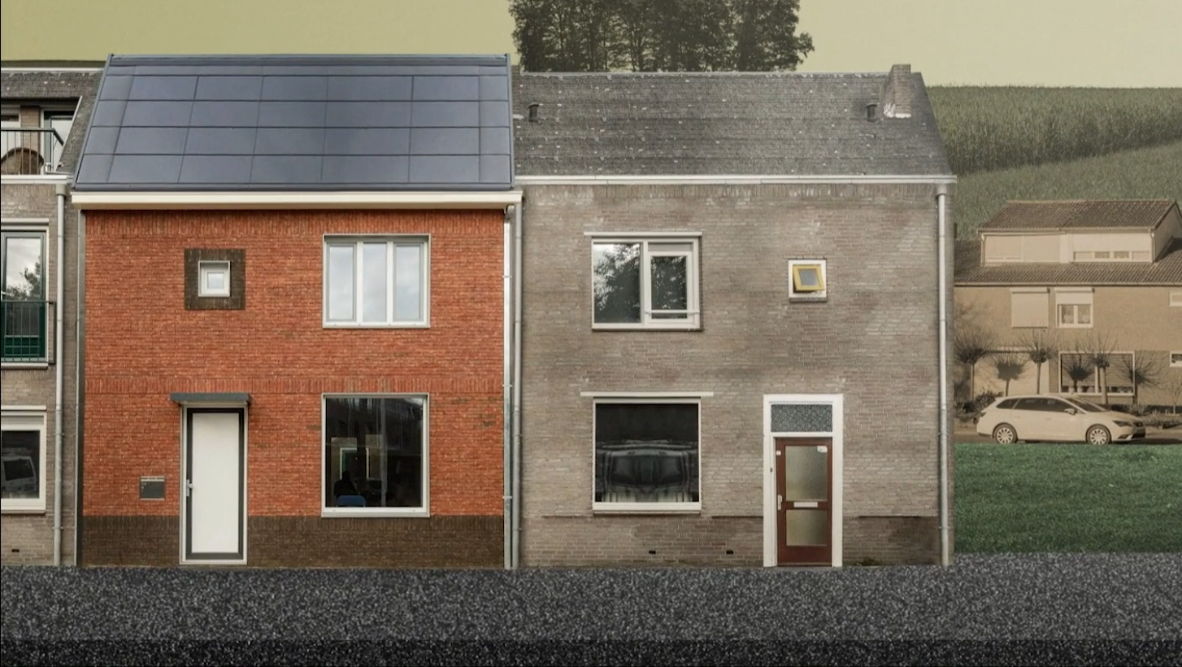
Notes:
Energiepsprong
Animation
Market transformation lost

Slide 7
Notes:
MD pillars
Reframed Lab
Rules

Slide 8
Rules of the game
Collaborate with competitors
4/6 months spent not designing
4 X the effort
… online
Notes:
Rule 1
Rule 2
Rule 3
Online
70+

Slide 9
Project reductions
Up to 93% heating energy demand
Up to 99% carbon emissions
Up to 60% embodied carbon
Notes:
Schematic design projections
No surprise technically feasible
Tech advances
Hope in participants
Non-energy design objectives

Slide 10

Notes:
Multi-parameter
First four months
Human-centered takeaway
Universal COVID experience
Ventilation awareness
Heat dome
BandAid solutions
Australia
Opening windows no longer enough

Slide 11
Notes:
More than just energy
Healthy, safe, climate-resilient
Affordable to heat and cool
Synergies: nailing pattern
Electrical grid
2003 power outage
Heating electrification
Analogous to EVs and congestion
Passive resilience

Slide 12

Up to
2/3
of municipal emissions come from existing buildings
2/3
will still be around by 2050
Notes:
Narrow focus
2/3 cold and dark
600,000 / year
Vulnerable populations
Energy poverty
Duty

Slide 13
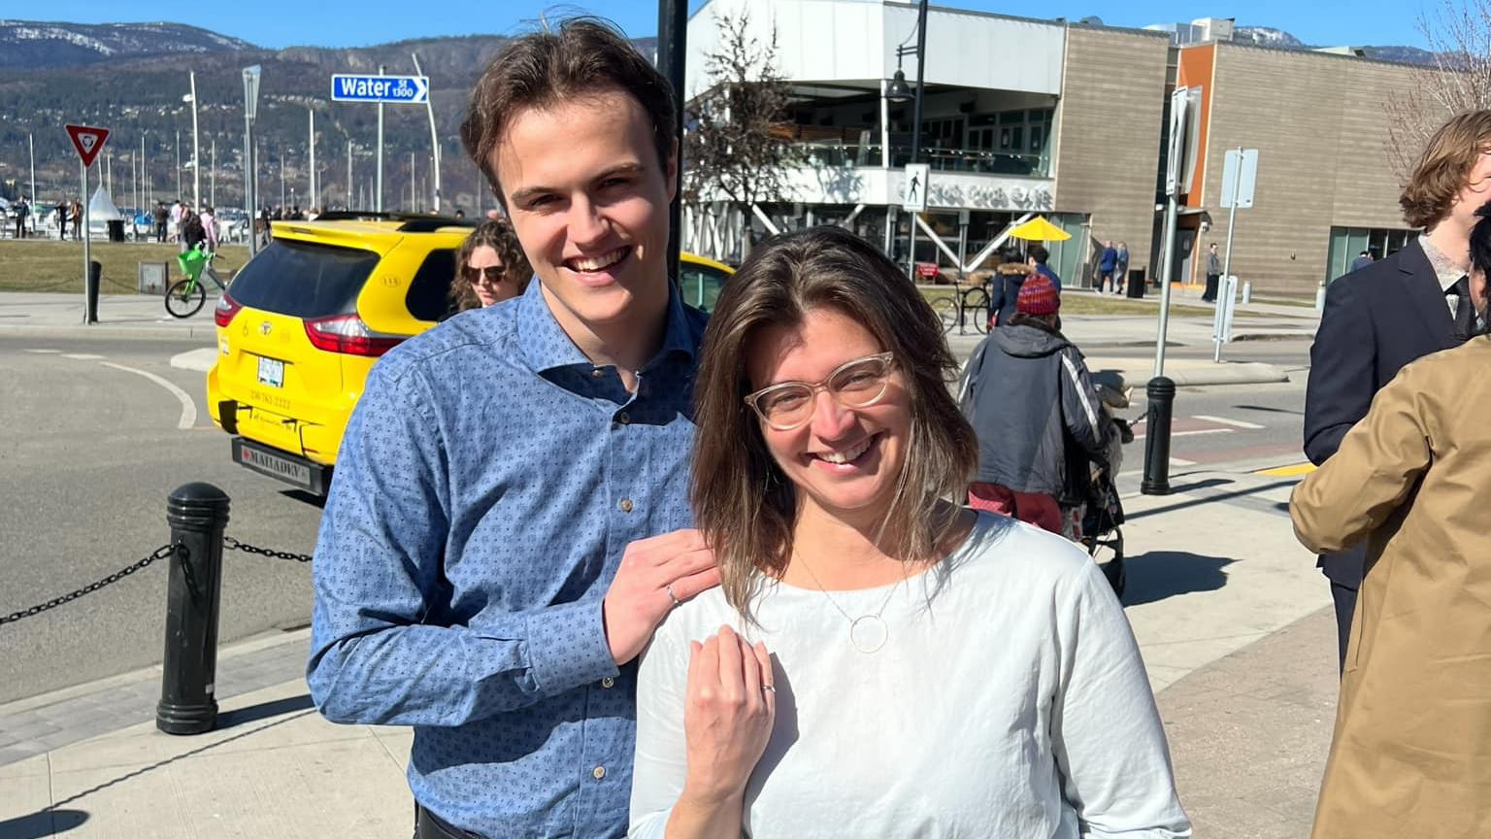
Notes:
Isaac
Family business
Household language spreading
Fractured sector

Slide 14
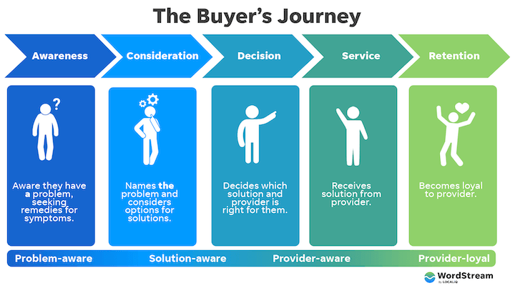
Awareness
Consideration
Decision
Service
Retention
Adapted from WordStream by LocalIQ
Notes:
Customer journey
Ideal business model

Slide 15

‘Has a guy’
Consideration
Decision
Like-for-like
Furnace fails
Consideration
Decision
Notes:
Winter failure
Has a guy
Like-for-like
Missing alternatives
Government role
Pembina role

Slide 16
Government actions to grow supply
Provide market certainty
Drive demand
Relieve cost of innovation
Grow the workforce
Notes:
Supply chain survey results
Regulation
Education and simplification
Grants / incentives
Equity deserving groups
Volatile politics
Non-partisan policy
IRA
Jobs
GDP
Industry against rapid shifts

Slide 17
Call to action
Coordinate across supply chain
Learn about other specialties
Leverage customer touchpoints
Engage deep retrofit accelerators
Notes:
Industry role
Service providers
Network to learn
Educate on other fields
DRAs
Justice a product of its time
Canadian right to health, safety, etc.
This is your moment
More than comfort
Not invisible
No longer alone
Together we can go further and faster

Slide 18


Betsy Agar betsya@pembina.org
pembina.org/subscribe
Receive our perspectives in your inbox.

